Slide 1

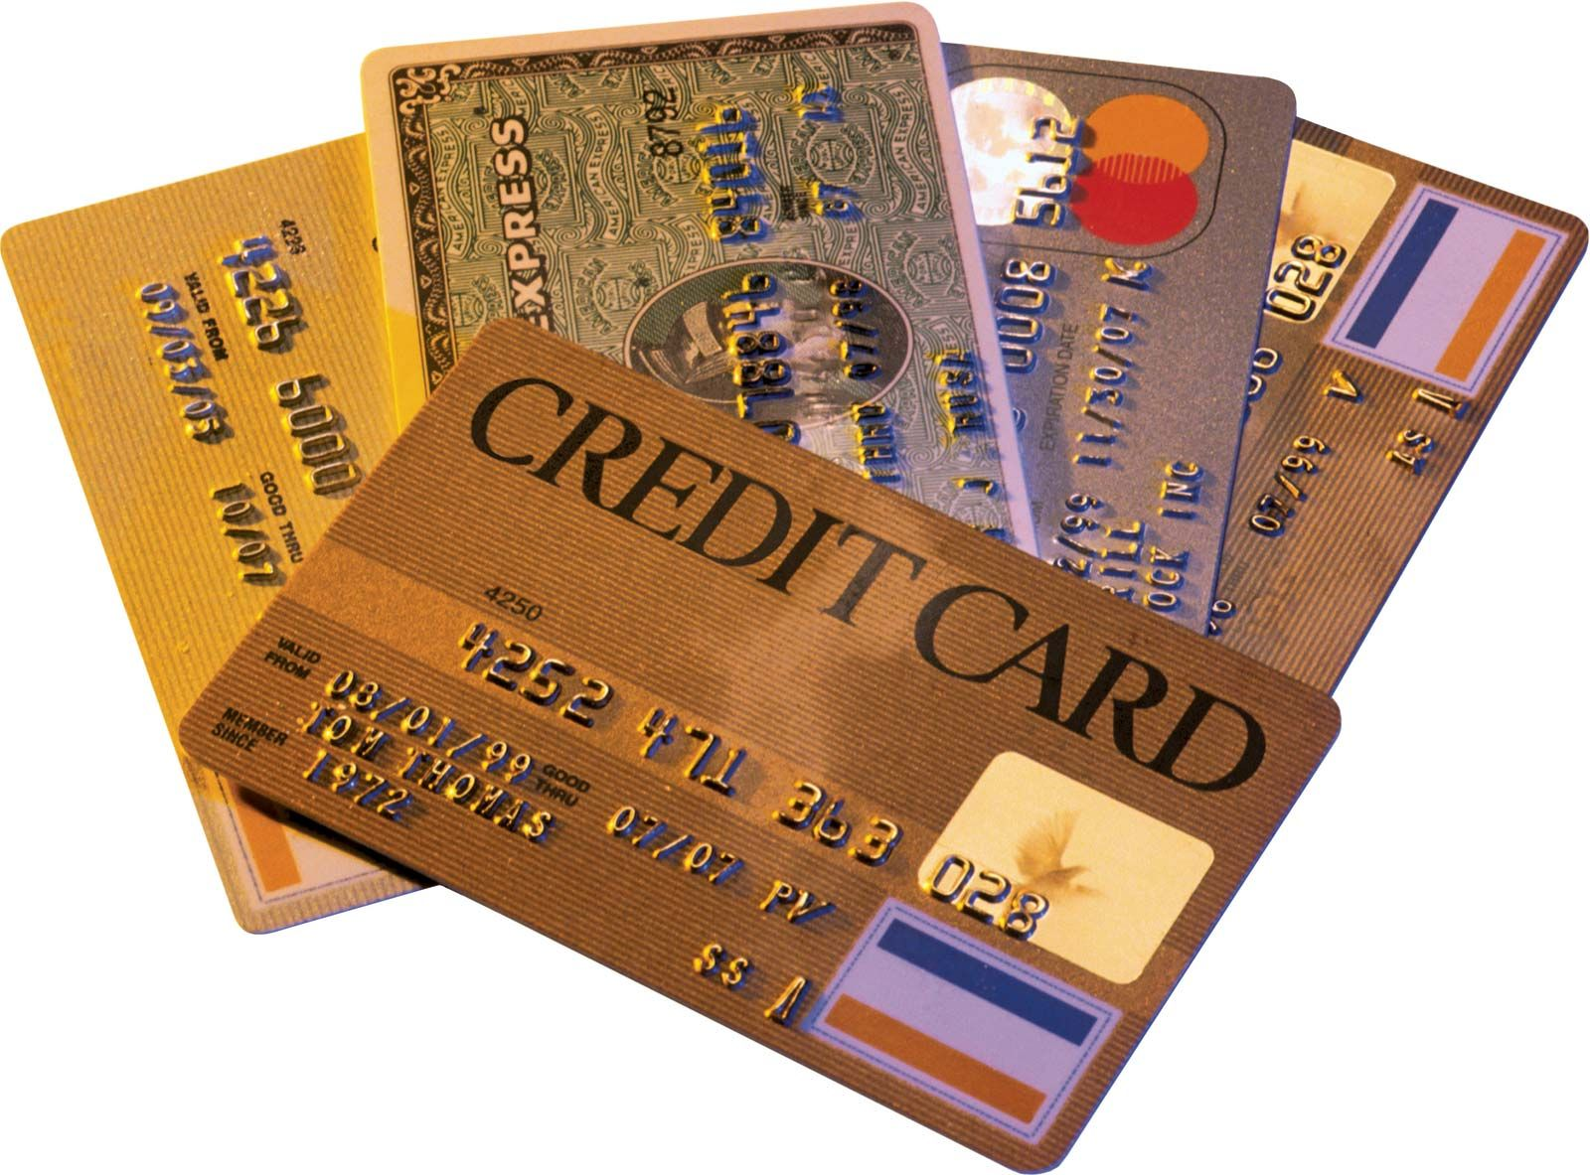
CASE STUDY ON CREDIT CARD FRAUD
DETECTION USING DATA MINING TECHNIQUES
DATA MINING (CS-330)
YELLUTLA JEEVANKUMAR
2019UGCS061R

Slide 2
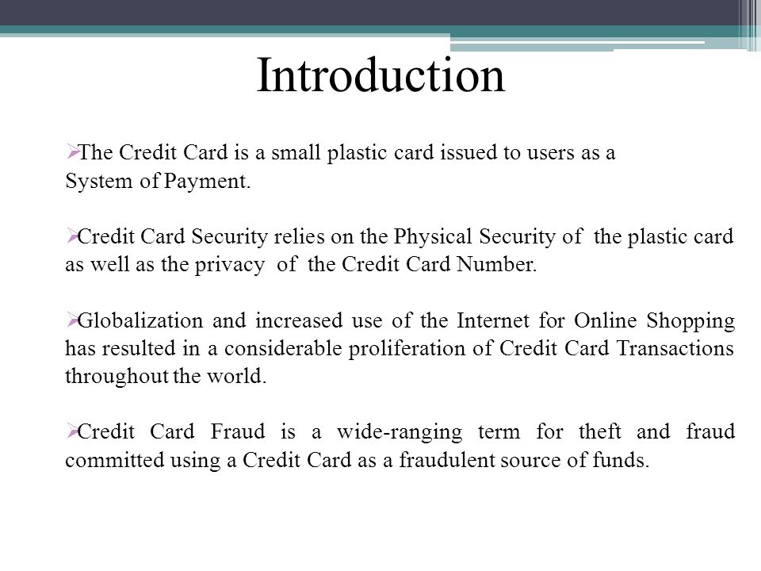

Slide 3
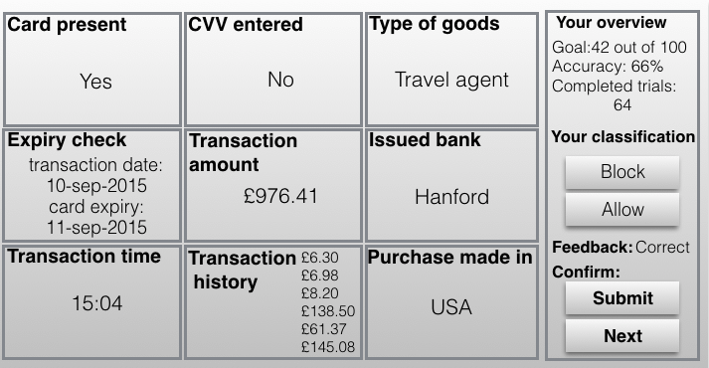
CREDIT CARD FRAUD VARIANTS

Slide 4
CREDIT CARD FRAUD DETECTION METHODS
The data mining includes the various techniques and
their properties that can be used to detect credit fraud.
Hidden Markov Model
Neural Network
Bayesian Network
Genetic Algorithm
K- nearest neighbour algorithm
Support Vector Machine
Decision Tree
Fuzzy Logic Based System

Slide 5
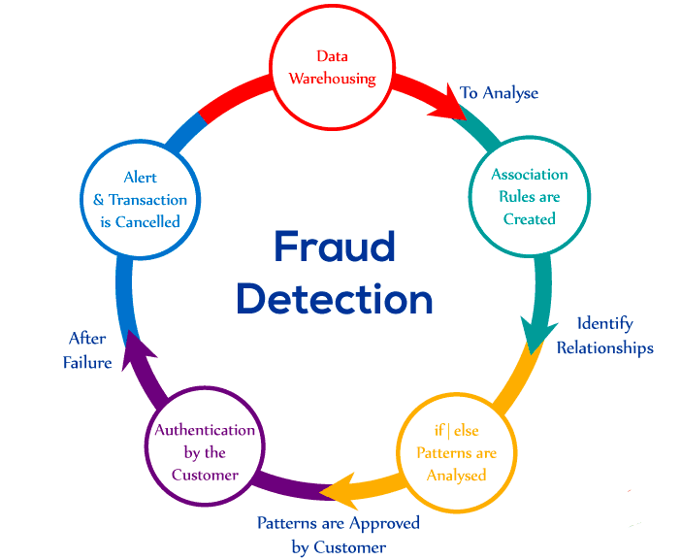

Slide 6
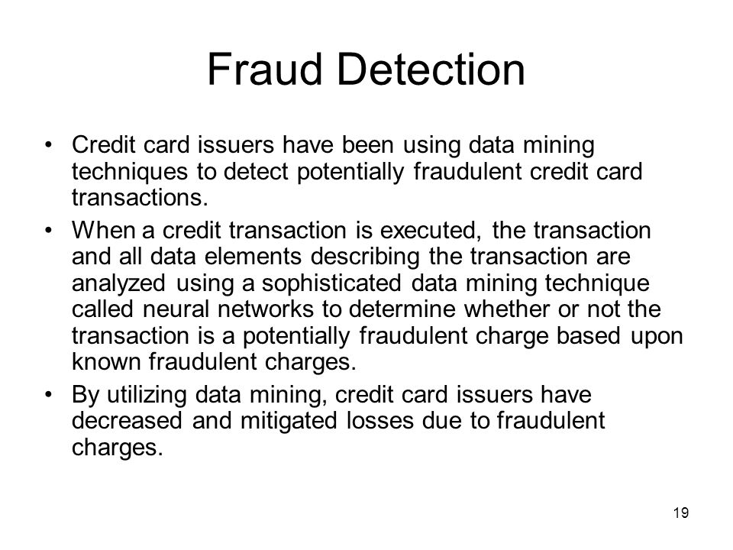

Slide 7
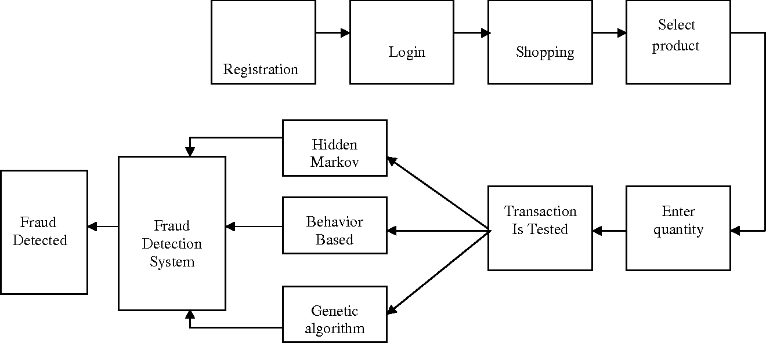

Slide 8
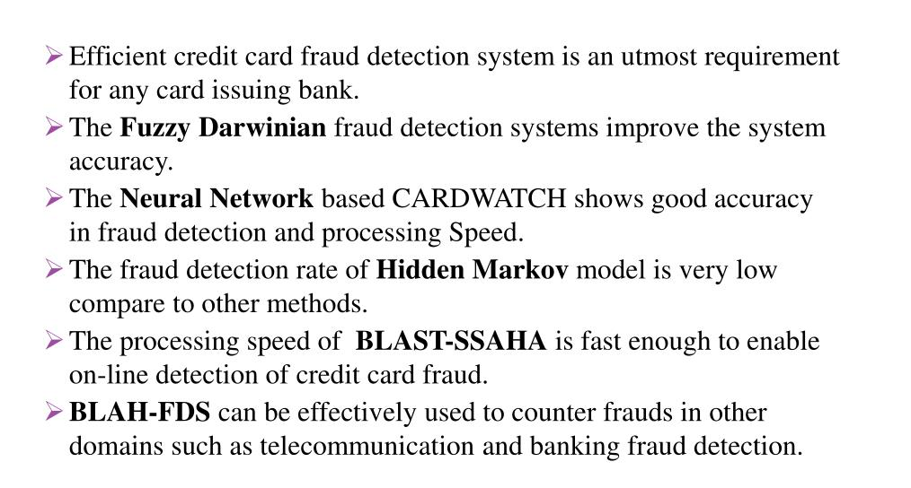
CONCLUSION

