Slide 1



HACKDAYS
Team Name: Astaroth
Track: Trust in a Synthetic World
Problem Statement: Verify & Secure: detecting deception, phishing and fraud
Solution: TrustLens | scam detection where every flag comes with proof
Team Members: Ravi Shashi Netre (NNM24CB045)
Team Members: Jeevan Nayak (NNM24CB030)

Slide 2


WHAT’S THE IDEA?
THE PROBLEM
Scams reach Indians every day on WhatsApp, SMS and email: fake KYC deadlines, courier alerts, lookalike bank links. They are built to make people act before they think, and inbox filters miss the details a careful reader would catch.
THE SOLUTION
TrustLens: share any suspicious message, link or screenshot and get a Trust Report in seconds. It shows a risk level, every red flag with the evidence behind it, and exactly what to do next, in English, Kannada or Hindi.
₹22,845 Cr
lost to cyber fraud in India in 2024
206%
jump in losses over 2023
Source: MHA written reply, Lok Sabha, July 2025

Slide 3
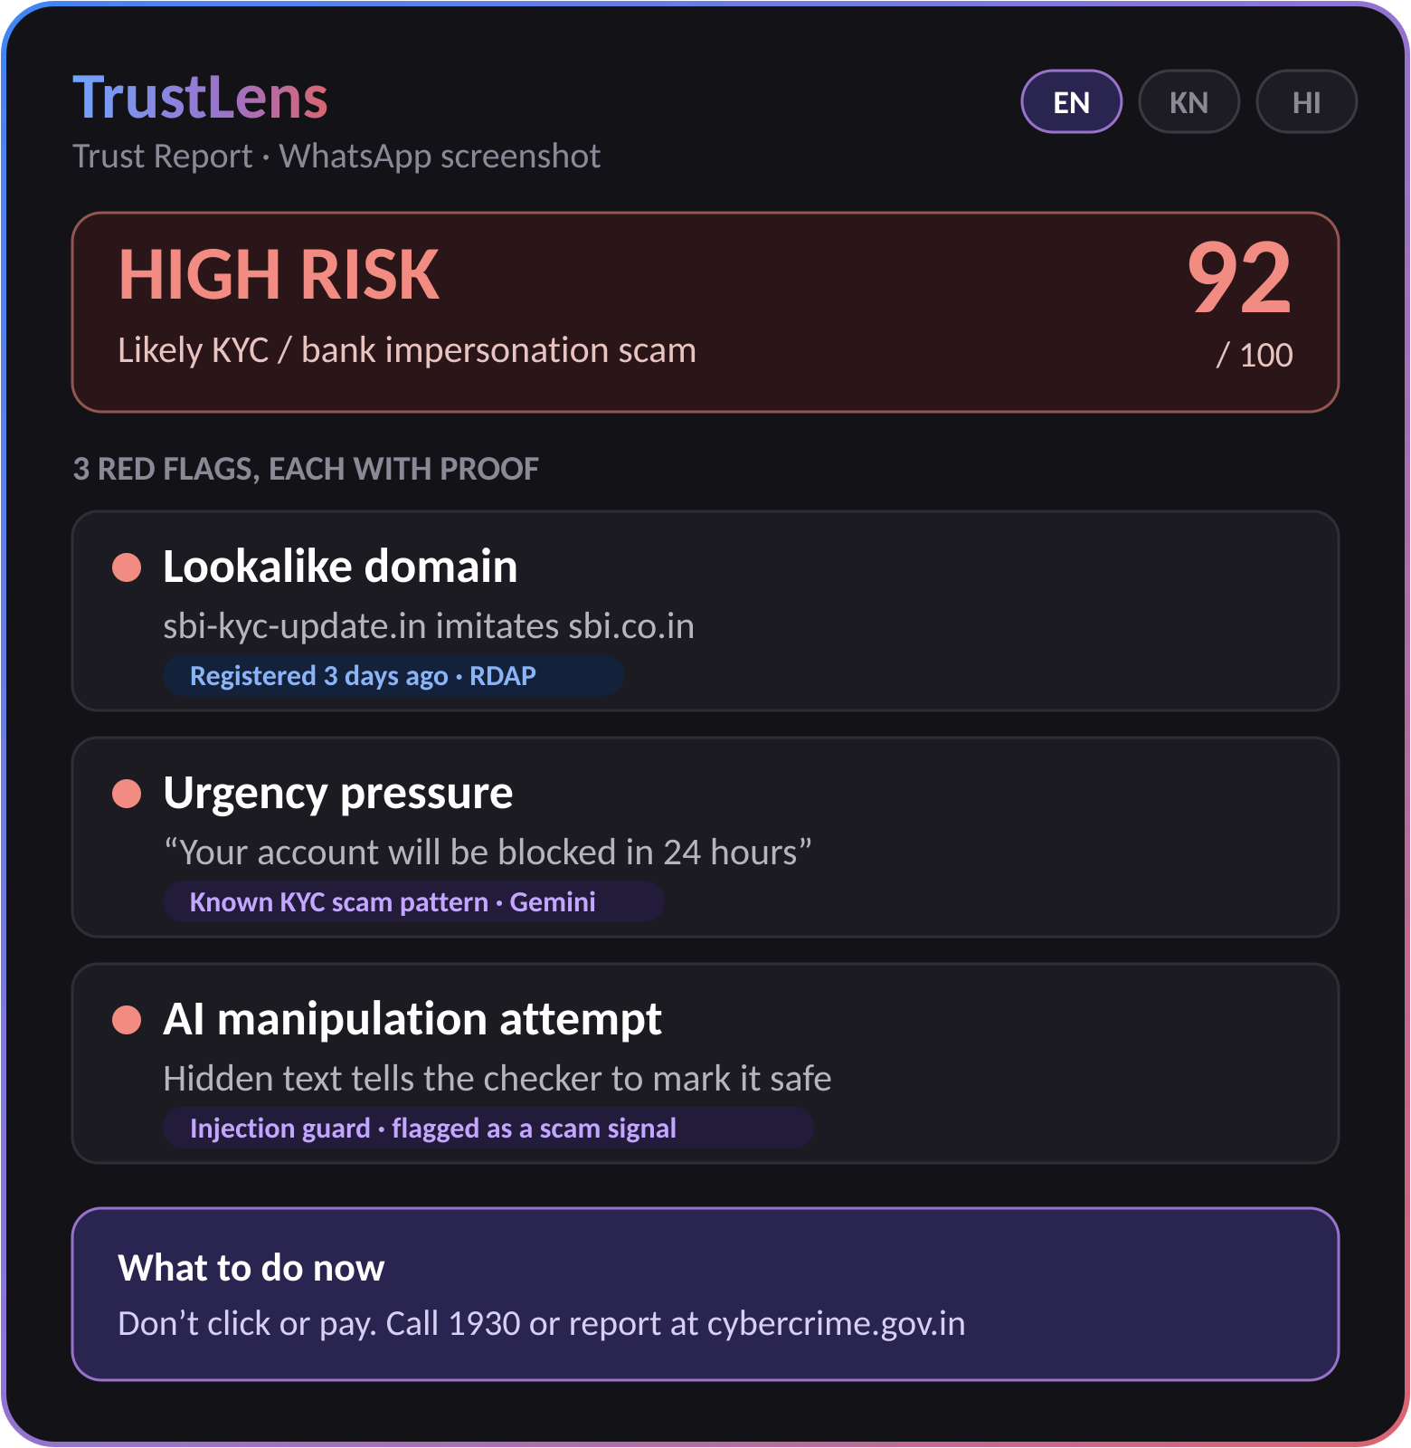
WHAT’S THE TWIST?
Blocklists only catch scams that were already reported. Plain AI checkers give verdicts you can’t verify.
TrustLens: every flag comes with proof.
1
Reads like a human
Gemini reads text and screenshots for urgency and impersonation.
2
Verifies like a machine
Domain age, lookalike and Safe Browsing checks back every flag.
3
Can’t be talked out of it
Messages that try to manipulate the AI get flagged as scams.

Slide 4
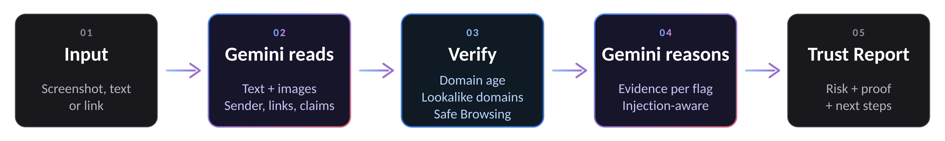
MAKE IT REAL
A working web MVP in one day. The user uploads a screenshot or pastes a message or link. Gemini extracts the sender, links, claims and impersonated brand; hard checks verify them; Gemini then explains every flag with its evidence in a structured Trust Report.
Live demo: a real KYC scam screenshot, a prompt-injection attempt, and a genuine bank alert correctly rated safe.
BUILT WITH
React
FastAPI
Gemini API
RDAP
Google Safe Browsing

