Slide 1
Team Name:
ThraaantriC’$404
Team Mentor:
Dr.M.P.Pushpalatha
Team Members:
Manthan M Kulakarni
Ankita Ashok Baleri
Disha Bhat
Jayanth D
Jeevanth D
Nanda Krishna K S

Slide 2
Problem statement:
Reduce the amount of push notifications require for ecommerce apps.
As intimated to focus on Right date and time, we have executed the following task

Slide 3
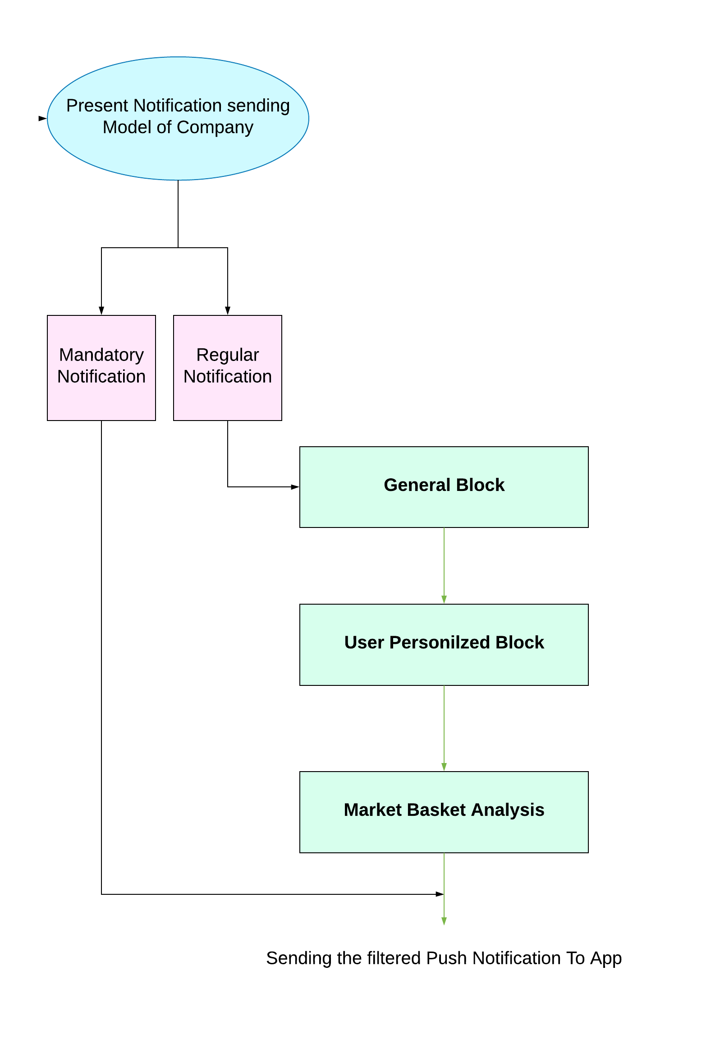
MODEL OVERVIEW

Slide 4
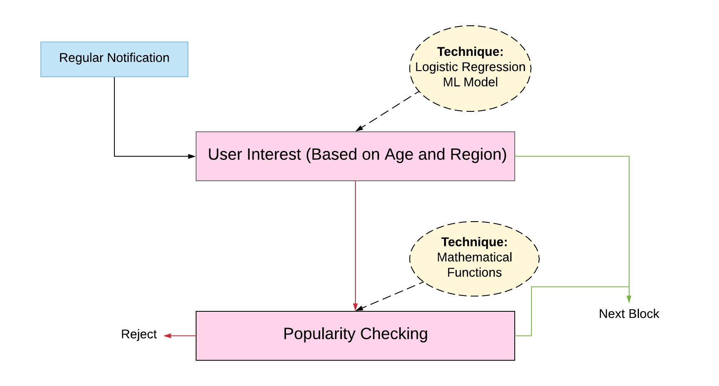
General Block:

Slide 5
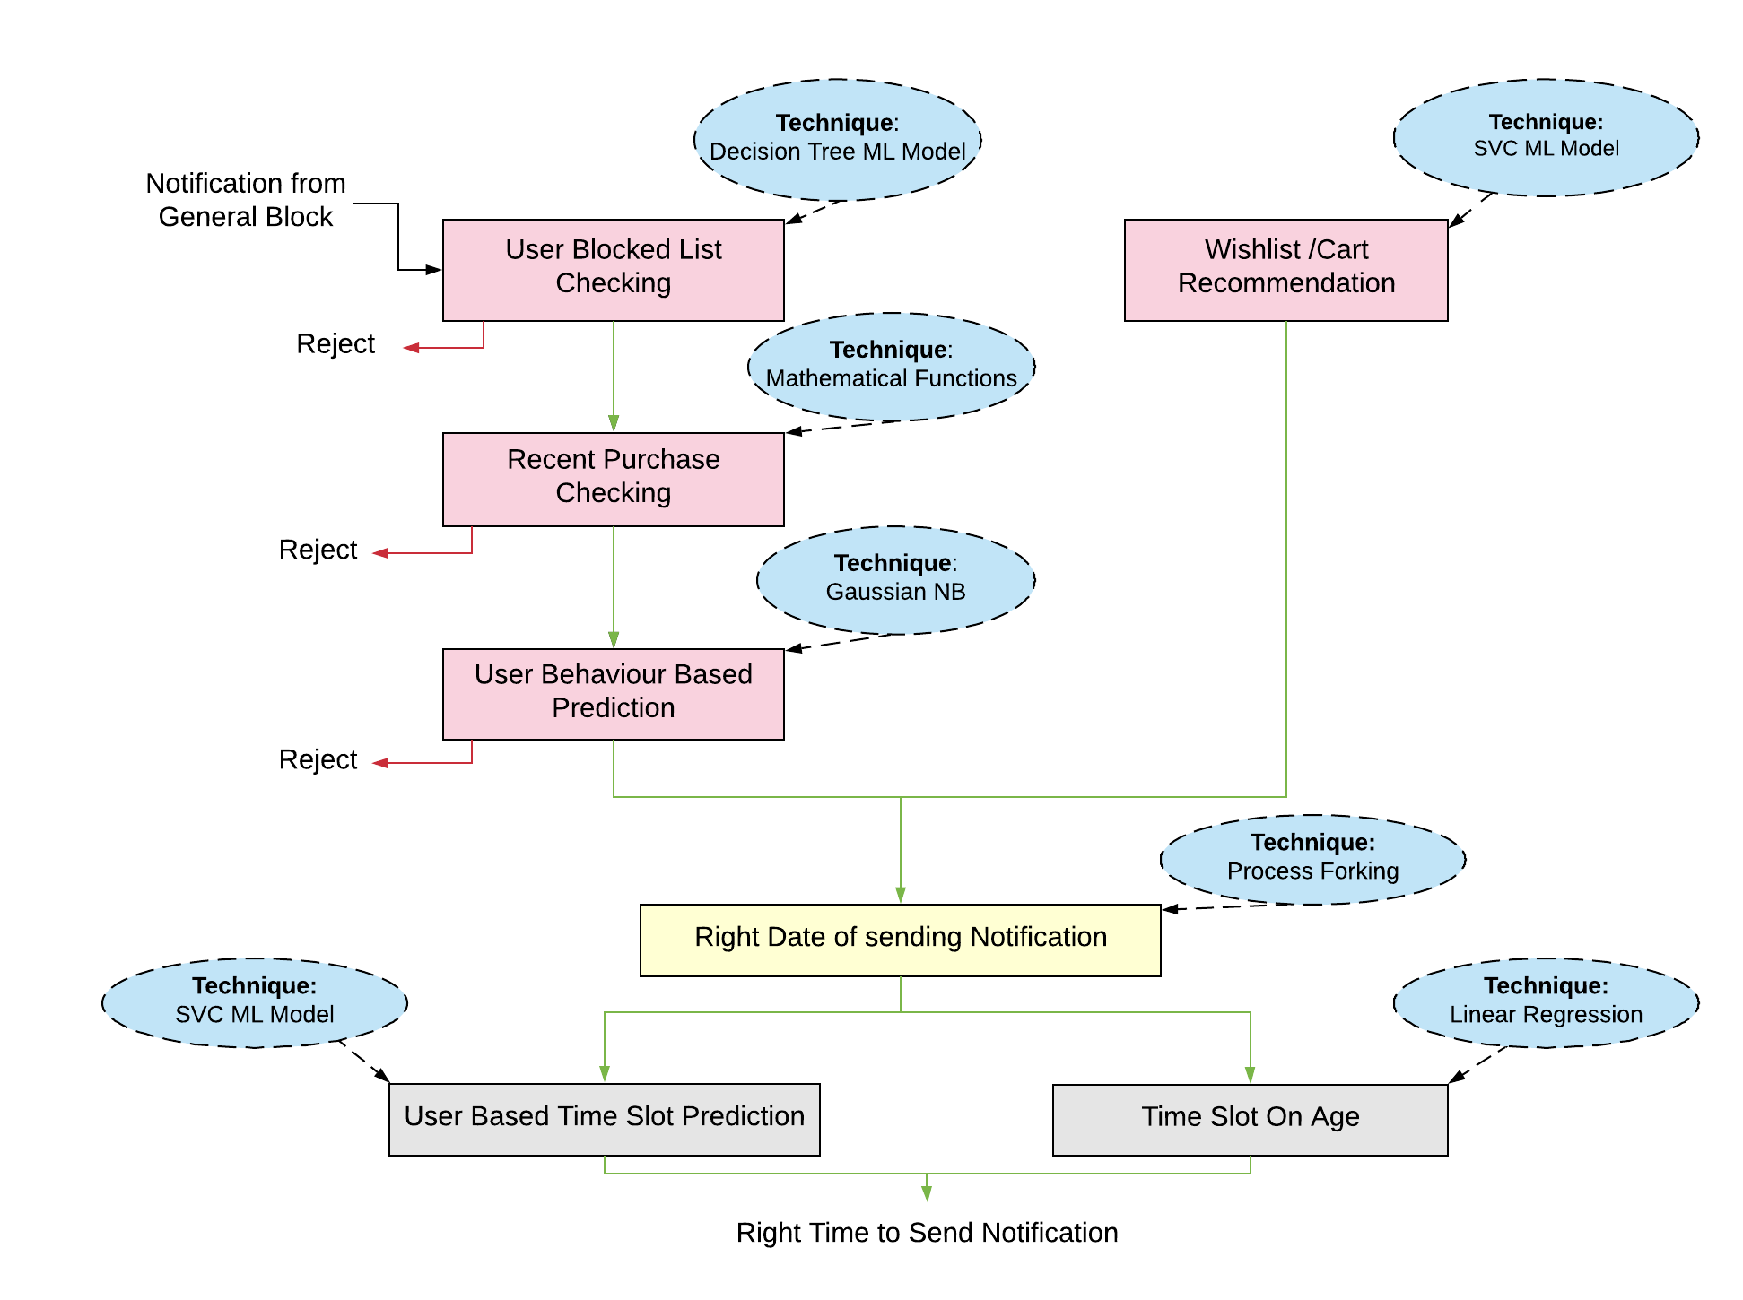
User Personalized Block:

Slide 6
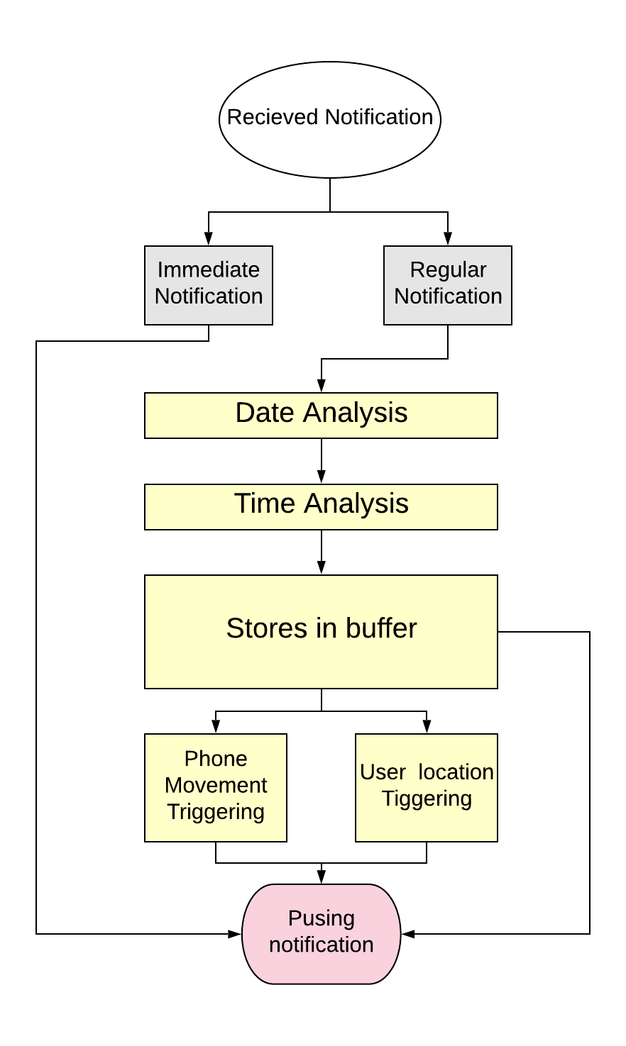
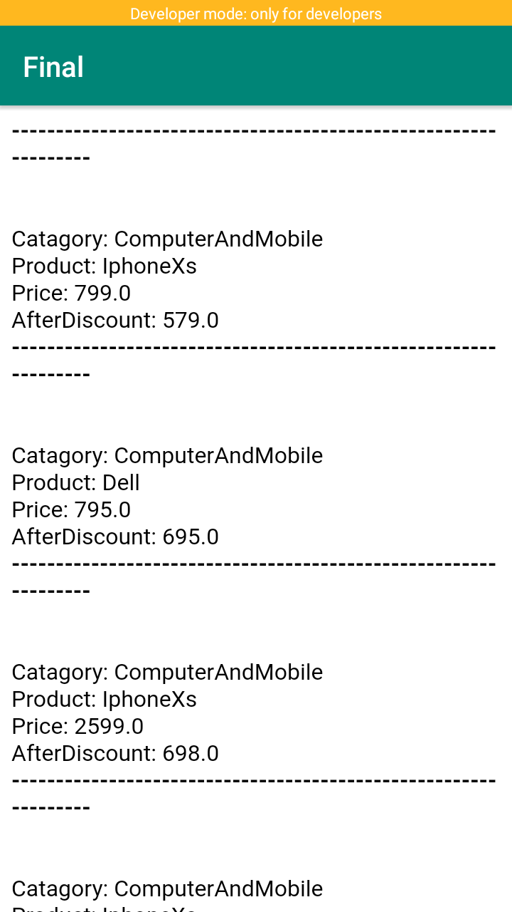
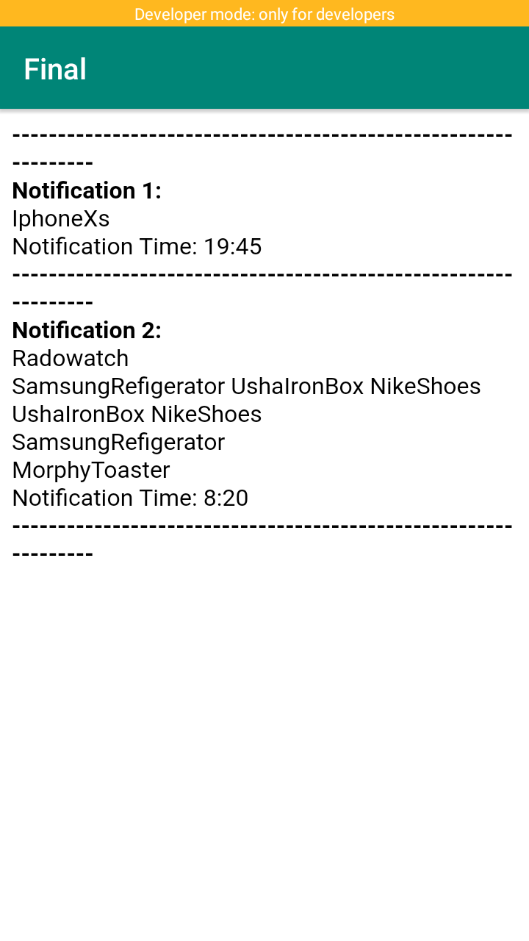

Slide 7
Uniqueness:
1.General Block helps the new customer with no personnel data.
2.Right Time triggering using current GPS location
3.Right Time triggering using Positional change w.r.t to phone
4.Right Time triggering using Positional change w.r.t to outside world

Slide 8
Technology stack :
Machine Learning
Android Studio
Firebase
Node Js
PostMan

Slide 9
Algorithms :
Linear Regression
Decision Tree
Gaussian Noise Base
Support Vector Classification
Graph theory and classification

