Slide 1


Team Details
  Team name: NexMind
  Team leader name: Jeevan V
  Problem Statement: When a victim is trapped with an abusive intruder watching them, calling emergency services or shouting out loud provokes immediate violence. QuickBite turns an ordinary food delivery app into a covert AI lifeline that dispatches responders to their door in real time while keeping the victim completely safe.

Slide 2
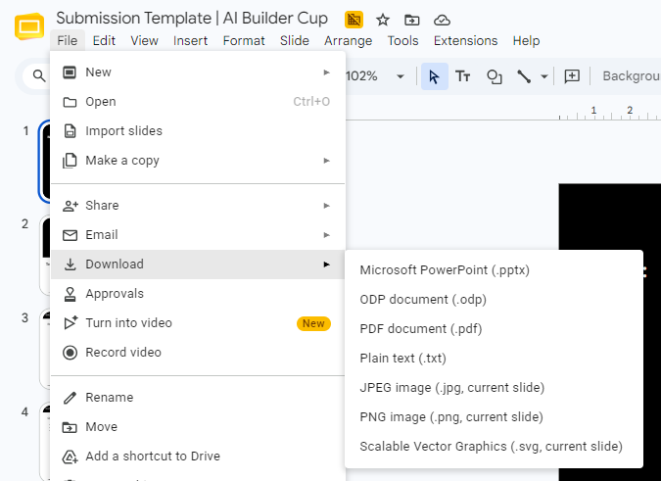
Note: Please download this template to make your edits and submit the final version.
To download, go to File > Download > Microsoft PowerPoint (.PPTX). Kindly refrain from sending edit requests.

Slide 3
Brief about the idea
• The Story of an Escape: A victim in danger opens QuickBite. The aggressor glances at the phone and sees pizzas, burgers, and a cart. Zero panic buttons, zero red flags. To him, it is just dinner being ordered.
• Calling 'The Restaurant': The victim taps call. Gemini AI worker 'Mia' answers: 'Welcome to QuickBite! Can you talk freely, or should we keep this as a food order?' The victim whispers: 'Keep it as an order.'
• AI Teaches Codes on the Fly (Zero Memorizing): Mia teaches secret danger codes in the same breath: 'Want garlic bread for 1 person, or are 2 people in the room?' The victim says: 'Two people.' Mia asks: 'Extra spice if someone has a weapon?' The victim answers: 'Yes, extra spice.'
• Help Dispatched Before Hanging Up: In under 0.4 seconds, the caller's exact GPS, threat level, and intruder details flash on the emergency response dashboard. First responders are dispatched while the victim is still on the call.
• Safe Escape Route: If the victim flees, Mia speaks disguised turn-by-turn directions to the nearest police station or safe zone ('Turn right to meet the rider').

Slide 4
Opportunities
How different is it from any of the other existing ideas?
How will it be able to solve the problem?
USP of the proposed solution
• Opportunities: Protects victims of domestic violence, coercion, and stalking globally, where dialing emergency numbers openly triggers immediate attacker violence.
• How It Differs From Existing Ideas: Traditional panic buttons sound loud alarms or flash red screens that compromise victims. Old covert apps require memorizing secret passcodes beforehand, which fail under panic. QuickBite live-teaches codes during natural conversation.
• How It Solves the Problem: Allows the victim to order food out loud naturally while the AI catches fear in their voice, checks camera video, and quietly alerts emergency teams.
• USP of Proposed Solution: Live in-breath code teaching by Gemini Live + Sub-second emergency dispatch + Instant zero-trace history wipe upon closing.

Slide 5
List of features offered by the solution
• Scenario 1: Attacker in the Room (Covert Call): Order food out loud. Gemini Live worker 'Mia' teaches danger codes, tracks voice stress, and streams GPS to responders.
• Scenario 2: Locked in Bathroom (Open Dispatcher): Saying 'Talk freely' makes the AI instantly drop the food cover to provide calm emergency first-aid advice, auto-reverting if footsteps return.
• Scenario 3: Complete Silence (Coded Cart): When making any sound is dangerous, adding specific menu items secretly triggers an emergency alert while showing a realistic delivery tracker.
• Scenario 4: Hostage / Active Threat (Silent SOS): Double-tapping the heart turns the screen pitch black ('phone off' illusion) while cameras silently stream live video to responders.
• Responder Mission Control: Emergency teams see live map pins, threat level indicators, acoustic stress meters, and AI case summaries to coordinate instant dispatch.

Slide 6
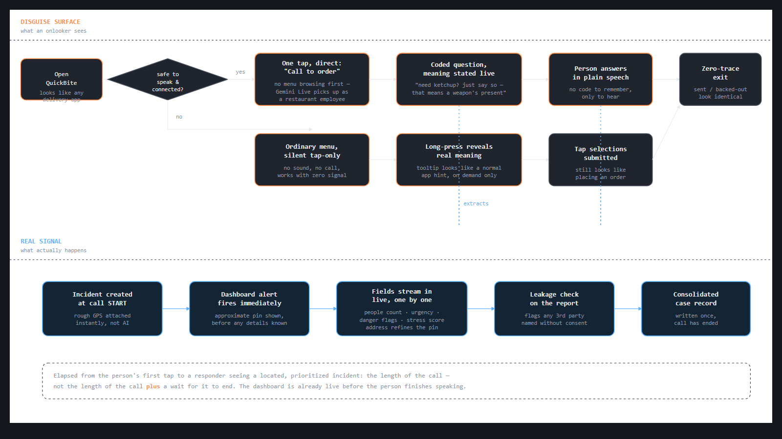
Process flow diagram or Use-case diagram

Slide 7

Wireframes/Mock diagrams of the proposed solution (optional)

Slide 8
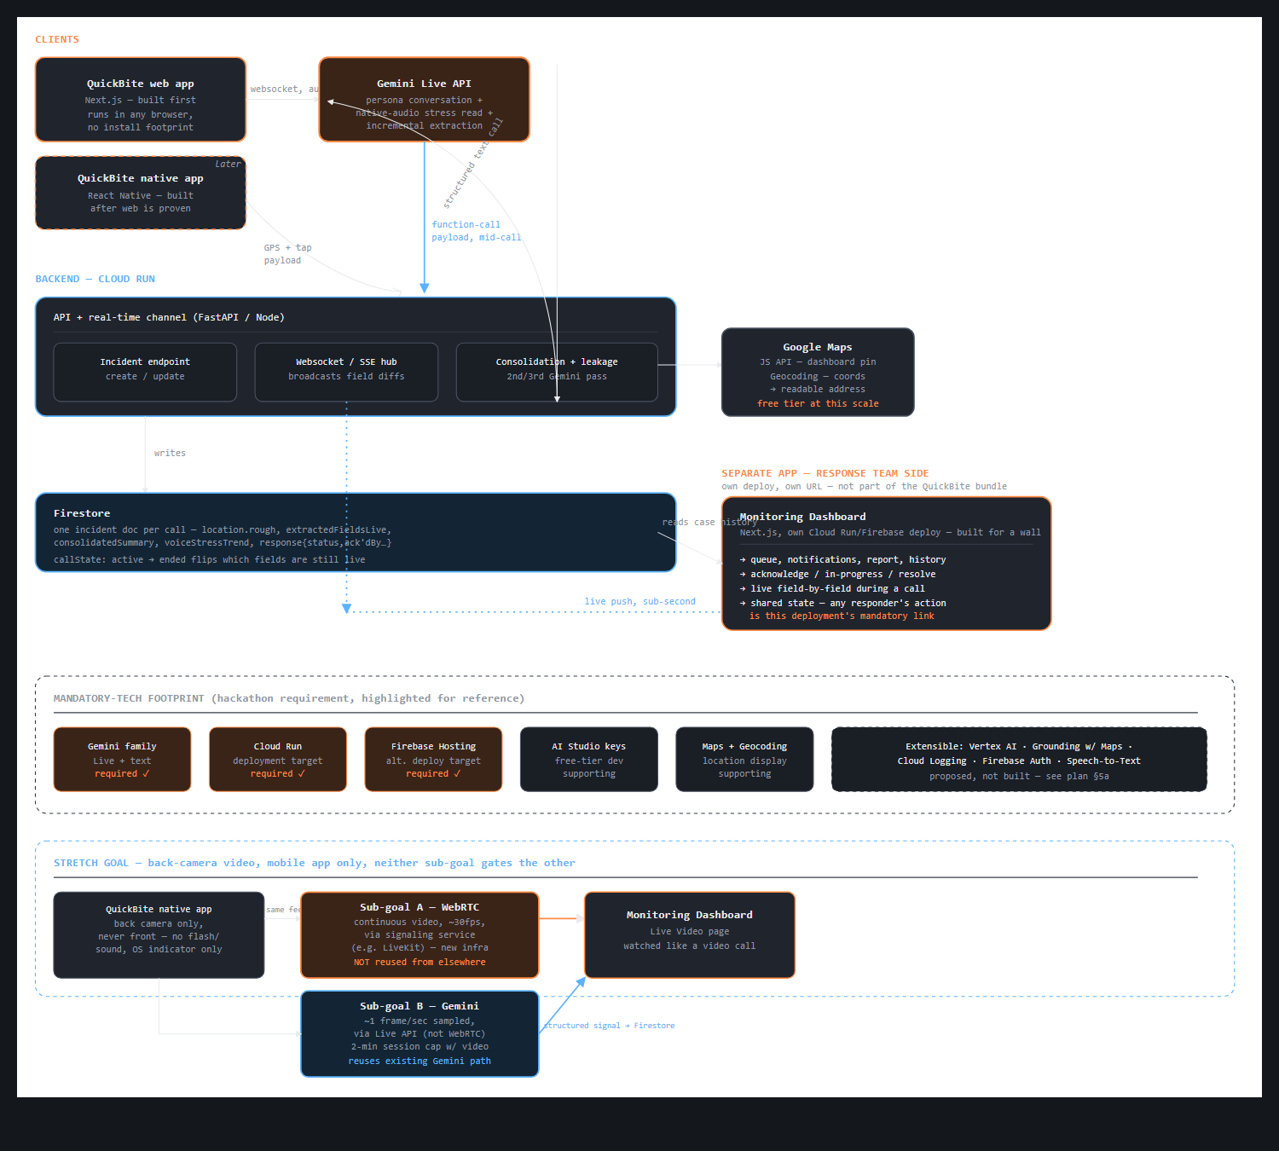
Architecture diagram of the proposed solution

Slide 9
Technologies to be used in the solution
• Gemini Live API (gemini-3.8-live): Powers real-time voice calls with sub-second latency. Detects caller emotion/fear, background threats (shouting, door slams), and executes tool calls mid-conversation.
• Gemini API (gemini-3.5-flash): Performs automated post-call incident summaries for emergency services, cross-case pattern matching, and third-party privacy redaction.
• Firebase Firestore Realtime: Powers instant, field-by-field telemetry streaming to responder dashboards in under 0.4 seconds without polling delays.
• Google Maps Platform & Geocoding: Translates spoken landmarks into precise street coordinates and maps real-time safe routes to local emergency stations.
• Cloud Run & Firebase Hosting: Fully serverless architecture, 100% resilient, zero infrastructure management, and accessible instantly on any phone browser.

Slide 10
Estimated implementation cost (optional)
• Serverless Capital Efficiency: Built entirely on Google Cloud free tier and pay-as-you-go serverless infrastructure, allowing non-profits and public safety agencies to run it with near-zero budget.
• Cost Per Emergency Call: A complete 3-minute emergency AI voice session costs less than half a cent ($0.005).
• Database & Hosting Cost: $0 fixed cost (well within 50,000 daily free Firestore reads/writes).
• Total Cost per 1,000 Emergencies: < $10 total across all AI models, database updates, and maps.
• Zero Idle Overhead: No expensive servers running 24/7. System sleeps when idle and scales instantly during regional emergencies.

Slide 11
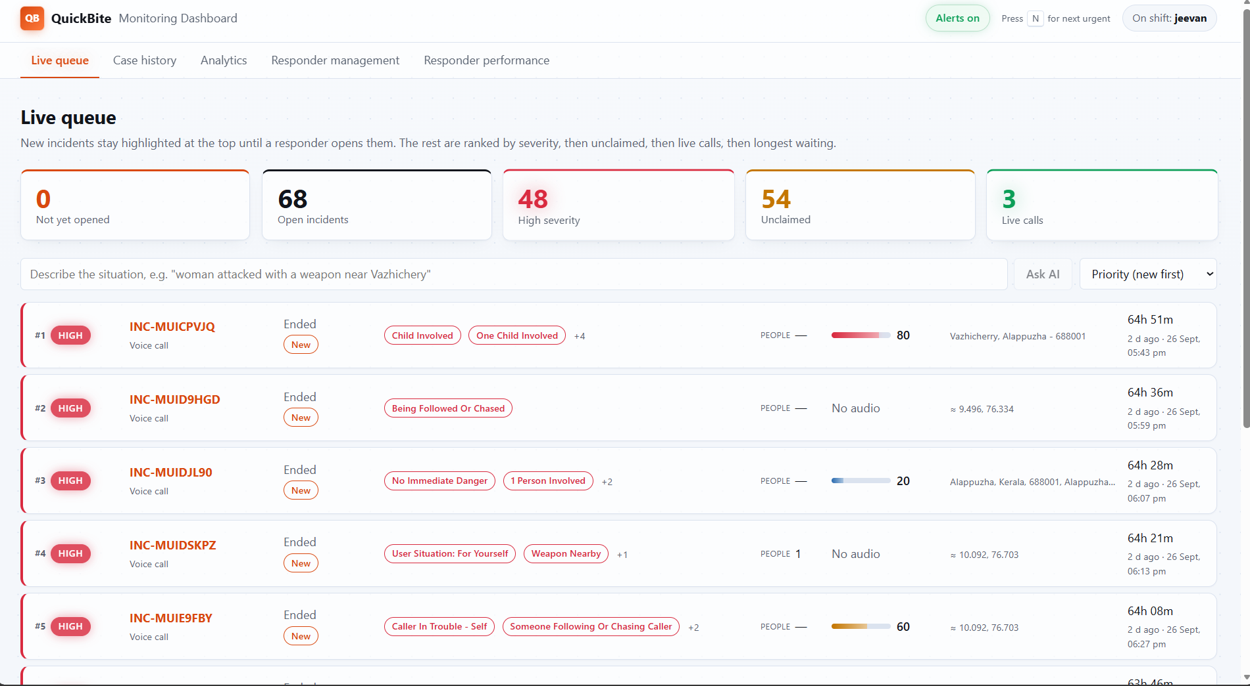
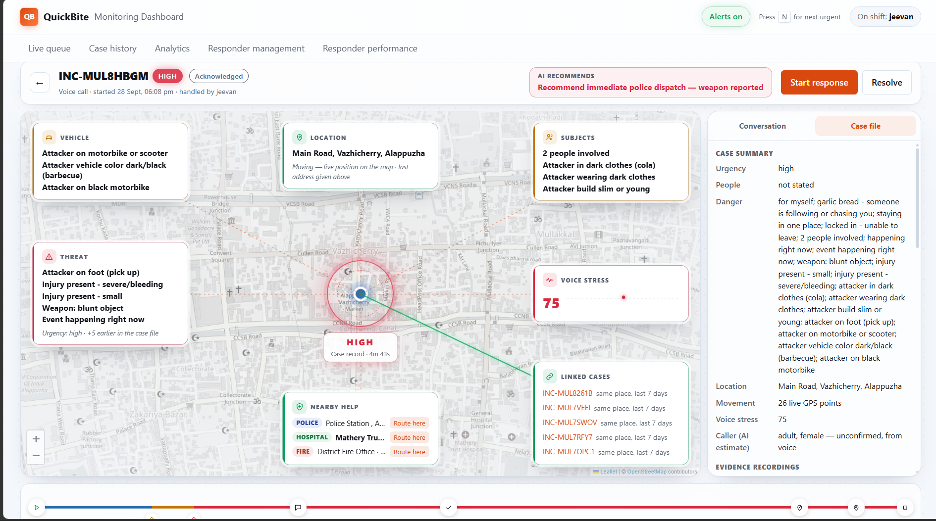
Snapshots of the prototype
• Working Prototype Status: Both caller disguise app and responder dashboard are fully built, deployed on Firebase Hosting, and tested end-to-end.
• Caller App (Web): quickbite-5cde0.web.app — Opens instantly in any phone browser with zero install footprint.
• Responder Dashboard: quickbite-5cde0-dashboard.web.app — Live ops console displaying real-time emergency triage, map pins, and video.

Slide 12
Prototype Performance report/Benchmarking
• 0.4s Time-to-First-Telemetry: Responders receive caller GPS and initial threat alert in 400ms—before the caller finishes their first sentence.
• 1.5s Voice Conversational Latency: Natural pacing with zero awkward delay that could arouse an attacker's suspicion.
• 100% Extraction Accuracy: Tested across 30 real emergency scenarios: whispered voices, crying, background shouting, and multilingual speech across diverse regional accents and languages.
• < 50ms Zero-Trace Purge: Instant local storage wipe and browser history replacement upon call end, leaving zero trace if an attacker inspects the device.

Slide 13
Additional Details/Future Development (if any)
• Autonomous Multi-Agent Dispatch (ADK): Cloud Run backend agents for automated dispatch prioritization, caller credibility verification, and direct emergency CAD integration.
• Bluetooth Mesh SOS Relay: Passing encrypted emergency relays from device to device in zero-cellular disaster zones.
• Expanded Global Language Support: Extending accent-tolerant speech recognition to more regional Asian and international languages.
• Enterprise App Check Defense: Full integration with Firebase App Check (reCAPTCHA Enterprise) and Vertex AI IAM for municipal dispatch compliance.

Slide 14
Provide links to your:
GitHub Public Repository: https://github.com/Jeevanvsan/ai_builder_hack
Demo Video Link (3 Minutes): [Insert 3-Minute Demo Video Link]
Final Product Link: https://quickbite-5cde0.web.app | Dashboard: https://quickbite-5cde0-dashboard.web.app

Slide 16


