Slide 1


Team Details
  Team name: NexMind
  Team leader name: Jeevan V
  Problem Statement:
People who are watched, coerced or held can't safely call for help: dialling 112, shouting or opening an SOS app can provoke the attacker. QuickBite is a real food-delivery app that is secretly a two-way emergency line. A Gemini Live “restaurant employee” turns a whispered food order into a live, located incident for responders and guides the caller to safety, without ever breaking the disguise.
Theme: Sustainability & Social Impact · resilience strengthening · community support
Notes:
NexMind — team leader Jeevan V.
One-line problem: when someone is being watched, coerced or held, the normal ways to get help (calling 112, shouting, opening a safety app) are exactly what they can't do.
QuickBite: an ordinary-looking food-delivery app. Calling 'the restaurant' reaches Mia, a Gemini Live persona who takes the order, teaches each danger code in the same sentence, and streams a structured incident to a response team live. Theme fit: societal impact via the theme's own named approaches, resilience strengthening and community support.

Slide 2
Brief about the idea
The people who most need help often can't be seen asking for it
1 in 3
women experience partner or sexual violence in their lifetime
ONE CALL, TWO CONVERSATIONS
1
Priya's partner is in the room, watching her phone.
WHO, 2026
2
She opens QuickBite (menu, cart, offers) and taps “Call to order”.
10 min
one woman or girl is killed by a partner or family member, every 10 minutes
3
Mia, the Gemini Live “restaurant”, answers and takes the order:
UNODC / UN Women, 2025
"Garlic bread on the side? Garlic bread tells me someone is following you."
4,45,256+
crimes against women in India, in one year
He hears dinner being ordered. Responders see a located, high-severity incident fill in field by field, then Mia guides Priya to the nearest police station as “the rider’s pickup point”.
NCRB, 2022
< 40%
of women facing violence seek any help; under 10% go to police
Disguised request
any of 4 hidden ways in
Gemini decodes live
codes → structured facts
Responders act
map, route, video, evidence
UN DESA
Sources: WHO violence against women fact sheet (Jun 2026); UNODC/UN Women “Femicides in 2024” (Nov 2025); NCRB Crime in India 2022; UN DESA The World’s Women 2015. Priya is an illustrative caller.
Notes:
Hook: 1 in 3 women experience partner or sexual violence (WHO). One woman or girl is killed by a partner or family member every 10 minutes (UNODC/UN Women, Nov 2025: ~50,000 of ~83,000 femicides in 2024). India recorded 4,41,534 crimes against women in 2024 (NCRB, released May 2026); 'cruelty by husband or relatives' is the largest category. Fewer than 40% of women who experience violence seek any help, under 10% from police (UN DESA, World's Women 2015).
The insight: the danger is often in the same room. A visible SOS, a 112 call or a shout can provoke immediate violence. Help has to be invisible to the person watching.
Story: Priya (illustrative) opens a normal food app and calls 'the restaurant'. Mia, a Gemini Live persona, asks menu questions and says each code's real meaning in the same sentence, so Priya never has to have memorised anything. Her partner hears an order; responders see a live incident and Mia routes her to safety.
Sources: https://www.who.int/news-room/fact-sheets/detail/violence-against-women ; https://news.un.org/en/story/2025/11/1166452 ; NCRB Crime in India 2024 via https://theprint.in/india/ncrb-report-out-crimes-against-women-saw-minor-dip-in-2024-maximum-cases-were-cruelty-by-husband/2924248/ ; https://unstats.un.org/unsd/gender/chapter6/chapter6.html

Slide 3
Opportunities
Every other option has a tell. QuickBite looks like dinner.
How different is it from any of the other existing ideas?
How will it be able to solve the problem?
USP of the proposed solution
 | Looks harmless | Nothing to memorise | Two-way guidance | Live structured data
112 call / phone SOS | ○ | ● | ● | ●
SOS apps (Himmat Plus, bSafe) | ○ | ● | ○ | ●
Disguised apps (Aspire News) | ● | ● | ○ | ○
Code words (Ask for Angela) | ● | ○ | ● | ○
Improvised “pizza” 112 call | ● | ● | ● | ○
QuickBite | ● | ● | ● | ●
1
Disguise holds
real app + a persona that never breaks character
“
The only emergency line that looks like ordering dinner, and teaches its own code while you talk.
2
Zero memorising
every code’s meaning is spoken with it
3
Instant incident
created the moment the call starts, with location
4
Live, not after
facts stream to responders field by field
● yes ● partly / needs setup or luck ○ no
No product we found combines all four columns (desk research, Oct 2026).
5
Two-way
route to safety, first aid, responder messages via Mia
Why not just a code word? 911/112 bodies avoid published codes because abusers learn them too (NENA). Mia teaches the code inside the call, so it never has to be published.
Sources: NENA via CNN (Nov 2019); Oregon, Ohio “pizza” 911 call (ABC7/WTOL, Nov 2019); Aspire News, Himmat Plus, bSafe, Ask for Angela public pages.
Notes:
How different: compare against what a person in danger can use today.
- A 112 call or the phone's SOS works but is obvious to anyone in the room.
- SOS apps (Delhi Police Himmat Plus, bSafe, Noonlight) send an alert but are visibly safety apps and mostly one-way.
- Disguised apps exist (Aspire News since ~2013 hides a help button inside a news app) but need pre-set contacts and only send a one-way alert.
- Code words (Ask for Angela, Signal for Help) must be known in advance and work in person.
- The famous 2019 Oregon, Ohio 'pizza order' 911 call worked only because the dispatcher guessed. NENA says there is no universal code because abusers would learn it.
QuickBite makes the pizza call systematic: the AI does the guessing every time and teaches its own code in the conversation, so nothing is published or memorised.
How it solves it: the disguise holds; the incident exists from the first second with location; facts stream live; Mia brings help back (route to safety, first aid, responder messages).
Honest framing: disguise alone is not new. The combination (live AI persona + codes taught in the call + live structured extraction + two-way guidance) is what we did not find anywhere.
Sources: https://www.cnn.com/2019/11/26/us/what-to-do-if-you-cant-speak-to-911 ; https://abc7news.com/911-call-pizza-order-oregon-ohio/5715159/ ; https://www.domesticshelters.org/articles/technology/apps-designed-to-keep-you-safe ; https://apps.apple.com/us/app/himmat-plus/id1337677961 ; https://en.wikipedia.org/wiki/Ask_for_Angela

Slide 4
List of features offered by the solution
A complete loop: four hidden ways in, one AI that listens, one console that acts
1
Four ways in
2
Mia, on Gemini Live
3
Getting to safety
• Call to order: live call with Mia
• Click & order: coded cart, tracking mirrors the response
• Delivery instructions: silent taps + photo read by Gemini
• Heart double-tap SOS: “phone off” screen, both cameras, silent AI observer
• Meaning spoken with every code; covert and open modes
• 12 function-calling tools, live extraction
• English, Malayalam, Hindi, Tamil, Manglish, Hinglish
• Voice stress, coercion signals, camera + sound evidence
• GPS with IP fallback; spoken address confirmed and geocoded
• Turn-by-turn route to police, hospital or fire, with landmarks
• Directions disguised as “meet the rider”
• Open-mode first aid; responder messages relayed by Mia
4
After the call
5
Responder console
6
Disguise & security
• Case summary with field confidence + dispatch bulletin
• Third-party details redacted; linked cases found
• Case-report email (PDF, scene sketch, map)
• Trusted-contact alert; recordings saved to Drive
• Ranked live queue, critical alerts, “N” for next urgent
• Map case board: 8 evidence tiles, scene sketch
• Live transcript with codes decoded, live video, listen-in
• Replay, claim/resolve, AI search, analytics, insights
• Zero-trace exit: no way back to the call
• Food-app wording on every permission prompt
• Strict Firestore security rules; role-based responder access
• Practice call (long-press logo) never reaches responders
All features above are built and running in the deployed web app.
Notes:
Six groups, everything verified against the code.
1) Four hidden ways in, all separate forks from the home screen: Call to order (Gemini Live call with Mia); Click & order (menu items are codes, quantity = people, delivery speed = urgency; the order-tracking screen mirrors the responder's real status: Rider assigned / On the way / Delivered); Delivery instructions (five ordinary options, long-press reveals the meaning, optional photo analysed by Gemini); Heart double-tap silent SOS (screen goes black like the phone is off, records mic + front and back cameras, a silent Gemini observer reports what it sees and hears; three taps to exit).
2) Mia: covert mode (only food words) and open mode (plain dispatcher + first aid), switching instantly if someone comes near; 12 tools; multilingual; voice stress; coercion signals (second voice, scripted answers, forced cancel); camera + background sound (weapon, vehicle, plate, gunshot).
3) Safety: live GPS trail, turn-by-turn routing (OSRM) to the nearest police/hospital/fire with landmarks (Photon/OSM), disguised as meeting the rider.
4) After the call: Gemini case summary with per-field confidence, dispatch bulletin, redaction of third-party details, linked-case detection, case-report email with PDF and scene sketch, trusted-contact email alert, recordings to Google Drive.
5) Console: see snapshots slide.
6) Security: zero-trace exit replaces browser history; App Check with reCAPTCHA Enterprise; Firestore rules (no deletes, status only moves forward); gitleaks secret scanning on every push.

Slide 5
Process flow diagram or Use-case diagram
The incident exists before Priya finishes her first sentence
Caller
(QuickBite)
Opens app, picks a way in: call · cart · silent tap · SOS
Answers as if ordering food
Walks to police / hospital; zero-trace exit
Gemini
Coded question, meaning in the same breath
Tool call → facts: danger, people, urgency, address
Relays message as delivery chat; route to safety
Post-call: summary, redaction, case linking
Firestore
(realtime)
Incident created at the tap + GPS / IP location
Live fields; severity by rules in code
Case record + report email
Responder
console
Alert rings; pin appears on the map
Acknowledge, respond, message caller
Resolve → caller’s app shows “Delivered”
Use cases: caller in danger · witness (“for someone else” codes: crime seen, fight, child in danger, fire) · responder · admin. Measured: danger tag on the dashboard before the caller’s line is transcribed (8 real calls)
Notes:
Read left to right; lanes show who does what.
1. Priya opens QuickBite and picks a way in. 2. The incident is written to Firestore the instant the call starts, with GPS (or IP fallback) location, before any AI output; the responder console rings and pins it. 3. Mia asks a coded question and says its meaning in the same breath; Priya answers as if ordering. 4. Each answer becomes a function call; the app writes the fields and computes severity with deterministic rules (not AI). 5. A responder acknowledges (a Firestore transaction, so only one can claim it) and can message the caller; Mia relays it as delivery chat and gives turn-by-turn directions to the nearest police station or hospital. 6. On hang-up, a zero-trace exit removes the call from browser history; Gemini writes the case summary, redacts third-party details and links related cases. 7. Case record and report email; when the responder resolves it, the caller's order screen simply says Delivered.
Use cases: a person in danger (domestic violence, being followed, abduction, hostage), a witness reporting for someone else (crime, group fight, child in danger, fire/accident), responders and admins.

Slide 6
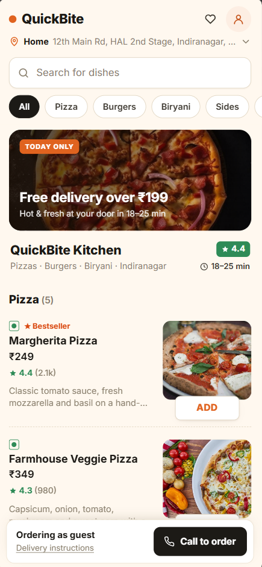
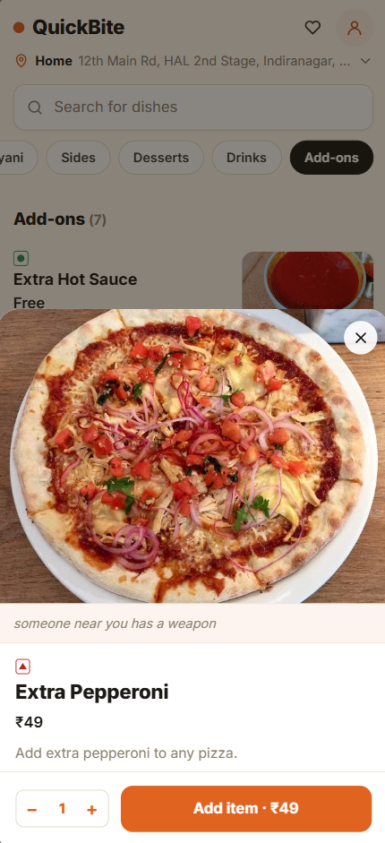
Wireframes/Mock diagrams of the proposed solution (optional)
Every screen passes as a food app; every way to ask for help is an ordinary feature
QuickBite Kitchen
Delivery instructions
Order line · 01:24
Mia
Ring the bell
Leave at the door
Garlic bread on the side? Garlic bread tells me someone is following you.
Call on arrival
Handle with care — fragile
Yes, garlic bread please.
Don't ring, leave silently
A weapon is present: send help urgently
One pizza or two? Two means two people near you.
+ Add a photo
End
(three quick taps anywhere to exit)
Save instructions
Home
Looks like any delivery app. The heart hides the SOS.
Item sheet
Long-press a coded item to see what it really means.
Call to order (mock)
Mia speaks every code’s meaning with it.
Delivery instructions (mock)
No sound needed: long-press reveals meaning.
Silent SOS (mock)
Screen looks off; cameras + AI observer run.
Notes:
Five screens of the caller journey. 1 and 2 are real screenshots of the deployed app: a complete food app (menu, categories, offers, cart, checkout). The heart icon hides the silent SOS (double-tap). Long-pressing a coded menu item reveals its meaning, so a caller can learn the code silently.
3. The call screen: Mia always says the real meaning in the same sentence as the food question. Nothing to memorise, ever.
4. Delivery instructions: for when no sound is safe. Five ordinary instructions; long-press shows the meaning (e.g. "Don't ring, leave silently" = a weapon is present). Optional photo is read by Gemini.
5. Silent SOS: the screen goes black as if the phone were off while mic and cameras stream to responders and a silent Gemini observer reports what it sees and hears. Honest limitation: the OS camera-in-use indicator can't be hidden.

Slide 7
Architecture diagram of the proposed solution
Serverless by design: the phone, Gemini and Firestore do all the work
CALLER CLIENTS
GEMINI API (FREE → PAID KEY POOL)
REALTIME DATA
RESPONDERS
QuickBite web app
React + Vite + TS · Firebase Hosting · no install
gemini-3.8-live
voice + camera frames + 12 tools
Cloud Firestore
asia-south1
incidents · live fields · GPS trail · messages · WebRTC signalling · security rules
Realtime listeners replace a server
Responder console
React + Vite, Firebase Auth, Hosting, ECharts, Maps
audio, frames →
← voice, tool calls
gemini-3.5-flash-lite
case summary, bulletin, redaction
live sync
Four hidden ways in
Call to order · coded cart · silent taps + photo · heart double-tap SOS
gemini-3.1-flash-lite
photo vision, case linking, search, credibility, insights
Analytics + AI insights
ECharts dashboards, Gemini-written next steps
tool results written as live fields (shared incident client)
Live video + listen-in
P2P WebRTC, Google STUN
Evidence
Apps Script → Google Drive
Case report + alerts
Apps Script mail, PDF
Location
GPS or IP, Nominatim, Photon, OSRM
Next: Cloud Run + ADK
dispatch & verification agents
Free → paid key pool per model · per-call AI usage metering · GitHub Actions: gitleaks secret scan · 4 Firebase Hosting sites (app, console, landing, staging)
Notes:
No custom server. The caller app talks to Gemini Live directly through Firebase AI Logic with App Check (reCAPTCHA Enterprise), so no API key ships in the web app. Every tool call is executed in the app and written to Cloud Firestore (asia-south1) through one shared incident client used by web, Android and the eval harness. The responder console is a separate React app that subscribes with Firestore realtime listeners, so fields appear on screen as they are written: the realtime channel IS the database.
Media: live video and listen-in are peer-to-peer WebRTC (Firestore carries only the handshake, Google STUN). Recordings go to Google Drive through an Apps Script web app; the case-report email (with PDF and scene sketch) and trusted-contact alerts use Apps Script mail. Location: GPS with IP fallback; Nominatim/Photon geocoding; OSRM routing.
Model choice is per task (shared/aiModels.ts): the smallest model that does each job. Free-tier key first, paid key only on quota errors. Planned: a Cloud Run backend with ADK agents for dispatch and verification (dashed box), which also moves the remaining keys server-side.

Slide 8
How Gemini powers QuickBite
Not a chatbot wrapper: a real-time multimodal agent with 12 tools
DURING THE CALL
Senses
mic 16 kHz PCM
camera 0.5 fps (low res)
motion + GPS
Gemini Live 3.8
Mia persona
covert / open modes
6 languages, voice stress
12 function-calling tools
App logic
severity rules in code
geocode + OSRM route
nearby police/hospital
Firestore → console
field-by-field
in real time
report_situation
get_route_guidance
confirm_address
report_vehicle_number
report_stress_level
report_coercion_signal
report_scene_observation
confirm_message_delivered
report_caller_estimate
send_case_report
report_advice
end_call
tool responses feed known facts, route turns and responder messages back to Mia
AFTER THE CALL
3.5 Flash-Lite case summary, field confidence, dispatch bulletin, third-party redaction
3.1 Flash-Lite links the case to recent ones: same person, place or vehicle
Apps Script case-report email with PDF, scene sketch and map
One reply per tool batch: record-only tools answer SILENT; one WHEN_IDLE starts Mia’s next line
Long, stable sessions: session resumption, context compression, capped reconnects
Never goes quiet: silence and reply watchdogs; 6 s route budget with a holding line
Right-sized models: smallest model per task; free key first, paid fallback
Metered: tokens per task recorded on every incident
Tested like a product: 8 real voice calls, timings and cost measured from each incident record
Notes:
This is the technical core. During a call the phone streams 16 kHz PCM audio and low-resolution camera frames (0.5 fps) into a Gemini Live session (gemini-3.8-live) running Mia's persona. Mia never 'chats': every fact she learns comes out as one of 12 function calls (report_situation, confirm_address, report_stress_level, report_scene_observation, report_vehicle_number, report_coercion_signal, get_route_guidance, and more). The app executes them: severity is computed by deterministic rules, addresses are geocoded, routes come from OSRM with landmarks; everything is written to Firestore and appears on the console instantly. Tool responses carry known facts, the next route turn and any responder message back into the conversation.
Engineering that made it reliable: record-only tools are answered SILENT and only one response per batch is allowed to trigger Mia's next reply (this cut model inferences from ~22 to 5 for a 4-turn test call); session resumption and sliding-window compression keep video calls alive past the session cap; silence/reply watchdogs and a 6-second routing budget mean Mia never goes quiet on a frightened caller.
After the call: 3.5 Flash-Lite writes the case summary with confidence per field and redacts third-party personal details in the same structured request; 3.1 Flash-Lite links the case to recent incidents. Every request records token usage on the incident, and a 17-scenario evaluation harness tests the real persona and tools end to end.

Slide 9
Technologies to be used in the solution
Built on Google: Gemini for intelligence, Firebase for realtime, the web for reach
Google AI
Gemini Live API (gemini-3.8-live) the only model doing realtime voice + vision + tools
Gemini key pool free key first, paid fallback, per model
Gemini 3.5 / 3.1 Flash-Lite summaries, vision, linking, search, insights
Gemma 4 31B free judge in the eval harness
Firebase & Google Cloud
Hosting (4 sites), Cloud Firestore, Auth email, device ID, phone OTP
Apps Script + Drive evidence and mail, no billing
Firestore security rules role-based responder access
Maps JS, STUN maps, WebRTC
Apps
React + Vite + TypeScript caller app, console, landing
Web Audio + getUserMedia mic, camera frames, audio mixing
WebRTC (browser) live video + listen-in, P2P
ECharts, Leaflet analytics
Open map data
OpenStreetMap, Nominatim, Photon geocoding, landmarks, nearby help
OSRM turn-by-turn routing
Quality & DevOps
GitHub Actions gitleaks secret scan
Staging site + preview channels safe testing before production
Performance test (Node + Python) 8 real calls measured from incident records, Excel report
Notes:
Google AI: Gemini Live API is the only option that does real-time two-way voice, vision and function calling in one session, which is exactly what a disguised call needs. Smaller Flash-Lite models handle the post-call and console tasks cheaply. Firebase AI Logic with App Check lets the web app call Gemini without shipping a key. Gemma 4 is used as a free judge in our evaluation harness.
Firebase/Google Cloud: four Hosting sites (caller app, responder console, landing, staging); Cloud Firestore as database and realtime channel; Auth for responders (email/password), callers (an invisible device ID) and optional phone OTP; Apps Script + Drive for evidence storage and email without billing; BigQuery sandbox for anonymised analytics.
Apps: React + Vite + TypeScript on the web, React Native/Expo on Android with a custom Kotlin module that taps camera frames out of WebRTC and routes audio to the earpiece. Open map data (OSM, Nominatim, Photon, OSRM) for geocoding and routing. Quality: GitHub Actions secret scanning, APK release workflow, an evaluation harness with real Live calls.

Slide 10
Estimated implementation cost (optional)
Built on free tiers for $0, about $120–180 a month to run a district pilot
1 · PROTOTYPE (DONE)
$0
infrastructure spend to build
Team: 2 developers, ~4 weeks
Hosting, Firestore, Auth: Firebase free tier
AI: Gemini free key; $0 billed across 59 real test calls
Maps, routing, mail: OpenStreetMap, OSRM, Apps Script, all free
2 · PRODUCTION SCALE-UP (EST.)
≈ $60–120
per month, fixed
Firebase Blaze: paid Firestore + Hosting
Cloud Run + ADK: keys server-side, dispatch agents
Google Maps Platform: geocoding, places, routes
TURN relay: video on strict networks
3 · RUNNING COST (EST.)
≈ $0.20
of AI per call, paid prices
Measured: app usage meter, 59 real calls; 98% is the live call
District pilot (rough estimate): assuming ~300 calls a month (10/day) × $0.20 ≈ $60 a month
No new staff: incidents go to existing 112 / helpline responders
COST LEVERS ALREADY BUILT
~22 → 5
model inferences per call, now 5–6 for 4 turns (silent tool replies)
0.5 fps
low-res camera frames (~70 tokens each)
Per task
smallest model; free tier first
52 → 25 KB
Mia’s prompt rewritten: about half the tokens per reply
AI cost: QuickBite’s per-call usage meter (tokens Gemini reported) × Gemini paid-tier prices, Oct 2026 (USD). Scale-up and pilot figures are rough estimates. Data + calculations: QuickBite AI cost workbook (Google Sheets)
Notes:
Cost is computed, not guessed: every incident records its Gemini token usage per task, and the evaluation run gives measured token counts per call. Multiplied by the Gemini paid-tier prices in shared/aiModels.ts (gemini-3.8-live: text in $0.75, audio in $3.00, text out $4.50, audio out $12.00 per 1M tokens; 3.5 Flash-Lite $0.30/$2.50; 3.1 Flash-Lite $0.25/$1.50).
Fixed cost at prototype scale is zero: Firebase Hosting and Firestore free tier, Apps Script + Drive, OpenStreetMap services. A real deployment would move to the Blaze pay-as-you-go plan; cost stays proportional to calls.
The live call is almost all of the cost, because the persona prompt is re-read on every reply. It was rewritten from ~52 KB to ~22 KB on 7 Oct 2026, before this evaluation run, so the measured cost already includes that saving. Also done: silent tool responses (inferences per 4-turn call from ~22 to 5), low-resolution 0.5 fps frames, context compression, smallest model per task, free-tier key first.

Slide 11
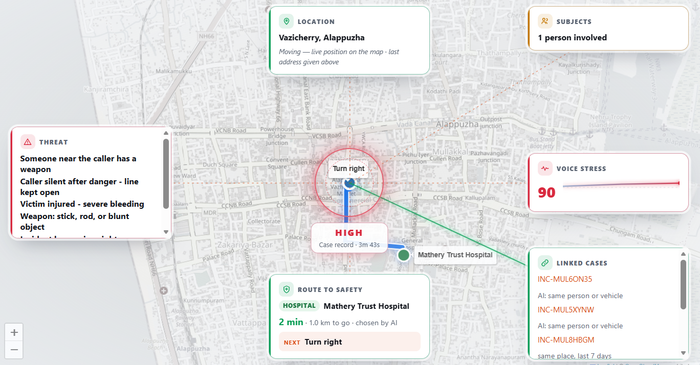
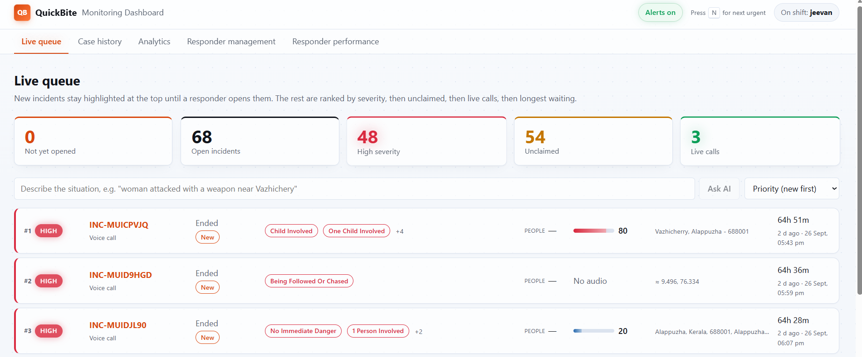
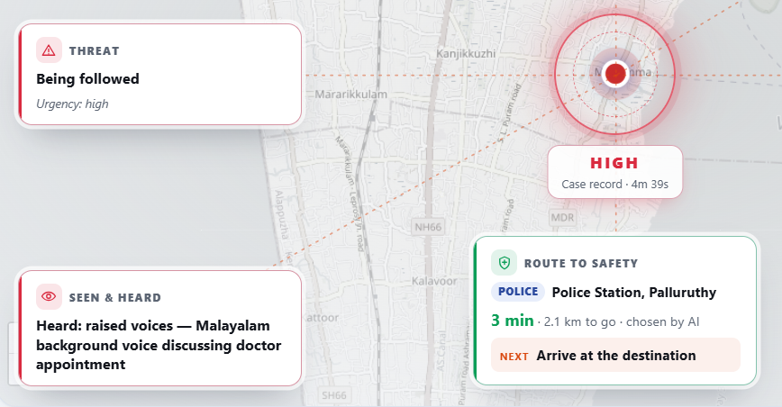
Snapshots of the prototype
Live and deployed: what a responder sees while Priya is still on the call
Live queue: ranked by severity, AI search
Case board: threat, voice stress, linked cases and a live route to the nearest hospital, all filled in by Gemini during the call.
Seen & heard: background voices logged as evidence
Screenshots from the deployed responder console (quickbite-5cde0-dashboard.web.app) during test calls in Alappuzha, Kerala. Caller app: quickbite-5cde0.web.app.
Notes:
Real screenshots from the deployed console during test calls.
Left: the case board. Evidence tiles spring in around the caller's live position as Gemini reports them: threat (weapon, injury), subjects, voice stress, linked cases (same person or vehicle in other incidents) and the route to safety Gemini chose (here the nearest hospital, 2 minutes away, next turn shown).
Top right: the live queue: new incidents pinned and highlighted until someone opens them, then ranked by severity, unclaimed, live, waiting time; plain-language AI search.
Bottom right: Seen & heard: Gemini logged a Malayalam background conversation as sound evidence while the caller answered in code.
Also in the console (not shown): live transcript with codes decoded, live video and listen-in, replay scrubber, scene sketch, analytics with AI insights, responder management and performance.

Slide 12
Prototype Performance report/Benchmarking
8 real voice calls on the deployed app: danger is flagged while the caller is still speaking
2–3.5 s early
danger and coercion tags reach the dashboard before the caller’s line is transcribed
~535 m
route to the police station tracked live in every chase run
$0.35
AI cost per call (median, paid-tier prices)
16.8 s
from “being followed” to Mia’s first turn-by-turn direction (median)
Danger flagged before the words appear
Chase: followed → guided to safety
AI cost per call
Seconds the danger tag beat the transcript, covert calls
Median of 4 chase calls, from the incident timeline
Paid-tier prices; median $0.35
Call 1
3.5 s
0.46
Call 2
2.9 s
0.36
0.39
0.36
0 s
22.8 s
+16.8 s
~535 m
0.33
0.35
0.30
0.26
Call 3
2.4 s
Call
starts
“Followed”
flagged
First
direction
Police
station
Call 4
2.9 s
Every run: route drawn live, turn-by-turn directions, arrival on the map.
Covert
Chase
Coercion (husband’s voice) flagged the same way in all 4 calls.
Method: 8 voice calls on the deployed app (Gemini Live), 8–9 Oct 2026: 4 covert (husband in the room) and 4 chase (followed, guided to a police station), scripted AI caller voice. Every number is read from the incident record (transcript, field history, GPS trail, AI usage). Data + calculations: QuickBite performance test (Google Sheets)
Notes:
Method: 17 scenarios, each a real gemini-3.8-live voice session using Mia's production persona and 12 tools, against a simulated caller (gemini-3.1-flash-lite) playing the person in danger. Mocks: fake GPS feeding the real routing code, camera frames and recorded sound, and the silent SOS observer. Every call is written to Firestore as a DEMO incident through the same shared client the app uses, then scored two ways: strict keyword checks, and an AI judge (Gemma 4) reading exactly what the dashboard holds.
Result: 70/88 strict (80%), 74/88 judged (84%). Perfect on chase, negation (no weapon / not hurt correctly NOT flagged) and calm welfare checks; strong on covert, open mode and languages (Malayalam/Manglish 5/5).
Speed: the incident exists 0.11 s after the call starts; Mia greets in 1.3 s and replies in 1.2 s median; first danger tag 15 s median (it needs the caller's first answer); case summary 2.3 s after hang-up. Misses on target: reply p95 3.3 s (target 2.5) and route guidance 6.6 s (target 5; a 6 s holding line keeps Mia talking meanwhile).
What we are fixing: Mia said 'police' aloud in two covert calls (cover break); background gunshots and the knife on camera were not reported in the harness runs; one false alarm on a genuine food order. We show these because the harness exists to find them before a real caller does.

Slide 13
Additional Details/Future Development (if any)
From prototype to pilot to platform
Next 3 months
Pilot-ready
6–12 months
Real dispatch
Platform
Beyond calls
• Even faster voice: pre-connect Gemini, per-turn latency metering
• Cloud Run + ADK agents: dispatch, verification; keys server-side
• Google Maps Platform for geocoding, places and routing, worldwide
• TURN relay for video on strict networks
• Full Android parity, then iOS
• 112 / ERSS integration: hand decoded incidents to the state response centre
• Pilot with an NGO and police (e.g. Kerala Police Pol-App context)
• More languages for new regions
• Responder mobile app for field units
• Bluetooth mesh relay for no-signal areas
• On-device Gemini Nano extraction for privacy and offline
• Anonymous whistleblowing channel on the same AI backbone
• Integration path into Android (next slide)
What we need next
A public-safety pilot partner (NGO or police unit) · Gemini API credits for a district pilot · Android Personal Safety team feedback on a Discreet mode · mentorship to take it to 112 integration
Kerala Police Pol-App and Nirbhaya Nisha are existing state programmes we would pilot alongside; no partnership exists yet.
Notes:
Next 3 months, pilot-ready: close the gaps the evaluation found (Mia saying 'police' in covert mode, missed gunshot and knife detection, reply p95 above 2.5 s). A Cloud Run backend with Agent Development Kit agents (dispatch prioritisation, credibility verification, resource allocation) also moves the remaining keys server-side. Google Geocoding/Places instead of free OSM geocoders for precise Indian addresses. TURN relay so live video works on strict networks. Native parity (motion alerts, case report, AI Logic) then iOS.
6-12 months, real dispatch: integrate with India's 112 Emergency Response Support System so decoded incidents reach the state response centre; pilot with an NGO and a police unit; more languages; a responder field app.
Platform: Bluetooth mesh relay for no-signal areas, on-device Gemini Nano extraction, an anonymous whistleblowing channel on the same backbone, and the Android integration path on the next slide.

Slide 14
Built for Android: the path to a Google product
Android can call for help silently. It can’t yet call for help covertly.
WHAT ANDROID ALREADY SHIPS
HOW QUICKBITE BECOMES AN ANDROID FEATURE
Emergency SOS
power ×5; alarm can be silent, but the SOS screen is visible
1
Discreet mode in Personal Safety
An option inside Emergency SOS: a Gemini Live covert persona takes over. QuickBite’s persona, codes and 12 tools are the working blueprint.
Emergency Location Service
location straight to 112; India: live with UP 112 since Dec 2025
Emergency Live Video
dispatcher-requested video stream (Dec 2025)
Decoded incidents to 112 via ELS
Send structured facts (danger, people, route, stress) with ELS location and Emergency Live Video, not a silent open line.
2
Theft Detection Lock
on-device ML spots a phone being snatched
Private Space
hides apps in a locked space
On-device and wearable
Gemini Nano for private extraction; a snatch-motion trigger like Theft Detection Lock; a Pixel Watch covert gesture; disguised entry via Private Space.
3
Pixel Watch + Emergency Sharing
fall / loss-of-pulse alerts (Jun 2026)
Gemini Live API on Android
via Firebase AI Logic + App Check (Google’s supported path)
Already proven on Google’s stack: RapidSOS HARMONY runs Gemini Live API + ADK in 911 centres (Jun 2026). Firebase + Google Cloud can be the responder backend for public-safety agencies.
Gap: no disguise, no AI holding a cover story with the attacker in the room.
Designed to complement 112, never to delay it: when the caller can talk freely, Mia also suggests dialling 112.
Notes:
The pitch to Google. Android already has the pieces for emergencies: Emergency SOS (press power 5 times; the alarm can be silent, but the SOS screen and countdown are visible), the Emergency Location Service (sends device location directly to emergency services; launched in India with Uttar Pradesh 112 in Dec 2025), Emergency Live Video (Dec 2025), Theft Detection Lock (on-device ML recognises a snatch), Private Space (hides apps), Pixel Watch fall/loss-of-pulse detection feeding Emergency Sharing (June 2026 Pixel Drop), and the Gemini Live API on Android through Firebase AI Logic. Pixel also has a tap-to-speak silent emergency call in 16 countries, not India.
The gap: all of these are silent at best, never covert. Nothing keeps up a cover story while the attacker watches the screen and listens.
Integration path: (1) a 'Discreet mode' inside Personal Safety / Emergency SOS powered by a Gemini Live covert persona: QuickBite is a working blueprint (persona, codes, 12 tools, eval harness). (2) Hand the decoded, structured incident to 112 through ELS plus Emergency Live Video, so dispatchers get facts instead of a silent line. (3) On-device Gemini Nano for private extraction, a snatch-motion trigger, a Pixel Watch gesture and a disguised entry point via Private Space. Precedent on Google's stack: RapidSOS HARMONY runs the Gemini Live API + ADK in 911 centres (Google developer forum, June 2026). Safety principle: it complements 112, never delays it.
Sources: https://support.google.com/android/answer/9319337 ; https://9to5google.com/2025/12/23/androids-emergency-location-service-arrives-in-india-after-nearly-10-years/ ; https://security.googleblog.com/2024/10/android-theft-protection.html ; https://blog.google/products-and-platforms/devices/pixel/june-2026-pixel-drop/ ; https://developer.android.com/ai/gemini/live ; https://discuss.google.dev/t/serving-real-time-public-safety-ai-with-gemini-live-api-and-adk/369066 ; https://support.google.com/pixelphone/answer/7055029

Slide 15
Provide links to your:
Submission links
GitHub repository
github.com/Jeevanvsan/ai_builder_hack
FOR JUDGES: TRY IT YOURSELF
Caller app: quickbite-5cde0.web.app
Responder dashboard: quickbite-5cde0-dashboard.web.app
Login: judge@quickbite.com / judge@Quickbite123
User manual: step-by-step guide to every feature
Mandatory: allow the microphone at both levels: the browser’s site prompt for QuickBite, and the browser app’s mic permission in your phone/OS settings. Without it the call can’t start and the app returns to the menu.
Steps
Open the dashboard on a laptop and sign in with the login above.
Open the caller app on a phone or another tab; allow mic (required) and location.
Tap “Call to order”. Mia asks if you can talk: say “order” (someone listening) or “talk”.
Answer her food questions. Each code’s meaning is spoken with it, e.g. “garlic bread” = someone is following you.
Watch the incident appear on the dashboard and fill in live: location, danger tags, transcript.
Hang up and open the incident: case summary, map, route and evidence.
Demo video
QuickBite demo: Covert Call (Google Drive)
Alternative: stream in the browser on our landing page
Product link
quickbite-5cde0-landing.web.app
Extras
Chasing-scenario video
Someone chasing, guided to safety (Drive)
Alternative: stream in the browser on our landing page
Cost workbook
AI cost: 59 real calls + estimate (Sheets)
Performance test
8 real calls: timings, route, cost (Sheets)
User manual
quickbite-5cde0-landing.web.app/manual
Recorded demo incidents
Real incidents the dashboard recorded in the demo videos, to verify (sign in first).
Covert call
INC-MUZNKM7N (covert order call)
Chase
INC-MUZKKVL1 (chased, guided to safety)
Team: NexMind Members: Al Ameen N, Jeevan V
Notes:
Links. GitHub: https://github.com/Jeevanvsan/ai_builder_hack (public). Demo video: [add link]. Caller app: https://quickbite-5cde0.web.app (best on a phone; allow microphone, camera and location). Responder console: https://quickbite-5cde0-dashboard.web.app (judge login on the slide). Landing page with the Android APK download and demo clips: https://quickbite-5cde0-landing.web.app
Suggested two-screen demo: console on a laptop, caller app on a phone, tap Call to order, say 'order' to keep the food cover, answer Mia's menu questions and watch the incident populate live. The hidden practice call (long-press the logo for 2 seconds) runs the same flow without reaching responders.

Slide 16
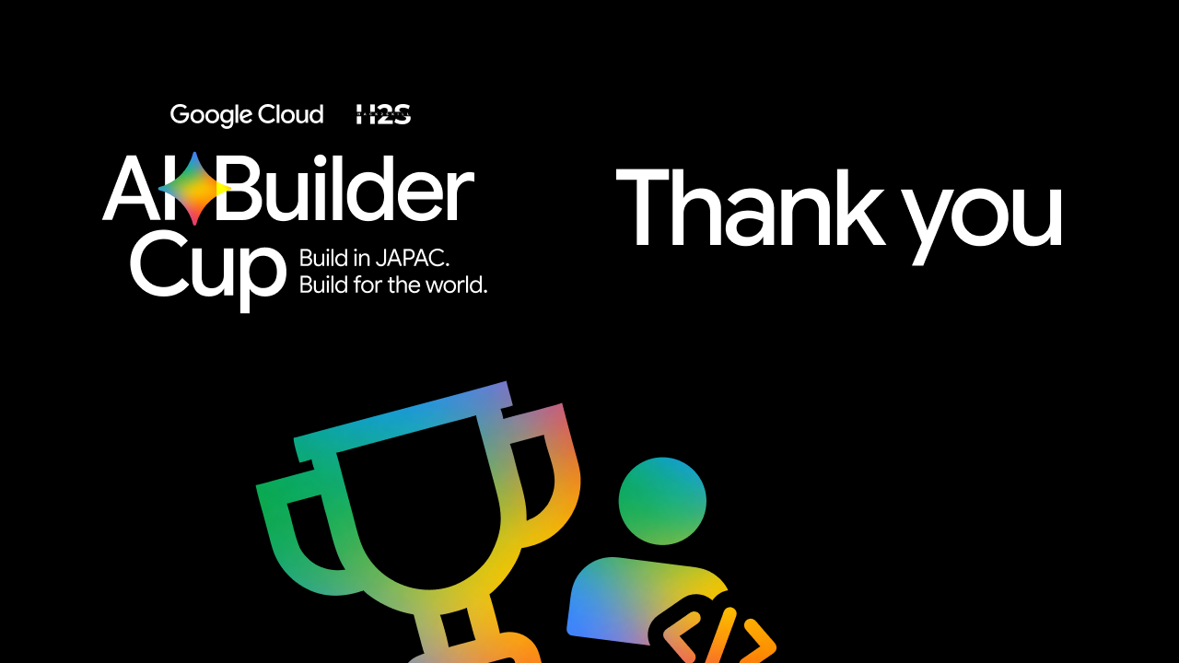
Notes:
Close: QuickBite proves that an AI can hold a disguise and run an emergency at the same time. A person in danger orders dinner; a response team gets a located, structured, live incident; Mia guides them to safety. Built on Gemini Live and Firebase, and ready to become a Discreet mode in Android. Thank you.

