Slide 1



SMARTGRID MAINTENANCE BOT
PROJECT MEMBERS:
JEENAS DEEPA.A (23ITR070)
JEEVASHRE.G (23ITR071)
NANDHINI.E(23ITR108)
JAIHARI D (19ITR028)
PROJECT GUIDE:
Dr . J. PREMALATHA (PROFESSOR)

Slide 2
Problem Description
Design an intelligent chatbot that provide timely responses to the user’s queries related to substation.
It offers step-by-step instructions for maintenance tasks, suggests acceptable test values, and provides troubleshooting tips.
This chatbot provides answers related to industry standards, safety guidelines, and recommends appropriate test equipment.
This ensures that maintenance efficiency and safety, minimizing downtime and ensuring reliable power transmission.

Slide 3
Objectives
To develop the chatbot to bring new ideas of maintenance of substation in a easy way.
To provide simple maintenance procedures, testing equipment
and safety protocols.
To ensure User-Friendly Interaction.
3

Slide 4





Software / Hardware Tools used
Frontend:
JavaScript
HTML
CSS
Backend:
MySQL : Database Management
Chatbot development tool:
Landbot
4

Slide 5
Implementation Details
Create a Flow diagram using Landbot.
Build a structure of the conversation by selecting appropriate nodes.
The Chatbot starts by identifying the user’s maintenance needs (e.g., type of equipment, safety checks) to guide them to the correct workflow.
Integrating the Chatbot with the website
Test the embedded Chatbot on the website to confirm it functions as expected.
5

Slide 6
Modules
1. Webpage development
2. Chatbot implementation
3. Integration of Chatbot with webpage

Slide 7
1.Webpage Development
1) MAIN PAGE
For the main page of the chatbot website,HTML and CSS is used and the text editor used is VS code.
Includes links to Home, About, Log In, and Sign Up Page.
2) DATABASE CONNECTIVITY
For the login and signup module,MYSQL is used to manage and store user credentials.

Slide 8
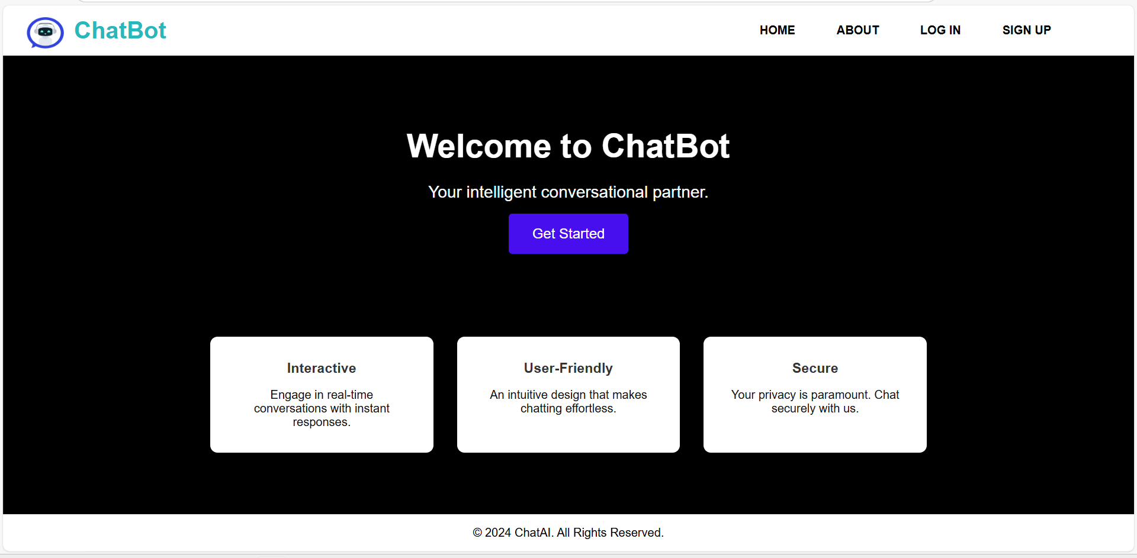
1.Webpage Development
Main page

Slide 9
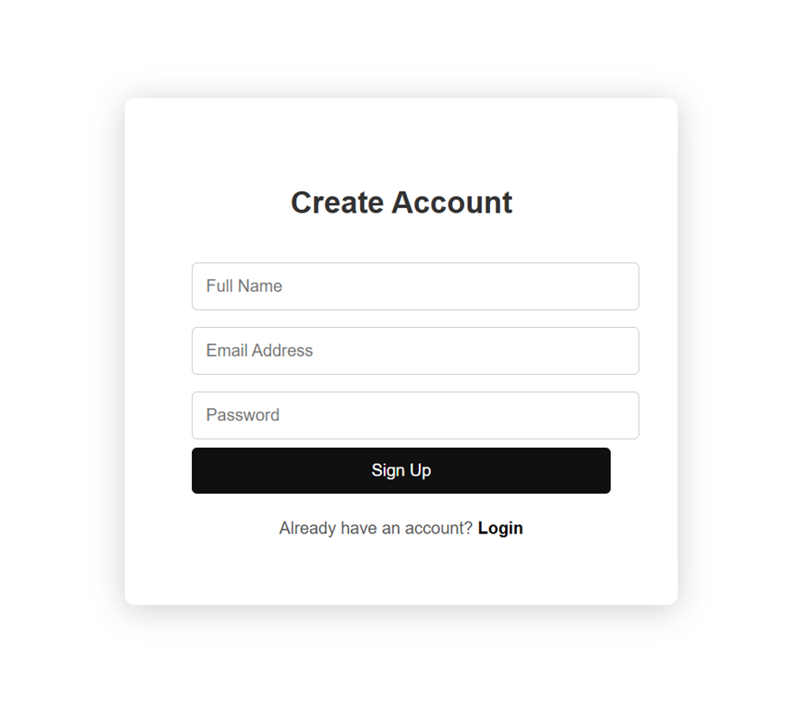
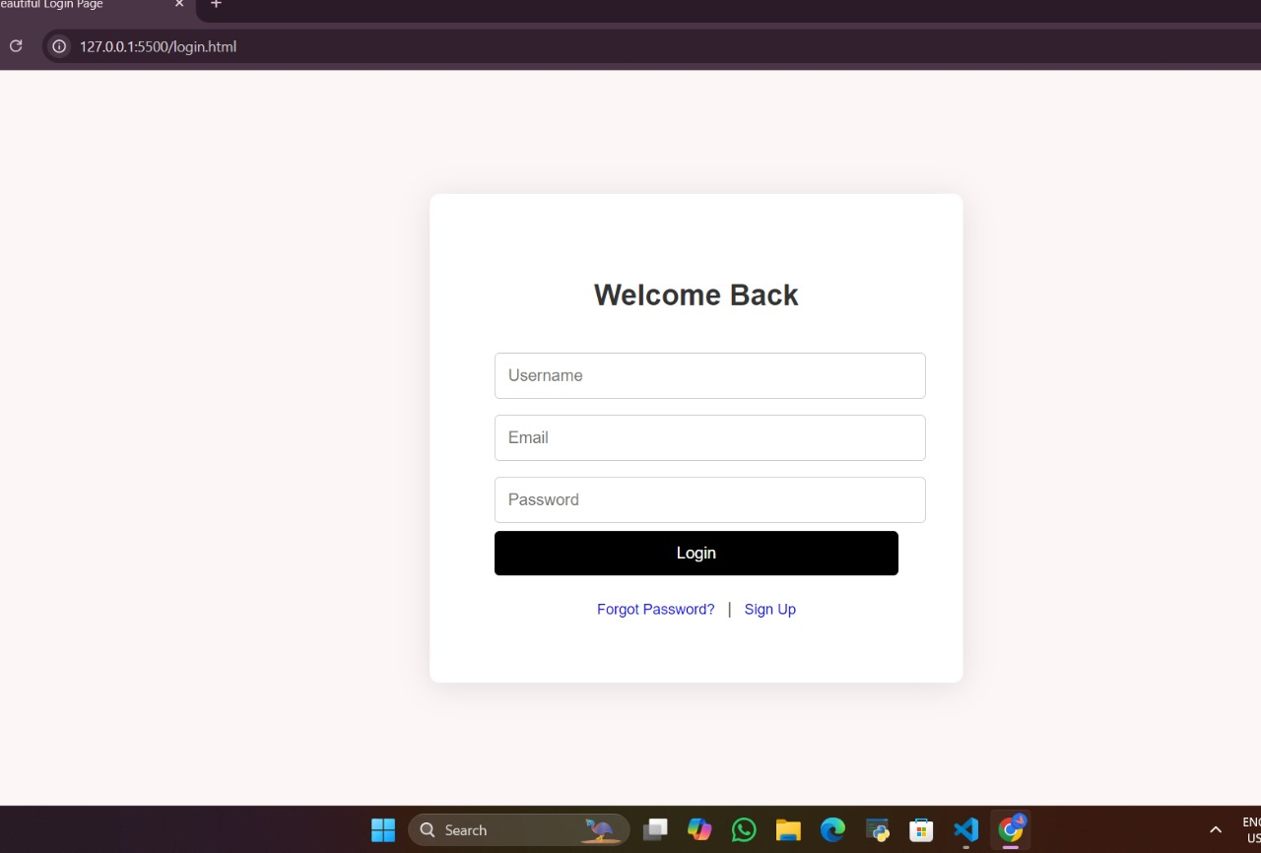
1.Webpage Development
Login and Signup page

Slide 10
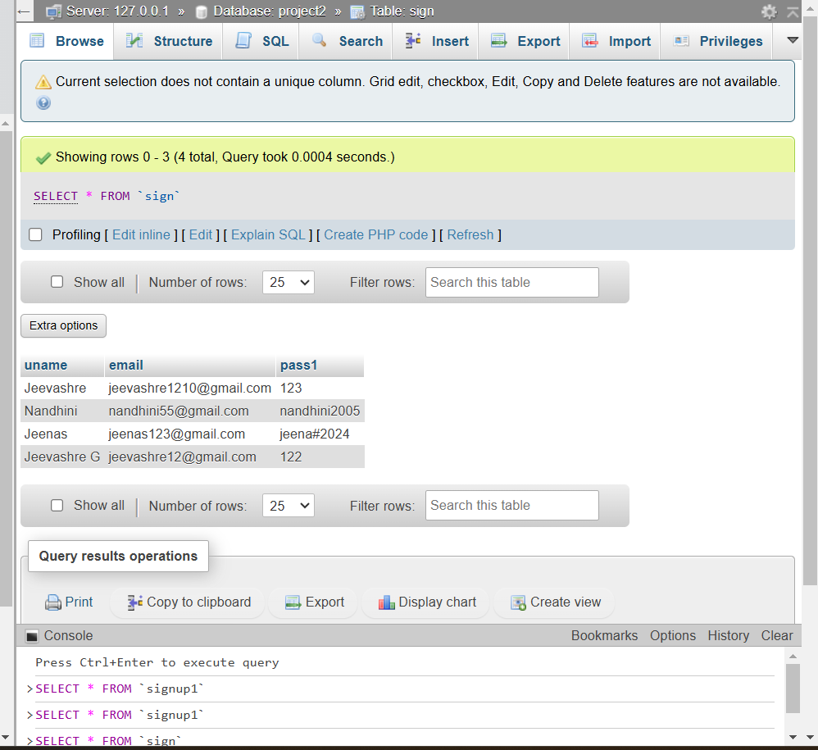
1.Webpage Development
Database connectivity

Slide 11
2.Chatbot Implementation
In this module,the chatbot is created using Landbot.
The chatbot provides various options to the user.
When the user clicks options in the chatbot,they are taken through a series of steps to provide information.

Slide 12
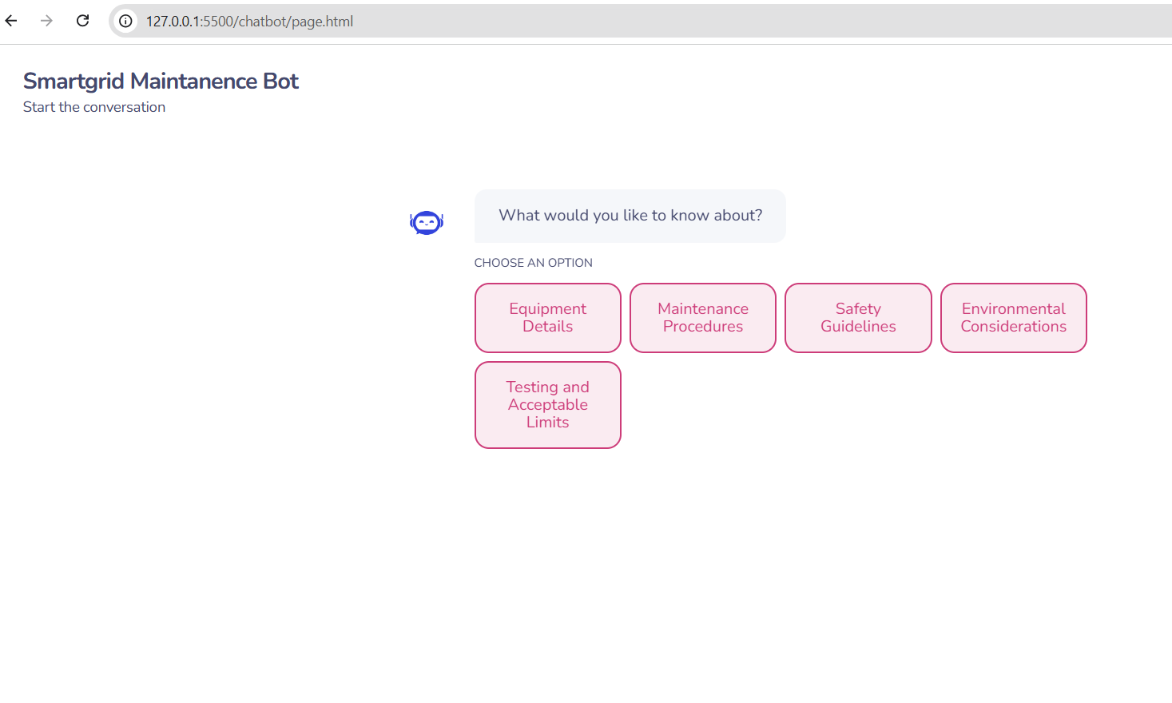
2.Chatbot Implementation

Slide 13
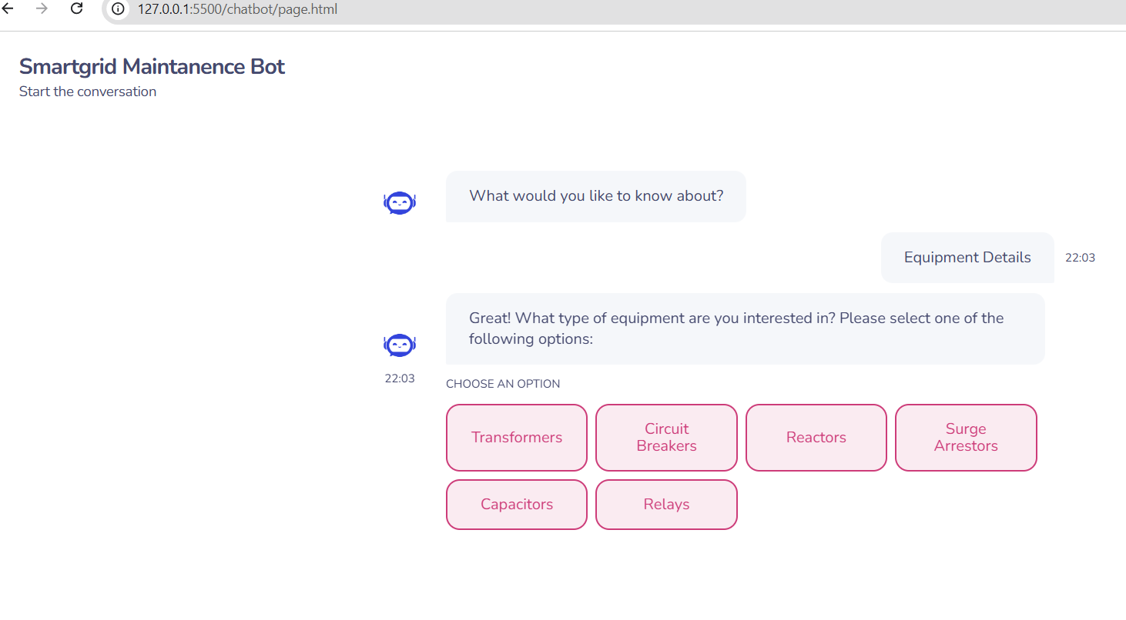
2.Chatbot Implementation
Options provided by chatbot

Slide 14
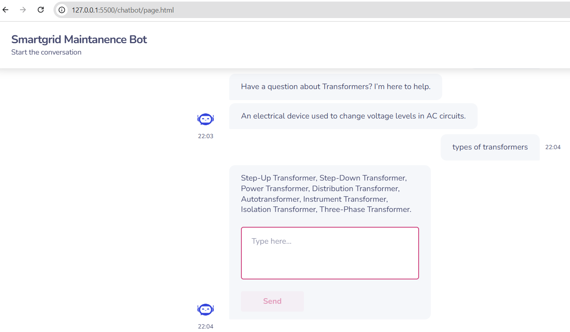
2.Chatbot Implementation
User asking queries to the chatbot

Slide 15
3.Integration of Chatbot with Webpage
The Module shows the embedding of Smartgrid Maintanence Bot with the website.
Javascript code snipped is provided by the Landbot platform.
Then embedding the code with the website’s HTML.
The chatbot becomes the integral part of the website

Slide 16
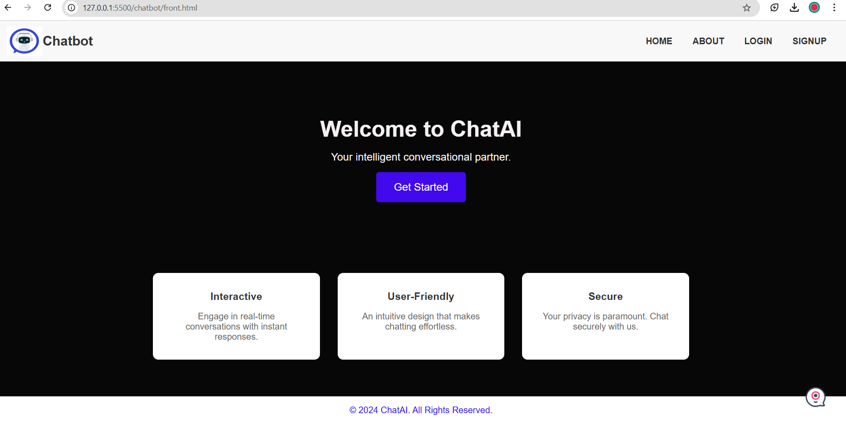
3.Integration of Chatbot with Webpage
Chatbot is integrated

Slide 17
Reference
https://landbot.io/academy/home
https://www.w3schools.com/
https://landbot.io/academy-tutorials/how-to-embed-your-chatbot
https://github.com/ElAmirr/LandBot

Slide 18
Thank you

