Slide 1
Chicago City Crime Data Analysis
Department of Information Technology and Management
Jeevith Hebbaka Mallikarjunaiah (A20382020)
Phanindra Chandraprakash (A20376416)

Slide 2
Introduction
Crimes are anti-social activities which causes society profoundly in innumerable ways. There had been humongous expansion in the crime in the recent past. It has become the most critical concern about the national security, especially after the 9/11 attacks at World Trade Center at New York city. Determining solution for crimes has been the prerequisite of the law enforcement specialists. With the advent of computerized systems, it has become more convenient to track the data of criminals, which will speed up the process of solving crimes.

Slide 3
Objective
To perform classification task on Chicago Crime Data with different classification algorithms.
To compare the classification algorithms based on its accuracy to predict the class label correctly and finalize a classification algorithm for classifying the Chicago City Crime Data.

Slide 4
Data Source and Test Data
Crime Data from Chicago Data Portal (https://data.cityofchicago.org/).
This dataset reflects reported incidents of crime (with the exception of murders where data exists for each victim) that occurred in the City of Chicago from 2001 to present, minus the most recent seven days.
FinalData.csv: Contains 5100 Records (Which is 7% resampled data from 72859 Records)
TestData.arff: Contains 1145 Records (34% resampled data from 5100 Records)
TrainingData.arff: Contains 3366 Records (64% resampled data from 5100 Records)

Slide 5
Data Pre-processing
NA values were removed using RStudio and exported the dataset into a CSV file.
CSV file is then loaded into Weka, where Normalization and Resampling was performed to make the data suitable for feature selection and classification processes.

Slide 6
Feature selection process
Below are the settings used in feature selection process:
Attribute Evaluator: Wrapper Subset Eval
Search Method: Best Fit
Classifier: Naïve Bayes, KNN, Decision Table, Random Tree and J48.
Attribute Selection Mode: Full Training Set
Class Attribute: Arrest and Primary Type

Slide 7
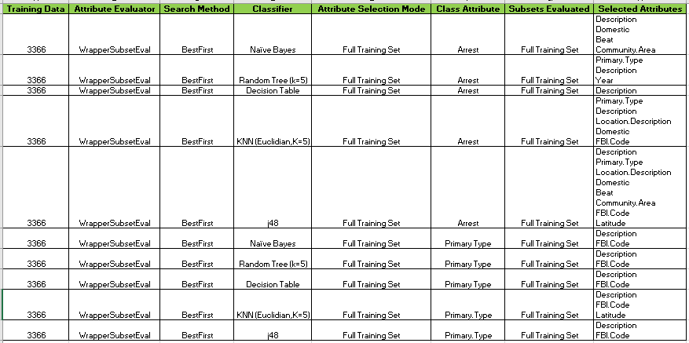
Feature selection output

Slide 8
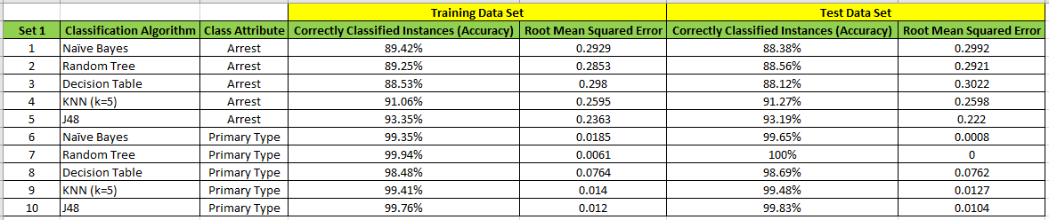
Classification Task Output

Slide 9
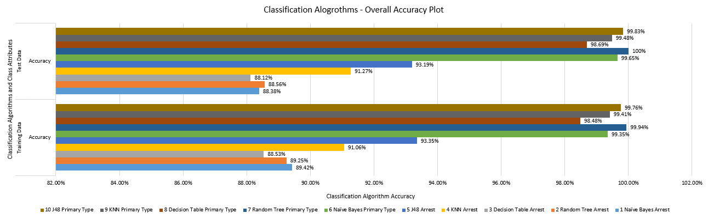
Classification Algorithms Consolidated output

Slide 10
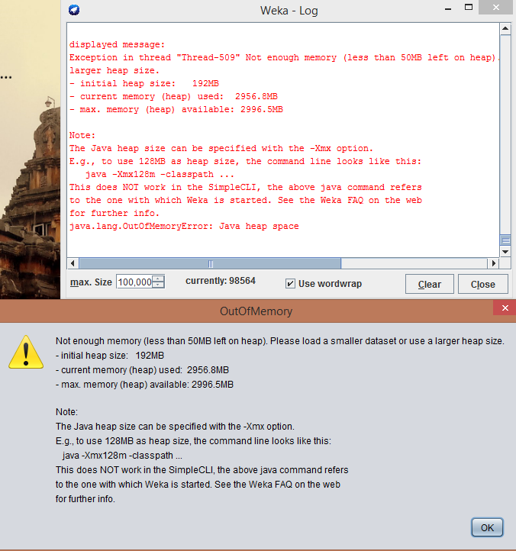
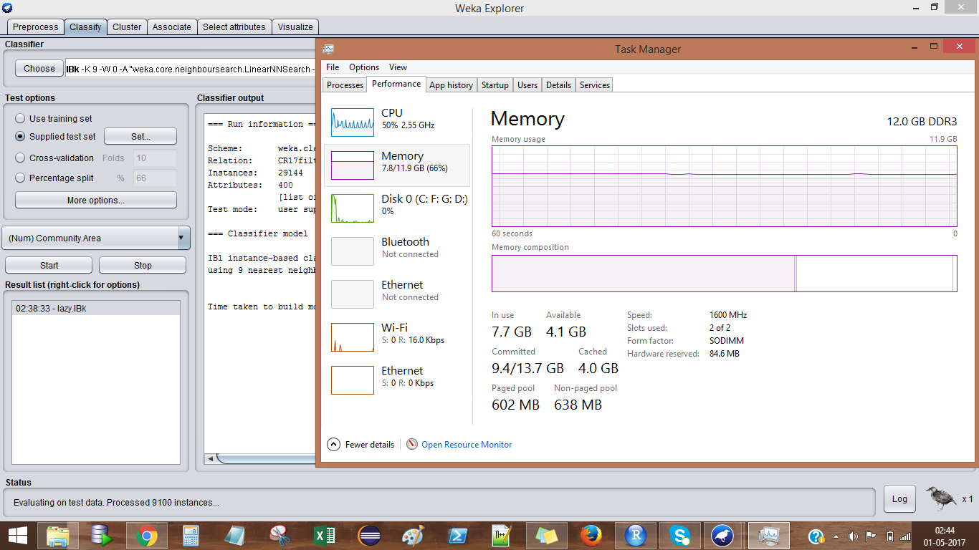
Challenges

Slide 11
Conclusions
Based on the analysis, we have chosen Random Tree classification algorithm to classify the Chicago City Crime Data, since accuracy was 100% and Root Mean Squared Error was zero.

Slide 12
Thanks !!! Any Questions?

