Slide 1
Employee Data Analysis using Excel
STUDENT NAME:V.Jeevitha
REGISTER NO:312202994
NM ID : 5CB2C20AF7A083CA7F3499733EC7FDB5
DEPARTMENT:COMMERCE (B.COM)
COLLEGE:ASAN MEMORIAL COLLEGE OF ARTS AND SCIENCE

Slide 2
PROJECT TITLE
EMPLOYEE DATA ANALYSIS

Slide 3


AGENDA
Problem Statement
Project Overview
End Users
Our Solution and Proposition
Dataset Description
Modelling Approach
Results and Discussion
Conclusion
3/21/2024 Annual Review

Slide 4

PROBLEM STATEMENT
It helps organizations harness the power of data, enabling them to make decisions, optimize processes, and gain a competitive edge. By turning raw data into meaningful insights, data analysis empowers businesses to identify opportunities, mitigate risks, and enhance their overall performance.

Slide 5

PROJECT OVERVIEW
.
Employee analytics is the practice of collecting, analyzing, and interpreting data to improve decision-making, enhance productivity, and foster a better workplace environment.

Slide 6
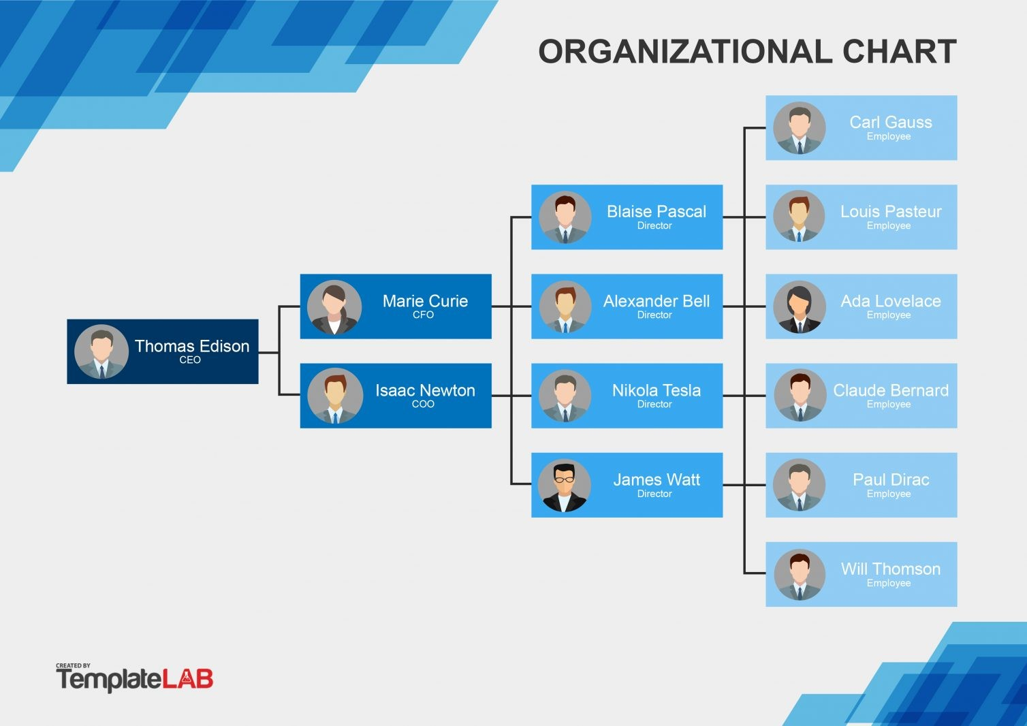

WHO ARE THE END USERS?

Slide 7

OUR SOLUTION AND ITS VALUE PROPOSITION
FILTERING
COLOURING
GRAPH
CONDITIONAL FORMATING
PIVOT TABLE

Slide 8
Dataset Description
EMPLOYEE DATASET COLLECT FROM IBM DASHBOARD
THERE ARE 26 FEATURES IN THE DATASET
ONLY 7 FEATURES WE COLLECT IN THE DATASET
THE 1ST DATA IS EMPLOYEE ID IN NUMERICAL DATA
THE 2ND DATA IS TITLE IN DATASET
THE 3RD DATA IS AD EMAIL
THE 4TH DATA IS PAYZONE
THE 5TH DATA IS TERMINATION
NEXT DATA IS DIVISION
AND THE LAST DATA WE COLLECT IN THE DATASET IS STATE

Slide 9
MODELLING
DATA COLLECTION
1. DATASET DOWNLOAD FROM EDUNET DASHBOARD
2. EMPLOYEE DATA ANALYSIS USING EXCEL
FEATURES COLLECTING
1. THERE ARE 26 FEATURES IN THE DATA
2. EMLOYEE ID,FIRST NAME,LAST NAME,START DATE,EXIT DATE,ETC….,
3. IN THIS 26 FEATURES I WILL COLLECT ONLY 7 FEATURES
4. EMPLOYEE ID,TITLE,AD EMAIL,PAYZONE,TERMINATION,DIVISION AND STATE
9

Slide 10
DATA CLEANING
IN THE DATA CLEANING WE ALSOM USED CONDITIONAL FORMATING
IDENTIFYING THE MISSING VALUE
USING CONDITIONAL FORMATING AND HIGHLIGHTING BY COLOURS
REMOVE THOSE BLANK VALUES WITH USING FILTERS
SUMMARIZING (PIVOT TABLE)
COLLECT THE DATA FROM EXCEL SHEET
SUMMARIZE THE VALUES USING PIVOT TABLE
A PARTICULAR DATA IS SET TO BE IN THE ROW , COLUMN AND VALUE
CHART FOR PIVOT TABLE
CLICK ON THE PIVOT TABLE TO ACTIVATE THE PIVOT TABLE TOOLS
CLICK PIVOT CHART IN THE TOOLS GROUP
CHOOSE THE COLUMN CHART AND ENTER THE TREND VALUE AND THE CHART HEADING

Slide 11
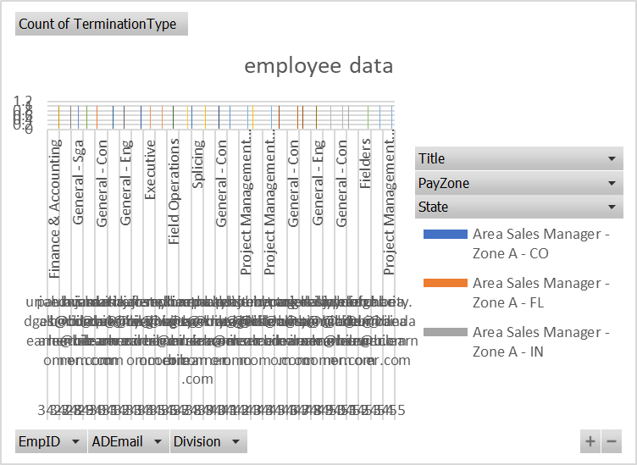
RESULTS
11

Slide 13
conclusion
In conclusion, analyzing employee data using Excel provides a robust framework for gaining valuable insights into workforce dynamics and operational efficiency. Excel's diverse array of tools and functions, such as pivot tables, charts, and allows for comprehensive data manipulation and visualization.

