Slide 1
Keylogger and security
CAPSTONE PROJECT
Presented By:
JEEVITHA Priyadarshini Engineering College -CSE

Slide 2
OUTLINE
Problem Statement
Proposed System/Solution
System Development Approach
Algorithm & Deployment
Result (Output Image)
Conclusion
Future Scope
References

Slide 3
Problem Statement
In the digital age, where information is constantly exchanged through computers and other electronic devices, ensuring security and monitoring user activities have become paramount. One effective tool for achieving this is a keylogger, a software program capable of recording keystrokes made by users on a computer keyboard. However, the development of a keylogger presents a set of challenges and considerations that need to be addressed:

Slide 4
Proposed Solution
Security and Privacy Concerns: Developing a keylogger raises ethical concerns regarding user privacy and data security. How can the keylogger be designed and implemented to ensure that sensitive information, such as passwords and personal conversations, is not compromised or misused?
Legality and Compliance: There are legal and regulatory considerations surrounding the use of keyloggers, particularly in terms of monitoring employee or user activities. How can the keylogger be developed to comply with relevant laws and regulations while balancing the need for security and monitoring?
Detection and Antivirus Bypassing: Keyloggers are often flagged and removed by antivirus software due to their potential association with malicious activities such as identity theft and unauthorized surveillance. How can the keylogger be developed to evade detection by antivirus programs while maintaining its functionality?
User Interface and Accessibility: The usability of the keylogger is essential for its effectiveness in security and monitoring applications. How can the keylogger be designed with a user-friendly interface that allows authorized users to access recorded data efficiently while preventing unauthorized access?
Compatibility and Integration: Keyloggers need to be compatible with various operating systems and software configurations to ensure broad applicability. How can the keylogger be developed to seamlessly integrate with different operating systems and applications while minimizing compatibility issues?
Data Encryption and Storage: Recorded keystrokes must be securely encrypted and stored to prevent unauthorized access and tampering. How can the keylogger implement robust encryption techniques and secure storage mechanisms to safeguard sensitive data effectively?
Ethical Use and Accountability: The development and deployment of a keylogger must adhere to ethical guidelines and principles. How can the keylogger be used responsibly, and what measures can be implemented to ensure accountability and transparency in its deployment?

Slide 5
System Approach
Software keyloggers: This approach involves installing software that replaces the keyboard interaction driver, positions a filter driver within the keyboard stack, or intercepts kernel or dynamic link library functions to capture keystrokes.
System Hook: This method involves intercepting keypress notifications by creating a system hook.
By meeting these system requirements and utilizing the specified libraries, the keylogger project aims to provide a robust and user-friendly solution for capturing and logging keystrokes on various computer systems.

Slide 6
Algorithm & Deployment
ALGORITHM
1. Initialization: Initialize variables and setup necessary configurations.
2. Start Keylogger:
- Create a keyboard listener using the `pynput` library.
- Define functions to handle key press and release events (`on_press` and `on_release`).
- Start the keyboard listener to capture keystrokes in real-time.
3. Capture Keystrokes:
- Upon key press event, append the pressed key information to the `keys_used` list.
- If a key is held down, continuously append the held key information until it is released.
- Upon key release event, append the released key information to the `keys_used` list.

Slide 7
Algorithm & Deployment
4. Logging:
- Implement functions (`generate_text_log` and `generate_json_file`) to log captured keystrokes into text and JSON files, respectively.
- Ensure secure and consistent storage of keystrokes locally on the system.
5. User Interface:
- Develop a simple GUI using `tkinter` with buttons to start and stop the keylogger.
- Configure button callbacks to initiate and terminate the keylogging process.

Slide 8
Algorithm & Deployment
DEPLOYMENT
Define Purpose and Scope:
Clearly define the purpose of deploying the keylogger, whether it's for security monitoring, parental control, or other legitimate purposes.
Determine the scope of monitoring, including which users or devices will be monitored and what types of activities will be logged.
Choose the Right Keylogger:
Select a keylogger software that aligns with your objectives, platform compatibility, and security requirements.
Ensure the chosen keylogger offers necessary features such as keystroke logging, screenshot capture, and encryption capabilities.
Obtain Legal and Ethical Clearance:
Research and understand the legal implications of deploying a keylogger in your jurisdiction.
Obtain necessary permissions and consents from relevant stakeholders, such as employees, if deploying in a workplace environment.
Ensure compliance with privacy laws and regulations to protect individuals' rights and privacy.
Configure Settings:
Customize the keylogger settings according to your monitoring requirements.
Specify which activities to monitor (e.g., keystrokes, application usage, website visits) and adjust logging intervals as needed.
Implement Security Measures:
Secure the keylogger software and its data against unauthorized access.
Use strong encryption algorithms to protect captured keystrokes and sensitive information.
Implement access controls to restrict who can view and manage the logged data.

Slide 9
Algorithm & Deployment
6.Deploy in a Controlled Environment:
Install the keylogger on target devices in a controlled and authorized manner.
Ensure that users are aware of the presence of monitoring software, where applicable, and provide transparent information about its purpose and usage.
7.Monitor and Review:
Regularly monitor the keylogger's activity logs to ensure it is functioning as intended.
Review captured data for any security incidents, policy violations, or suspicious activities.
Address any issues promptly and take corrective actions as necessary.
8.Educate Users:
Provide training and awareness programs to users about the presence and purpose of the keylogger.
Educate users on safe and responsible use of computer systems and emphasize the importance of privacy and data security.
9.Maintain Compliance:
Stay informed about changes in laws, regulations, and industry standards related to monitoring and data privacy.
Update the keylogger software regularly to address security vulnerabilities and ensure compliance with evolving requirements.
10.Regular Review and Assessment:
Periodically review the deployment and usage of the keylogger to assess its effectiveness and compliance with legal and ethical standards.
Solicit feedback from users and stakeholders to identify areas for improvement and address concerns proactively.

Slide 10
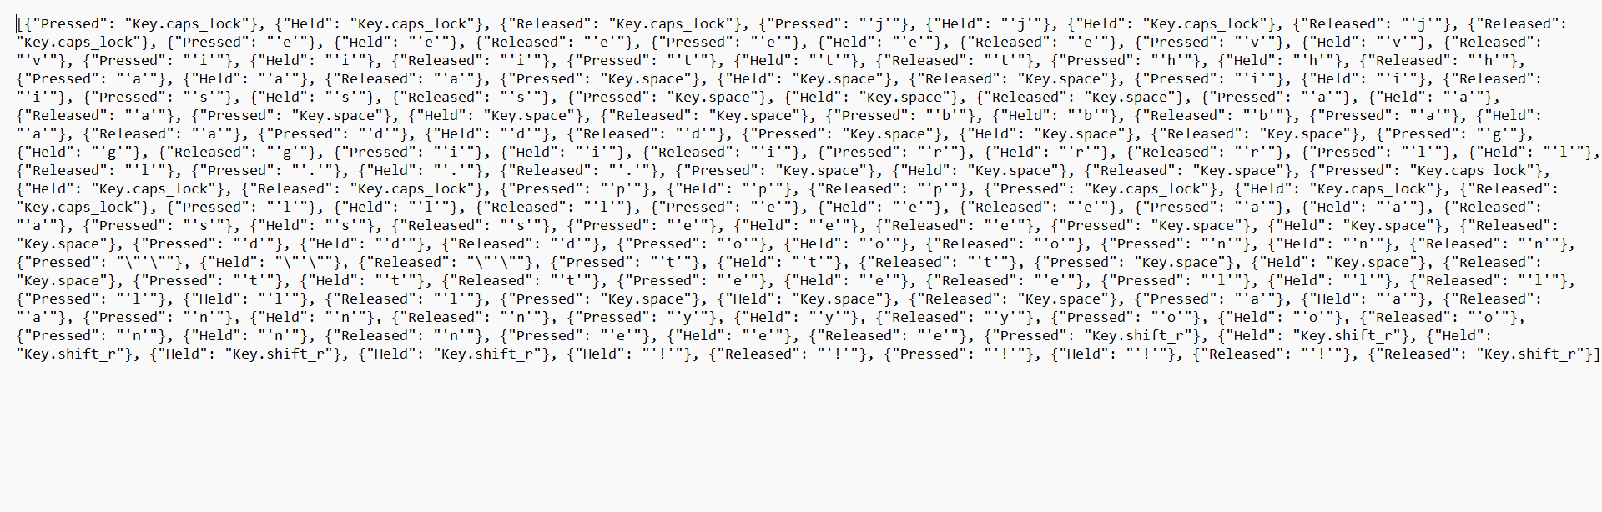
Result
Keylogger is running and key_log.txt is generated:

Slide 11
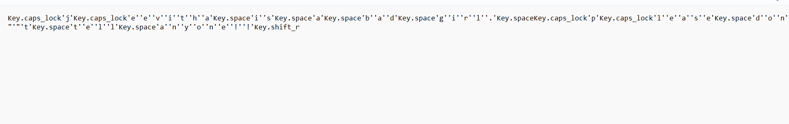
Result
The generated Key_log.txt with the keystrokes recorded:

Slide 12
Security Measures:
Keep Software Updated: Ensure that your operating system, antivirus software, web browsers, and other applications are always up to date with the latest security patches. Software updates often include fixes for vulnerabilities that could be exploited by keyloggers.
Install Antivirus and Antimalware Software: Use reputable antivirus and antimalware software to detect and remove keyloggers and other malicious software from your system. Regularly scan your computer for malware and ensure real-time protection is enabled.
Use a Firewall: Enable a firewall on your computer to monitor and control incoming and outgoing network traffic. A firewall can help block unauthorized access attempts and prevent keyloggers from transmitting captured data to remote servers.
Exercise Caution with Email Attachments and Links: Be cautious when opening email attachments or clicking on links, especially if they are from unknown or suspicious sources. Keyloggers can be distributed via email attachments or links to malicious websites.
Educate Yourself and Others: Stay informed about the latest cybersecurity threats and educate yourself and others about best practices for staying safe online. Awareness and vigilance are essential for protecting against keyloggers and other forms of cybercrime.

Slide 13
Conclusion
In conclusion, keyloggers pose a significant threat to personal and organizational cybersecurity by covertly capturing keystrokes and potentially compromising sensitive information.
To safeguard against this malicious software, it is imperative to employ a multi-faceted approach to security. This includes keeping software updated, utilizing antivirus and antimalware solutions, enabling firewalls, exercising caution with email attachments and public networks, employing virtual keyboards for sensitive data entry, implementing two-factor authentication, encrypting data, monitoring account activity, and promoting cybersecurity awareness.

Slide 14
Future scope
Keyloggers may increasingly be used in targeted attacks against specific individuals or organizations. Cybercriminals could tailor keyloggers to target high-value individuals or organizations, such as executives, government agencies, or financial institutions, to steal sensitive information or conduct espionage.
Future keyloggers may leverage machine learning and artificial intelligence (AI) techniques to improve their capabilities. They could adapt their behavior based on patterns observed in user input, making them more effective at capturing sensitive information and evading detection by security software.
As more data moves to the cloud, keyloggers may evolve to target cloud-based services and applications. Cybercriminals could develop keyloggers that intercept keystrokes before they are encrypted and sent to cloud servers, allowing them to steal sensitive information such as passwords or credit card numbers.

Slide 15
Future scope
Future keyloggers may become even more stealthy and persistent, making them harder to detect and remove. They might employ advanced techniques to hide their presence on a system, such as rootkit capabilities or encryption to evade detection by security software.
With the proliferation of mobile devices and Internet of Things (IoT) devices, keyloggers may increasingly target these platforms. Mobile keyloggers could capture keystrokes on smartphones and tablets, while IoT keyloggers could compromise smart home devices or industrial control systems.
The future scope of keyloggers also includes legal and ethical considerations. As the use of keyloggers becomes more widespread, there may be increased scrutiny and regulation surrounding their use, particularly in terms of privacy rights and data protection laws.

Slide 16
References
Python Documentation:
- Website: https://docs.python.org/3/
- Python's official documentation provides comprehensive information on the Python programming language, including tutorials, guides, and references for various modules and libraries used in the project.
Tkinter Documentation:
- Website: https://docs.python.org/3/library/tkinter.html
- Tkinter is Python's standard GUI (Graphical User Interface) toolkit. The documentation offers detailed explanations, examples, and references for building GUI applications using Tkinter.
Pynput Documentation:
- Website: https://pynput.readthedocs.io/en/latest/
- Pynput is a Python library used for controlling and monitoring input devices such as keyboards and mice. The documentation provides guidance on how to capture keystrokes and handle input events using Pynput.

Slide 17
References
JSON Documentation:
- Website: https://docs.python.org/3/library/json.html
- JSON (JavaScript Object Notation) is a lightweight data-interchange format commonly used for storing and transmitting data. The Python documentation offers guidance on working with JSON data, including parsing, encoding, and decoding operations.
Cybersecurity Resources:
- OWASP Website: https://owasp.org/
-This provide valuable resources, guidelines, and best practices for enhancing cybersecurity and addressing security concerns in software development projects.

Slide 18
THANK YOU

