Slide 1
AZSevai
Madras SAPpers
Company Restricted
AZ Connect - Hackathon
August 2019

Slide 3
Design
MS Teams
SAP Solution Manager
AZURE Bot Framework
Mulesoft
?
.AI
AZURE Cloud

Slide 4
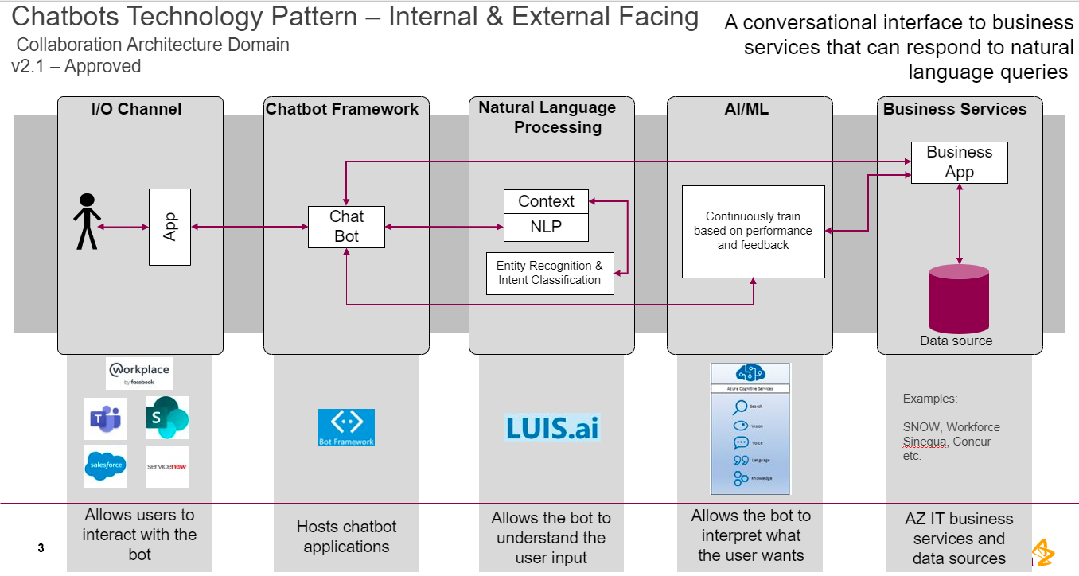










Design

Slide 5
Creating bullet point copy
A layout with ‘Content’ labelled in the title has specifically been styled to contain the corporate bullet styles
A ‘Body’ box is for copy only and is not styled for bullets – it will always default to PowerPoint original style bullets

Slide 6
Example graph 1
$m
For highlighted type within a graph, use dark colours to ensure legibility
Or use black as a default if the colour is too light
EM
$16m
EST ROW
$10m
EUR
$61m
US
$40m
Magna
Lorem

Slide 7
Example graph 2
Graph title
Graph title

