Slide 1
Capstone Project - University Success Analysis. BY Jeevitha G

Slide 2


YEAR ANALYSIS
UNIVERSITY SUCCESS ANALYSIS
Country Analysis
Valuable Insights
The project unveils critical patterns in global university performance, highlighting the uneven distribution of academic institutions, the impact of ranking methodologies, and the interplay between institutional metrics and student demographics. These insights empower decision-makers to understand key drivers of academic success and identify strategic opportunities.
Improvement Focus
By identifying gaps and areas of strength within university systems, the analysis pinpoints where targeted improvements can be made—whether in boosting research output, enhancing teaching quality, or promoting diversity and inclusivity—guiding stakeholders in optimizing institutional performance.
University Analysis
Evaluation of Effectiveness
The project rigorously evaluates the effectiveness of various ranking systems and institutional policies through quantitative analysis, offering a robust framework to assess how well universities are performing relative to key performance indicators such as student-to-staff ratios and international enrollment trends.
Ranking Analysis
Trend Identification
Through historical data analysis, the study identifies evolving trends in university rankings and demographic shifts, enabling stakeholders to forecast future changes and adapt strategies in response to emerging global education patterns.
Comprehensive Understanding
By integrating data from multiple sources and dimensions—including rankings, demographics, and operational metrics—the project provides a holistic view of the higher education landscape, facilitating a deep, nuanced understanding of the complex factors that contribute to university success.

Slide 3
OBJECTIVE :
The primary objective of this project is to leverage data analytics (Power BI, SQL, and Excel) to examine and interpret the key factors that drive university success on a global scale. By exploring university rankings, demographic trends, and institutional performance.
ANALYSIS SCOPE :
Identify Patterns in how universities are distributed across different countries and ranking systems.
Uncover Correlations between ranking criteria, student demographics, and institutional characteristics (e.g., student-to-staff ratios, gender representation).
Analyze Trends in ranking performance over time, including changes in scores, criteria weights, and demographic compositions.
GOAL :
Provide Actionable Insights for policymakers, academic institutions, and stakeholders to inform data-driven strategies, improve institutional quality, and foster inclusive, globally competitive education.

Slide 4
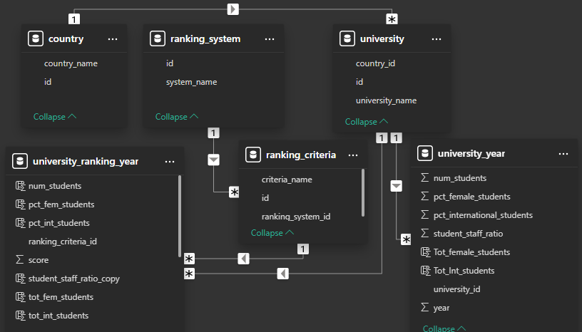
ER - DIAGRAM.

Slide 5
POWER BI PROBLEM STATEMENT

Slide 6
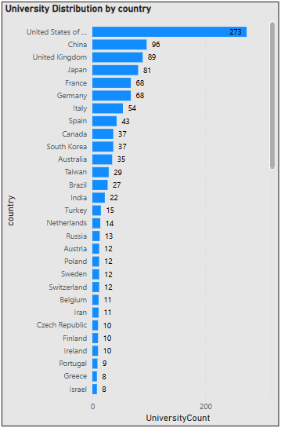
(1)How many universities are there in each country?
Top Countries with the Most Ranked Universities :
United States (273 universities) has the highest number of ranked institutions, dominating global rankings.
China (96), United Kingdom (89), and Japan (81) also have a significant presence. France (68) and Germany (68) are among the leading European countries.

Slide 7
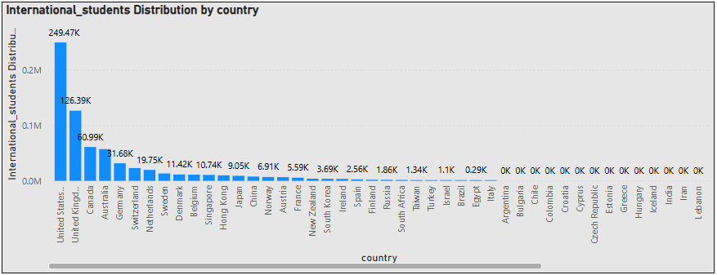
(2) What is the distribution of international students across different countries?
Top Host Countries for International Students :
The US (24,968,846 students ) is the leading destination for international students, significantly ahead of other countries.
The UK(12,635,743 students) is the second-largest host country, with renowned institutions like Oxford, Cambridge, and Imperial College.
Followed by Canada (6,108,748 students) that has Lower tuition fees compared to the US make it a favorable destination.
Australia – (5,726,985 students) for its strong education system and post-graduation work opportunities.
Germany – (3,174,065 students) Offers tuition-free or low-cost education.

Slide 8
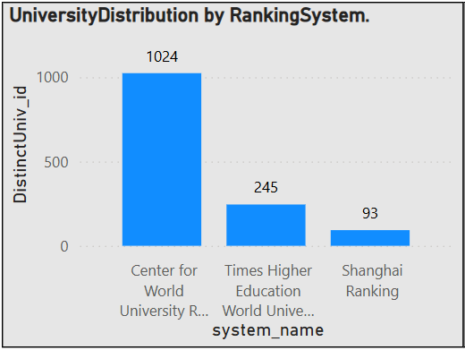
(3) How many universities are ranked by each ranking system?
Times Higher Education World University Ranking
The number of universities ranked varies across years.
The ranking peaked in 2015 (199 universities) and was lowest in 2011 (185 universities).
This suggests that the methodology or the number of institutions considered changed over time.
Center for World University Rankings
Consistently ranks 100 universities every year.
This suggests a fixed ranking approach, where they always rank the same number of institutions.
Shanghai Ranking
Mostly ranks 71–74 universities per year, except for 2014, where it ranked 70.
This indicates a relatively stable ranking system with minor yearly fluctuations.

Slide 9
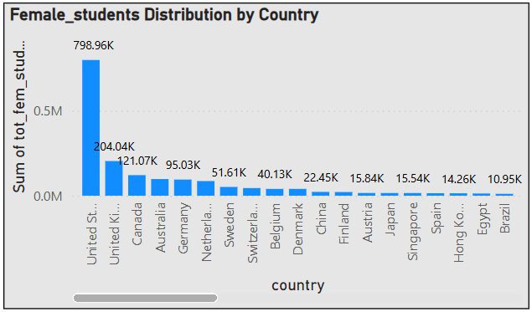
(3) Which country has the highest number of female students enrolled in universities?
Country with the Highest Female Enrollment:
The United States has the highest number of female students enrolled in universities, with approximately 79.89 million female students out of a total 167.25 million students. This means that about 31.16% of all university students in the U.S. are female.
Lowest Female Proportions :
South Korea (3.57%), China (3.92%), Brazil (4.48%), and Japan (4.68%) also show notably low female student representation.

Slide 10
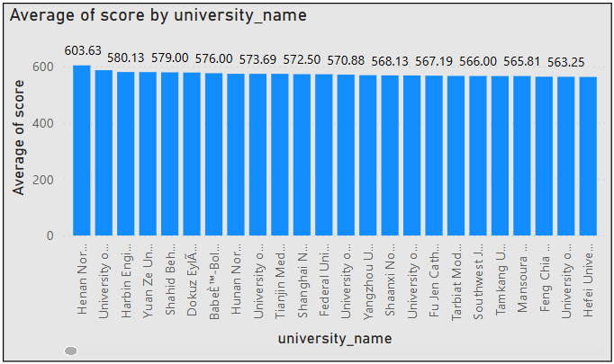
(4) What is the average score for universities according to each ranking system?
CWUR scores are significantly higher (356.19) than THE (56.88) and Shanghai Ranking (32.90).
Insights on Average Scores by Ranking System
This suggests that CWUR uses a different scale, possibly scoring universities out of higher numerical values.
THE and Shanghai Ranking might use a normalized scale with a lower range.
Shanghai Ranking gives the lowest average scores (32.90), indicating a more stringent evaluation process.
It is known for emphasizing research output and Nobel Prize winners, which might explain lower scores.
THE considers teaching, research, and international outlook, leading to slightly higher scores.

Slide 11
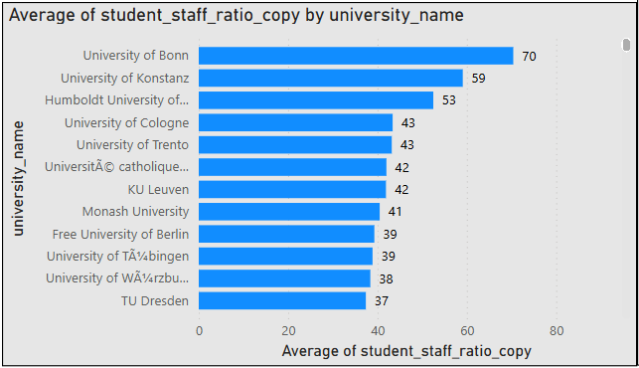
(5) How does the ranking system affect a university's student-staff ratio?
Shanghai Ranking Has the Lowest Student-Staff Ratio (14.74)
Universities ranked by Shanghai Ranking tend to have smaller class sizes and more faculty per student.
THE and CWUR Have Slightly Higher Ratios (~16.2) Times Higher Education (16.32) and CWUR (16.17) show similar trends.
These ranking systems may focus on other academic factors like research output, citations, or employer reputation, rather than just student-faculty interaction.
Variation Is Relatively Small (~1.58 Difference Between Highest and
Lowest)
The difference in student-staff ratio between ranking systems is not drastic (~1.58 points).
This indicates that faculty availability does not significantly change across ranking systems.

Slide 12
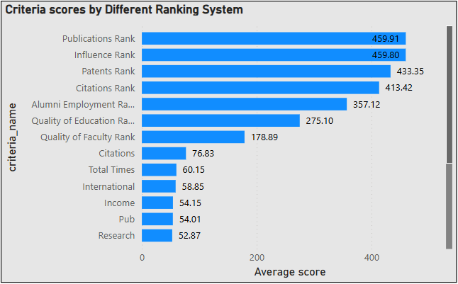
(6) What are the most important criteria considered by ranking systems?
Research output, citations, and publications play the most crucial role in university rankings across different ranking systems.
The highest average scores belong to Publications Rank (459.91) and Influence Rank (459.80) in the Center for World University Rankings (CWUR).
Citations Rank (413.42) is also highly significant, indicating that universities with more research output and citations are ranked higher.
In Times Higher Education, Citations (76.83) has the highest score, further emphasizing the role of research.
Shanghai Ranking also prioritizes research with Pub (54.01) and HiCi (Highly Cited Researchers, 36.59).

Slide 13
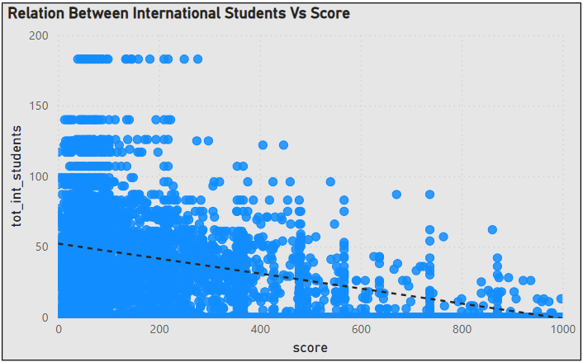
(7) Is there a correlation between a university's score and the number of international students?
A moderate negative correlation is observed, indicating that an increase in the total number of international students tends to result in a decrease in scores.
This relationship remains consistent even in the presence of outliers. From the chart on the left, it can be inferred that ranking criteria associated with higher scores exhibit a moderate negative correlation.
Conversely, ranking criteria with lower scores either have fewer international students or show no significant correlation

Slide 14
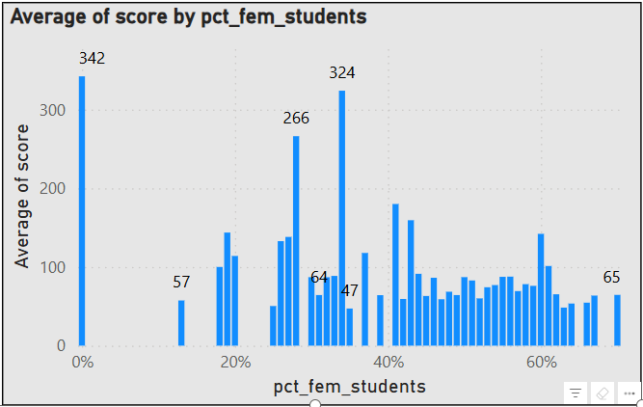
(8) How does the percentage of female students impact a university's ranking?
In Ranking System(CWUR), universities with a higher percentage of female students (e.g., 34%, 28%, 27%) tend to have higher ranking scores (479.38, 360.93, 301.41, etc.).
In Ranking System (Shanghai & THE Rankings), many universities with low female representation (0%, 19%, 20%) have significantly lower ranking scores (e.g., 61.26, 50.22, 48.5).
The lowest scores (e.g., 23.9, 24.61, 26.45) tend to appear when female representation is low.
Universities with 30%-50% female students appear throughout the ranking spectrum, meaning they do not disproportionately affect rankings.

Slide 15
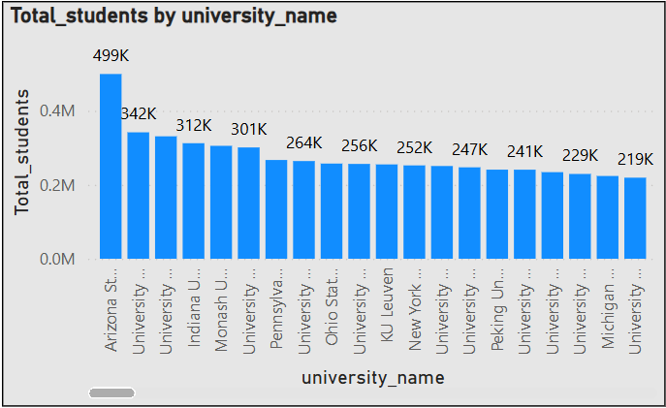
(9) Which university has the highest number of students?
Arizona State University (499,416 students) is the largest university in terms of total student enrollment.
University of Massachusetts (341,754 students) and University of Toronto (330,990 students) follow as the second and third largest institutions.
The majority of the largest universities are in the United States, Canada, Europe, and Asia.
United States dominates the list with many universities having large student enrollments (e.g., Penn State, Ohio State, University of California schools).
Canada has significant representation with major institutions like University of Toronto, University of British Columbia, and McGill University.
European universities such as KU Leuven, LMU Munich, University of Vienna, and University of Manchester have high student populations.
Asian universities like Peking University, Tsinghua University, National University of Singapore, and Seoul National University have substantial enrollments.

Slide 16
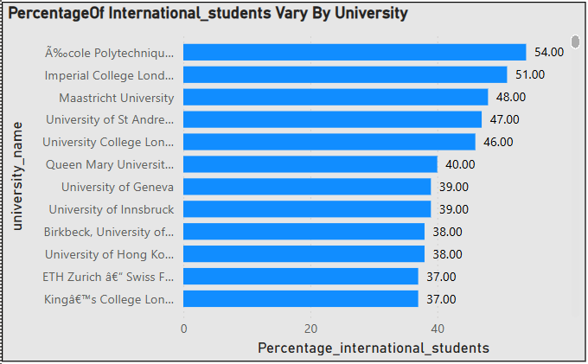
(10)How does the percentage of international students vary across different universities?
UK and Switzerland Dominate: Many of the top institutions are from the United Kingdom (e.g., UCL, Imperial, St Andrews, Cambridge, Oxford) and Switzerland (EPFL, ETH Zurich).
Hong Kong and Singapore Also Rank High: Universities like University of Hong Kong (38%), Hong Kong University of Science and Technology (36%), and National University of Singapore (34%)
have strong international appeal.
Australia and Canada Have Strong Representation: Australian universities like Monash (36%) and University of Melbourne (35%), along with University of British Columbia. (25%) and McGill University, (23%), also attract large numbers of international students.
European universities, particularly in Switzerland, the UK, and the Netherlands, have the highest
international student ratios.
The U.S. has a mix of highly international universities (MIT, Columbia) and more domestically focused
institutions (Wisconsin, Texas, Florida).
Asian universities (Tsinghua, Peking, Tokyo) have lower international enrollment compared to
Western counterparts.

Slide 17
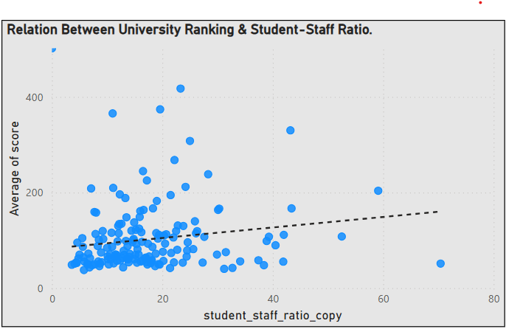
(11) Is there a correlation between a university's ranking and its student-staff ratio?
This indicates a weak positive correlation between the student-staff ratio and the university score.
The weak correlation suggests that student-staff ratio is not a strong determinant of university ranking.
Higher-ranked universities do not necessarily have lower student-staff ratios. Some top institutions might still have high ratios but compensate in other ways.

Slide 18
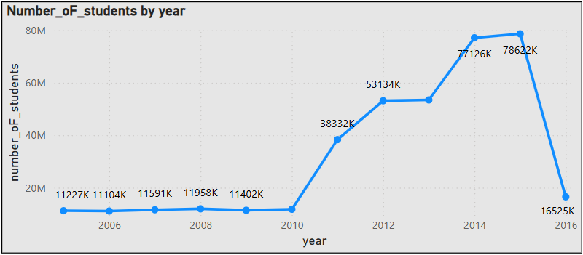
(12) How does the number of students in universities change over time?
US :The number of students peaked in 2015 (29.3 million) but showed a decline afterward.
UK: Student numbers peaked in 2014 (8.07 million) and slightly declined in 2015.
Canada : Consistent growth from 2005 (~1.2 million) to 2015 (~5.98 million). Suggests increasing demand for education or higher international student intake.
Germany: Gradual increase from 2011 (~2.48 million) to 2015 (~5.35 million).
China: Lower student counts compared to the U.S. but a steady rise from 2011 (~1.25 million) to 2015 (~2.71 million).
Australia & Netherlands: Australia showed steady growth, reaching 3.63 million in 2015. The Netherlands followed a similar trend but at lower numbers (~3.6 million in 2015).
Japan, South Korea, and Hong Kong showed stable but stagnant or slightly declining numbers.

Slide 19
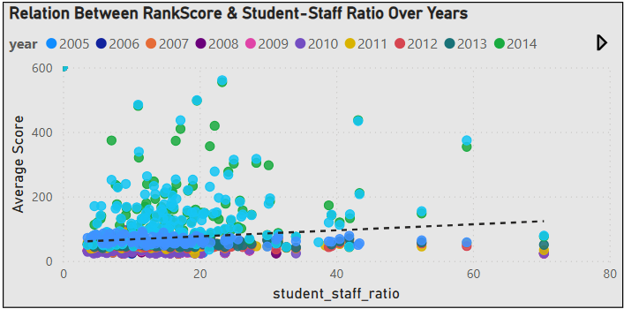
(13) Is there a correlation between a university's ranking score and the student-staff ratio over the years?
This indicates a very weak positive correlation, meaning that as the student-staff ratio increases, the ranking score slightly increases, but the relationship is not strong.
The weak correlation suggests that student-staff ratio alone does not significantly impact ranking score. Other factors likely play a more substantial role.
Diverse University Models: Some universities may have a high student-staff ratio but still maintain high ranking scores due to other quality metrics like research output, funding, or reputation.

Slide 20
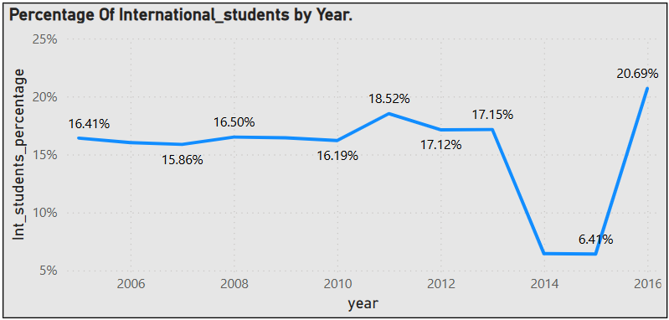
(14) How does the percentage of international students vary across different years?
The peak percentage of international students was in 2016 (21%), indicating a strong attraction of international students to universities during that time.
The percentage hovered between 16% to 19% from 2005 to 2013, showing relative stability.
The slight increase in 2011 (19%) and 2013 (17%) might suggest a period of growth in international student enrollment.
A sharp decline to 6% in 2014 and 2015 suggests major disruptions.
After the 2014-2015 dip, the percentage jumped back up to 21% in 2016.
The percentage of international students was relatively stable (16%-19%) from 2005 to 2013.
A sharp decline in 2014-2015 (6%) signals a major disruption.
A strong recovery in 2016 (21%) suggests a bounce-back in international student interest.

Slide 21
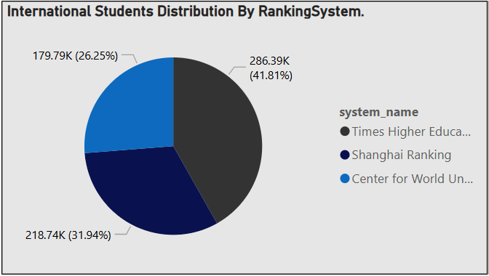
(15) What is the impact of a university's ranking on the number of international students it attracts?
Centre For World University Ranking :
The number of international students was relatively low in 2012 (24,032) and 2013 (24,864). In 2014 and 2015, it jumped significantly to 65,448, indicating a major increase.
Shanghai Ranking :
The number of international students remained fairly stable from 2005 to 2015, fluctuating around 19,000 to 20,500.
A slight drop in 2014 (18,900) was followed by a recovery in 2015 (20,265).
There was a steady increase from 2011 (47,556) to 2015 (51,924), suggesting a growing attractiveness.
Times Higher Education :
There was a steady increase from 2011 (47,556) to 2015 (51,924), suggesting a growing attractiveness.
However, in 2016, the number dropped significantly to 31,452, which could indicate a decline in ranking, stricter immigration policies, or financial constraints for international students.

Slide 22
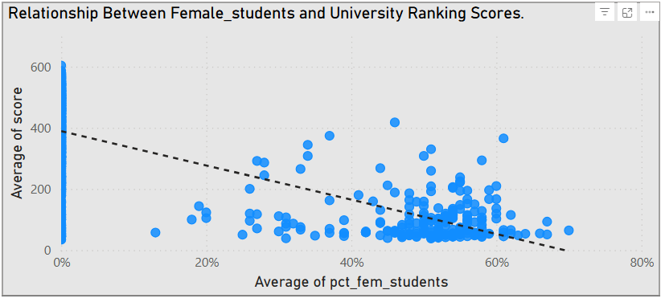
(16) Is there a relationship between a university's ranking score and the percentage of female students enrolled?
The correlation coefficient between the university ranking score and the percentage of female students enrolled suggests a moderately strong negative relationship: as the percentage of female students increases, the ranking score tends to decrease.

Slide 23
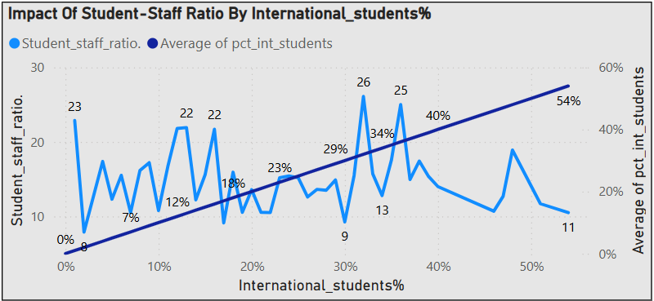
(17) How does the percentage of international students affect a university's student-staff ratio?
Insight:
Universities with higher international student percentages (e.g., 51%, 54%) tend to have a lower student-staff ratio (e.g., 11.7, 10.5).
Universities with a lower percentage of international students (e.g., 1%, 13%) exhibit a higher student-staff ratio (e.g., 22.86, 21.91).
Some universities with moderate international student percentages (e.g., 32%, 36%) still have a high student-staff ratio (e.g., 26.1, 25.01).
The data shows an inverse correlation between the percentage of international students and the student-staff ratio in many cases. However, exceptions exist where high international student enrollment does not necessarily translate into a lower student-staff ratio.

Slide 24
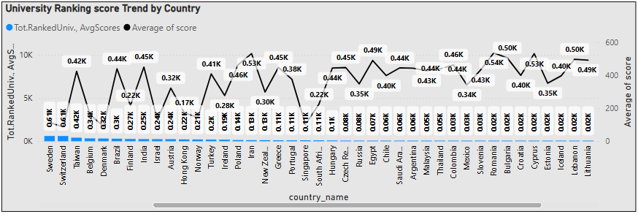
(18) Are there any significant trends or patterns in the rankings of universities from different countries?
The United States has the highest number of universities in the dataset (9,969), followed by the United Kingdom (2,621) and Japan (1,700).
Countries like China (413.83), Brazil (439.13), India (449.51), and Iran (531.2) have higher average scores, suggesting that many of their universities are ranked lower in global standings.
Countries like Iran (531.2), Romania (535.46), and Uganda (519.13) have high average scores, suggesting that their universities are less competitive globally.

Slide 25
EDA PROBLEM STATEMENTS

Slide 26
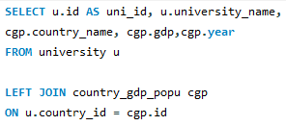
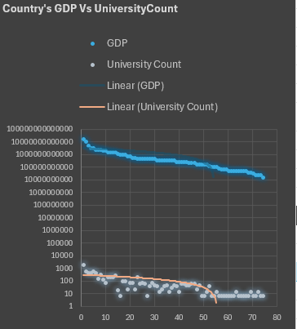
(1) Is there a correlation between a country's GDP and the number of universities?
The Pearson correlation coefficient between GDP and the number of universities is 0.954, indicating a very strong positive correlation.
Higher GDP, More Universities: Countries with higher GDP tend to have a larger number of universities. This makes sense as wealthier nations invest more in education and research institutions.
Education as an Economic Driver: The strong correlation suggests that a country's economic strength supports a robust higher education sector.
Outliers Exist: Some countries (like the U.S. and China) have significantly more universities compared to others with similar GDP levels, indicating differences in education policies and priorities.

Slide 27
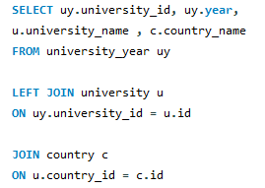
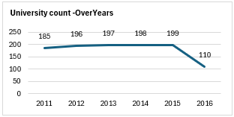
(2) How has the number of universities changed over the years in each country?
The total number of ranked universities increased steadily from 185 in 2011 to 199 in 2015, indicating growth in higher education institutions meeting ranking criteria. However, in 2016, the number dropped significantly to 110, suggesting a possible change in ranking methodology.
United States: Dominates the rankings with a total of 404 universities over the years, with its highest count in 2015 (77) before a sharp decline to 36 in 2016.
United Kingdom: The second-highest contributor, maintaining a steady presence (~27-30 universities per year).
Germany, Netherlands, Canada, and Australia: These countries consistently rank within the top 10, showing stable higher education systems.

Slide 28
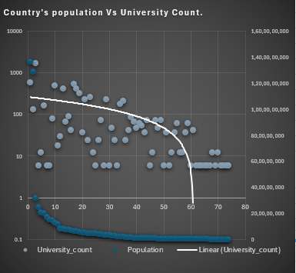

(3) Is there a relationship between a country's population and the number of universities?
There is a weak positive correlation; countries with larger populations tend to have more universities, but it's not a strict linear relationship.
The United States has a very high number of universities relative to its population. China and India, despite their huge populations, have fewer universities compared to the U.S.
Small Populations: Many small-population countries cluster at the bottom left with only a handful of Universities. Europe & Developed Nations: Some countries with moderate populations (e.g., Germany, UK, France) have a disproportionately high number of universities.

Slide 29

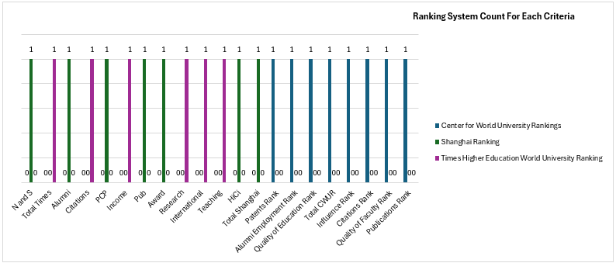
(4) Are there any common criteria used by different ranking systems?
Each ranking system applies distinct evaluation criteria. While some criteria seem thematically similar (e.g., Citations and Publications), they are not explicitly shared across multiple ranking system.
This confirms that no two ranking systems use the exact same criteria, making each system unique in its ranking approach.

Slide 30
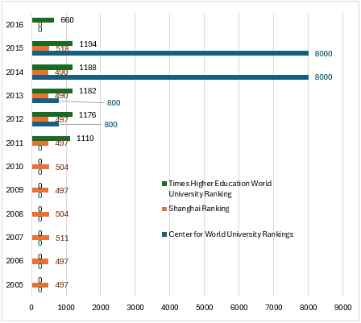
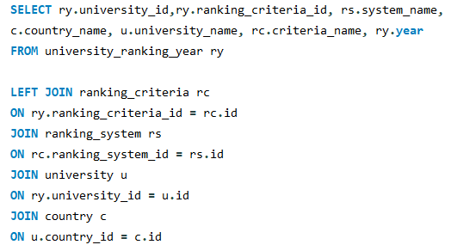
(5) What is the trend in university rankings over the years according to each system?
CWUR expanded significantly from 2012 to 2015 but has missing data in 2016.
Shanghai Ranking remained consistent with slight variations.
THE Ranking saw an increase until 2015 but dropped in 2016.

Slide 31
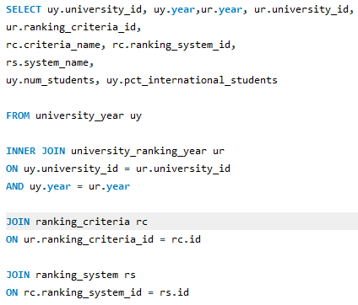
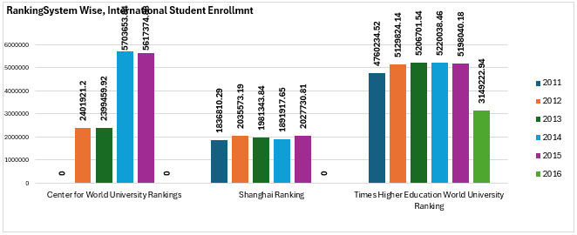
(6) How does the choice of ranking system affect a university's international student enrollment?
Times Higher Education (THE) Ranking: Highest values overall, making it the most influential among the three. Drop in 2016 might indicate a change in methodology, which could have influenced student choices. 53% of the international student enrolled with the universities that follows ‘THE Ranking' . In 2011, 72% international students enrolled. It was 54% in 2012 & 2013. And 40% in 2014&2015.
Centre for World University Rankings (CWUR) : Shows a huge jump in values from 2013 to 2014. 30% international students enrolled with universities that follows CWUR.(25% in 2012 &2013 and 44% in 2014 &2015).
Shanghai Ranking (ARWU) : Stable trends with minor fluctuations over the years.18% international students enrolled with universities that follows 'Shanghai Ranking'(In 2011, 28% students enrolled are international Students, it was 21% in 2012 &2013, it was 15% in 2014 &2015)

Slide 32
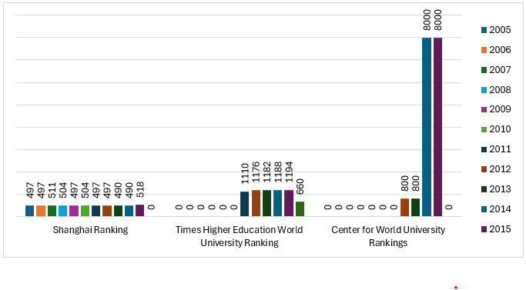
(7) Are there any criteria that have different weights in different ranking systems?
More than one Category don't Follows the same Ranking System.
So the criterion has No different weights in different ranking systems.
All the ranking System has the same weightage with their respective categories.
(8) How have the weights of ranking criteria changed over time?
There are 7 Ranking criteria under Shanghai Ranking. All the 7 criteria have been followed by an average of 71 universities from 2005 till 2015 consistently. There are 6 Ranking criteria under THEW University. All 6 criteria have been followed by an average of 180 universities from 2011 to 2016. There are 8 Ranking criteria under Centre for World University Rankings and 100 universities have followed each ranking criteria from 2012 to 2013. There is a sudden spike & 1000 universities have followed each ranking criteria in 2014 & 2015.

Slide 33
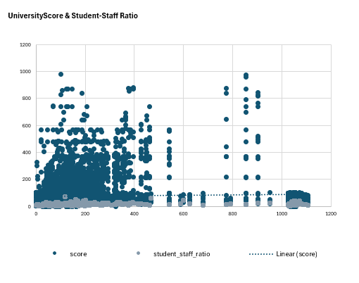
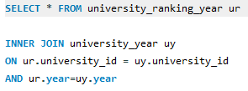
(9) Is there a relationship between a university's score and the student-staff ratio?
This indicates a very weak positive correlation, meaning that as the student-staff ratio increases, the ranking score slightly increases, but the relationship is not strong.
The weak correlation suggests that student-staff ratio alone does not significantly impact ranking score. Other factors likely play a more substantial role.
Diverse University Models: Some universities may have a high student-staff ratio but still maintain high ranking scores due to other quality metrics like research output, funding, or reputation. Co-relation coefficient is 0.063

Slide 34
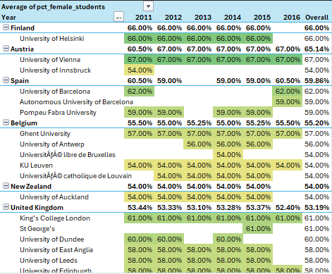

(10) How does the number of female students differ among universities?
University of Helsinki from Finland (67%) & University of Vienna from Austria(65%) has higher female enrolment than male students.
Followed by (3 univ.) Spain, (5 univ. )Belgium, (1 univ.) Newsland, (28 univ.) UK has 50% of their students to be Female.
However, universities from Japan, s.Korea, Norway has very less female enrolment lower than (30%).

Slide 35

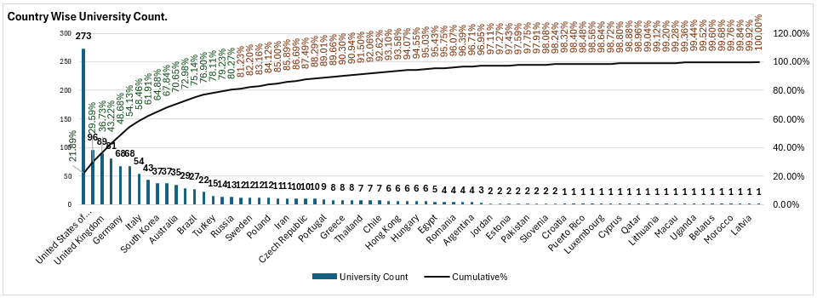
(11) What is the distribution of universities across different countries?
The United States has the highest number of ranked universities (273)(22%).China (96 universities) follows as the second-highest. The United Kingdom (89), Japan (81), and several European countries (Germany - 68, France - 68, Italy - 54, Spain - 43, Netherlands - 14, Sweden - 12, etc.) also have substantial representation. Countries like India (22 universities), Brazil (27), South Korea (37), and Canada (37) indicate strong academic investments.

Slide 36
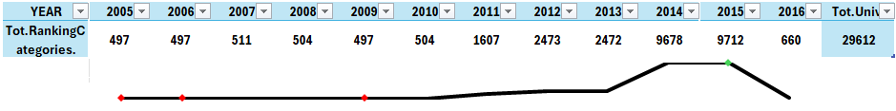
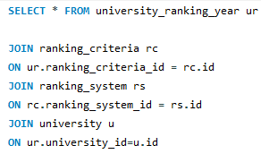
(12) How has the ranking of universities changed over the years?
From 2005 to 2010 there was only 1 ranking system(Shanghai Ranking) been followed by 80 Universities from 15 countries.
Times Higher Education World University Ranking was followed by 245 universities from 30 countries as of 2011 till 2016.
Centre for World University Rankings was followed by 1024 universities from 59 countries as of 2012 till 2015
From 2012, All the 3 ranking system has been diversely followed in 1064 universities from 59 countries.Since 2005 till 2016, there are 1065 universities across 59 countries following a ranking system.

Slide 37
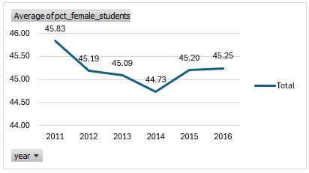
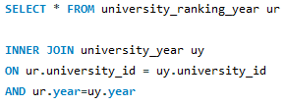
(13) What is the trend in the percentage of female students over time?
There is a small decrease from 45.83% in 2011 to 44.73% in 2014, followed by a gradual rebound to 45.25% in 2016.
This fluctuation is minor (within a 1–1.5% range), suggesting no dramatic shifts in female enrollment during the observed period.

Slide 38
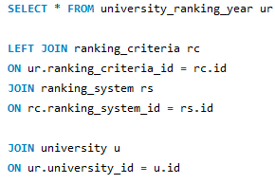
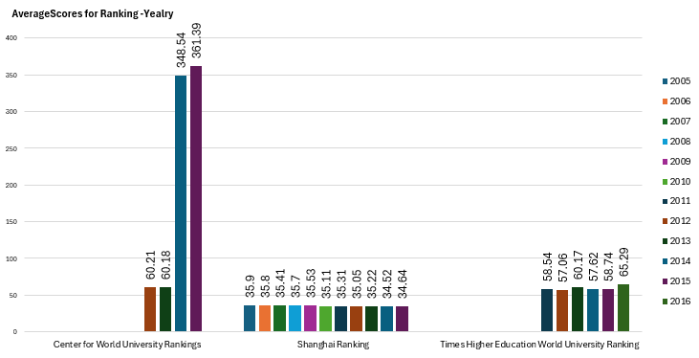
(14) How has the ranking score of universities evolved over the years?
CWUR shows a sharp increase, indicating a growing number of ranked universities or changes in its ranking methodology. Shanghai Ranking (ARWU) remains relatively stable, suggesting a consistent evaluation process. THE Ranking exhibits fluctuations, possibly due to changes in criteria, methodology, or global academic performance trends.

Slide 39
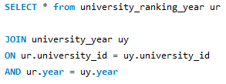
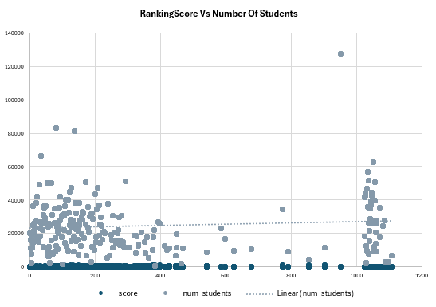
(15) Is there a relationship between a university's ranking score and the number of students over time?
A weak negative correlation (-0.11718) between ranking score and number of students suggests that as the number of students increases, the ranking score slightly tends to decrease—but the effect is minimal.

Slide 40
CONCLUSION
This comprehensive analysis of university rankings, demographics, and global trends has illuminated key factors shaping higher education worldwide. By leveraging Power BI, SQL, and Excel, the study uncovered uneven distributions of universities across nations, revealed how ranking criteria affect institutional scores, and explored correlations between ranking systems and student demographics. Notably, the concentration of universities in the United States underscores its pivotal role in academia, while the distinct methodologies of various ranking systems highlight the complexities of global benchmarking. Furthermore, shifts in rankings over time, connections between ranking scores and student-to-staff ratios, and trends in female and international enrollment emphasize the need for inclusive, data-driven strategies. Ultimately, these findings affirm the importance of evidence-based decision-making in guiding educational policies, investments, and initiatives, and lay a strong foundation for further exploration of the dynamic higher education landscape.

Slide 41
THANKS FOR WATCHING

