Slide 1







RAJEEV INSTITUTE OF TECHNOLOGY
DEPARTMENT OF INFORMATION SCIENCE ENGINEERING
Project On:
“DIABETES PREDICTION USING MACHINE LEARNING ALGORITHMS”
Under The Guidance of:
Ms. Sindhu Jain A M
Assistant Professor,
Department of ISE,
RIT, Hassan.
Presented By:
Abdul Faraz [4RA21IS001]
Abhishek K [4RA21IS002]
Jeevitha [4RA21IS020]
Keerthana D Y [4RA21IS022]

Slide 2



CONTENTS
ABSTRACT
INTRODUCTION
LITERATURE REVIEW
PROBLEM STATEMENT
IMPLEMENTATION
OBJECTIVES
SCOPE AND IMPACT OF PROJECT
WORKFLOW DIAGRAM
SOFTWARE AND HARDWARE REQUIREMENTS
CONCLUSION
REFERENCES

Slide 3
ABSTRACT
Diabetes is among critical diseases and lots of people are suffering from this disease. Age, obesity, lack of exercise, hereditary diabetes, living style, bad diet, high blood pressure, etc. can cause Diabetes. People having diabetes have high risk of diseases like heart disease, kidney disease, stroke, eye problem, nerve damage, etc.This project aims to design and implement a Diabetes Detection System that leverages AI and machine learning to predict the likelihood of diabetes based on various health metrics such as glucose level, BMI, blood pressure, and age. Using advanced algorithms, the system identifies high-risk individuals early, aiding in timely intervention and preventive healthcare. The proposed solution is scalable and accessible through web-based and mobile platforms, ensuring wide usability.

Slide 4
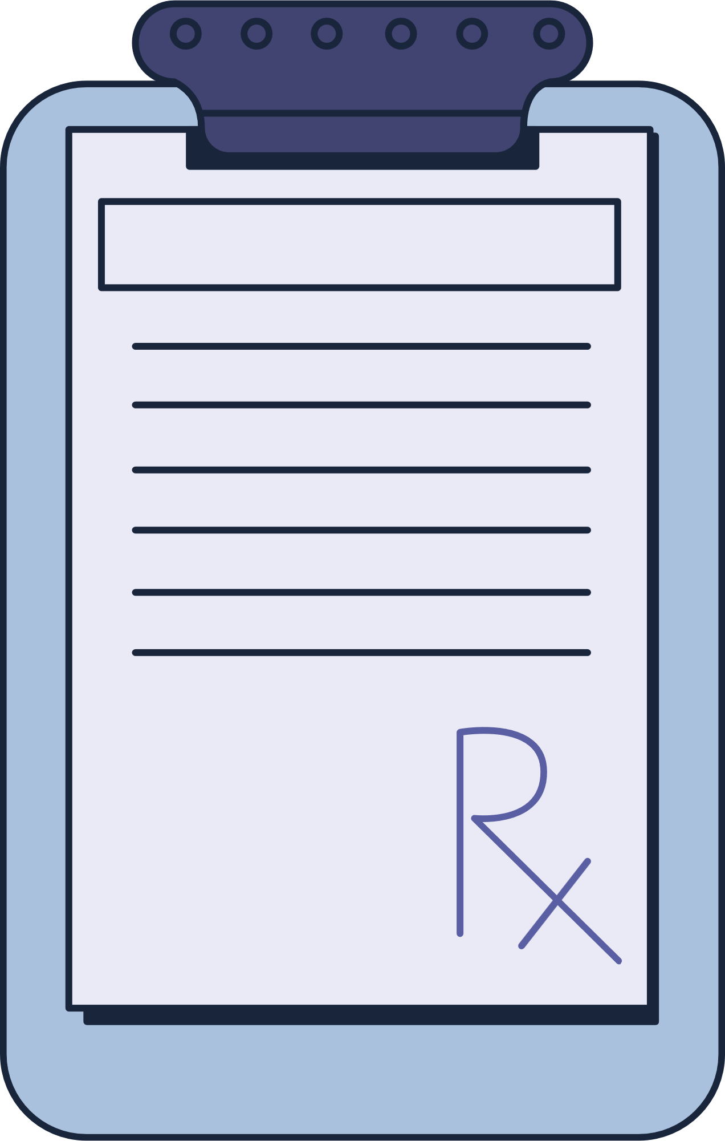
INTRODUCTION
How does diabetes work?
Insulin: A hormone produced by the pancreas, insulin helps glucose get into your cells to be used for energy.
Diabetes: When you have diabetes, your body either doesn't produce enough insulin or doesn't use insulin properly. This causes glucose to build up in your blood.
Diabetes is a chronic health condition affecting millions worldwide, with significant health and economic consequences. Early diagnosis is critical to manage the disease and prevent severe complications. However, traditional diagnostic methods are time-consuming, expensive, and not always accessible to everyone.

Slide 5
LITERATURE REVIEW
Sl.No | Paper | Author | Published
1 | Prediction of Diabetes Based on Personal Lifestyle Indicators. | Ayush Anand and Divya Shakti | September 2015. | Naïve Bayes and Decision Trees were used in this model. Comparison was made form performance of both algorithms and effectiveness of both algorithms was shown as a result
2 | Application of machine learning in disease Prediction. | P. S. Kohli and S. Arora, | 2018 | used a diverse genera of machine learning algorithms like support vector machine, random forest, logistic regression, Decision tree and many more and various types of disease dataset to show the applicability of Machine Learning in disease prediction and analysis.
3 | Application of Data Mining Methods and Techniques for Diabetes Diagnosis. | K. Rajesh and V. Sangeetha | September 2012 | They used C4.5 decision tree algorithm to find hidden patterns from the dataset for classifying efficiently.
4 | A Data Mining Approach for the Diagnosis of Diabetes Mellitus using Random Forest Classifier. | Mani Butwall and Shraddha Kuma | Number 8,2015. | model using Random Forest Classifier to forecast diabetes behaviour.

Slide 6
PROBLEM STATEMENT
The problem is the lack of accessible, efficient, and accurate methods for early diabetes detection. Early diagnosis is crucial, yet many people either remain undiagnosed or receive a diagnosis too late. Despite the potential benefits of ML in healthcare, there is a need to develop and implement accurate, efficient, and scalable machine learning models for early detection and diagnosis of diabetes. These models must be able to process diverse and complex data, including medical history, lifestyle factors, lab test results, and genetic information, to provide a reliable diagnosis. Current practice in hospital is to collect required information for diabetes diagnosis through various tests and appropriate treatment is provided based on diagnosis.

Slide 7
IMPLEMENTATION
  Data Collection Dataset:
  Use the PIMA Indian Diabetes Dataset or similar.
  Features: Include glucose level, BMI, age, blood pressure
  Data Preprocessing:
  Handle missing values with imputation. Normalize numerical features.
  Perform Exploratory Data Analysis (EDA) to understand data distribution and relationships.
  Model Selection:
  Evaluate the following machine learning models:
  Logistic Regression ,Decision Trees Random Forest ,Support Vector Machines
  (SVM)Neural Networks for advanced use cases.
  Model Training and Testing:
  Split data into training and testing sets (e.g., 80%-20%).Evaluate models using metrics like accuracy, precision, recall, and AUC-ROC score.
  Deployment:
  Use Flask or Streamit to build a web interface
  Deploy on Heroku, AWS, or Google Cloud.

Slide 8
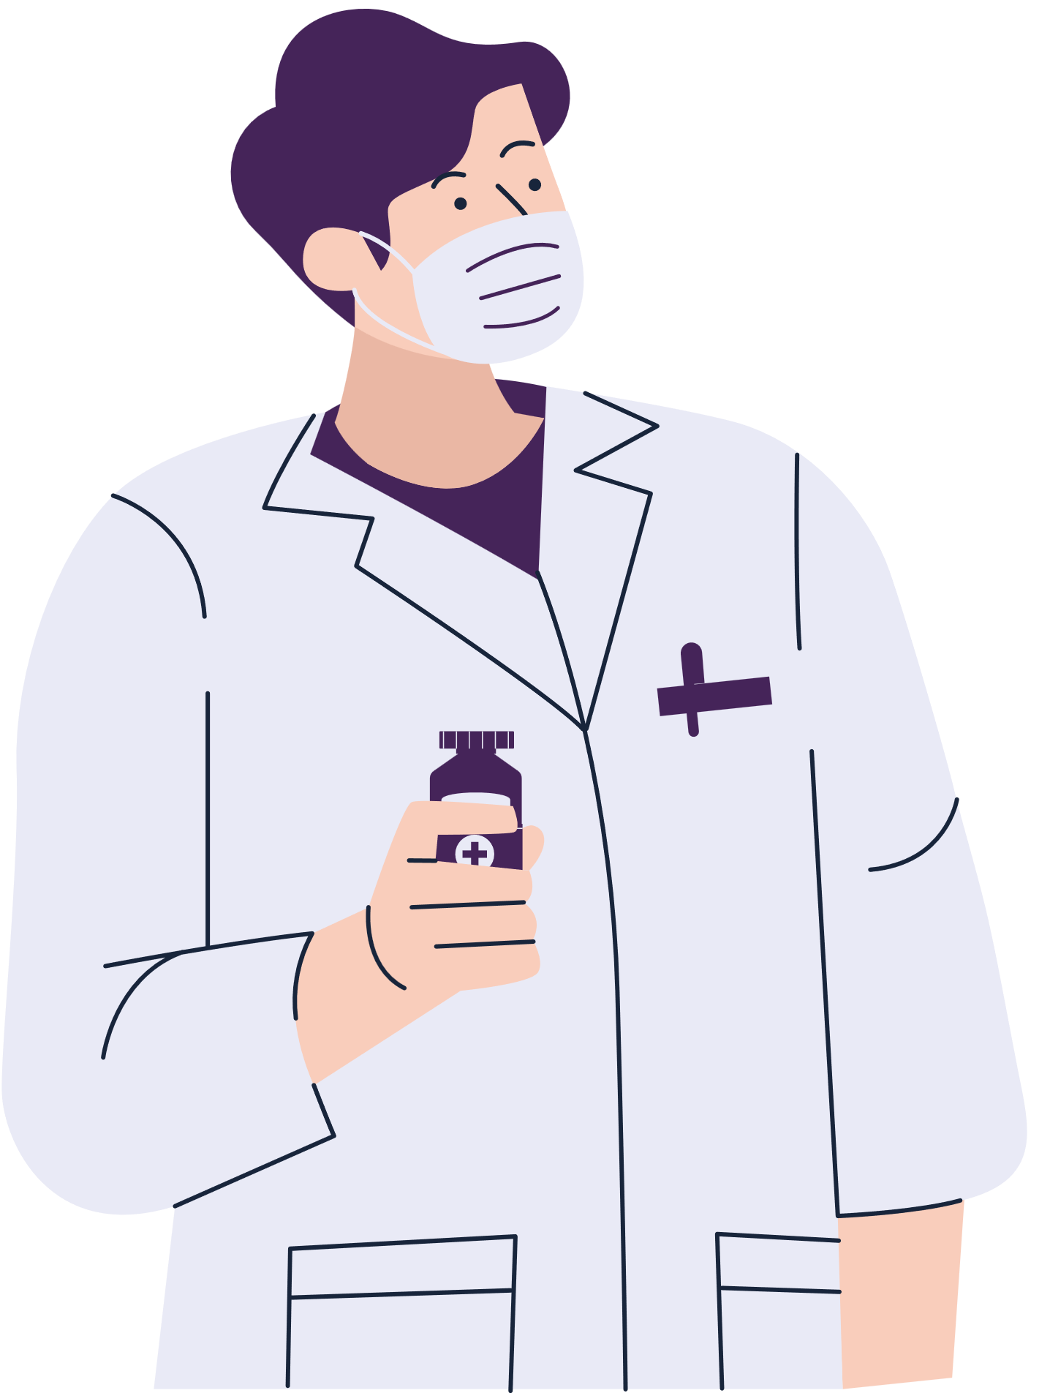
Early Detection and Prevention:
To proactively identify individuals who are at high risk of developing diabetes based on their medical history, lifestyle factors, and genetic predispositions.
OBJECTIVES
Improved Diagnosis Accuracy:
To improve the accuracy of diabetes diagnosis by analyzing a wide range of medical data, including patient history, lab results, and imaging scans.
Advance Medical Research:
To uncover new insights into the underlying mechanisms of diabetes and identify potential novel therapeutic targets.

Slide 9
Scope and Impact Of Project:
Improved Early Detection
Increased Access to Healthcare
The system would enable the identification of diabetes risk in its early stages, even before patients develop noticeable symptoms, leading to preventive measures and reduced progression to diabetes.
AI-based tools could be deployed in remote and underserved areas, making diabetes detection and management more accessible and cost-effective.
Personalized Healthcare
Healthcare Cost Reduction
AI can help tailor treatment plans based on individual risk factors and medical histories, leading to more personalized and effective care.
By reducing the need for expensive diagnostic tests and hospital visits, and by preventing complications, AI-powered diabetes detection can help reduce long-term healthcare costs.

Slide 10
WORKFLOW DIAGRAM
Data Retrieval
Machin Learning
Algorithm
Database
Data
Processing
Feature
extraction &
Engineering
Feature
Scaling &
Selection
Modeling
Modeling
Evaluation &
Tuning
Deployment & Monitoring
Data Preparation
Re-iterate till satisfactory model performance

Slide 11
SOFTWARE AND HARDWARE REQUIREMENTS
Hardware Requirements
Software Requirements
Processor: Intel i5
RAM: 8 GB or higher
Storage: 500 GB or higher
Operating System :Windows 10 or 11
IDE: Jupyter Notebook, PyCharm or
VS Code.
Deployment: Flask, Django.

Slide 12
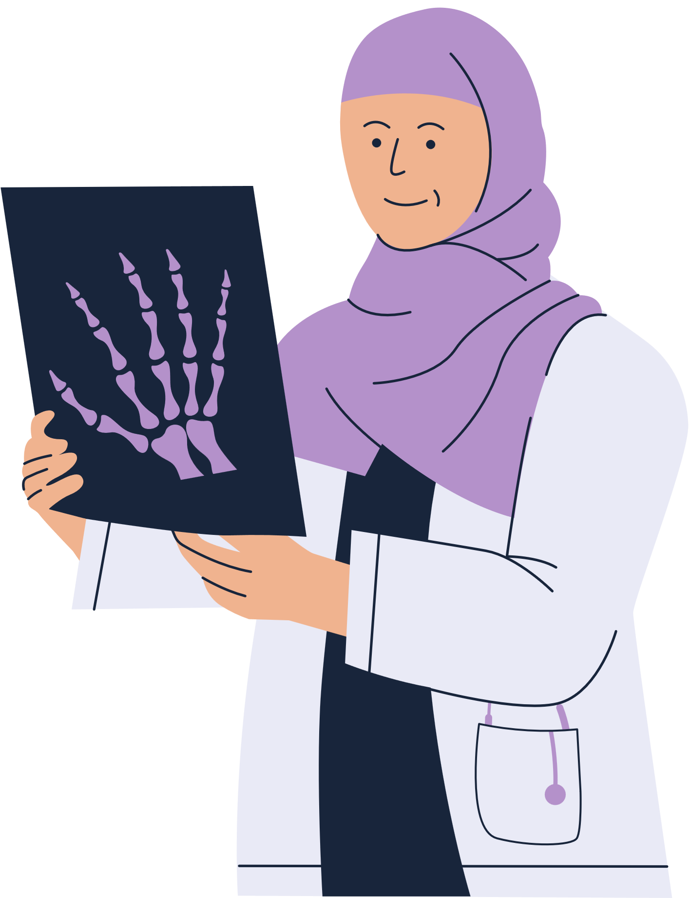
CONCLUSION
In this project, we have explored the potential of Machine Learning (ML) and Artificial Intelligence (AI) in transforming the approach to diabetes detection, diagnosis, and management. As diabetes continues to be a major global health concern, early identification and intervention are critical in preventing complications that can lead to severe health outcomes. Through this project, we aimed to design and implement an AI-driven system capable of accurately detecting diabetes using diverse healthcare data and improving the overall clinical decision-making process.

Slide 13
REFERENCES
[1] Gauri D. Kalyankar, Shivananda R. Poojara and Nagaraj V. Dharwadkar,” Predictive Analysis of Diabetic Patient Data Using Machine Learning and Hadoop”, International Conference On I-SMAC,978-1-5090-3243-3,2017.
[2] Ayush Anand and Divya Shakti,” Prediction of Diabetes Based on Personal Lifestyle Indicators”, 1st International Conference on Next Generation Computing Technologies, 978-1-4673-6809-4, September 2015.
[3] B. Nithya and Dr. V. Ilango,” Predictive Analytics in Health Care Using Machine Learning Tools and Techniques”, International Conference on Intelligent Computing and Control Systems, 978-1-5386-2745-7,2017.
[4] Dr Saravana kumar N M, Eswari T, Sampath P and Lavanya S,” Predictive Methodology for Diabetic Data Analysis in Big Data”, 2nd International Symposium on Big Data and Cloud Computing,2015.

Slide 14
Thank you

