Slide 1




RETIAL SALES ANALYSIS
STUDENT NAME: S.JEEVITHA
REGISTER NO: 422200031
DEPARTMENT: 3rd B.COM(ISM)
COLLEGE: S.I.V.E.T College

Slide 2
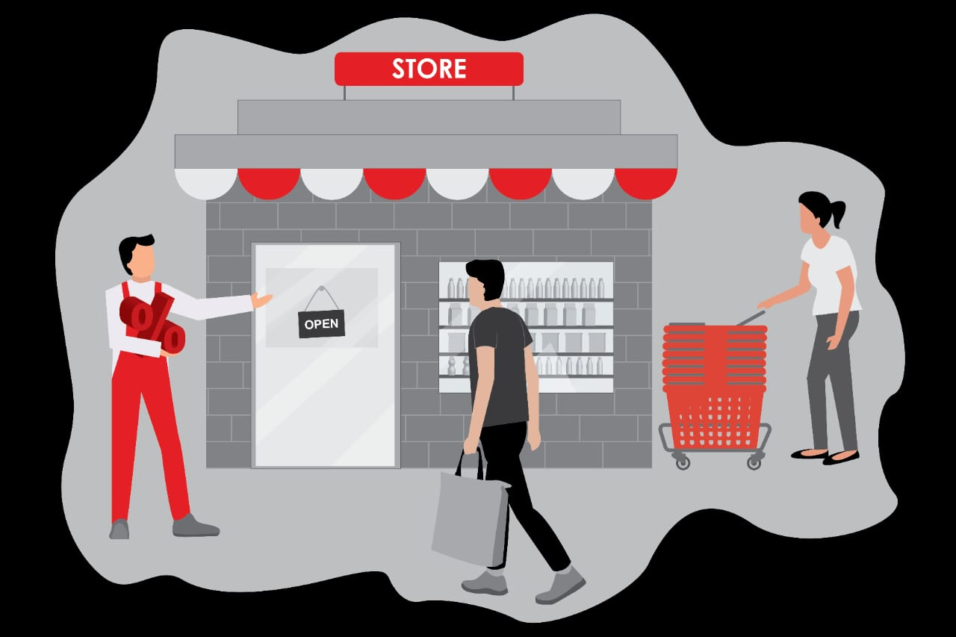
PROJECT TITLE
RETAIL SALES ANALYSIS

Slide 3


AGENDA
Problem Statement
Project Overview
End Users
Our Solution and Proposition
Dataset Description
Modelling Approach
Results and Discussion
Conclusion
3/21/2024 Annual Review

Slide 4

PROBLEM STATEMENT
STEPS TO DEVELOP A RETAIL SALES PROMBLEM STATEMENT
Identify the core problem
Understand the impact
Specify the scope
Set the context
Outline desired outcomes

Slide 5

PROJECT OVERVIEW
.Retail sales refers to the transaction where goods or services are sold directly to consumers for personal use,as opposed to being sold for resale or business use.retail can be conducted through various channels, including physical stores,online platform,and mobile apps.

Slide 6

WHO ARE THE END USERS?
Individual consumers
Business consumers
Institutional consumers
Characteristics and preferences
Engagement and interaction
Trends influencing end user

Slide 7

OUR SOLUTION AND ITS VALUE PROPOSITION
A retail sales value proposition is a clear statement that explains how a retailer’s products or services solve customer problems or improve their situation, delivering specific benefits and differentiating the retailer from competitors. A strong value proposition helps attract and retain customers, drives sales, and fosters brand loyalty

Slide 8
Dataset Description
DATASET ANALYTICS
A Retail sales dataset capture information about transaction made in a Retail environment. This data can be used for analysing sales performance, customer behaviour, inventory management and marketing effectiveness.
2. KEY ATTRIBUTES AND METRICS
Transaction information
Product details
Customer information
Sales and revenue metrics
Inventory details
Promotional and marketing data
3. USES OF THE DATASET
Sales anaysis
Customer insight
Inventory management
Accuracy
Timeliness

Slide 9

THE "WOW" IN OUR SOLUTION
Retail sales solutions refer to strategies, technologies, and services that help retailers optimize their sales processes, enhance customer experience, and improve operational efficiency.
3/21/2024 Annual Review
9

Slide 10
MODELLING
Retail sales modeling involves using statistical and analytical techniques to predict future sales performance and understand patterns in consumer behavior. The process typically includes the following steps:
Data Collection
Data Preparation
Feature Selection
Model Selection
Model Training
Effective retail sales modeling helps businesses optimize operations, enhance decision-making, and improve overall profitability.
10

Slide 11
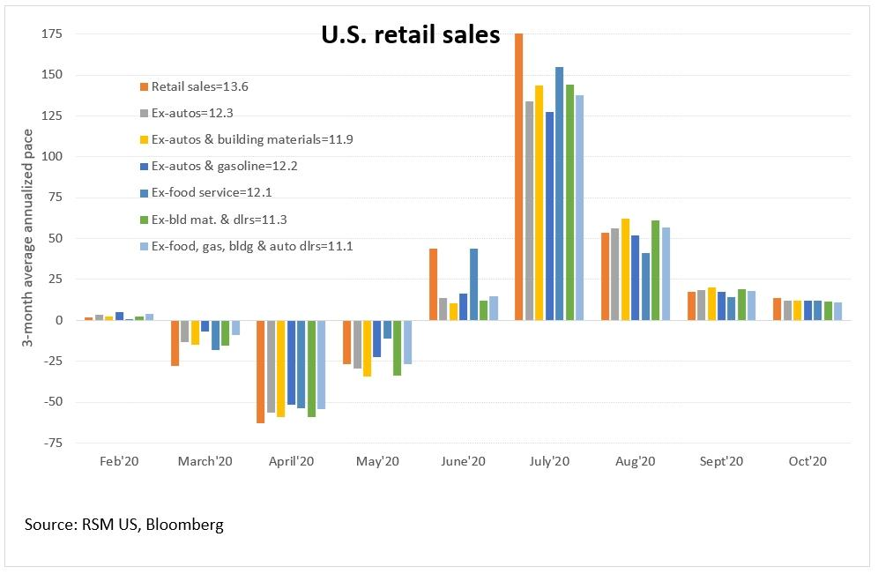
RESULTS
11

Slide 12
conclusion
In conclusion, retail sales are a vital indicator of economic health, reflecting consumer confidence and spending patterns. Analyzing retail sales data helps businesses and policymakers make informed decisions regarding inventory management, pricing strategies, and economic policies. Trends in retail sales can reveal shifts in consumer preferences, emerging market opportunities, and potential economic challenges, making it a crucial component of economic analysis and strategic planning.

