Slide 1
Using PageRank to Identify Critical Airports
PageRank converts a route map into a ranking of structural importance.
Applied Linear Algebra course project
Airport route network • PageRank • Hub disruption
Instead of only counting routes, it asks whether an airport is connected to other important airports.
549 airports
5,450 directed routes
ATL closure scenario
Source: OpenFlights; project notebook
Team: Mindeok Seo, Jake Gust, Jeewan Khadka, Yijia Zhang, Alan Tang
01

Slide 2
Research Question
Why PageRank is useful for transportation networks
Which airports are most important when importance is measured by network structure, not just direct route count?
Traditional view
PageRank view
Project extension
Rank airports by number of direct routes. This measures connectivity but treats all connected airports equally.
Rank airports by recursive importance. Connections from important airports count more than isolated connections.
Remove a major hub and recompute PageRank to see how importance redistributes across the network.
Core idea: an airport is central if it receives connections from airports that are themselves central.
Source: OpenFlights; project notebook
02

Slide 3
Data and Network Setup
OpenFlights route data filtered to direct routes between U.S. airports
549
5,450
549×549
7
Binary model
Route = 1
No route = 0
airports in network
directed route edges
adjacency matrix
dangling airports
Filtering decisions
Interpretation
Only U.S. airports with valid IATA codes are included. Routes are kept only when both source and destination are U.S. airports, and the route has zero stops.
Because the matrix is binary, the model measures route connectivity rather than passenger volume, aircraft capacity, or flight frequency.
Source: OpenFlights; project notebook
03

Slide 4
From Routes to Matrices
The network becomes a linear algebra problem
1
2
3
4
Directed graph
Adjacency matrix
Transition matrix
PageRank vector
→
→
→
Airports are nodes;
routes are directed edges.
A[i,j] = 1 if route
j → i exists.
Normalize columns so
sum_i M[i,j] = 1.
Power iteration finds
the steady-state vector.
At convergence: Gv = v
The final vector is the principal eigenvector of the Google Matrix.
Source: OpenFlights; project notebook
04

Slide 5
PageRank Method
Power iteration with damping
Update equation
Why damping matters
vₖ₊₁ = dMvₖ + ((1 − d) / N)e
Prevents dead ends from trapping the model
Makes the Markov chain more stable
Ensures the vector converges
Allows every airport to retain some probability
d = 0.85 damping factor
85% follows actual routes
15% randomly jumps to any airport
Stop when L1 change is below tolerance
Result: one PageRank score for every airport.
Source: OpenFlights; project notebook
05

Slide 6
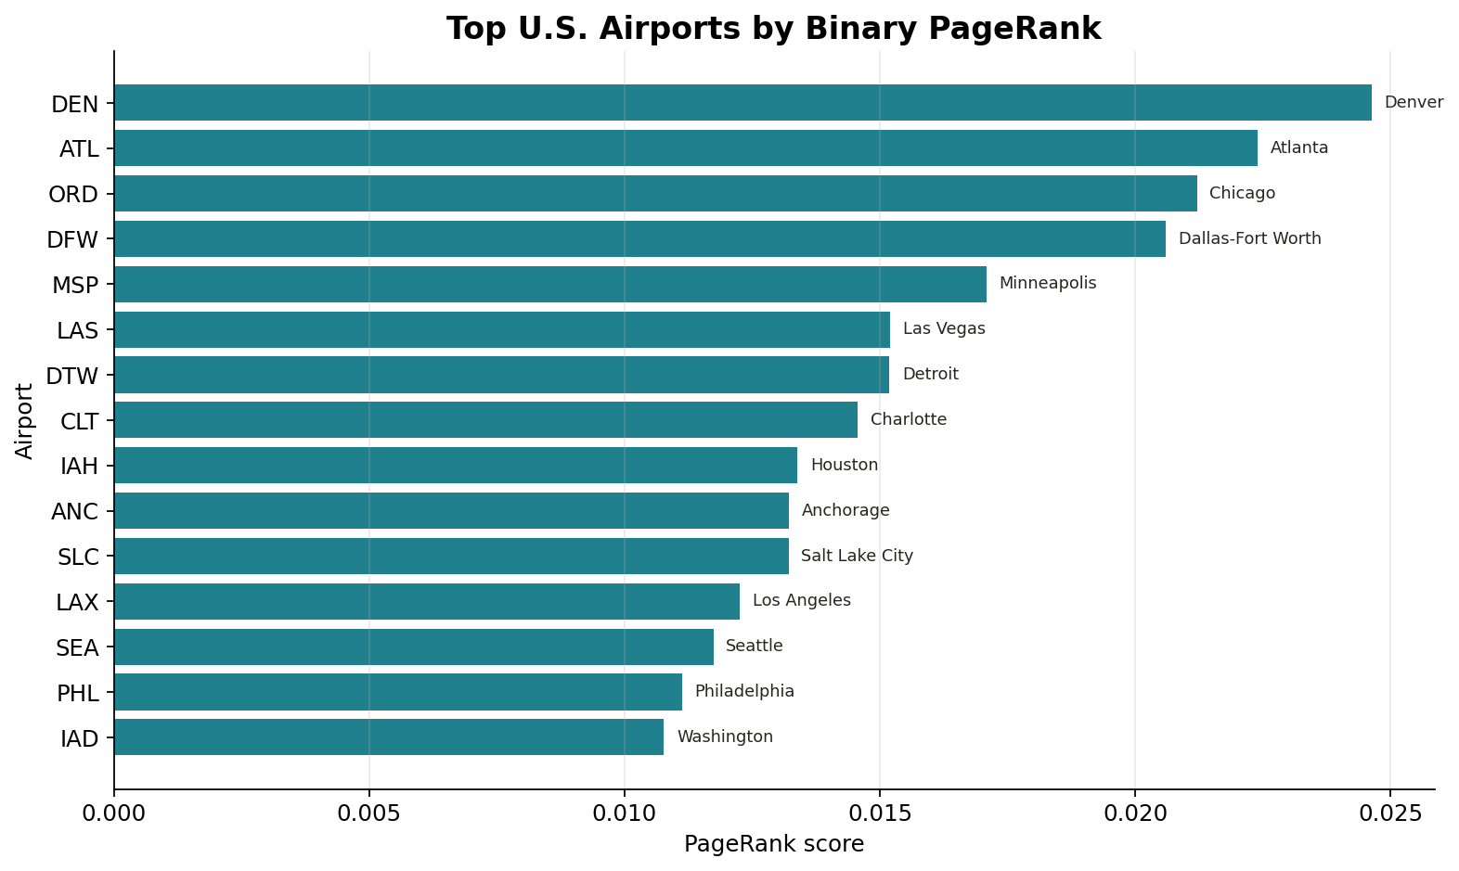
Baseline Results
DEN ranks first in the binary route network
Top PageRank airports
DEN has the highest PageRank score.
ATL has the highest total degree, but ranks second.
ORD and DFW follow closely.
PageRank is similar to degree centrality but not identical.
Interpretation
DEN's centrality reflects strong connections across important parts of the U.S. route network.
Source: OpenFlights; project notebook
06

Slide 7
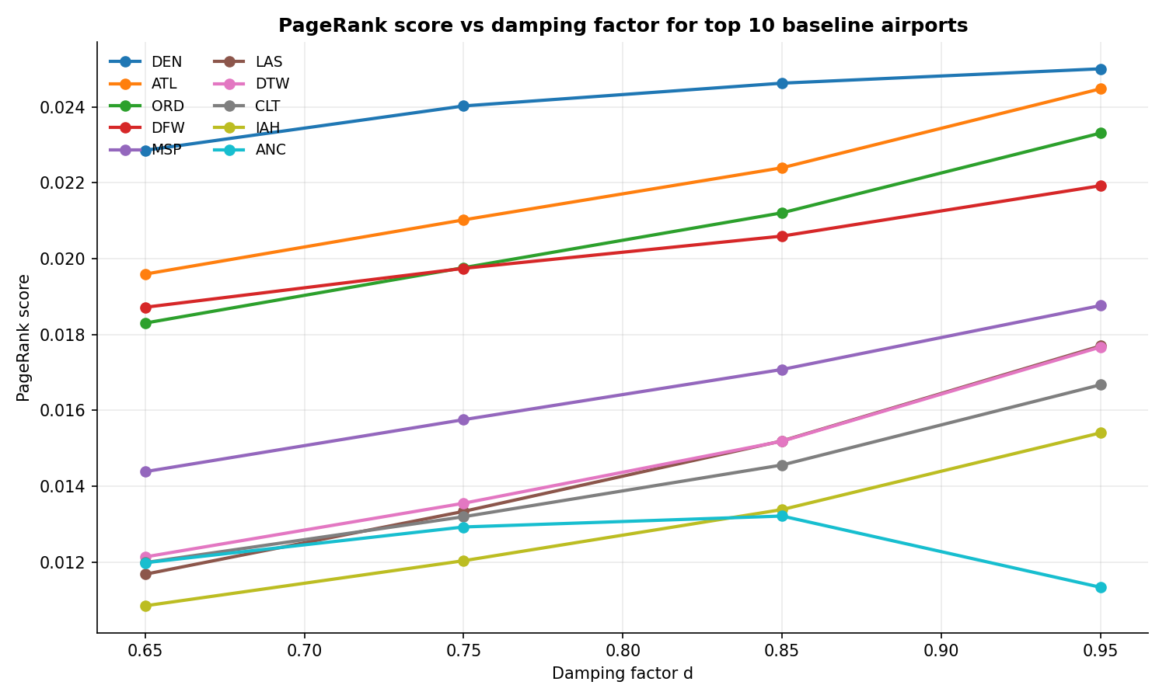
Damping Factor Sensitivity
Are the top hubs stable across choices of d?
Setup
Recompute PageRank at d = 0.65, 0.75, 0.85, 0.95.
Same transition matrix, same tolerance.
Compare top hubs and full ranking.
Findings
DEN, ATL, ORD, DFW stay top 4 for every d.
Spearman ρ ≥ 0.988 vs baseline.
Top-10 set overlaps 9 of 10 in every case.
Iterations rise: 43 → 64 → 112 → 353.
Top hubs are driven by network structure, not by d = 0.85.
Source: OpenFlights; project notebook
07

Slide 8
Hub Closure Experiment
What happens when ATL is removed?
Simulation: remove all incoming and outgoing ATL routes, rebuild the matrices, and recompute PageRank.
ATL
5,145
112
DEN
removed hub
remaining directed routes
post-closure iterations
still ranked #1
Main finding
The network does not collapse. Importance redistributes toward other major hubs, especially DEN, ORD, DFW, MSP, DTW, CLT, and IAH.
Source: OpenFlights; project notebook
08

Slide 9
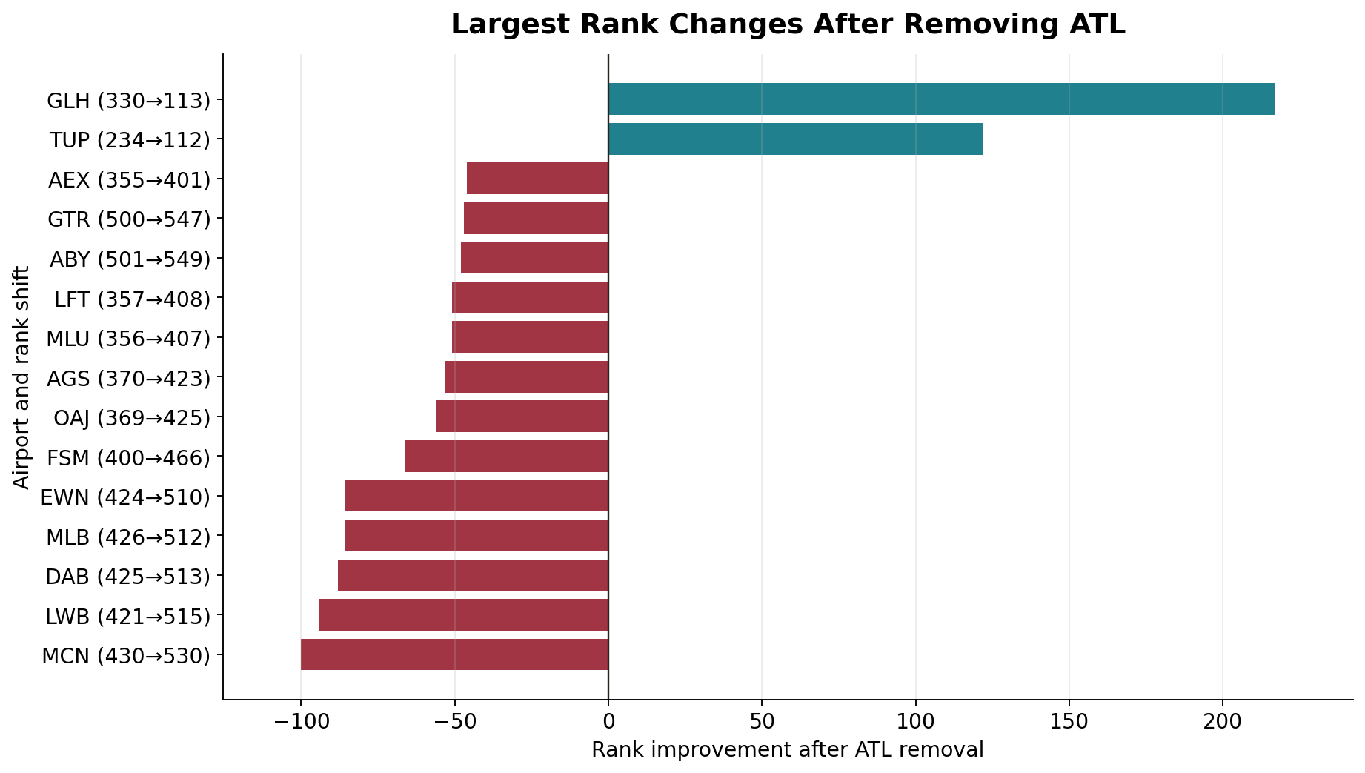
Rank Changes After Removing ATL
Largest movements in the disrupted network
How to read this
Positive rank change means the airport moved up.
Negative rank change means it moved down.
Small airports can jump many ranks because bottom scores are very close.
Key message
For hub-level interpretation, PageRank score change matters more than rank alone.
Source: OpenFlights; project notebook
09

Slide 10
What We Learned
Centrality and resilience in one model
1. Centrality is recursive
2. Robust to damping
3. The network is resilient
4. Local vulnerability remains
An airport is important when it is connected to other important airports, not only when it has many direct routes.
Top hubs stay the same for d = 0.65 through 0.95. The ranking reflects network structure, not the choice of d.
Removing ATL changes rankings, but other hubs absorb importance. The national structure stays connected through multiple hubs.
Some regional airports lose importance when ATL is removed, showing that local dependence can be high even if the full network is resilient.
PageRank gives a linear algebra-based way to quantify both structural importance and disruption response.
Source: OpenFlights; project notebook
10

Slide 11
Limitations and Extensions
How the project could be strengthened
Limitations
Extensions
OpenFlights route data is historical.
Binary matrix does not measure passenger volume.
All outgoing routes are treated as equally likely.
The ATL scenario is a complete closure, not a partial disruption.
Use BTS T-100 data to weight edges by passengers or flight counts.
Compare PageRank with degree, betweenness, and eigenvector centrality.
Simulate multiple hub closures.
Map centrality shifts geographically.
Source: OpenFlights; project notebook
11

Slide 12
Conclusion
Final takeaway
Airport importance is not just route count. It depends on where an airport sits inside the network of important connections.
DEN, ATL, ORD, and DFW are structurally central. Removing ATL shifts importance to other hubs, showing both centrality and resilience.
PageRank turns that idea into a matrix problem: construct the transition matrix, apply damping, iterate, and interpret the principal eigenvector.
Team: Mindeok Seo, Jake Gust, Jeewan Khadka, Yijia Zhang, Alan Tang
Repo: github.com/JeewaanK/Airport_PageRank
12

