Slide 1


Data wrangling 2: Web Scraping
18-February-2020
Sepi Chakaveh & Assel Altayeva
Overview Data Science

Slide 2
Learning Objectives:
Data wrangling of the Google Analytics pages
Data sourcing via web scraping
Web parsing
Web scraping in practice
Cleaning and stemming textual data

Slide 3
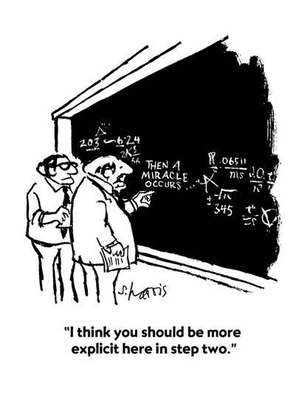
Data Wrangling
Data wrangling is the process of going from "raw"
data to "usable data”.
Transparency and reproducibility is essential for the
data wrangling process.
Task
To find raw data, document the wrangling
required to bring it to the stage where it can be analyzed.

Slide 4
Data wrangling challenges
Surgery Outcomes
Web browsing history
Neonatal ICU
Rainfall
UK E-Petitions
Cybersecurity
Obtaining, or inferring a data dictionary
Data integration
Record linkage
Spelling and format variability
Reformatting the structure of the data
Handling missing data
Anomaly detection

Slide 5
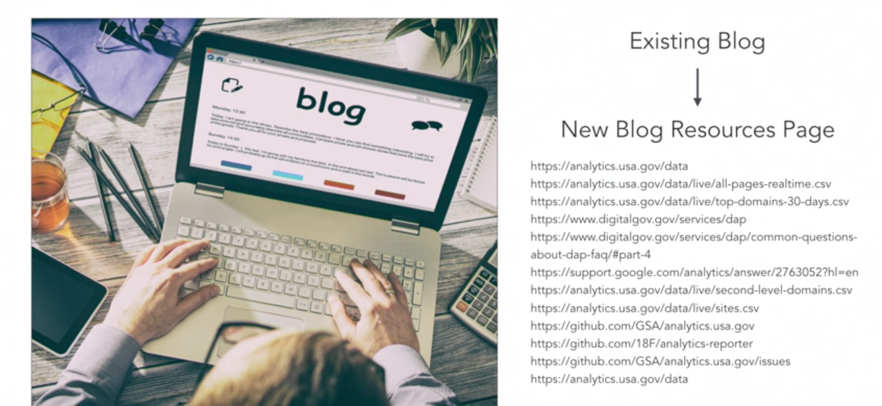
Web scraping use cases
Ecommerce store automation
Emergency resource allocation
Production intel
Alternative Data for Finance
Recruitment
Price intelligence
Market research

Slide 6
Four BeautifulSoup object types
BeautifulSoup object
representation of the document you're scraping as a whole
Tag object
corresponds to XML and HTML elements in an original document
NavigatableString object
container for bits of text within a tag
Comment object

Slide 7
Install BeautifulSoup package
Command line:
conda install –c anaconda beautifulsoup4

Slide 8
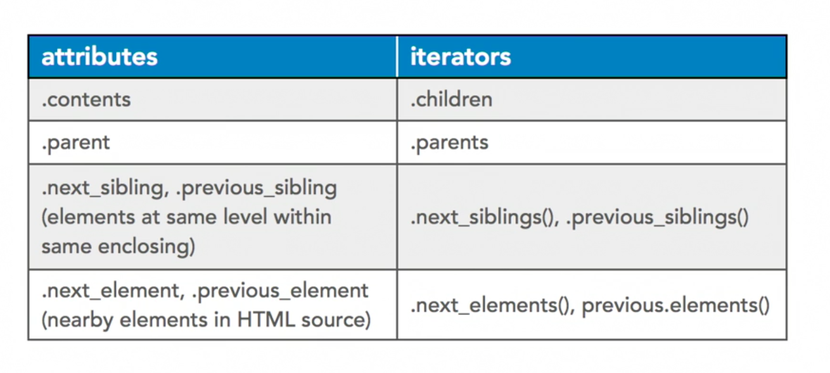
Navigating BeautifulSoup

Slide 9
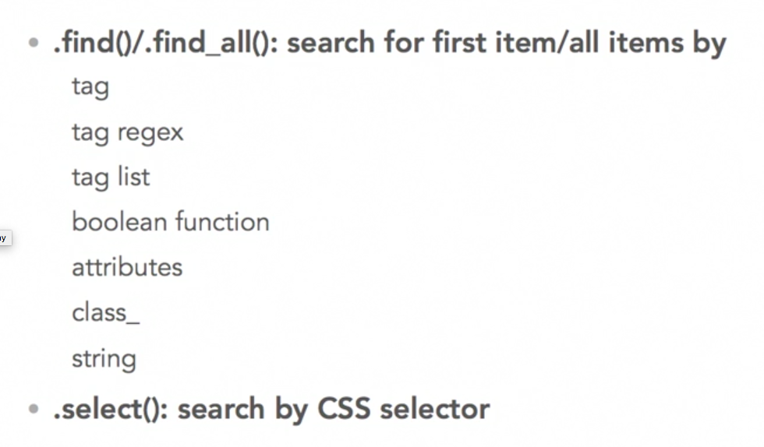
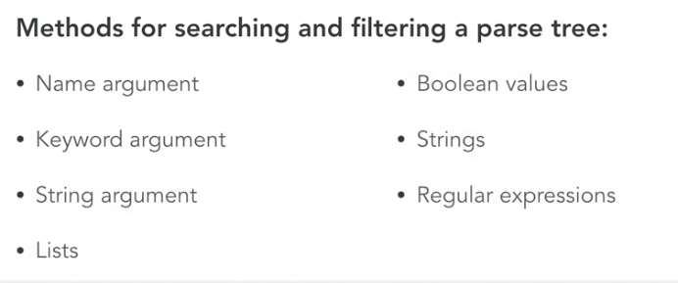
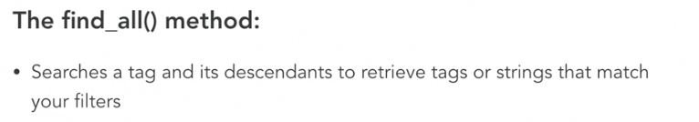
BeautifulSoup search

Slide 10
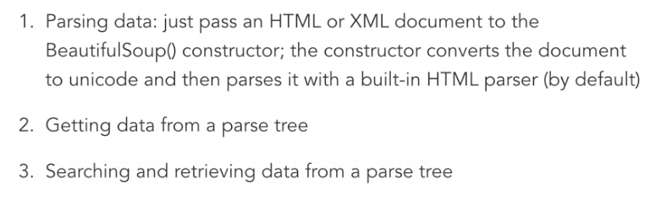
Working with parsed data in BeatifulSoup

Slide 11
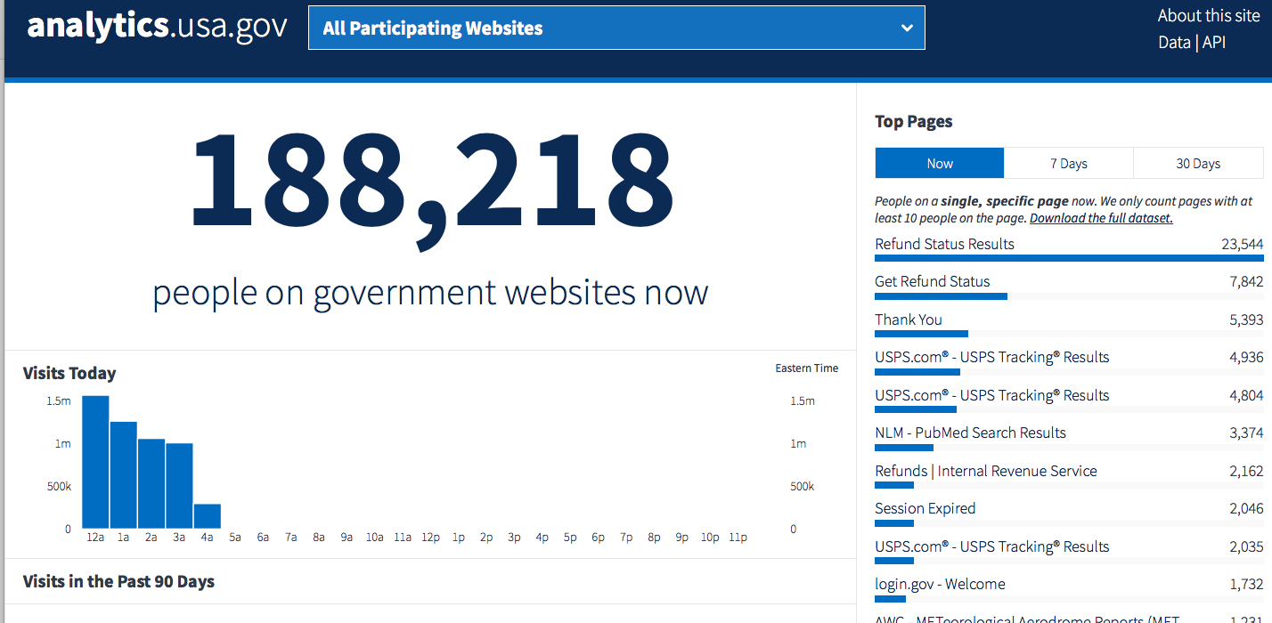
Practical
https://github.com/asel-datascience/ODS2020/blob/master/Week_4_Web_Scraping/Web_scraping.ipynb
https://raw.githubusercontent.com/asel-datascience/ODS2020/master/Week_4_Web_Scraping/IOTArticles.html
https://analytics.usa.gov

