Slide 1


Data Wrangling
11-February-2020
Sepi Chakaveh & Assel Altayeva
Overview Data Science

Slide 2
What Does Big Data Involve?
Acquisition, access – data may exist without being accessible
Wrangling – data may be in the wrong form
Integration, representation – data relationships may not be captured
Cleaning, filtering – data may have variable quality

Slide 3
Some Examples of Structured Data
JSON Object
Python Dictionary
{ "meta" :
{ "view" :
{ "id" : "rhe8-mgbb", "name" : "Medallion Vehicles - Authorized", "attribution" : "Taxi and Limousine Commission (TLC)", "averageRating" : 0, "category" : "Transportation", "createdAt" : 1362166028, "description" : ”Medallion vehicles authorized to operate in New York City. ", "displayType" : "table", "downloadCount" : 47921,
…
{‘a’: [‘apple’, ‘atom’], ‘b’: [‘bat’, ‘bar’, ‘book]}
File formats that store data in a way easily understood by machines are commonly referred to as machine readable . Common machinereadable formats include the following:
• Comma-Separated Values (CSV)
• JavaScript Object Notation (JSON)
• Extensible Markup Language (XML)

Slide 4
Some Examples of Structured Data
Relational Database Table
Vector of Numbers
[3,14,15,92,65,45,…]
(‘Carson Wentz’, 6’ 5’’, 25)
Name | Height | Age
Carson Wentz | 6’ 5’’ | 25
Zack Ertz | 6’ 5’’ | 27
[{‘name’: ‘Carson Wentz’, ‘height’: 6’ 5’’, ‘age’: 25},
{‘name’: ‘Zach Ertz’, ‘height’: 6’ 5’’, ‘age’: 27}, …]
Tuple

Slide 5
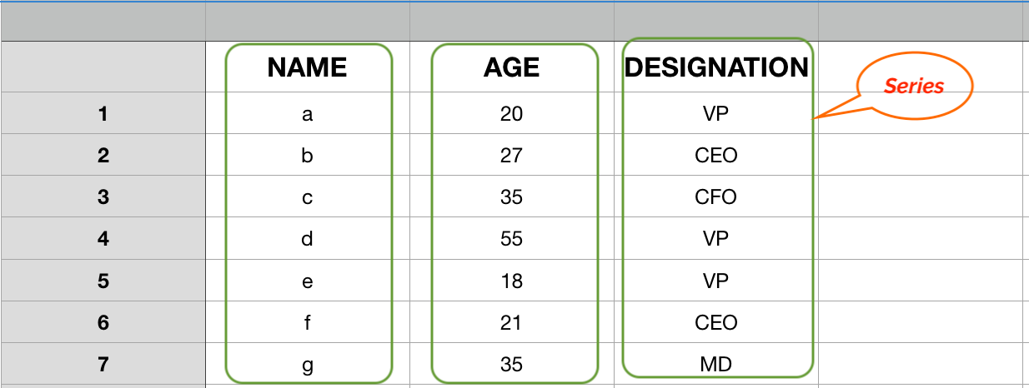
Pandas: Series
A one-dimensional labeled array capable of holding any data type
Imagine a column in an excel sheet.

Slide 6
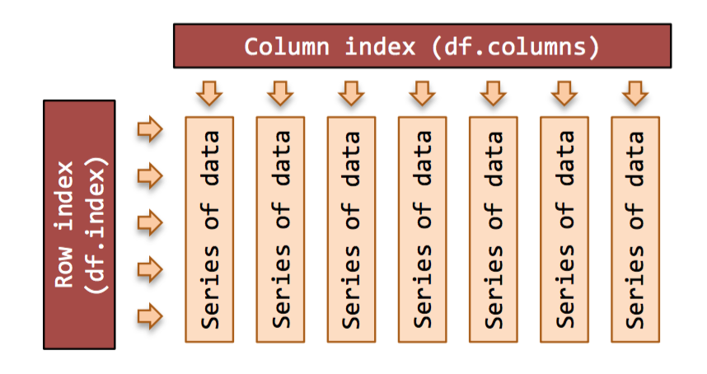
DataFrames

Slide 7
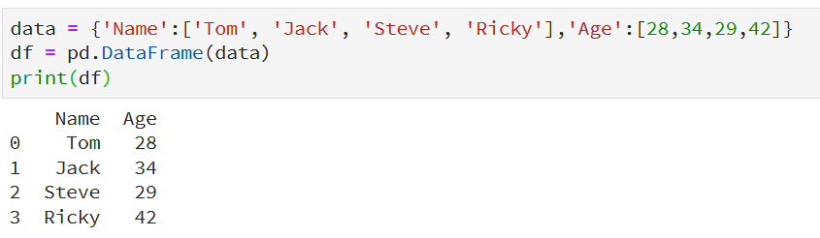
Create a DataFrame from Dict of ndarrays
All the ndarrays must be of same length
Default index

Slide 8
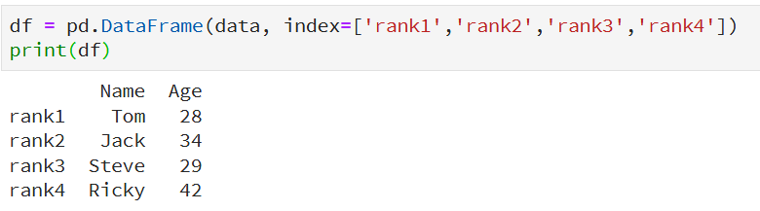
Create a DataFrame from Dict of ndarrays
The length of the index should equal to the length of the arrays.
Custom index

Slide 9
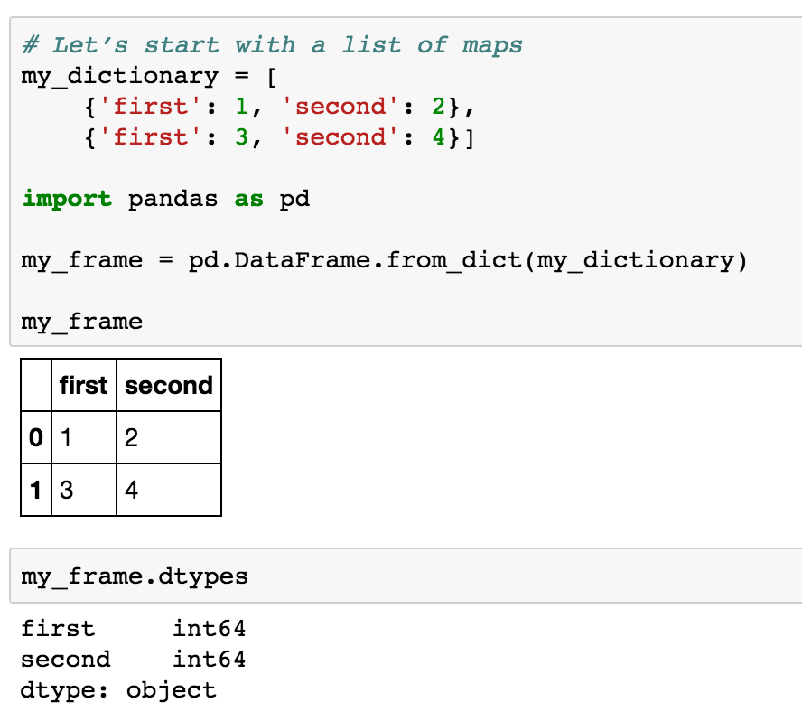
Creating a DataFrame from a List of Maps (“A Table”)
Index

Slide 10
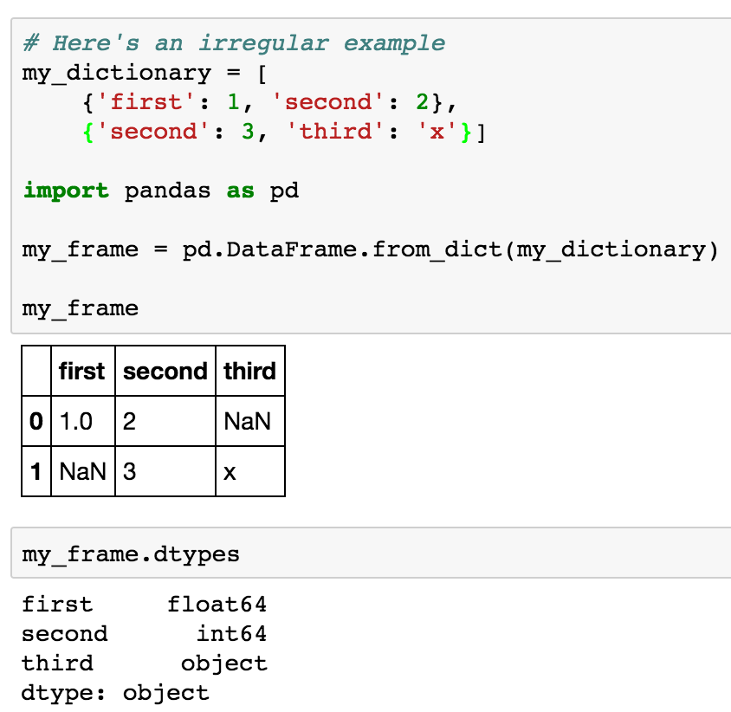
What If the Dictionary Isn’t Consistent? Padding…
(first, second)
(second, third)

Slide 11
Reading data

Slide 12
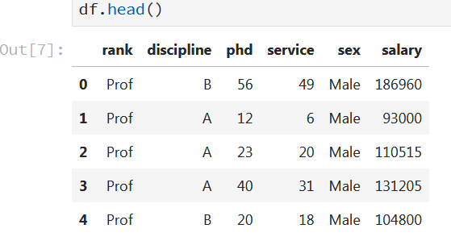
Reading data using pandas
In [ ]:
#Read csv file
df = pd.read_csv(" https://raw.githubusercontent.com/asel-datascience/ODS2020/master/Week_2_Data_Prep/Salaries.csv ")
Note: The above command has many optional arguments to fine-tune the data import process.

Slide 13
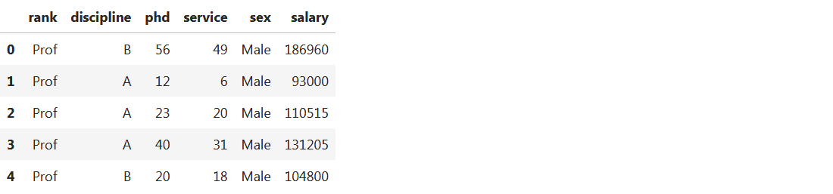
Another Example: read_table()
In []: df1 = pd.read_table(" https://raw.githubusercontent.com/asel-datascience/ODS2020/master/Week_2_Data_Prep/Salaries.csv ”,sep=’,’)
df1.head()
Out []:

Slide 14
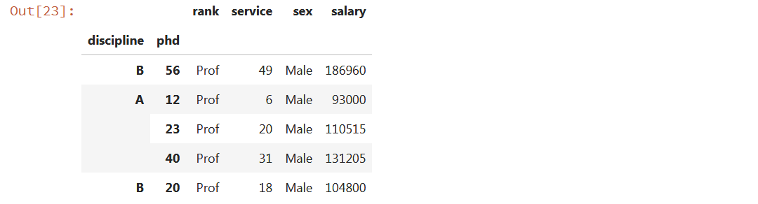
A Bit More Reading
Hierarchical Indices
df = pd.read_csv(" https://raw.githubusercontent.com/asel-datascience/ODS2020/master/Week_2_Data_Prep/Salaries.csv ”,
index_col=[‘discipline’,’phd’])
df.head

Slide 15


A Bit More Reading
The file may not have a fixed delimiter, using whitespace or some other pattern to separate fields
Use a regular expression as a delimiter
Skip rows

Slide 16
Reading Large Files
When processing very large files, you may only want to read in a small piece of a file or iterate through smaller chunks of the file.
Scenario 1: Read only a small number of rows from a large file
specify that with nrows
Scenario 2: read a file in pieces
specify a chunksize as a number of row:

Slide 17
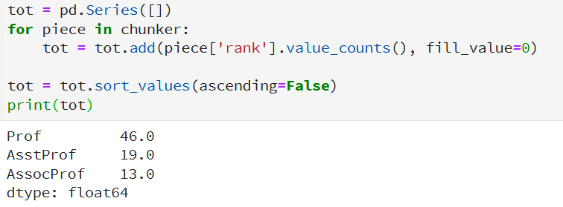
Iterating over Chunks
Iterate over the parts of the file according to the chunksize

Slide 18
Data Frame data types
In [4]:
#Check a particular column type
df['salary'].dtype
Out[4]: dtype('int64')
#Check types for all the columns
df.dtypes
In [5]:
Out[4]:
object
object
int64
int64
object
int64
rank
discipline
phd
service
sex
salary
dtype: object

Slide 19
Data Frames attributes
df.attribute | description
dtypes | list the types of the columns
columns | list the column names
axes | list the row labels and column names
ndim | number of dimensions
size | number of elements
shape | return a tuple representing the dimensionality
values | numpy representation of the data

Slide 20
Data Frames methods
Unlike attributes, python methods have parenthesis.
All attributes and methods can be listed with a dir() function: dir(df)
df.method() | description
head( [n] ), tail( [n] ) | first/last n rows
describe() | generate descriptive statistics (for numeric columns only)
max(), min() | return max/min values for all numeric columns
mean(), median() | return mean/median values for all numeric columns
std() | standard deviation
sample([n]) | returns a random sample of the data frame
dropna() | drop all the records with missing values

Slide 21
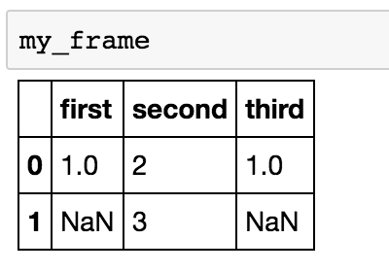
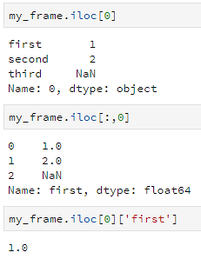
Accessing Elements of a DataFrame by Index: iloc
row
column
cell

Slide 22
“Bulk” Operations over Structured Data Objects
Key Data
Wrangling
Methods!
Extracting subsets of a DataFrame:
Selection / filtering – I want rows with certain data values
Projection – I want certain columns
Changing a DataFrame’s Schema
Composition of DataFrames:
Concatenation – append a table to another (more rows)
Joining – merge rows (expand # of columns)

Slide 23
Data Frames: Slicing
When selecting one column, it is possible to use single set of brackets, but the resulting object will be a Series (not a DataFrame):
In [ ]:
#Select column salary:
df['salary']
When we need to select more than one column and/or make the output to be a DataFrame, we should use double brackets:
In [ ]:
#Select column salary:
df[['rank','salary']]

Slide 24
Data Frames: Selecting rows
If we need to select a range of rows, we can specify the range using ":"
In [ ]:
#Select rows by their position:
df[10:20]
Notice that the first row has a position 0, and the last value in the range is omitted:
So for 0:10 range the first 10 rows are returned with the positions starting with 0 and ending with 9

Slide 25
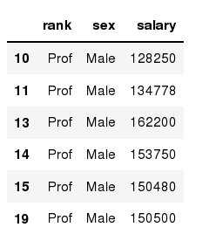
Data Frames: method loc
If we need to select a range of rows, using their labels we can use method loc:
In [ ]:
#Select rows by their labels:
df_sub.loc[10:20,['rank','sex','salary']]
Out[ ]:

Slide 26
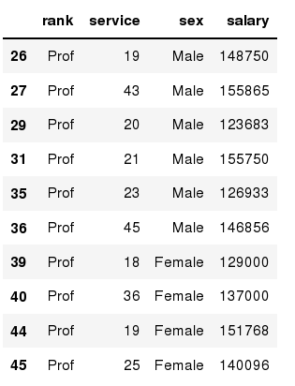
Data Frames: method iloc
If we need to select a range of rows and/or columns, using their positions we can use method iloc:
In [ ]:
#Select rows by their labels:
df_sub.iloc[10:20,[0, 3, 4, 5]]
Out[ ]:

Slide 27
Data Frames: method iloc (summary)
df.iloc[0] # First row of a data frame
df.iloc[i] #(i+1)th row
df.iloc[-1] # Last row
df.iloc[:, 0] # First column
df.iloc[:, -1] # Last column
df.iloc[0:7] #First 7 rows
df.iloc[:, 0:2] #First 2 columns
df.iloc[1:3, 0:2] #Second through third rows and first 2 columns
df.iloc[[0,5], [1,3]] #1st and 6th rows and 2nd and 4th columns

Slide 28
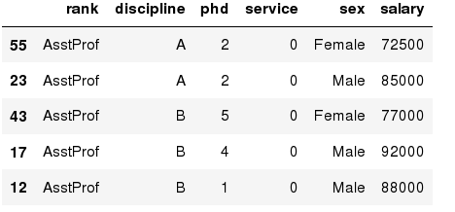
Data Frames: Sorting
We can sort the data by a value in the column. By default the sorting will occur in ascending order and a new data frame is return.
In [ ]:
# Create a new data frame from the original sorted by the column Salary
df_sorted = df.sort_values( by ='service')
df_sorted.head()
Out[ ]:

Slide 29
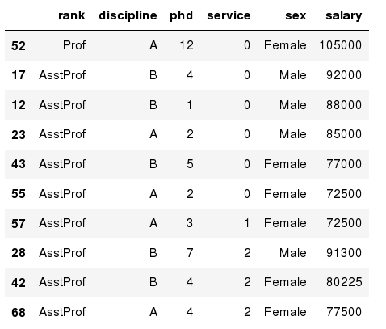
Data Frames: Sorting
We can sort the data using 2 or more columns:
In [ ]:
df_sorted = df.sort_values( by =['service', 'salary'], ascending = [True, False])
df_sorted.head(10)
Out[ ]:

Slide 30
Data Frame: filtering selection
Abstractly:
select(Table T)
Returns: a subset
of T, T’, with fewer rows but the same schema
To subset the data we can apply Boolean indexing. This indexing is commonly known as a filter. For example if we want to subset the rows in which the salary value is greater than $120K:
#Calculate mean salary for each professor rank:
df_sub = df[ df['salary'] > 120000 ]
In [ ]:
Any Boolean operator can be used to subset the data:
> greater; >= greater or equal;
< less; <= less or equal;
== equal; != not equal;
#Select only those rows that contain female professors:
df_f = df[ df['sex'] == 'Female' ]
In [ ]:

Slide 31
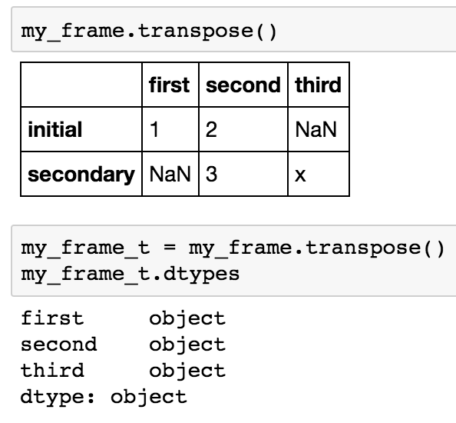
Transposing Rows + Columns

Slide 32
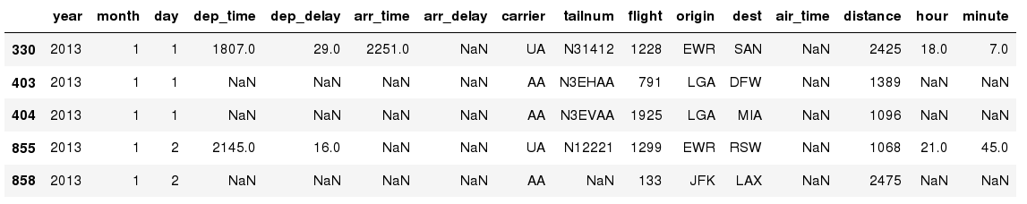
Missing Values
Missing values are marked as NaN
In [ ]:
# Read a dataset with missing values# Read a dataset with missing values
flights = pd.read_csv(" https://raw.githubusercontent.com/asel-datascience/ODS2020/master/Week_2_Data_Prep/flights.csv ")
In [ ]:
# Select the rows that have at least one missing value
flights[flights.isnull().any(axis=1)].head()
Out[ ]:

Slide 33
Missing Values
There are a number of methods to deal with missing values in the data frame:
df.method() | description
dropna() | Drop missing observations
dropna(how='all') | Drop observations where all cells is NA
dropna(axis=1, how='all') | Drop column if all the values are missing
dropna(thresh = 5) | Drop rows that contain less than 5 non-missing values
fillna(0) | Replace missing values with zeros
isnull() | returns True if the value is missing
notnull() | Returns True for non-missing values

Slide 34


Getting Rid of Dirty Data
DataFrames use the value NaN to represent a “null” (missing) value
dropna – remove rows
fillna – substitute value
Beware NaN in string column!

Slide 35
Missing Values
When summing the data, missing values will be treated as zero
If all values are missing, the sum will be equal to NaN
cumsum() and cumprod() methods ignore missing values but preserve them in the resulting arrays
Missing values in GroupBy method are excluded (just like in R)
Many descriptive statistics methods have skipna option to control if missing data should be excluded . This value is set to True by default (unlike R)

Slide 36
A Common Concept: Mapping elements of a collection
Suppose we have…
list: [1, 2, 3, 4, …]
Map each element of the list by applying function f(x) = x * 2

Slide 37
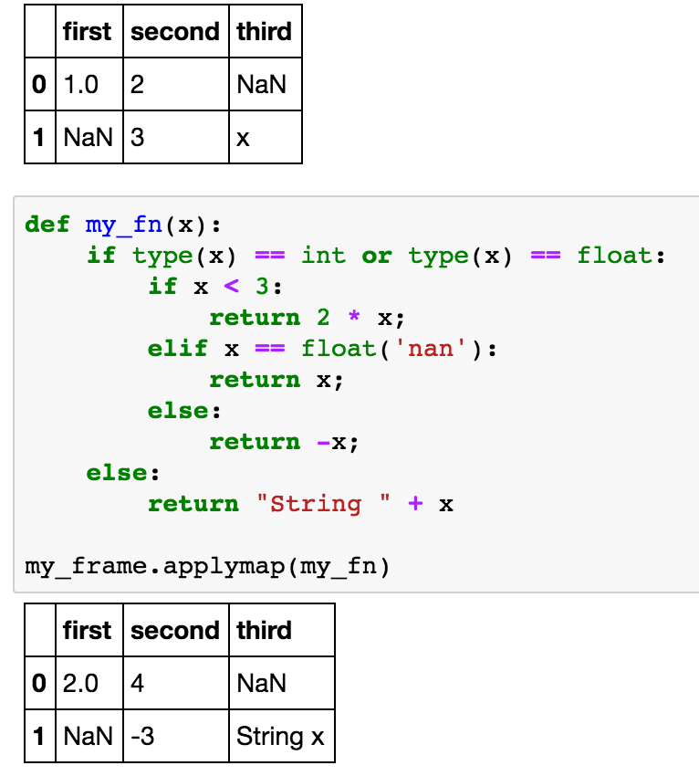
General Value Substitution mapping
To replace a value based on some conditions, use applymap and a function!
Abstractly:
apply(Table T,f)
Returns: a new Table T’ with all cell content
c replaced by f(c)

Slide 38
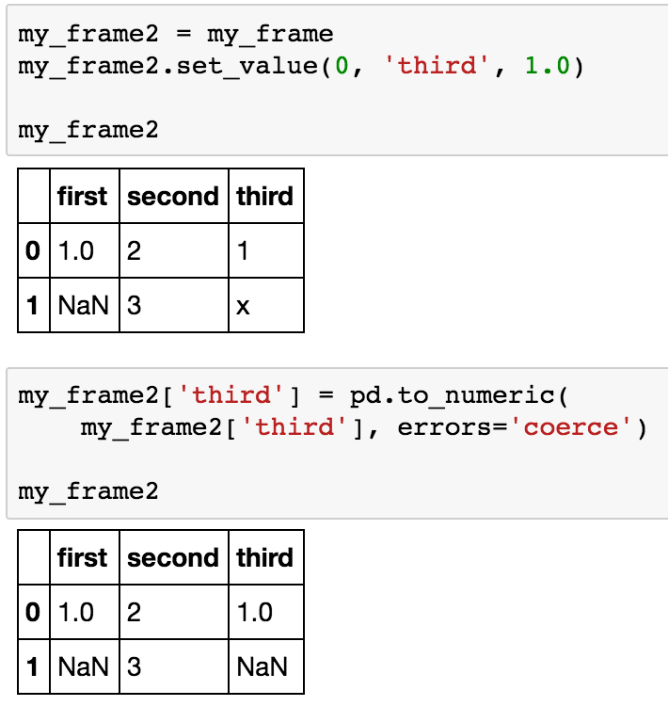
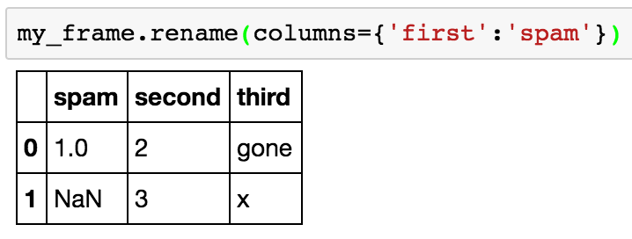
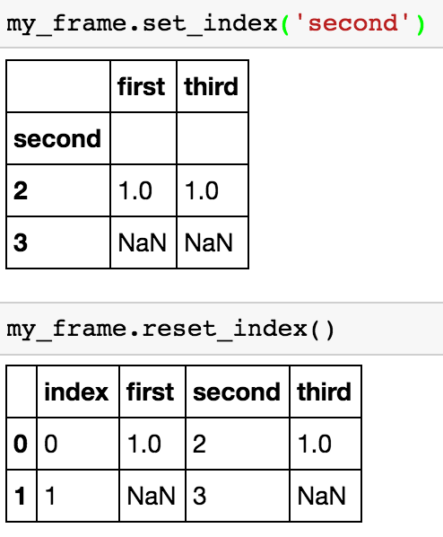
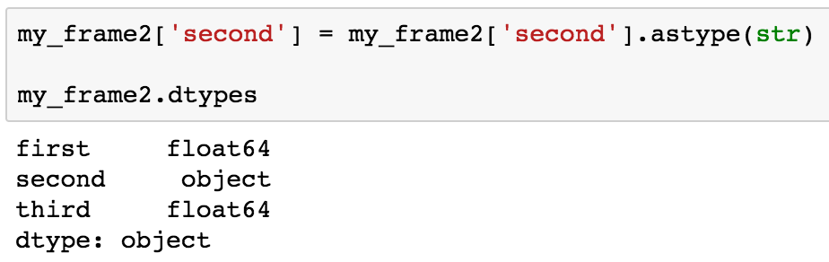
Restructuring the DataFrame Schema
Change column name
Change index columns
Change column type

Slide 39
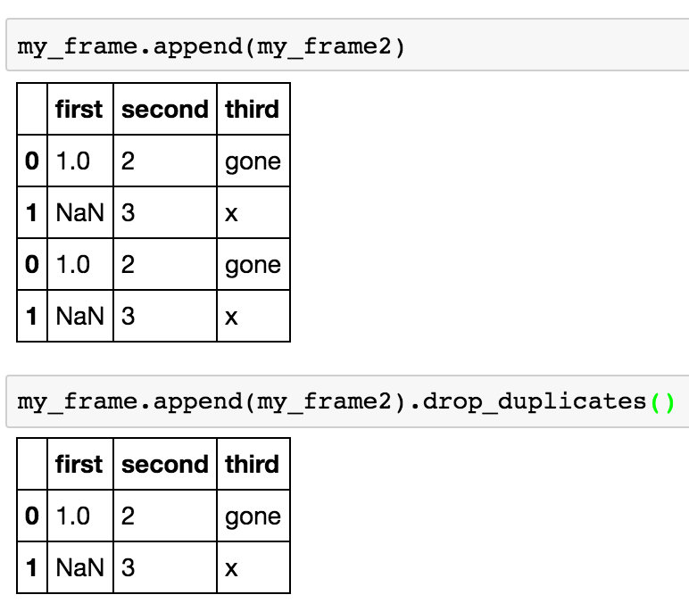
Concatenating DataFrames
Abstractly:
append(Table T1,Table T2)
Returns: if T1, T2 have the same schema, Table T’ with all rows in T1 followed by all rows in T2
May want to eliminate
duplicates

Slide 40
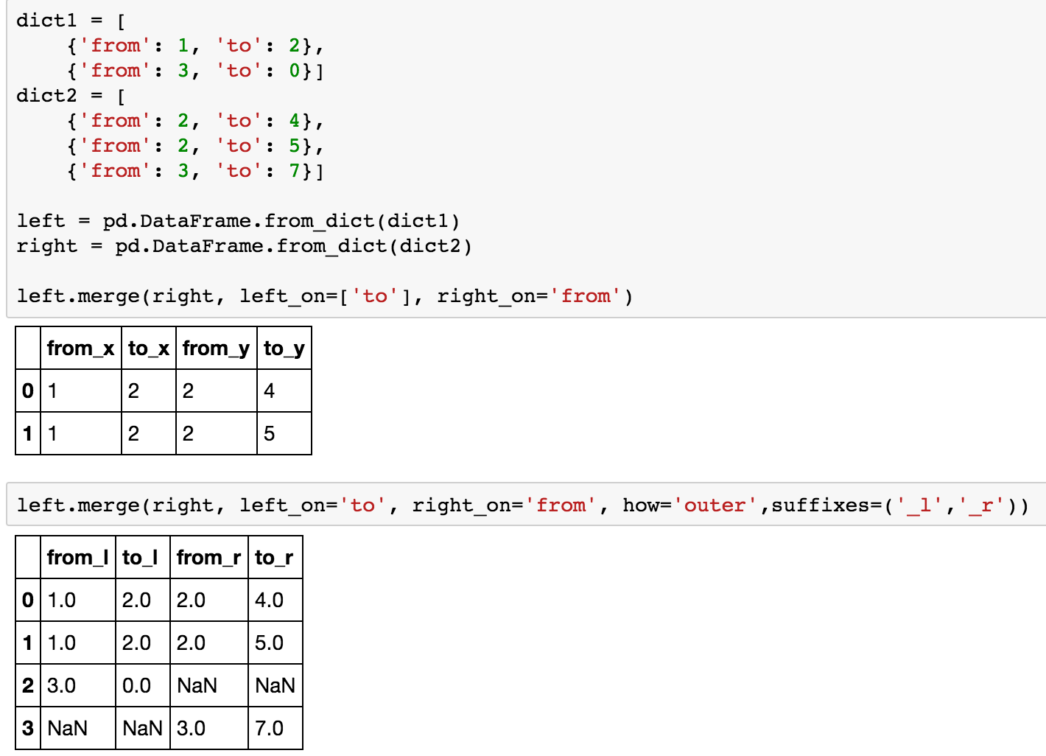
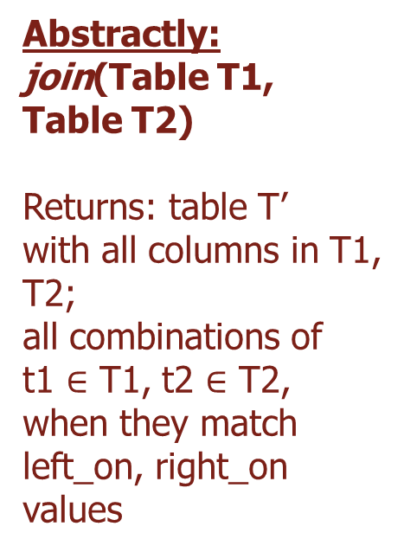
Merging (Joining) DataFrames
Abstractly:
join(Table T1, Table T2)
Returns: table T’ with all columns in T1,
T2; all combinations of
t1 $∈$ T1, t2 $∈$ T2, when they match left_on, right_on values
“inner”: matches
“left”: matches + left rows, NaN padded
“right”: matches + right rows
“outer”: matches + all rows padded

Slide 41
Hands-on exercises
Q: How can fillna and dropna be implemented with applymap?

Slide 42

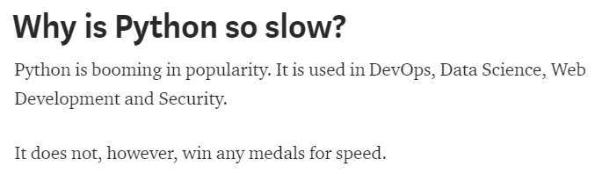
Thinking Beyond Iteration
Iteration in Python is generally VERY slow, leading to articles like…

Slide 43
Thinking Beyond Iteration
Again: Iteration in Python is generally VERY slow
Order doesn’t actually matter – left-to-right, right-to-left, top-to-bottom, etc. – as long as we combine the final output in the right way
So is there a way to do this that does multiple operations at the same time or in any arbitrary order?
Old idea in computer science: “single instruction, multiple data” aka “vector operations” aka “bulk operations” aka “operations over collections”
“Do the same thing over every element of this DataFrame”
The basis of parallel computers, GPU computing, supercomputers, vector instructions, databases, MapReduce, TensorFlow, …

Slide 44
GroupBy Mechanisms in Pandas
Step 1: Data contained in a pandas object, whether a Series, DataFrame, is split into groups based on one or more keys that you provide.
The splitting is performed on a particular axis of an object.
For example, a DataFrame can be grouped on its rows (axis=0) or its columns (axis=1).
Step 2: Apply a function to each group, producing a new value per group.
Step 3: The results of all those function applications are combined into a result object.

Slide 45
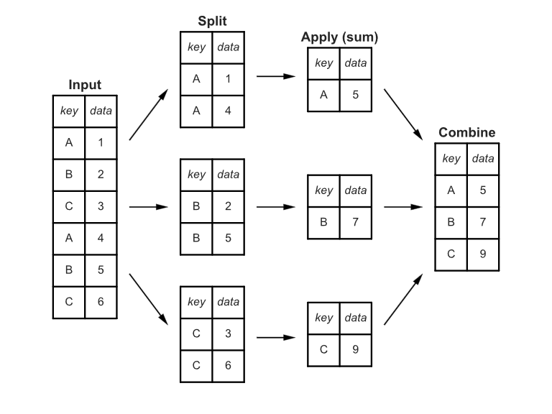
GroupBy Mechanisms

Slide 46
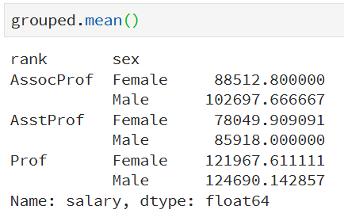
Group on Multiple Columns
Check the function unstack()…

Slide 47
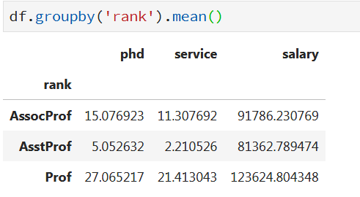
Aggregate on All Columns, But…
Something is missing….
Only numeric columns

Slide 48
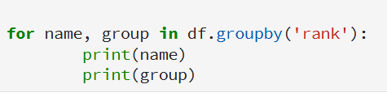

Iterating over Groups
What if you have multiple groupby columns/keys?

Slide 49


Syntactic Sugars
are syntactic sugar for:
Note: If single brackets are used to specify the column (e.g. salary), then the output is Pandas Series object. When double brackets are used the output is a Data Frame

Slide 50
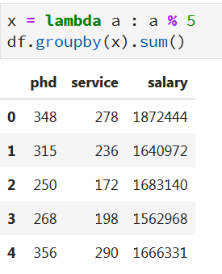
Grouping with Functions
Using Python functions is a more generic way of defining a group mapping.
Any function passed as a group key will be called once per index value, with the return values being used as the group names.
You can use both native functions as well as customs ones (lambdas)

Slide 51
Data Frames groupby method
groupby performance notes:
no grouping/splitting occurs until it's needed. Creating the groupby object only verifies that you have passed a valid mapping
- by default the group keys are sorted during the groupby operation. You may want to pass sort=False for potential speedup:
In [ ]:
#Calculate mean salary for each professor rank:
df.groupby(['rank'], sort=False)[['salary']].mean()

Slide 52
Hands-on exercises
Calculate the basic statistics for the salary column;
Find how many values in the salary column (use count method);
Calculate the average salary;

Slide 53
Aggregation Functions in Pandas
Aggregating a Series or all of the columns of a DataFrame is a matter of using aggregate with the desired function or calling a method like mean or std.
Aggregation - computing a summary statistic about each group, i.e.
compute group sums or means
compute group sizes/counts
Common aggregation functions:
min, max
count, sum, prod
mean, median, mode, mad
std, var

Slide 54
Basic Descriptive Statistics
df.method() | description
describe | Basic statistics (count, mean, std, min, quantiles, max)
min, max | Minimum and maximum values
mean, median, mode | Arithmetic average, median and mode
var, std | Variance and standard deviation
sem | Standard error of mean
skew | Sample skewness
kurt | kurtosis

Slide 55
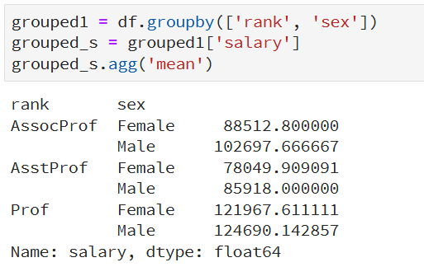
Aggregate on Series

Slide 56
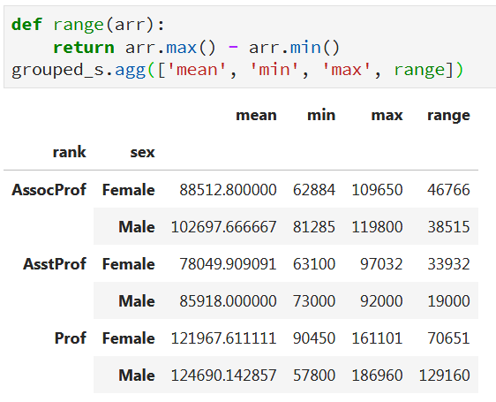
Aggregate with Multiple Functions
You can pass a list of functions or function names; you will get back a DataFrame with column names taken from the functions.

Slide 57
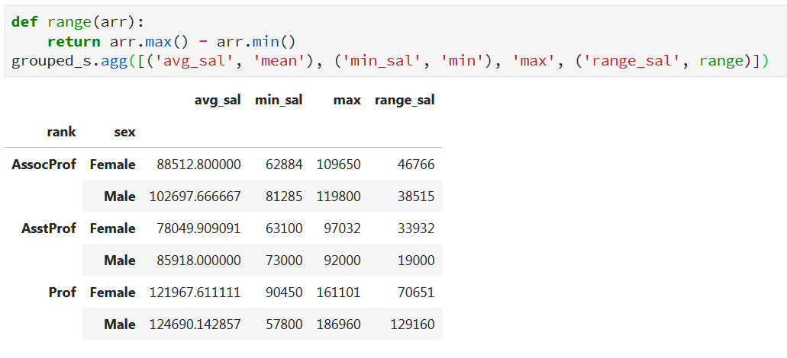
Aggregate: Renaming

Slide 58
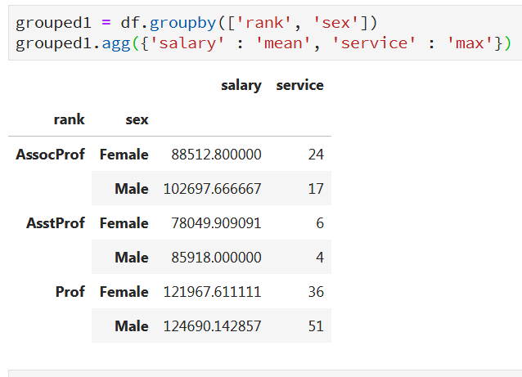
Different Functions for Different Columns
Pass a dict to agg that contains a mapping of column names to any of the function specifications listed so far

Slide 59
SHORT TUTORIAL DATA WRANGLING
Correcting data from Google Analytics by creating a new page URL
Group data
Fix data types
Drop columns
Replace data values
Join two dataset to create a new dataset
Save new datasets as CSV
download the notebook from the
https://github.com/asel-datascience/ODS2020/tree/master/Week_3_Data_Wrangling

Slide 60
