Slide 1
Penetration Testing Report
- Controlled Exploitation in HTB Lab -
Presented by: Muhammad Ubaid, Cybersecurity Intern
Date: 18/7/2025

Slide 2
Engagement Scope
What we tested:
Target: Hack The Box (HTB) Starting Point machine
IP: 10.129.82.6
Goal: Simulate a real penetration test in a safe lab
Tasks:
Reconnaissance
Vulnerability scanning
Exploitation
Documentation & recommendations

Slide 3
Recon Findings (Nmap)
What we discovered:
Open TCP Port: 23 (Telnet)
Service: Linux telnetd
No encryption → clear text credentials
Old Linux kernel (2.6.x) detected → possible privilege escalation risk

Slide 4
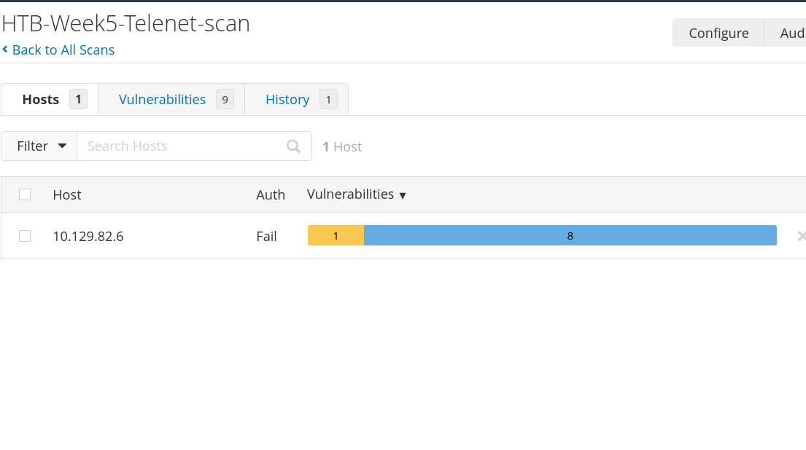
Vulnerability Scan (Nessus)
Nessus Scan:
Ran a full network scan on 10.129.82.6
Found 9 findings — 1 Low, rest Info
No direct remote CVE matched
Key takeaway: Telnet with weak/default credentials is likely

Slide 5
Exploitation Steps (Telnet)
How we exploited it:
Tried manual login: root/root, admin/admin
Gained access as root with default password
Verified full shell access: whoami, id, uname -a
Proved total control of the system

Slide 6
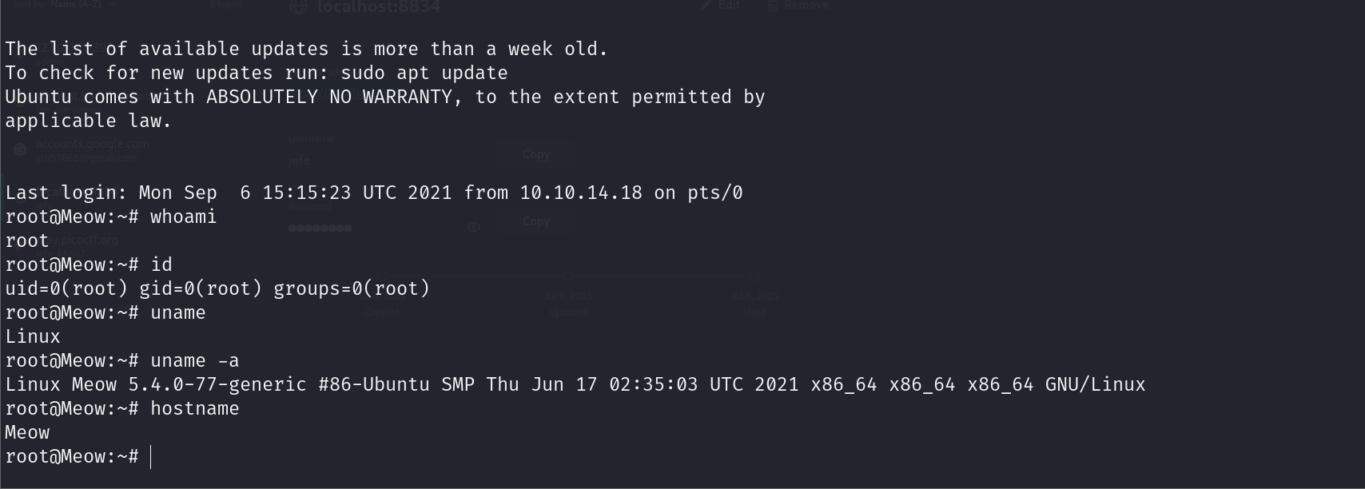
Exploitation Steps

Slide 7
Impact
What this means:
Unauthorized attackers can gain root shell
Total control: read, modify, delete any file
Passwords and sessions are unencrypted
Critical risk: anyone on the network can exploit it

Slide 8
Recommendations
How to fix this:
Disable Telnet → remove legacy servicesUse SSH only, with encryption Set strong, unique passwords for all accounts Patch & upgrade the OS — kernel 2.6 is outdated Implement network access controls
Regular vulnerability scans to detect these issues early

Slide 9
Conclusion
One weak/default password can lead to total system compromise.
Legacy services like Telnet should be retired.
Proactive scanning, strong credentials, and secure protocols keep systems safe

