Slide 1
Nopal-Sense
Mixed-Signal Soil Impedance Spectroscopy Hub IEEE SSCS PICO Open-Source Chipathon 2026 Week 24 Project Proposal Review - June 12, 2026
Team members: Leader: Ernest Zermeño (@Jefemaestro33) Affiliation: Universidad de Guadalajara (individual Track B participant)
Contact email: ernest@zlabstudio.com
Track: B - Circuits for Sensors Secondary relevance: D - AI/LLM-assisted audit and documentation workflow

Slide 2
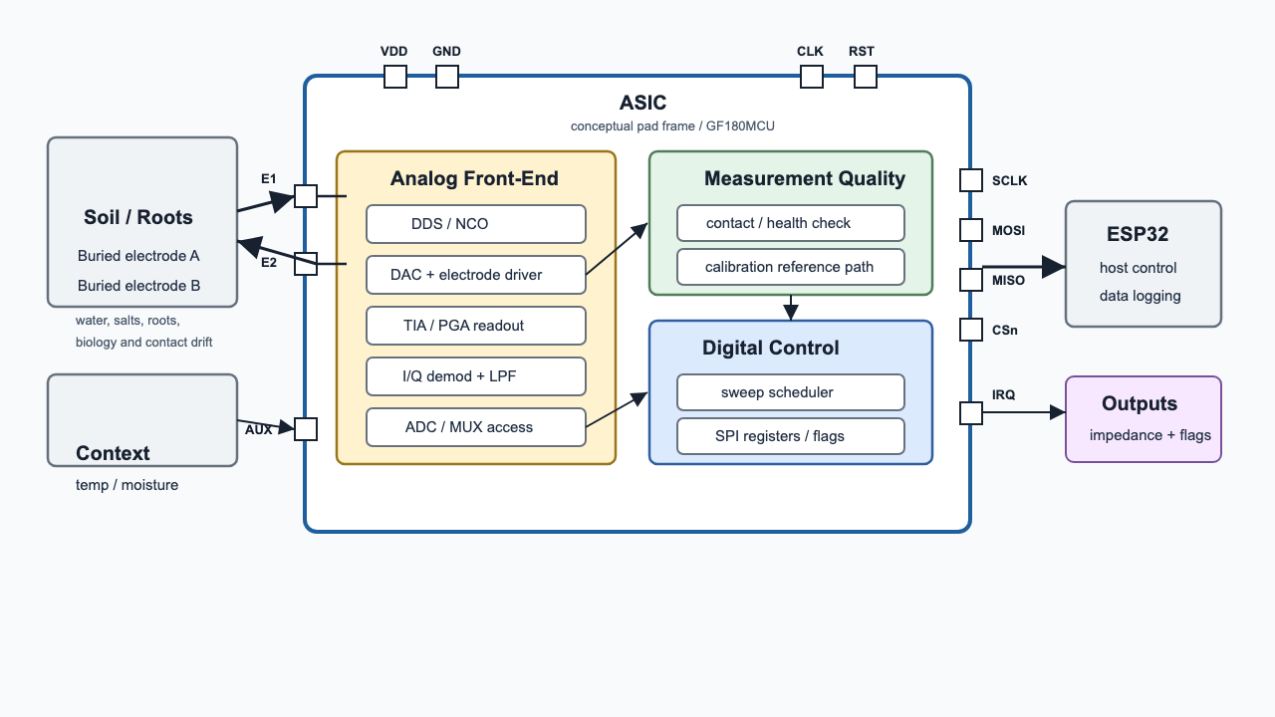
Project Information
Goal (2 sentences) Design a low-power mixed-signal ASIC for repeatable soil/root-zone impedance spectroscopy using buried electrodes. The research goal is to generate dense, calibrated datasets to test whether root-zone electrical patterns can indicate abnormal biological activity, including fungal or oomycete-related signals.
Design - High Level Proposal (2-3 sentences + image) The chip provides programmable AC excitation, electrode-interface readout, filtering, ADC access, and SPI-configurable control. It supports autonomous low-power frequency sweeps with synchronized moisture/temperature context and electrode contact/health checks. V1 is a measurement platform for calibrated soil data, not a pathogen-diagnosis chip.
Application (1 sentence) Low-cost agricultural root-zone monitoring for irrigation, salinity, and abnormal-condition screening, with a long-term path toward validated fungal/oomycete pattern detection.
References AD5940/ADuCM355 datasheets; Bukhari et al., arXiv:2508.13379; Zhang et al., Biosensors 2025; Corona-Lopez et al., Plant Methods 2019; Settimi 2011.

Slide 3
Team Background
Academic Experience Ernest Zermeño - Biology background, currently working in bioinformatics research involving CRISPR and experimental biology. Technical interests include computational biology, data analysis, embedded systems, and measurement tools for biological and agricultural systems.
Work Experience Software and applied technology work through zlabstudio. Previous work includes exploring FHE-based software development and building practical software systems, with a focus on turning technical ideas into usable tools.

Slide 4
Questions, Suggestions, Doubts?
What is the recommended must-work scope for v1 if the full architecture is too large for the tapeout schedule?
Should v1 reuse an existing open-source/reference SAR ADC instead of a custom ADC design to reduce schedule risk?
What electrode protection, ESD strategy, and analog pad usage are recommended for soil probes connected outside the chip package?
What minimum AMS validation evidence is expected by the July block and top-level simulation reviews?

