Slide 1

INFO-450: Data Analysis Project
By: Jeffrey Nana Kum
12/01/2022

Slide 2
Preamble
Souper Bowl is a privately-held business headquartered in Maine with a fiscal year end of December 31. The company has been in business for ten years and prides itself on offering creative soups made with locally sourced ingredients at a reasonable price. The most popular soups include sweet potato corn chowder, curried root vegetable and lentil, and maple-roasted butternut squash. Souper Bowl typically experiences increased sales during winter months since soup hits the spot on a cold and snowy day.
Souper Bowl sells soup out of several restaurant locations throughout Maine. The company employs three managers that direct the day-to-day operations for a set of stores that are organized by approximate geographic region: northern Maine (store type 1), mid-Maine (store type 2), and coastal Maine (store type 3).
Appendix A provides a map of these store locations. Each manager knows their local market well and has the flexibility to advertise and offer promotions with the overall goal of increasing sales year over year. Because of warmer weather and less snowfall in 2016, the company developed a new incentive plan for 2017 to boost sales. The manager whose set of locations (i.e., “store type”) has the highest year-over-year growth (%) will earn a monetary bonus from the company.

Slide 3
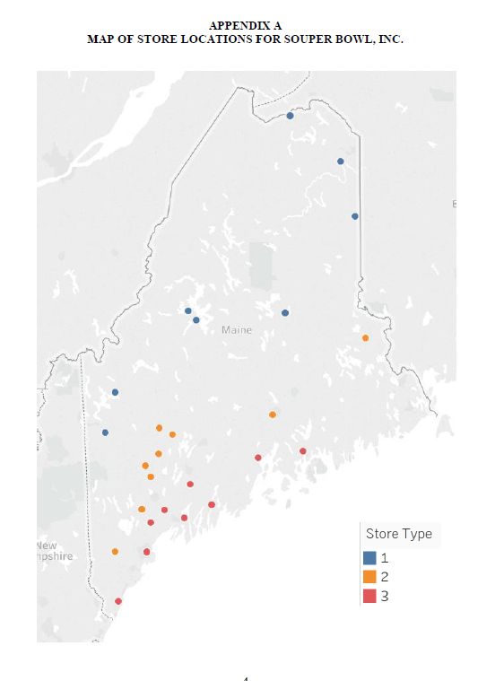


Slide 4
Problem Statement
I was recently promoted to audit senior at my firm, Snead Hall LLP, and one of my primary clients is Souper Bowl Inc.
AU-C Section 240.26 states that “when identifying and assessing the risks of material misstatement due to fraud, the auditor should, based on a presumption that risks of fraud exist in revenue recognition, evaluate which types of revenue, revenue transactions, or assertions give rise to such risks.”
During planning for the audit, the partner and manager determined that the following three management assertions represent significant risks for revenues:
recorded sales occurred
sales are accurately recorded
sales are recorded in the proper period

Slide 5
Problem Statement cont’d
The partner wanted to develop more focused procedures in the current year to hone in on potentially riskier sales transactions. As a result, the plan is to perform disaggregated sales analytics to identify unusual trends in the daily sales data with the goal of identifying sales on specific days at specific store locations that should be subjected to substantive testing due to heightened risks

Slide 6
Findings/Insights

Slide 7
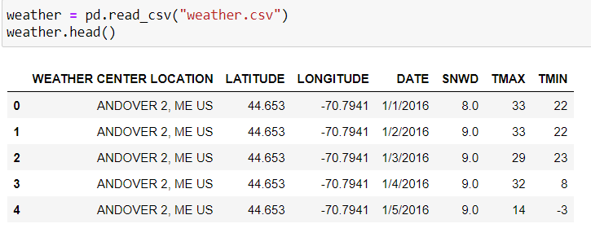
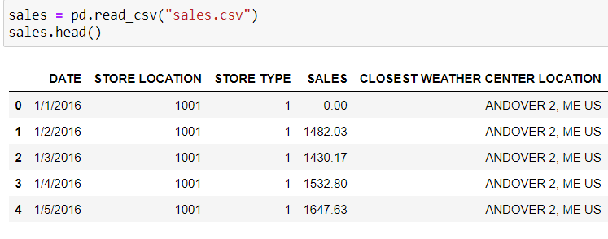
SOUPER BOWL SALES AND WEATHER DATA IN MAINE

Slide 8
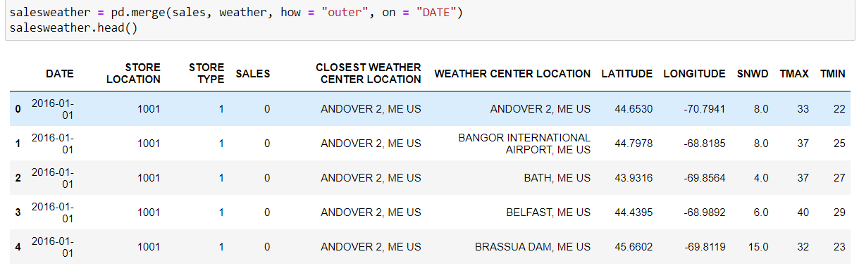
TABLES MERGED TOGETHER USING OUTER JOIN ON DATE

Slide 9
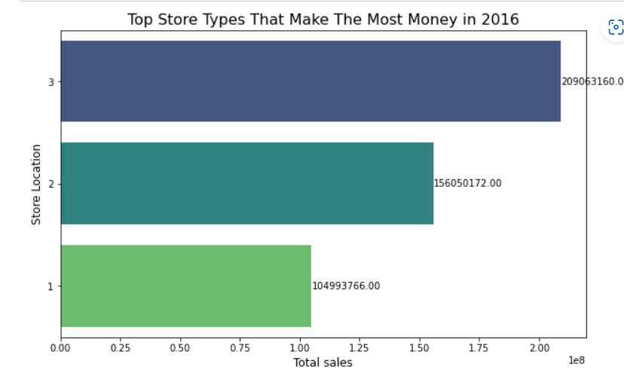
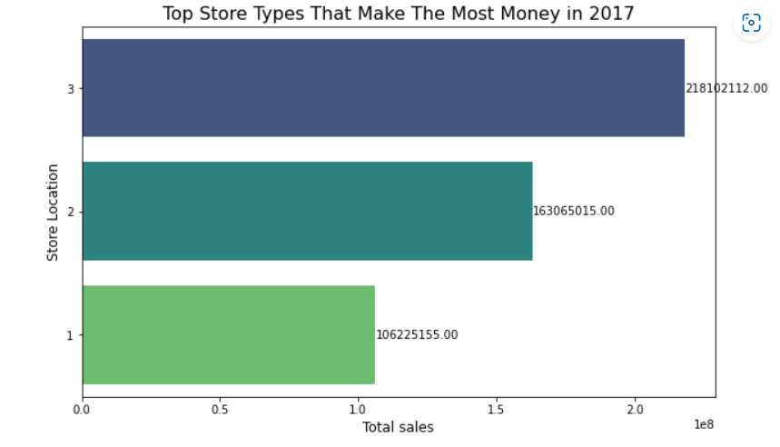
COMPARE REVENUES FROM 2016 AND 2017 FOR ANY SIGNIFICANT CHANGES
Store Type 3 - $209,063,160
Store Type 3 - $218,102,112

Slide 10
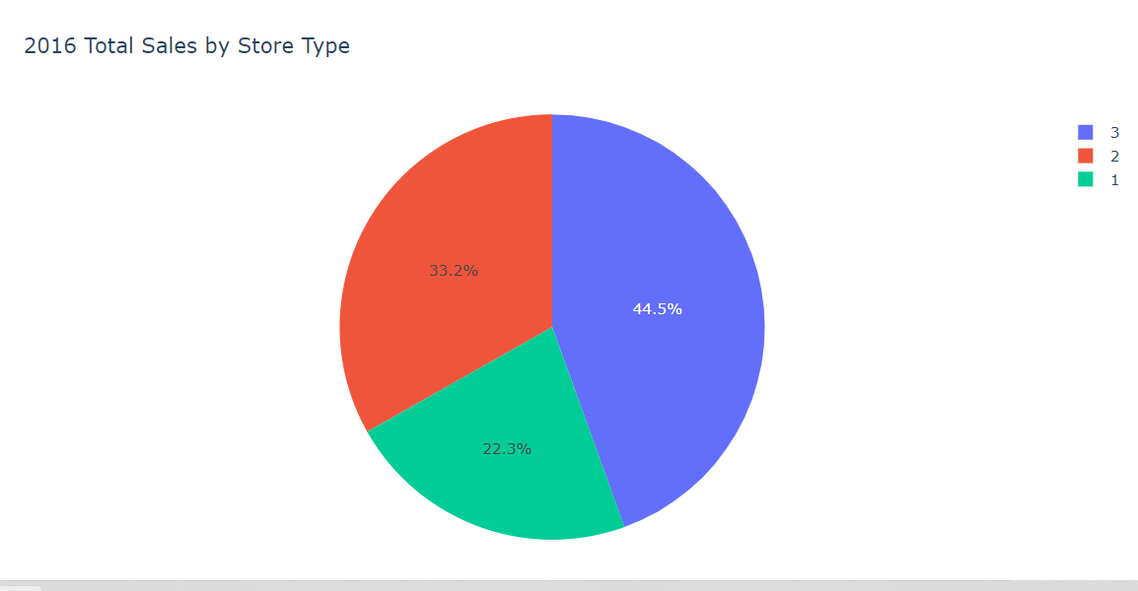
COMPARING PERCENTAGE CHANGES IN SALES FOR BOTH YEARS

Slide 11
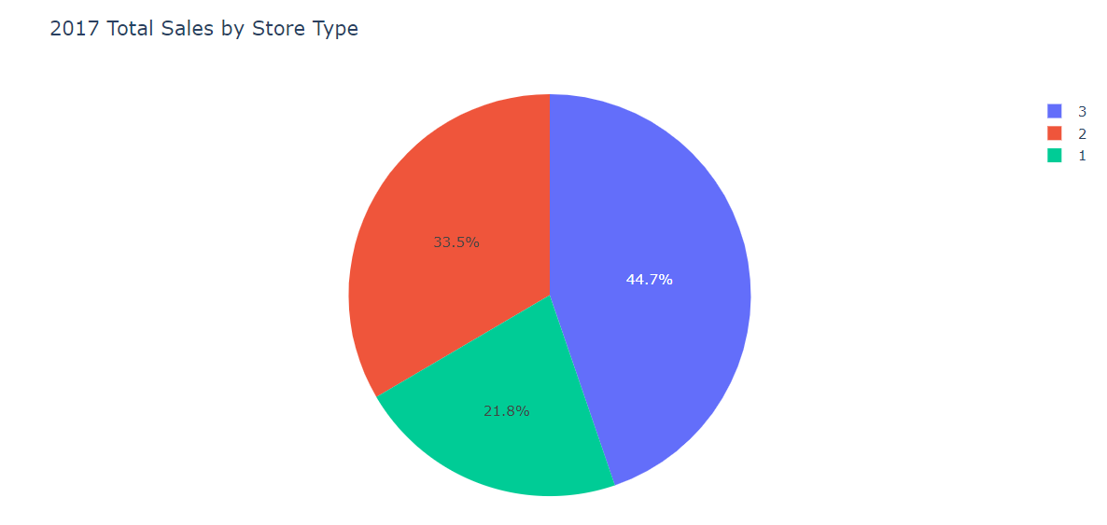
COMPARING PERCENTAGE CHANGES IN SALES FOR BOTH YEARS

Slide 12
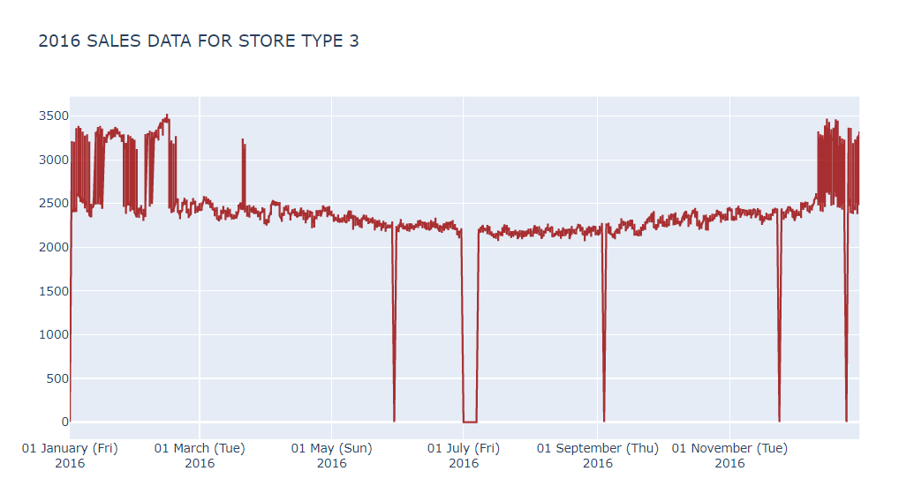
STORE TYPE 3 TOTAL SALES FOR 2016

Slide 13
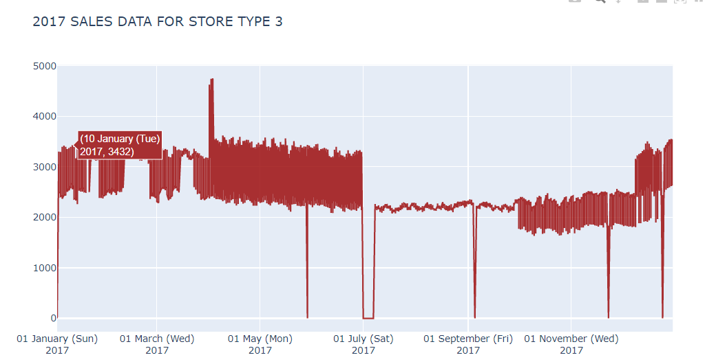
STORE TYPE 3 TOTAL SALES FOR 2016

Slide 14
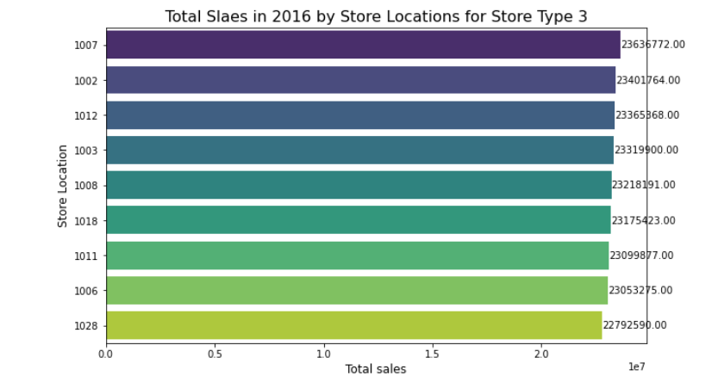
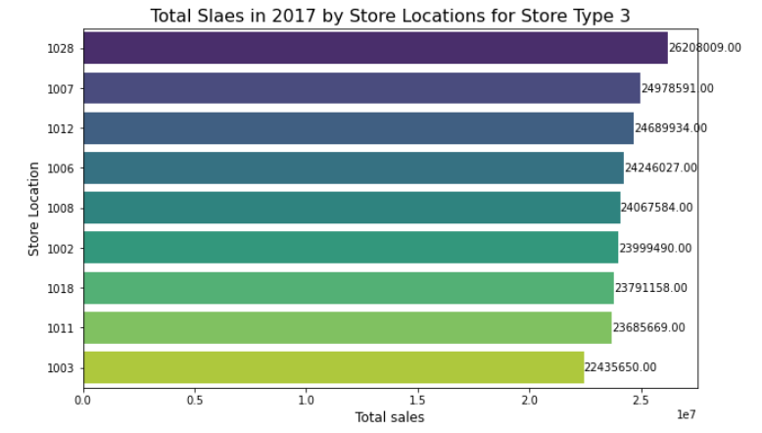
COMPARING SALES FOR STORE LOCATIONS IN STORE TYPE 3 FOR 2016 AND 2017
2016
1028 - $22,792,590
1003 - $23,319,900
2017
1028 - $26,208009
1003 - $22,435650

Slide 15
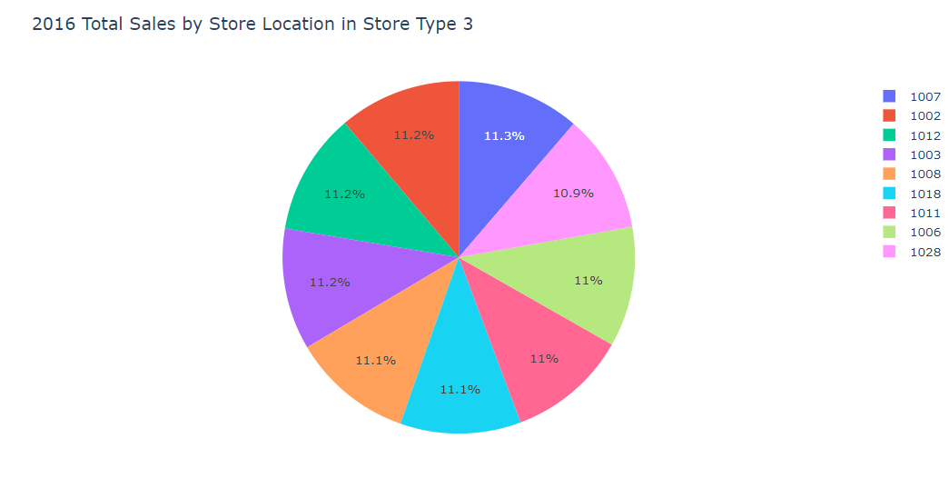
COMPARING PERCENTAGE CHANGES IN SALES FOR BOTH YEARS IN STORE LOCATIONS FOR STORE TYPE 3

Slide 16
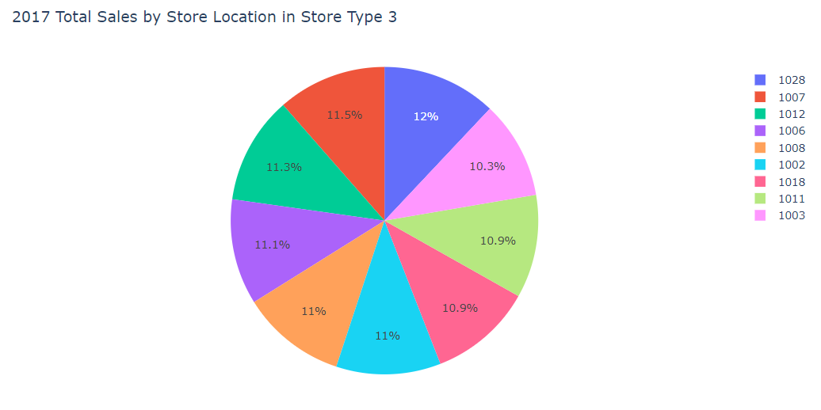
COMPARING PERCENTAGE CHANGES IN SALES FOR BOTH YEARS IN STORE LOCATIONS FOR STORE TYPE 3

Slide 17
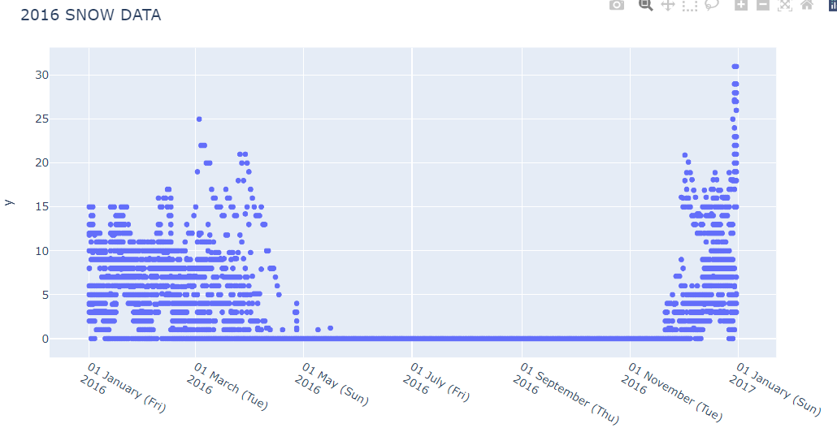
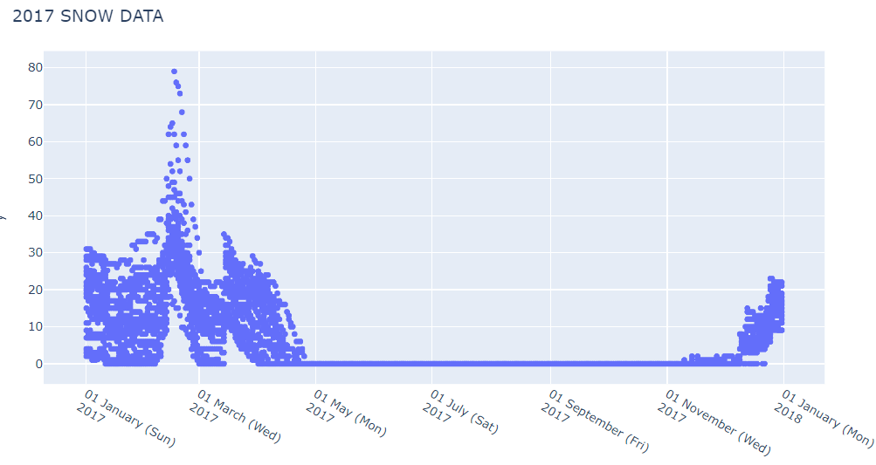
SNOW DATA FOR 2016 AND 2017

Slide 18
SNOW DATA FOR 2016 AND 2017
Our team’s expectation was for Souper Bowl’s daily sales to fluctuate with temperature and snow accumulation. Our expectations were that the company would experience increased sales during winter months and when there is a lot of snow and vice versa where low sales occur in periods when the weather is warm or less snow. Any deviations from our expectations will require a further detailed inquiry.

Slide 19
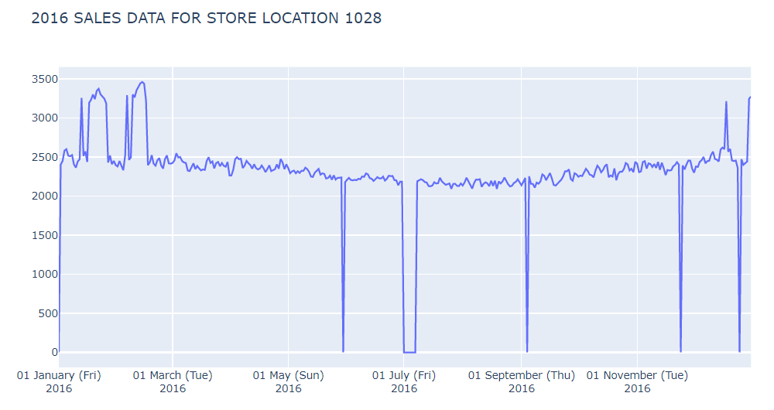
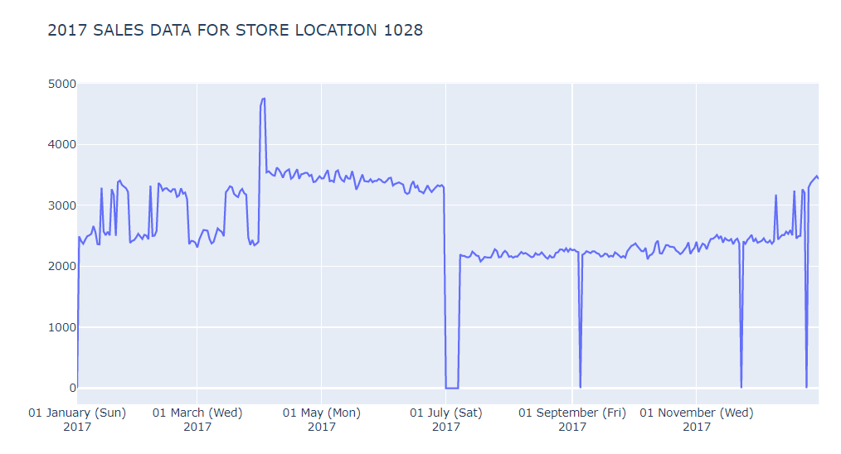
STORE LOCATION 1028 TOTAL SALES FOR 2017 AND 2016
Results: In the process of performing this analysis, we identified an anomaly in the sales data in the 2nd quarter of the year 2017. Sales were at their highest on April 3rd, 2017, for store location 1028 when there was less snowfall. Total sales for store 1028 on that day was $4,753 (highest in the whole year) with a snowfall of 5.10. This is a very unusual amount which totally deviated from our expectations that they should have recorded fewer sales. Therefore, the sales activities and documentation for this day need to be selected for further substantive testing.

Slide 20
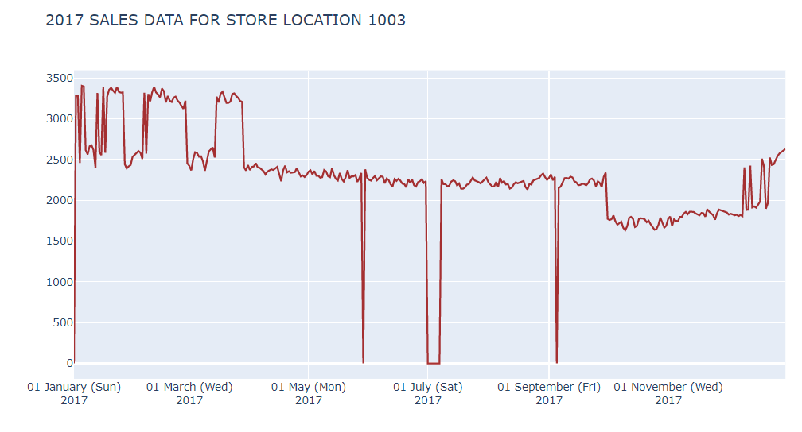
Total sales by store location during observed holidays

Slide 21
Total sales by store location during observed holidays
The engagement team predicted that stores will be closed during holidays, and we expected that there will be no sales in the various store at different locations. We used line graphs to show a correlation between daily sales recorded in the year with different store locations and the total snow recorded each day.
Results: Store 1003 recorded total sales of $1,774 on 23rd November and $2,460 on 25th December in 2017. All other stores were closed and had no sales for these two holidays.

Slide 22
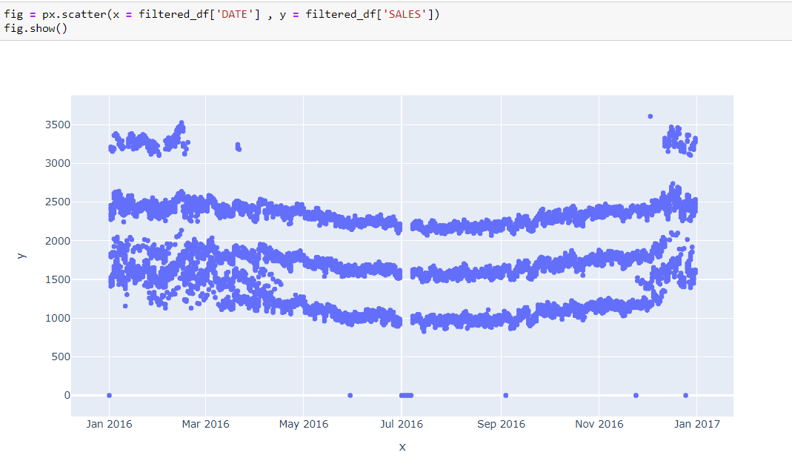
TOTAL SALES FOR ALL 3 STORE TYPES

Slide 23
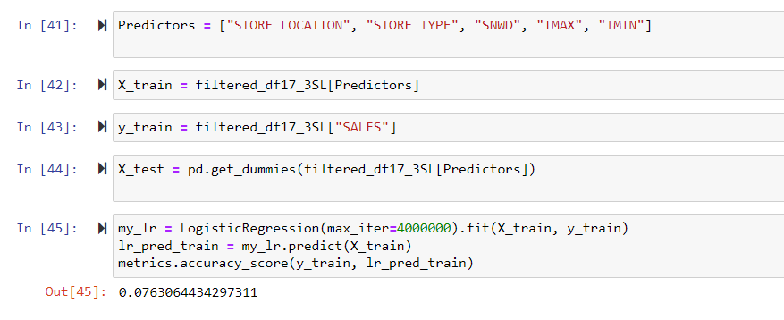
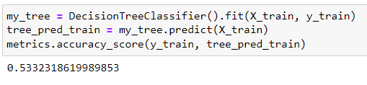
MACHINE LEARNING MODELS

Slide 24
Recommendations to the Audit team and Management
the audit team should pull random samples of sales invoices of all sales made on April 3rd,2017, at store location 1028 for further analysis. Sales were at their highest on April 3rd, 2017, for store location 1028 when there was less snowfall
the engagement team should make inquiries with the management of store 1003 on why there were sales reported on Thanksgiving Day and Christmas day. The audit team should pull the sales invoices reported on November 23rd, 2017, and December 25th, 2017, and investigate if the reported sales occurred.
the audit team should pull random samples of sales invoices of all sales made in the month of January 2017, from stores in Store Type 3 for further analysis.

Slide 25
Future Work
Use good predictors to achieve a better prediction
More data needed to improve ML
Better ML models that are more accurate

