Slide 1
Getting Started with SAS and Hadoop
Jeff Bailey

Slide 2
Why Hadoop?

Slide 3
HOW MUCH DOES THIS DRIVE COST?
3 TB

Slide 4
HOW MUCH DOES THIS DRIVE COST?
Silly, you couldn’t get a 3TB drive in 1980!
3 TB
1980
$1,312,500,000

Slide 5
HOW MUCH DOES THIS DRIVE COST?
That’s $0.03 per GB!
TODAY
$69
2010
$270
2005
$3,720
3 TB
2000
$33,000
1995
$3,360,000
1990
$33,600,000
1985
$315,000,000
1980
$1,312,500,000

Slide 6
HOW MUCH DOES THIS DRIVE COST?
That’s $0.03 per GB!
TODAY
TODAY
$92
$69
2010
2010
$270
$270
2005
2005
$3,720
$3,720
Insight: Disk Space is FREE!
3 TB
2000
2000
$33,000
$33,000
1995
1995
$3,360,000
$3,360,000
1990
1990
$33,600,000
$33,600,000
1985
1985
$315,000,000
$315,000,000
1980
1980
$1,312,500,000
$1,312,500,000

Slide 7
IT’S NOT JUST ABOUT COST!
How long does it take to read 3 TB of data?
3 TB

Slide 8
IT’S NOT JUST ABOUT COST!
How long does it take to read 3 TB of data?
3 TB
4.17 Hours

Slide 9
IT’S NOT JUST ABOUT COST!
How long does it take to read 3 TB?
3 TB
3 TB
What happens if you add more disks?
4.17 Hours
4.17 Hours

Slide 10
HOW LONG DOES IT TAKE TO READ A 3 TB FILE?
1 disk
4.17 hr
100 disks
2.5 min
1000 disks
15 sec

Slide 11
HOW LONG DOES IT TAKE TO READ A 3 TB FILE?
1 disk
4.17 hr
Insight: More Disks are FASTER!
100 disks
2.5 min
1000 disks
15 sec

Slide 12
What is Hadoop?

Slide 13
Hadoop is a Storage Platform
Distributed Storage Performs Great
Data is Replicated
Reasonable Cost
Sits on the OS File System
Hadoop
HDFS
Notes:
William Householders calls HDFS a Huge Lie. I like this. It is a layer on top of a real file system. Typically on Linux, but new operating systems support is being added at a rapid rate.

Slide 14
Hadoop is a Processing Platform
MapReduce/YARN
Distributed Processing
Data Locality
Usually Java
Hadoop
YARN / MapReduce
HDFS
Notes:
Describe YARN but don’t go into depth on it. These folks are not here for a detailed explaination

Slide 15
Apache Pig
Scripting Language
Higher level than programming Java MapReduce
Pig Latin scripts are converted to MapReduce jobs
Great for joining data
Great for transforming data
Hadoop
Pig
YARN / MapReduce
HDFS

Slide 16
Apache Pig: Example Program
Distributed Processing
Data Locality
Map Phase
Reduce Phase
people = LOAD '/user/training/customers' AS (cust_id, name);
orders = LOAD '/user/training/orders' AS (ord_id, cust_id, cost);
groups = GROUP orders BY cust_id;
totals = FOREACH groups GENERATE group, SUM(orders.cost) AS t;
result = JOIN totals BY group, people BY cust_id;
DUMP result;
Cloudera
Hadoop
YARN / MapReduce
HDFS
Notes:
Don’t spend a lot of time on this. Just point out that it is a programming language that is “easy” to write.
While it is easier to write than Java, it isn’t as easy as our next technology.
Tada! … HiveSQL

Slide 17
Apache Hive
SQL on Hadoop
Similar to traditional SQL
Reduces development time
Enables BI on Hadoop
Schema-on-Read
You choose underlying file format
Hadoop
Pig
YARN / MapReduce
Hive2
HDFS

Slide 18
Apache Hive
SQL on Hadoop
Similar to traditional SQL
Reduces development time
Enables BI on Hadoop
Schema-on-Read
You choose underlying file format
SELECT zipcode, SUM(cost) AS total
FROM customers JOIN orders
ON (customers.cust_id = orders.cust_id)
WHERE zipcode LIKE '63%'
GROUP BY zipcode
ORDER BY total DESC;
Hadoop
Cloudera
Pig
YARN / MapReduce
Hive2
HDFS

Slide 19
Apache Impala is a SQL Engine
High-performance SQL engine
Handles concurrency well
Does not rely on MapReduce
Supports a dialect of SQL very similar to Hive’s
100% open source
Apache License
Cloudera
Pig
YARN / MapReduce
Hive2
Impala
HDFS

Slide 20
How can SAS Interact with Hadoop?

Slide 21
Using Base SAS 9.4 with Hadoop
#1
FILEREF
Data Files
HDFS
Data Files

Slide 22
SAS FILENAME Statement for Hadoop
SAS
Hadoop
Pig
YARN / MapReduce
Hive2
Impala
HDFS

Slide 23
SAS FILENAME Statement for Hadoop
options set=SAS_HADOOP_CONFIG_PATH="\\sashq\cdh45p1";
options set=SAS_HADOOP_JAR_PATH="\\sashq\cdh45";
FILENAME hdp1 hadoop 'test.txt';
/* Write file to HDFS */
data _null_;
file hdp1;
put ' Test Test Test';
run;
/* Read file from HDFS */
data test;
infile hdp1;
input textline $15.;
run;
SAS
Cloudera
Pig
YARN / MapReduce
Hive2
Impala
HDFS

Slide 24
Using Base SAS 9.4 with Hadoop
#1
FILEREF
Data Files
HDFS
Data Files
#2
PROC Hadoop
Hadoop
MapReduce +
HDFS commands

Slide 25
Hadoop Procedure
SAS
Submit HDFS commands
Submit MapReduce Jobs
Submit Pig Latin programs
Hadoop
Pig
YARN / MapReduce
Hive2
Impala
HDFS

Slide 26
How Do I Submit HDFS Commands?
filename cfg 'C:\Hadoop_cfg\cdh57.xml';
/* Copy war_and_peace.txt to HDFS. */
/* Copy moby_dick.txt to HDFS. */
proc hadoop options=cfg username="sasxjb" verbose;
HDFS mkdir='/user/sasxjb/Books';
HDFS COPYFROMLOCAL="C:\Hadoop_data\moby_dick.txt"
OUT='/user/sasxjb/Books/moby_dick.txt';
HDFS COPYFROMLOCAL="C:\Hadoop_data\war_and_peace.txt"
OUT='/user/sasxjb/Books/war_and_peace.txt';
run;
SAS
Cloudera
Pig
YARN / MapReduce
Hive2
Impala
HDFS

Slide 27
How Do I Submit MapReduce Jobs?
filename cfg 'C:\Hadoop_cfg\cdh57.xml';
proc hadoop options=cfg user="sasxjb" verbose;
mapreduce input='/user/sasxjb/Books/moby_dick.txt'
output='/user/sasxjb/outBook'
jar='C:\Hadoop_examples\hadoop-examples-1.2.0.1.3-96.jar'
outputkey="org.apache.hadoop.io.Text"
outputvalue="org.apache.hadoop.io.IntWritable"
reduce="org.apache.hadoop.examples.WordCount$IntSumReducer"
combine="org.apache.hadoop.examples.WordCount$IntSumReducer"
map="org.apache.hadoop.examples.WordCount$TokenizerMapper";
run;
SAS
Cloudera
Pig
YARN / MapReduce
Hive2
Impala
HDFS
Notes:
As you can see here, you probably want to avoid doing this…

Slide 28
How Do I Submit Pig Latin Programs?
filename cfg 'C:\Hadoop_cfg\cdh57.xml';
proc hadoop options=cfg username="sasxjb“ verbose;
pig code=pigcode ;
run;
SAS
Cloudera
Pig
YARN / MapReduce
Hive2
Impala
HDFS

Slide 29
Using Base SAS 9.4 with Hadoop
#1
FILEREF
Data Files
HDFS
Data Files
#2
PROC Hadoop
Hadoop
MapReduce +
HDFS commands
#3
HiveQL
SAS/ACCESS
HiveServer2
Result sets

Slide 30
SAS/ACCESS Interface to Hadoop
SAS
Generates HiveQL
Connects via JDBC
Makes Hive tables look like SAS data sets
Bulk loads directly to HDFS
Can read directly from HDFS
Hadoop
Pig
YARN / MapReduce
Hive2
Impala
HDFS

Slide 31
How Does SAS/ACCESS Talk to Hadoop?
proc sql;
select count(*) from mycdh.customer_dim
where loyalty_program='Chocolate Club';
run;
?

Slide 32
How Does SAS/ACCESS Talk to Hadoop?
proc sql;
select count(*) from mycdh.customer_dim
where loyalty_program='Chocolate Club';
run;
select COUNT(*) from `CUSTOMER_DIM` TXT_1
WHERE TXT_1.`loyalty_program` = 'Chocolate Club'
SAS Generated This SQL

Slide 33
How Does SAS/ACCESS Talk to Hadoop?
proc sql;
select count(*) from mycdh.customer_dim
where loyalty_program='Chocolate Club';
run;
OPTIONS SASTRACE=',,,d' SASTRACELOC=SASLOG NOSTSUFFIX;
select COUNT(*) from `CUSTOMER_DIM` TXT_1
WHERE TXT_1.`loyalty_program` = 'Chocolate Club'
SAS Generated This SQL

Slide 34
SAS/ACCESS Interface to Hadoop
SAS
Generates HiveQL
Connects via JDBC
Makes Hive tables look like SAS data sets
Bulk loads directly to HDFS
Can read directly from HDFS
Hadoop
Pig
YARN / MapReduce
Hive2
Impala
HDFS

Slide 35
We Can Write Our Own HiveQL!
proc sql;
connect to hadoop (server=quickstart
user=cloudera);
execute (create table store_cnt
row format delimited
fields terminated by '\001‘
stored as parquet
as
select customer_rk, count(*) as tot
from order_fact
group by customer_rk) by hadoop;
quit;
Explicit Pass-Through

Slide 36
What about Apache Impala?
Cloudera
SAS/ACCESS Interface to Impala:
Connects via ODBC
Makes Hive tables look like SAS data sets
Bulk loads directly to HDFS
Pig
YARN / MapReduce
Hive2
Impala
HDFS
#4
HiveQL
SAS/ACCESS to Impala
Impala
Result sets
Notes:
Point out that there is an SGF paper on this…

Slide 37
In-Database: Code Accelerator

Slide 38
What is SAS In-Database Code Accelerator?
proc ds2 indb=yes;
thread tpgm / overwrite=yes;
method run();
set hdplib.intable;
output;
end;
endthread;
run;
data hdplib.outdata
(overwrite=yes);
dcl thread tpgm hdpdata;
method run();
set from hdpdata;
end;
enddata;
run;
quit;
SAS In-Database Code Accelerators let you run SAS code inside Hadoop. With this you get:
DS2 processing (modern DATA Step)
More Data Types
Code Packages
More Programming Structures
Parallel Database Operations
Thread Programs Run Inside Database

Slide 39
In-Database Code Accelerator Runs in Hadoop
proc ds2 indb=yes;
thread tpgm / overwrite=yes;
method run();
set hdplib.intable;
output;
end;
endthread;
run;
data hdplib.outdata
(overwrite=yes);
dcl thread tpgm hdpdata;
method run();
set from hdpdata;
end;
enddata;
run;
quit;
Hadoop
Pig
YARN / MapReduce
Hive2
SAS EP
HDFS

Slide 40
In-Database: Scoring Accelerator

Slide 41
What is SAS In-Database Scoring Accelerator?
SAS In-Database Scoring Accelerator lets you score models inside the cluster. With this you get:
Uses the SAS Embedded Process
Faster Scoring
Less data movement – score data where it lives
Uses fewer resources
Hadoop
Pig
YARN / MapReduce
Hive2
SAS EP
HDFS

Slide 42
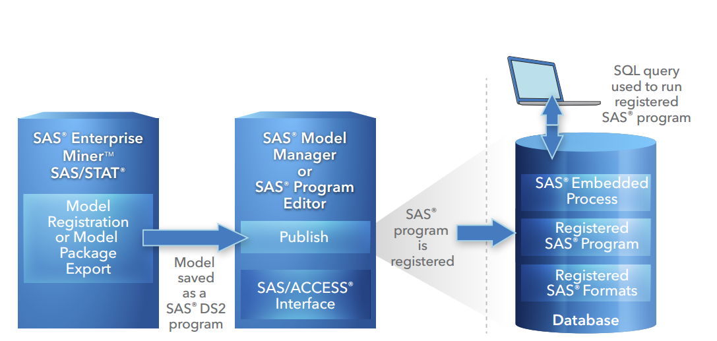
What does the Scoring Process Look like?

Slide 43
Data Loader for Hadoop

Slide 44
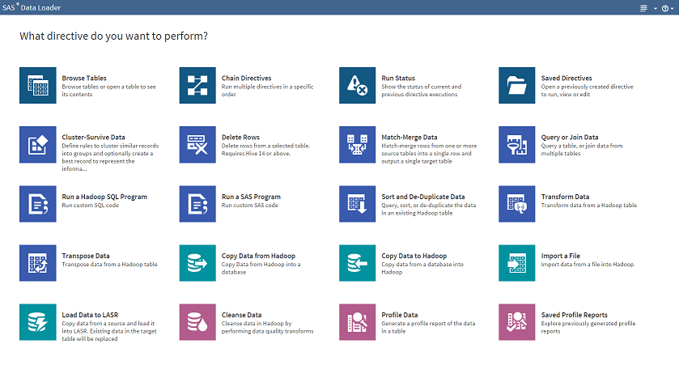
Data Loader for Hadoop – Self Service Big Data
Easy to use UI
Query Data
Manage Data
Transform Data
Run Custom Code
Move Data

Slide 45
SAS Grid Manager for Hadoop

Slide 46
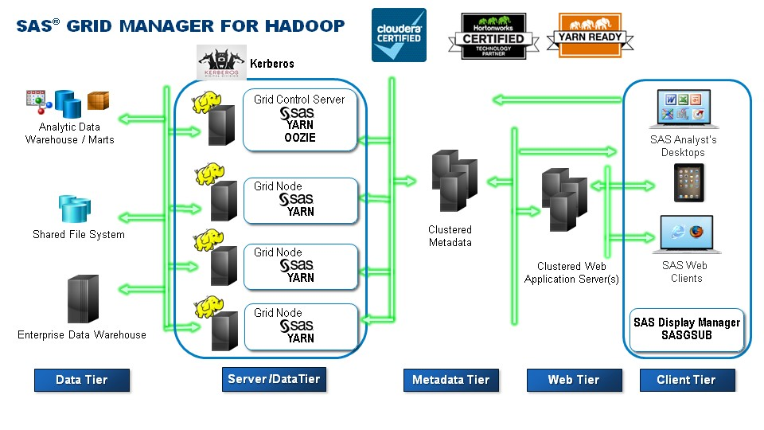
What is SAS Grid Manager for Hadoop?

Slide 47
Servers

Slide 48

SAS Viya + Hadoop Architecture
HDFS as
infrastructure
Cloud Analytic Services (CAS)
Microservices
In-Memory Engine
SAS Data Connect Accelerator
for Hadoop
SAS Data Connector to Hadoop
Hadoop
Notes:
Point out the the In-Memory Engine, like LASR, has an Hadoop-based data storage layer (HDFS).

Slide 49
Feel Free to Contact Me!
Jeff.Bailey@sas.com
http://www.linkedin.com/in/jeffreydbailey

