Slide 1

Team Awesome Sauce
James Tong, Matt Albrecht,
Patricia Gomes, Reshu Goel, Richard Liang, Shubham Kumar

Slide 2
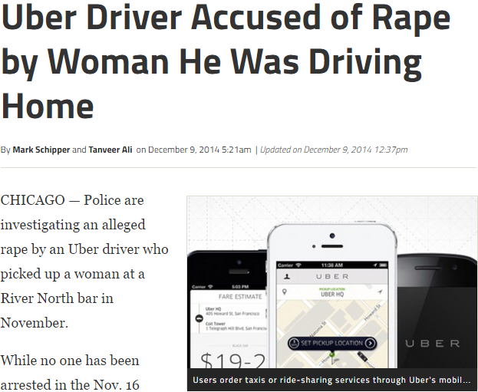

Staying safe is a huge concern when taking cabs
Isn’t Chicago dangerous?
Jenny
28
Management Consultant
Based in NYC
Travels to Chicago Monday morning and returns Thursday night
Fears for her safety
How do I know the cab driver is taking the right route?
If only my boyfriend knows where I am…
Notes:
Jenny
28
Management Consultant based in New York
Travels to Chicago every week Monday morning and returns Thursday night
Not familiar with city of Chicago and takes taxis to client site and airport alone
Heard about the recent sexual harassment stories in taxis/Ubers in Chicago
http://www.dnainfo.com/chicago/20141209/river-north/uber-driver-raped-woman-he-gave-ride-police-say
Fear of being kidnapped/sexually harassed
Feels uncomfortable in the car, but there is lack of way to get help from outside.
Need for an app with features (tracking to show deviation from expected route, sharing with friends/people expecting her at the destination, panic button etc) regardless of what taxi/bus/Uber/train she uses to make her feel safe

Slide 3
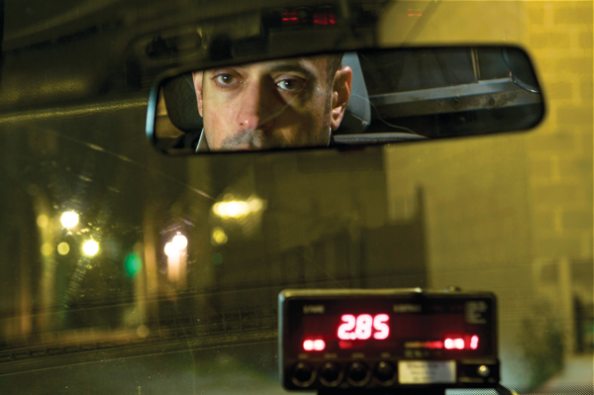
We can solve Jenny’s problem
Our app lets the customer's phone be the first line of defense against safety threats passengers face when they are travelling via a cab

Slide 4
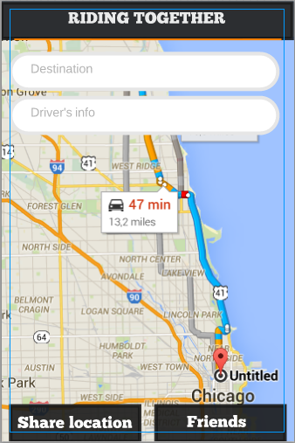
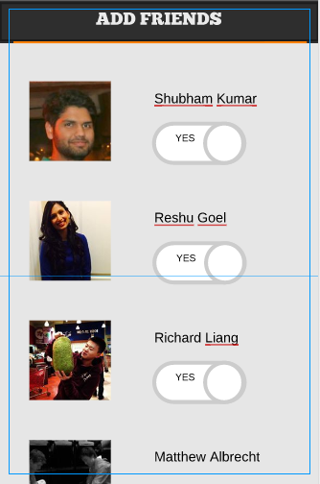
Tracking System
Share your real time location with Facebook friends
Automatically switches tracking off after reaching destination
Notes:
For now, we have 3 features:
1.Tracking system (image)
Tracking helps customers in 2 ways: Shows deviation from expected route to monitor the driver and sharing with friends or people at destination who can see your location
2. 911 button (image)
The alert button will contact local police and send your location
3. Deviation alert

Slide 5
Deviation Alert
App shows the deviation from the expected route calculated
Alerts friends when percentage deviation is too great
Notes:
For now, we have 3 features:
1.Tracking system (image)
Tracking helps customers in 2 ways: Shows deviation from expected route to monitor the driver and sharing with friends or people at destination who can see your location
2. 911 button (image)
The alert button will contact local police and send your location
3. Deviation alert

Slide 6
911 Button
The 911 button will contact local police and send your location
Notes:
For now, we have 3 features:
1.Tracking system (image)
Tracking helps customers in 2 ways: Shows deviation from expected route to monitor the driver and sharing with friends or people at destination who can see your location
2. 911 button (image)
The alert button will contact local police and send your location
3. Deviation alert

Slide 7
MVP

Slide 8
How we are different…
Specific features that address safety on cab rides
Independent of cab apps
WE ARE HERE!
Personal
Safety
Apps
Cab Apps
Notes:
Focusing entirely on cab apps
Linking with Facebook
Calculation of deviation from expected path in percentage terms to give you more information. If deviation is too great, generate alert for user and friends tracking
Specific destination based tracking system that only shares your location and ETA to friends at destination when you are travelling

Slide 9
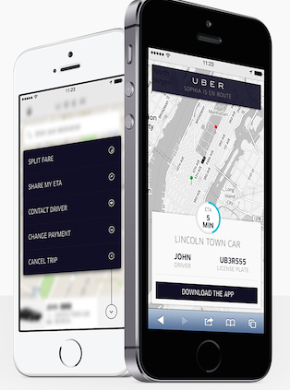
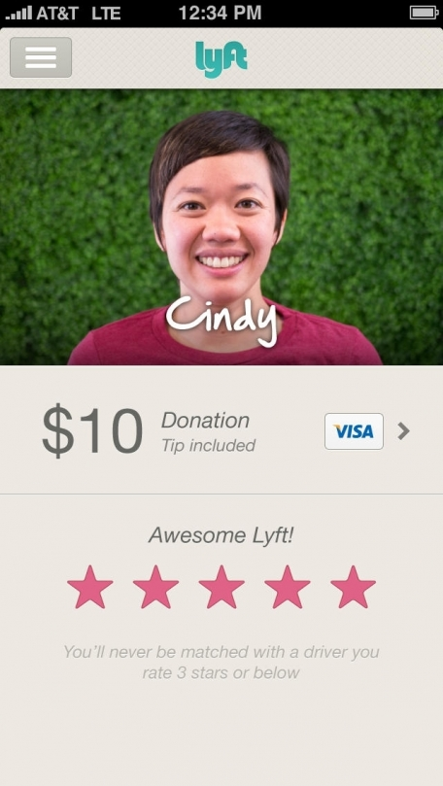
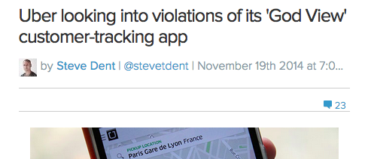
…compared to Cab Apps
Unreliable tracking systems
Privacy concerns
Rating systems available only after misconduct
Systems linked to the company
Notes:
Here we will discuss how cab apps are addressing safety. Orally we may have to add how we are different

Slide 10
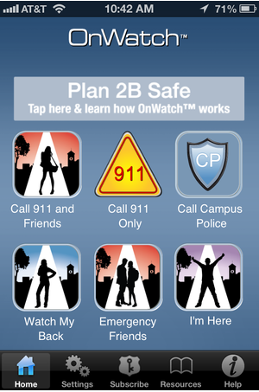
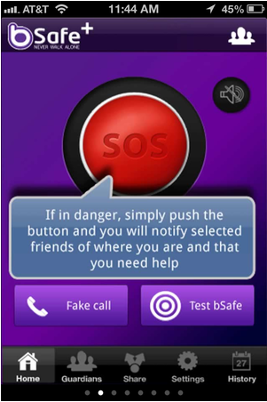
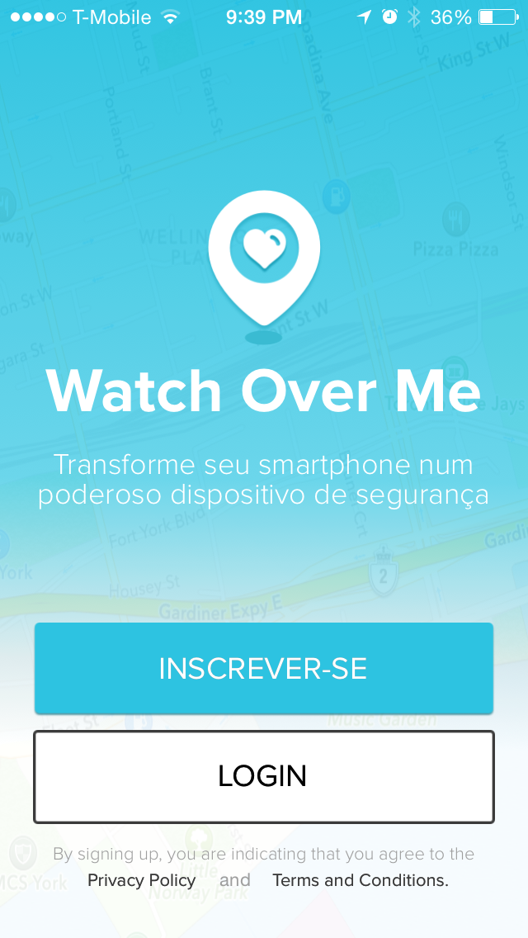
…compared to Safety Apps…
Buggy systems
Tracking system not adequate to cab rides
Notes:
Bsafe tracking system does not show where you are going. The user has to ask for help because the guardian does not know where the user is going

Slide 11
Next steps
Test app on potential customers
Add more features
Notes:
Test app on potential customers
More features on top of our MVP to make it comprehensive transportation safety suite
Expand offering to other means of transportation and walking alone

