Slide 1

HELM
Matthew Albrecht, Patricia Gomes,
Richard Liang, Reshu Goel, Shubham Kumar

Slide 2
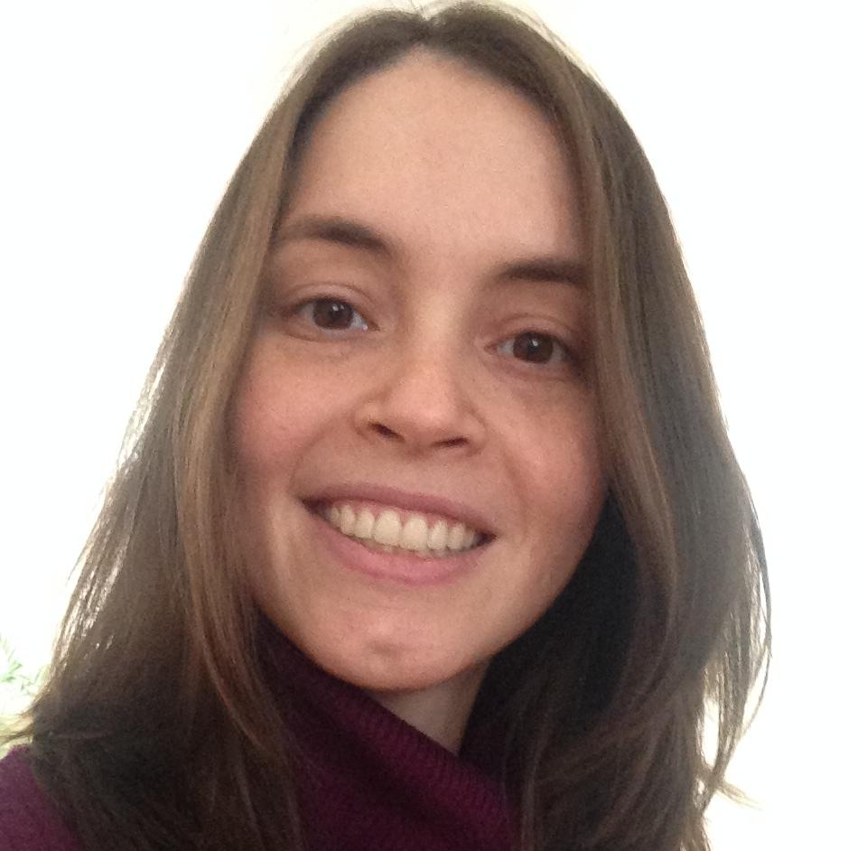
MATT ALBRECHT
Computer Science
McCormick School of Engineering and Applied Science
The team
PATRÍCIA GOMES
Journalism
Medill School of Journalism
RESHU GOEL
Computer Science
McCormick School of Engineering and Applied Science
RICHARD LIANG
Economics
Weinberg College of Arts and Science
SHUBHAM KUMAR
Computer Science
McCormick School of Engineering and Applied Science

Slide 3
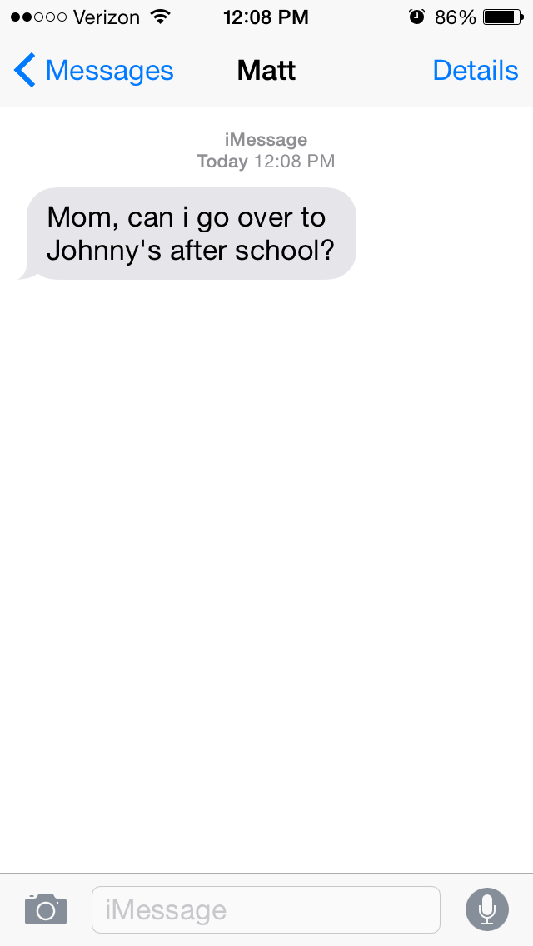
Solving a very common problem

Slide 4
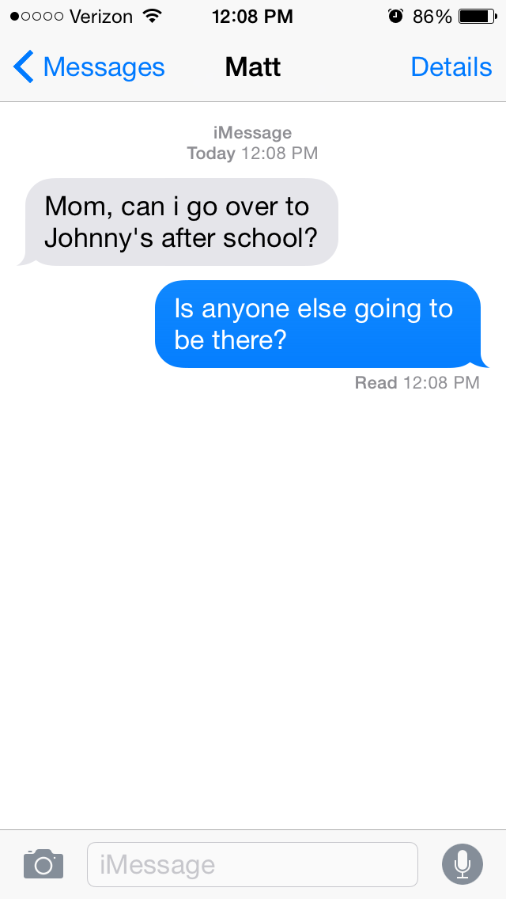
Solving a very common problem

Slide 5
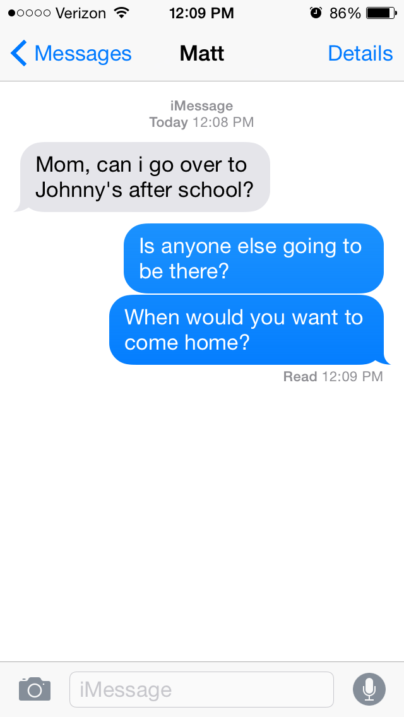
Solving a very common problem

Slide 6
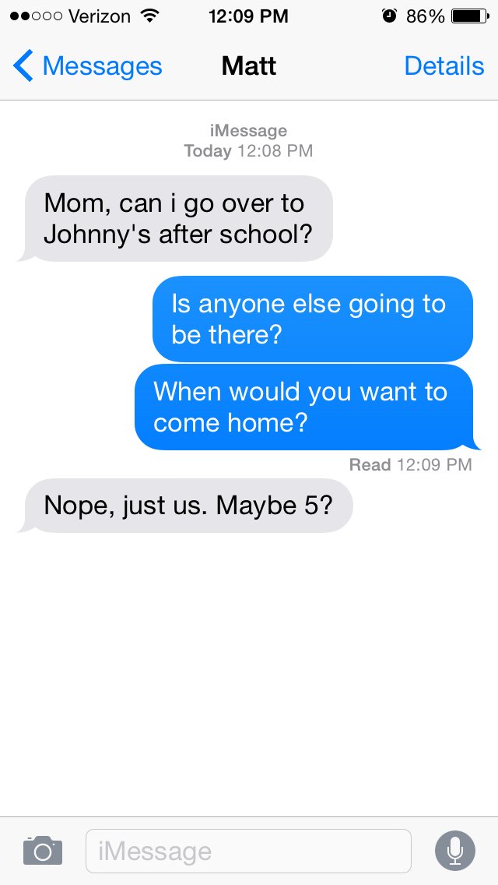
Solving a very common problem

Slide 7
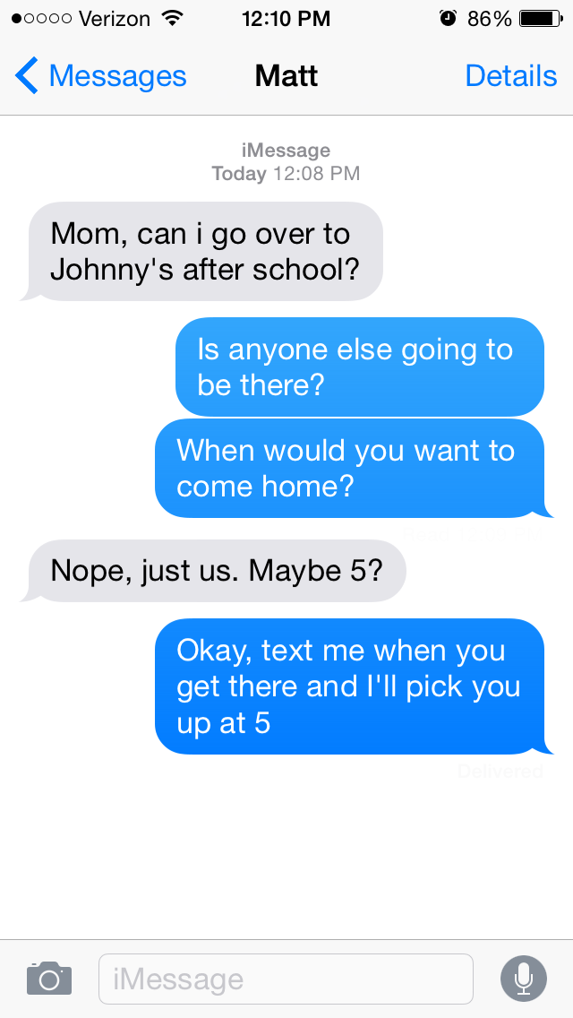
Solving a very common problem

Slide 8
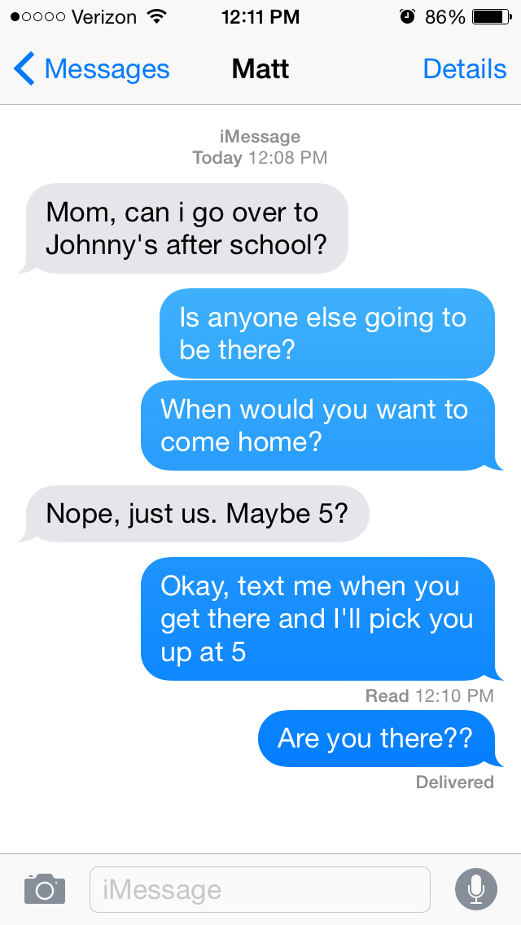
Solving a very common problem

Slide 9
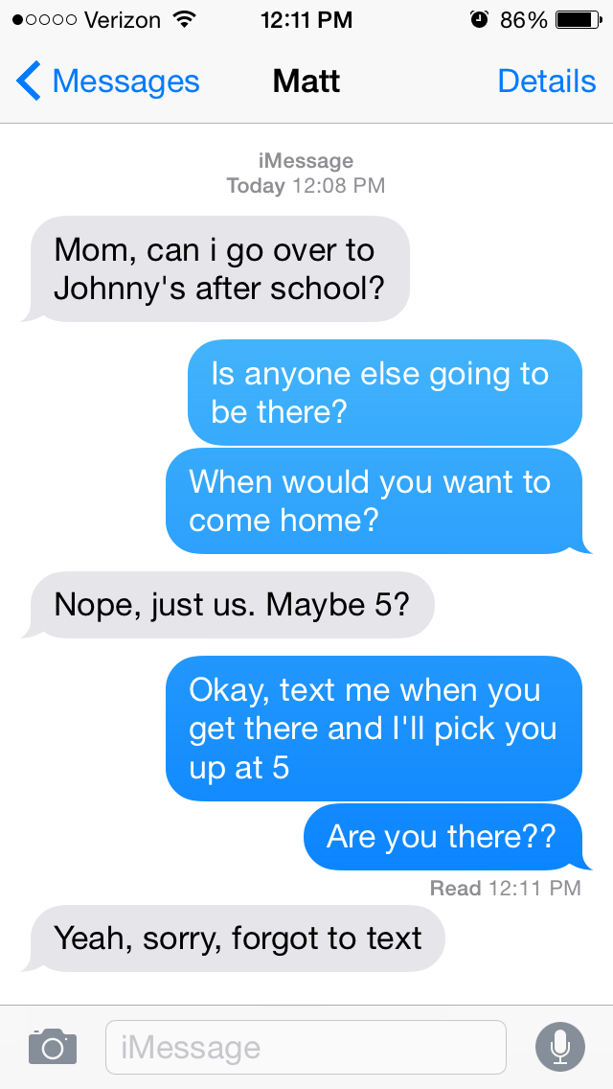
Solving a very common problem
Notes:
Video
Social Media Facebook,twitter,parent groups.
Chicago Parents meetup groups.
PTA meetings at various junior high groups.
Northwestern Community.

Slide 10
HELM
What the customers want
PARENTS
KIDS
Connection with their kids
Freedom
To know whenever their kids need help
Privacy

Slide 11
Percent of Families Who Give first Cellphone at Age
60%
20%
10-11 years old
8-9 years old
Notes:
Video
Social Media Facebook,twitter,parent groups.
Chicago Parents meetup groups.
PTA meetings at various junior high groups.
Northwestern Community.

Slide 12
Children with cellphone
56%
8-12 years old
Notes:
Video
Social Media Facebook,twitter,parent groups.
Chicago Parents meetup groups.
PTA meetings at various junior high groups.
Northwestern Community.

Slide 13
HELM
Notes:
Video
Social Media Facebook,twitter,parent groups.
Chicago Parents meetup groups.
PTA meetings at various junior high groups.
Northwestern Community.

Slide 14
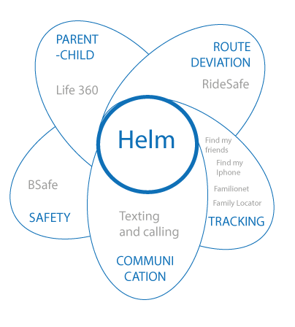
Our solution is unique
Notes:
Live demo here

Slide 15


HELM
Route Deviation
Can I Go?
Parental Dashboard
?
Notes:
Live demo here

Slide 16
Notes:
Video
Social Media Facebook,twitter,parent groups.
Chicago Parents meetup groups.
PTA meetings at various junior high groups.
Northwestern Community.

Slide 17
HELM
"My mom would let me go out alone if I had this app. Please, go and tell her about it!"
DEBORAH, 12
Notes:
Video
Social Media Facebook,twitter,parent groups.
Chicago Parents meetup groups.
PTA meetings at various junior high groups.
Northwestern Community.

Slide 18

HELM
Freemium Model, $2.99/month
Notes:
Video
Social Media Facebook,twitter,parent groups.
Chicago Parents meetup groups.
PTA meetings at various junior high groups.
Northwestern Community.

Slide 19
HELM
Freemium Model, $2.99/month
Break-even in second year
Targeting 1500 families in first year
Main expenses are salaries,
marketing and partnership efforts
Notes:
Video
Social Media Facebook,twitter,parent groups.
Chicago Parents meetup groups.
PTA meetings at various junior high groups.
Northwestern Community.

Slide 20
HELM
Next steps
> Premium features: parental dashboard, "Can I Go" feature
> Design improvement
> Customer acquisition
Notes:
Video
Social Media Facebook,twitter,parent groups.
Chicago Parents meetup groups.
PTA meetings at various junior high groups.
Northwestern Community.

