Slide 1
R Workshop #1
02/14/2015

Slide 2
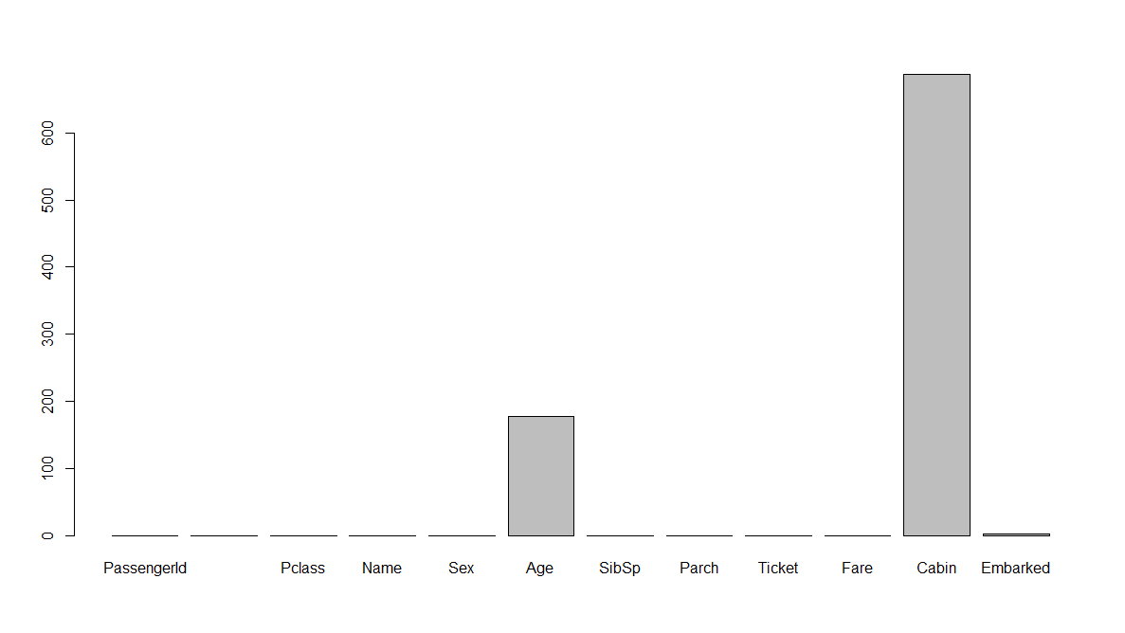
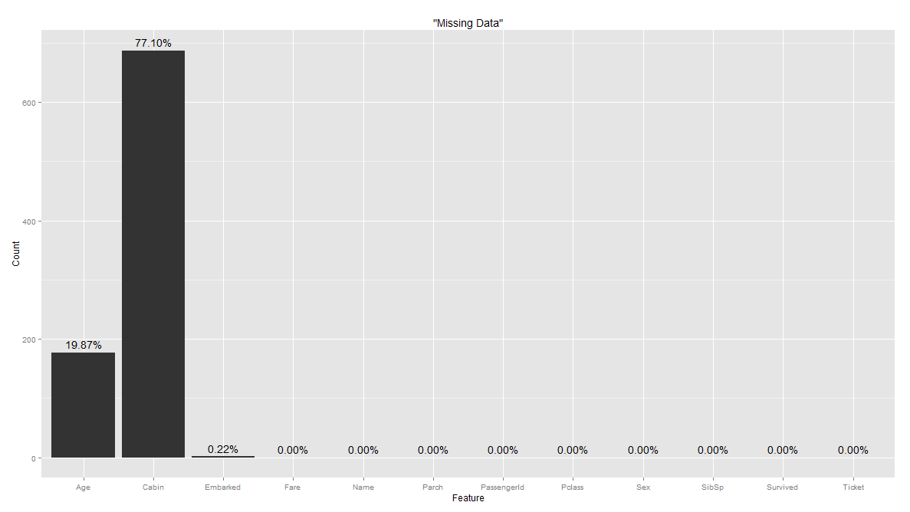
Visualizing Data
Always start by visualizing the information you’re given!
Visualization can be simple with built in R functions, or packages can be used for more freedom

Slide 3
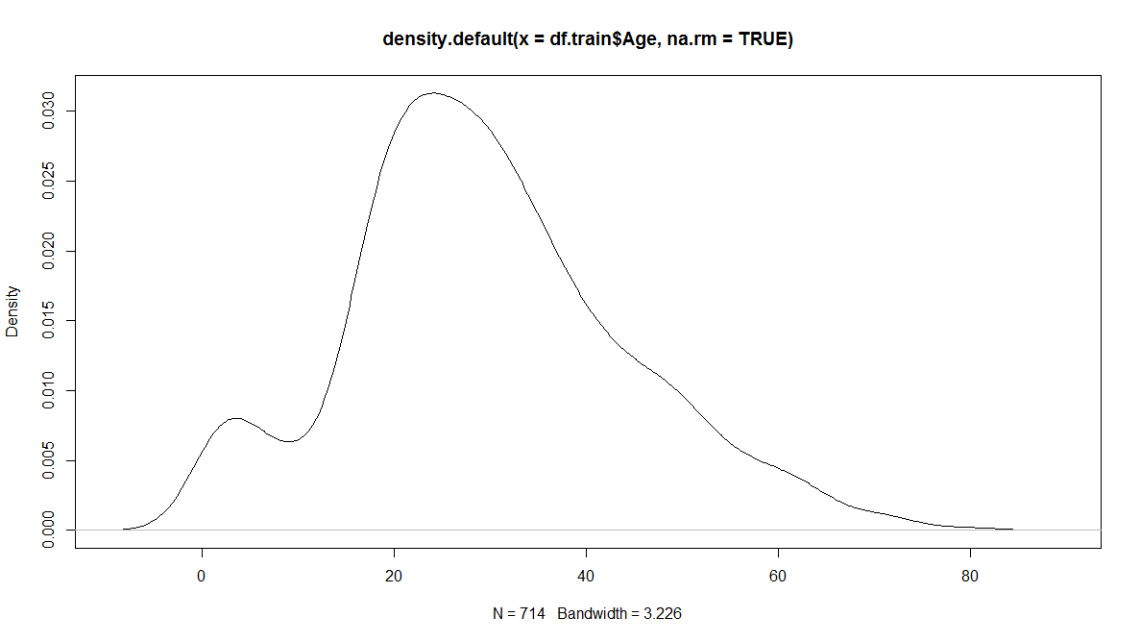
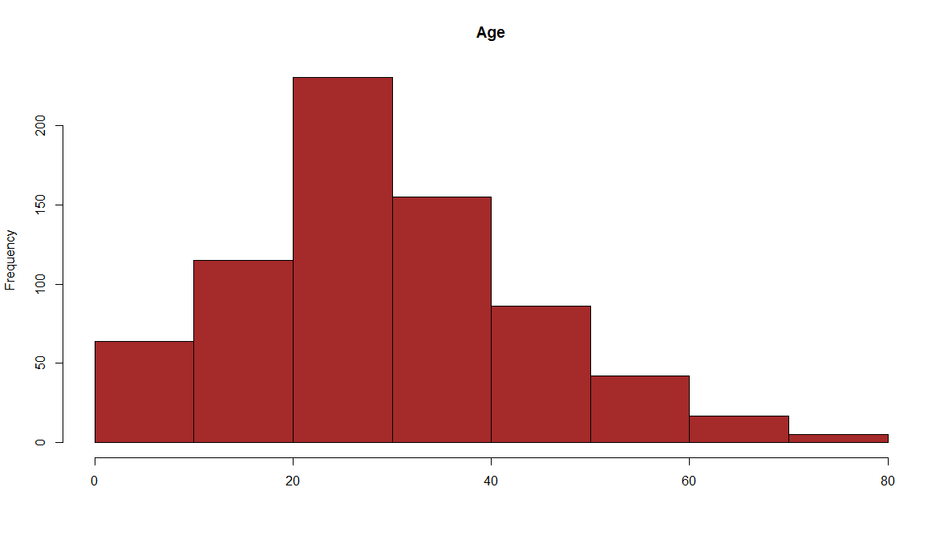
Types of Graphs
Think about how to best visualize your data!

Slide 4
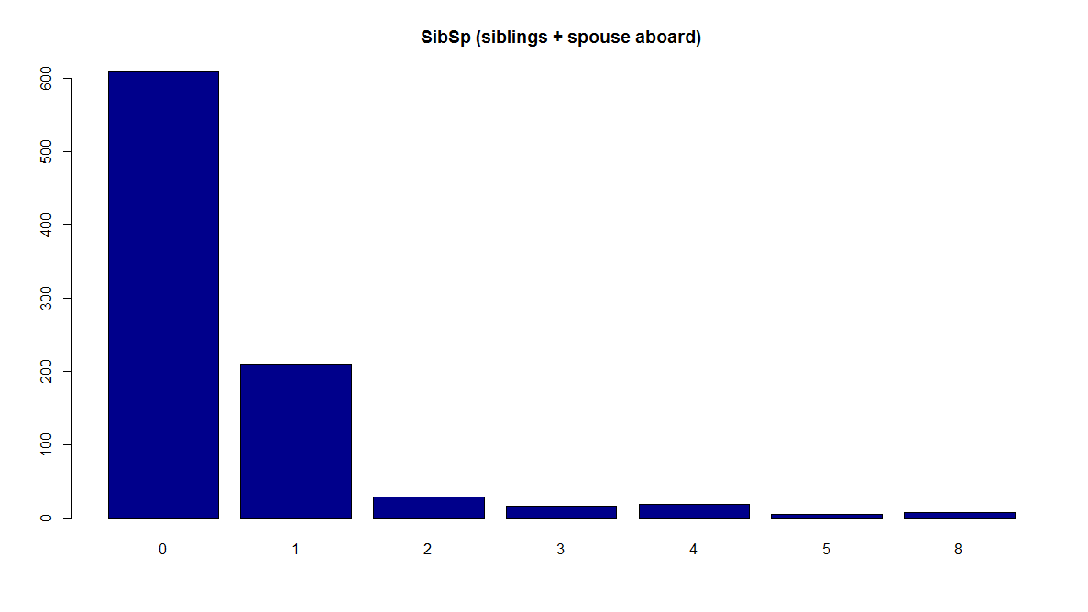
Data Exploration
Consider the difference between the Age and SibSp
Food for Thought: Does this matter? Can we do anything about it?

Slide 5
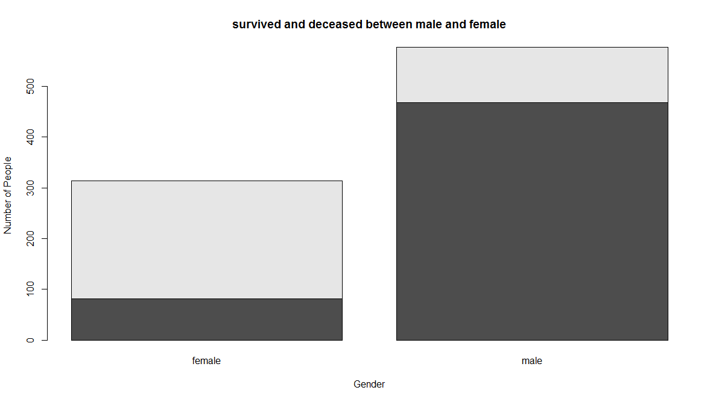
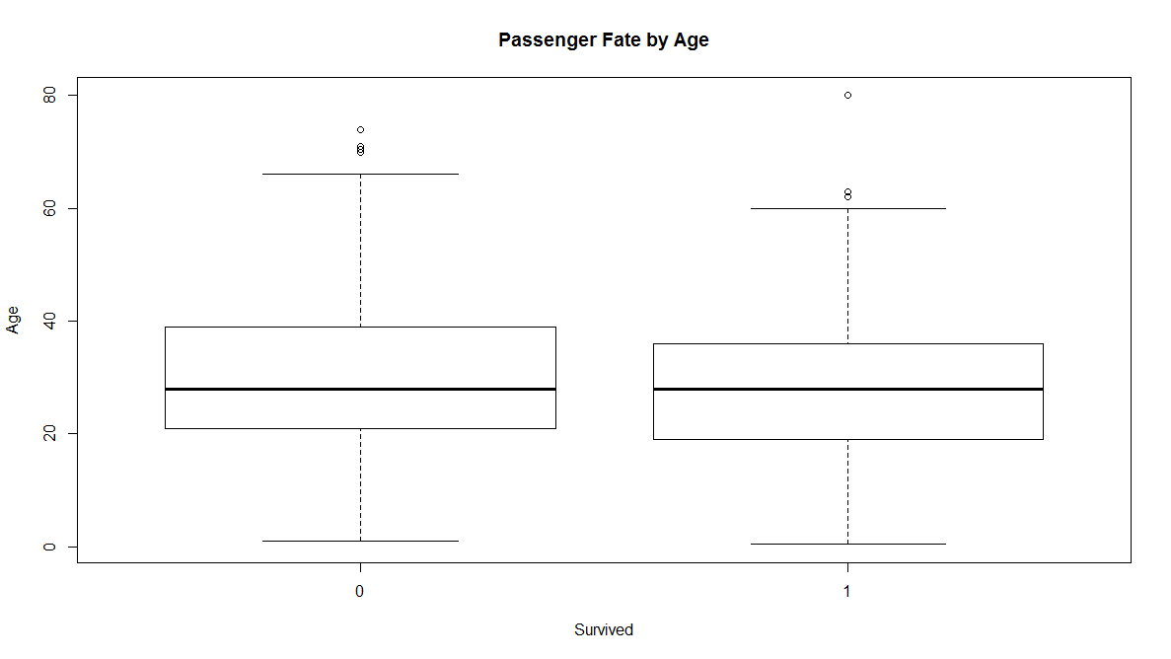
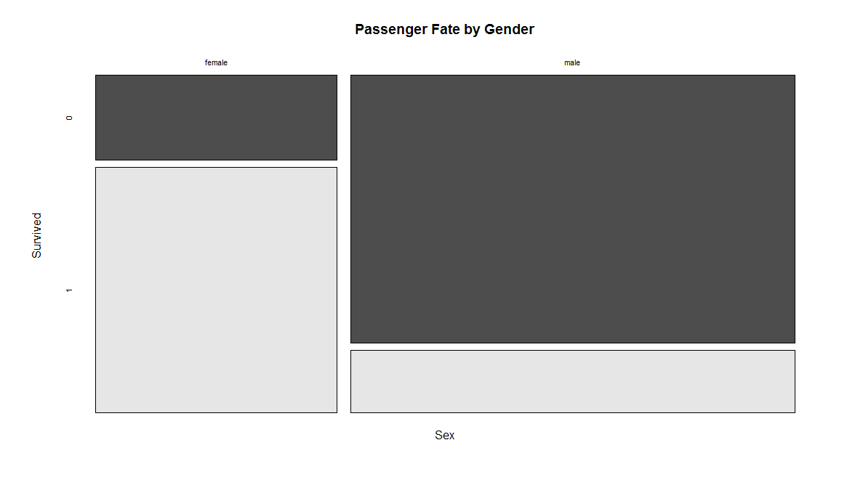
More Types of Plots
Plotting the data in different forms creates the ability to find small details and outliers that may help choose which model is best

Slide 6
Handling Incomplete Data: Segmentation
Real life data will almost never be complete
“Data scientists, according to interviews and expert estimates, spend from 50 percent to 80 percent of their time mired in this more mundane labor of collecting and preparing unruly digital data, before it can be explored for useful nuggets.” – New York Times
http://www.nytimes.com/2014/08/18/technology/for-big-data-scientists-hurdle-to-insights-is-janitor-work.html?_r=0
What is the most accurate way of “guessing” what the empty data will be?
With this data set, what characteristics should we segment on?

Slide 7
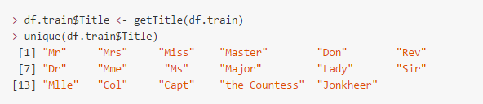
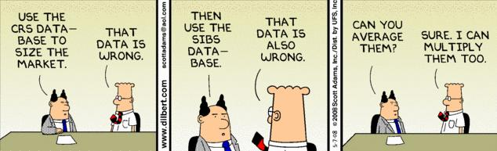
Handling Incomplete Data: Replacement
Do we need to account for all of the missing data?
With the data segmented, how do we fill in the missing entries?
Are there any downsides to this?

Slide 8
Handling Outliers

Slide 9
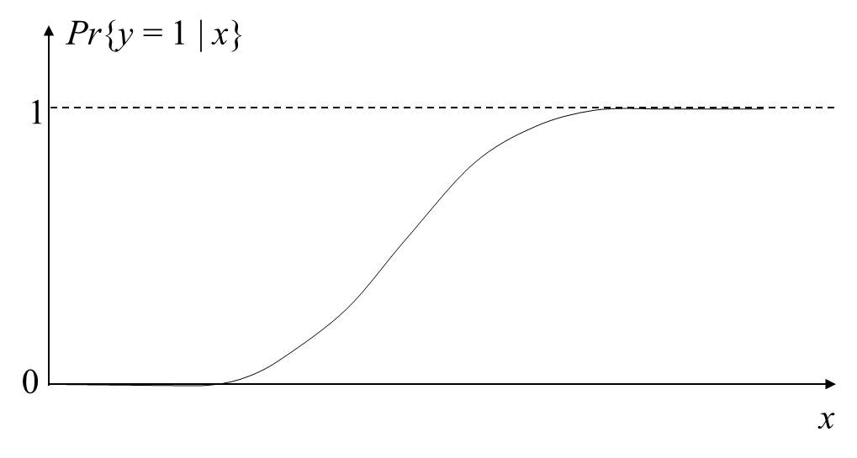
Fitting a Model
The initial model that we’re going to fit is Logistic Regression
Outputs the probability that y = 1 for a given x
Popular functions to achieve the s-shaped curve: logit, sigmoid, hyperbolic tangent (tanh)
When is logistic regression applicable, and when is it a good idea?
How can we convert the probabilities into predictions? What is our threshold?

