Slide 1
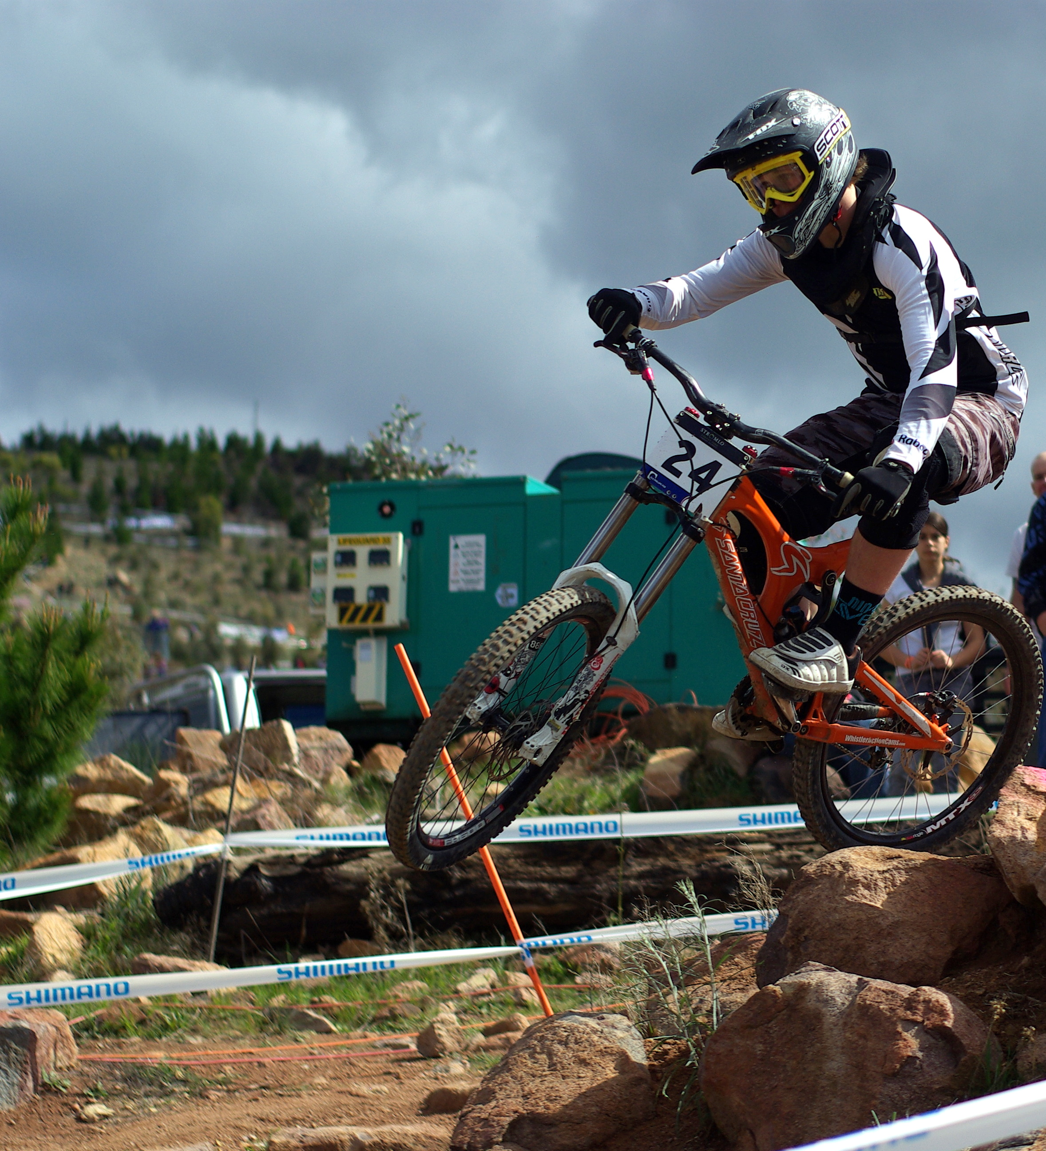

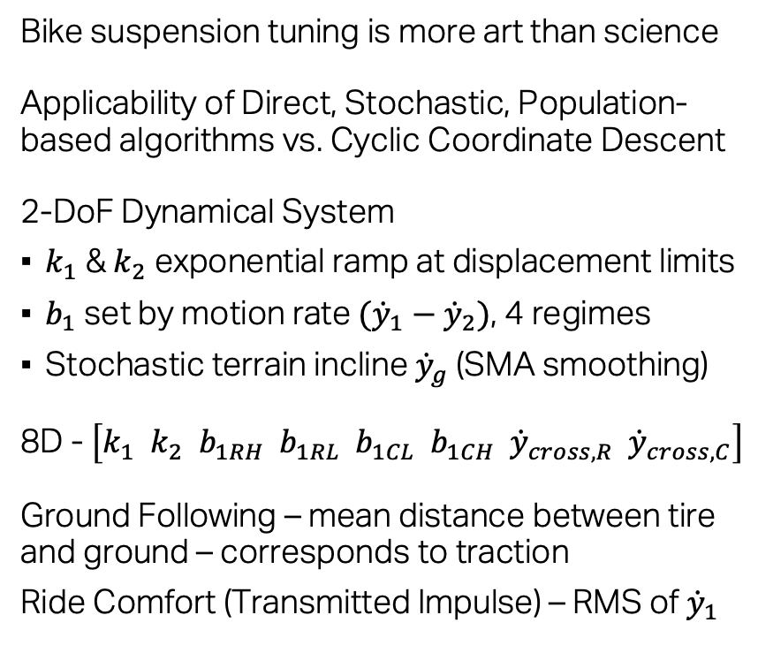






Optimization of Bicycle Suspension Tuning
Jeff Robinson AA222 Final Project Presentation June 4, 2019
Problem:
Goal:
Model:
Design Space:
Objectives:
Bike suspension tuning is more art than science
Applicability of Direct, Stochastic, Population-based algorithms vs. Cyclic Coordinate Descent
2-DoF Dynamical System
$k_{1}$ & $k_{2}$ exponential ramp at displacement limits
$b_{1}$ set by motion rate $({\dot{y}}_{1}−{\dot{y}}_{2})$, 4 regimes
Stochastic terrain incline ${\dot{y}}_{g}$ (SMA smoothing)
8D - $\left[k_{1} k_{2} b_{1RH} b_{1RL} b_{1CL} b_{1CH} {\dot{y}}_{cross,R} {\dot{y}}_{cross,C}\right]$
Ground Following – mean distance between tire and ground – corresponds to traction
Ride Comfort (Transmitted Impulse) – RMS of ${\dot{y}}_{1}$
By Steve Bennett - Taken by Steve Bennett, CC BY 2.5, https://commons.wikimedia.org/w/index.php?curid=7790524
$$y_{1}$$
$$m_{1}:frame$$
$k_{1}$ $b_{1}$
$$y_{2}$$
$$m_{2}:wheel$$
$$k_{2}:tire$$
$$y_{g}$$

Slide 2
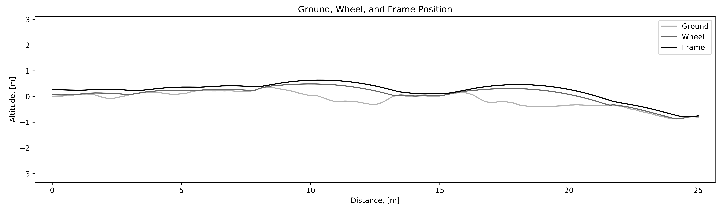
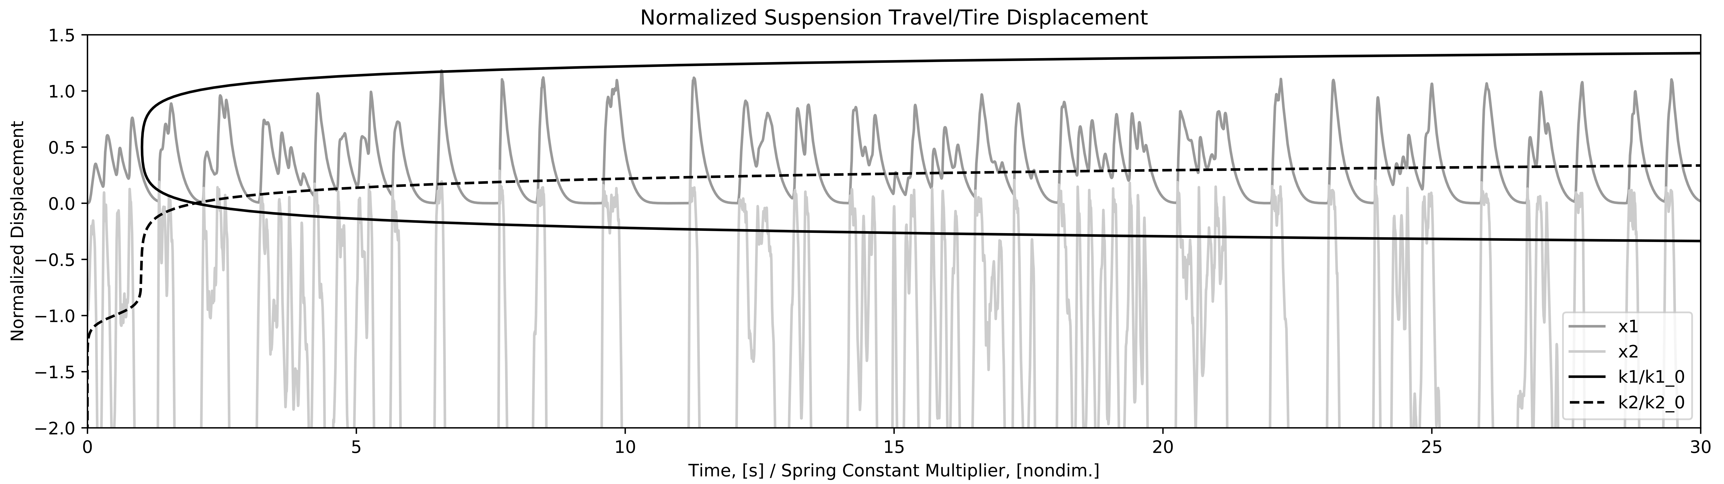
Optimization of Bicycle Suspension Tuning
Jeff Robinson AA222 Final Project Presentation June 4, 2019
Example Simulation Plots

Slide 3
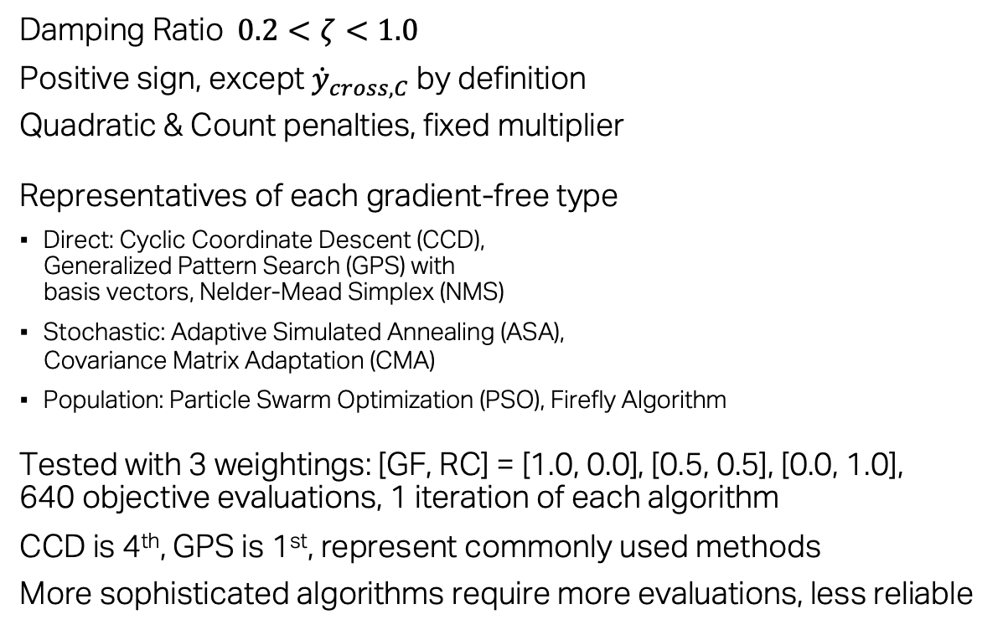
Optimization of Bicycle Suspension Tuning
Jeff Robinson AA222 Final Project Presentation June 4, 2019
Constraints:
Algorithms:
Results:
Damping Ratio $0.2<ζ<1.0$
Positive sign, except ${\dot{y}}_{cross,C}$ by definition
Quadratic & Count penalties, fixed multiplier
Representatives of each gradient-free type
Direct: Cyclic Coordinate Descent (CCD),
Generalized Pattern Search (GPS) with
basis vectors, Nelder-Mead Simplex (NMS)
Stochastic: Adaptive Simulated Annealing (ASA),
Covariance Matrix Adaptation (CMA)
Population: Particle Swarm Optimization (PSO), Firefly Algorithm
Tested with 3 weightings: [GF, RC] = [1.0, 0.0], [0.5, 0.5], [0.0, 1.0],
640 objective evaluations, 1 iteration of each algorithm
CCD is 4th, GPS is 1st, represent commonly used methods
More sophisticated algorithms require more evaluations, less reliable
Weights | 1.0, 0.0 | 0.5, 0.5 | 0.0, 1.0 | Mean Rank
CCD | 0.0002465 [1] | 3.773 [6] | 6.057 [3] | 3.33
GPS | 0.03780 [2] | 3.495 [4] | 5.781 [1] | 2.33
NMS | 0.04329 [3] | 3.975 [7] | (unstable) | 5.66
ASA | 0.4126 [6] | 3.675 [5] | 6.344 [5] | 5.33
CMA | 0.2389 [5] | 3.221 [1] | 6.215 [4] | 3.33
PSO | 0.1137 [4] | 3.301 [3] | 5.896 [2] | 3.00
Firefly | 0.1137 [4] | 3.277 [2] | 5.896 [2] | 2.66

