Slide 1

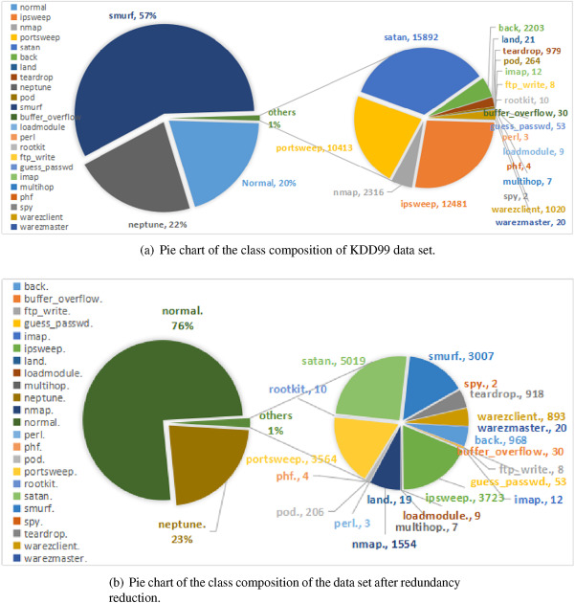
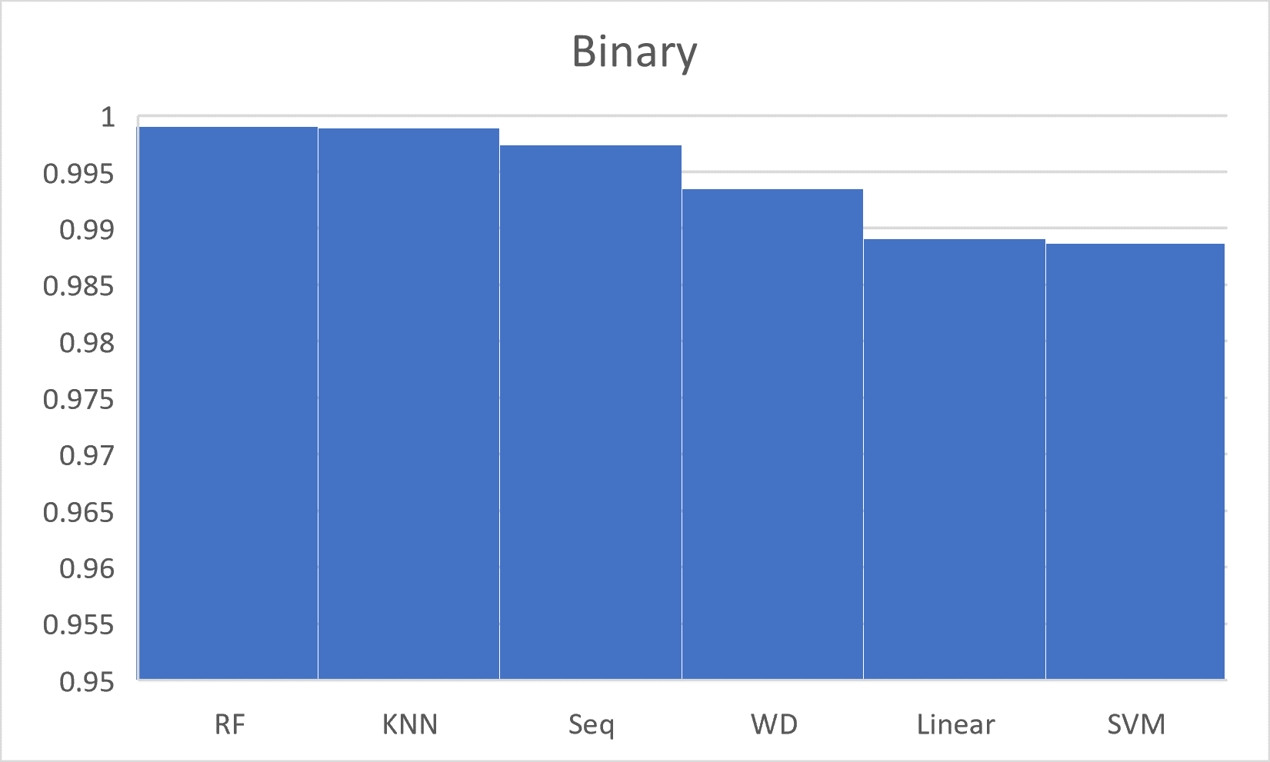
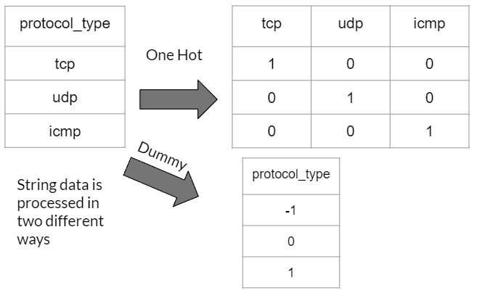
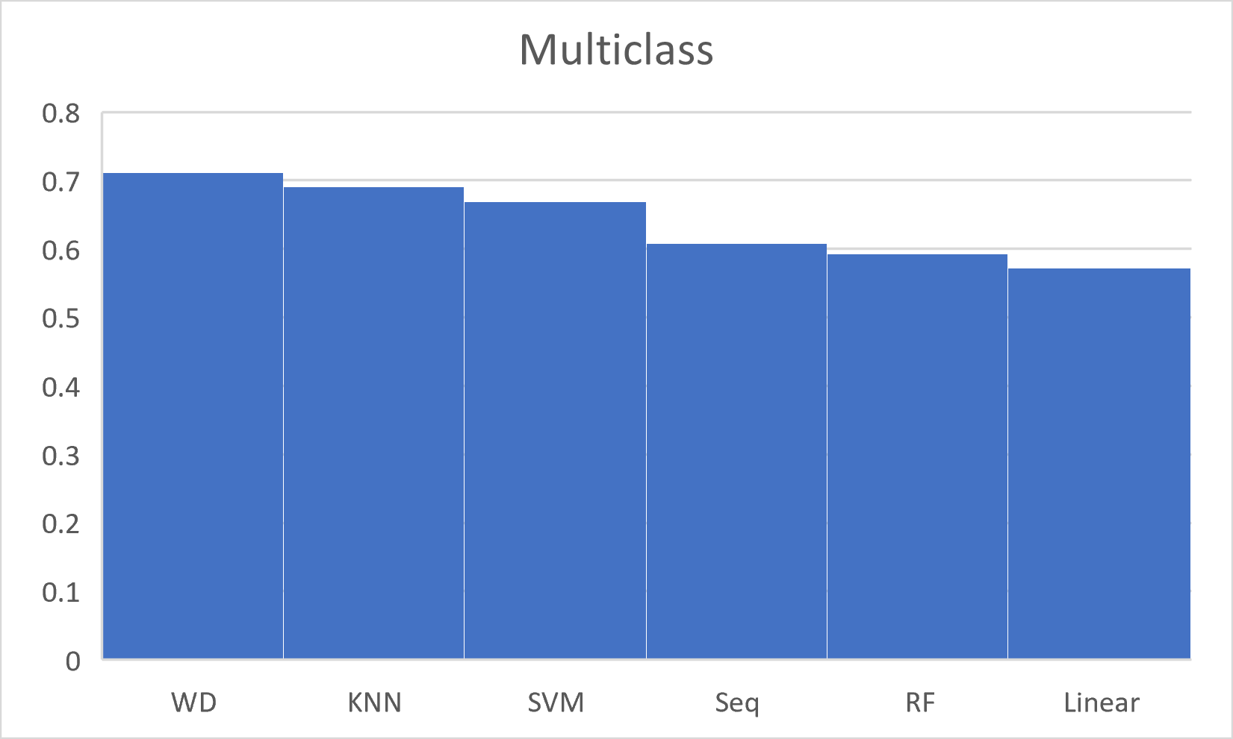
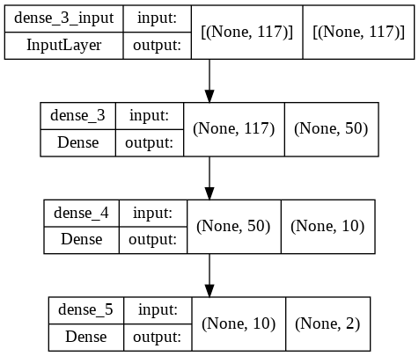
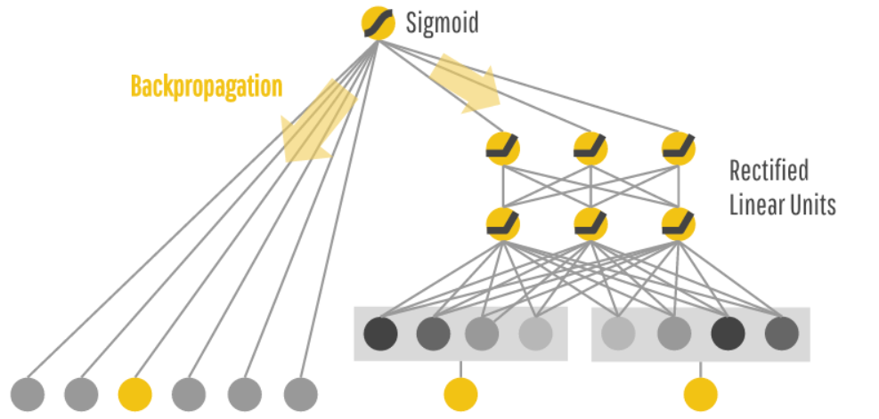

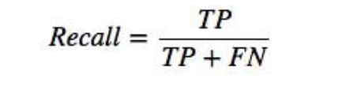
Developing Anomaly-based Intrusion Detection Approaches Using Artificial Intelligence Models
Jeffrey Rudolph
SUNY Brockport – Advisor: Dr. Ning Yu
Goals
Methodology
Results
Create multiple anomaly-based intrusion detection models using machine learning and AI methods.
Compare the models’ performances against each other when applied to the large KDD Cup 1999 dataset.
Data Preprocessing:
Duplicate entries from the dataset removed. (~75%)
Data randomly shuffled on each run then split. (70% training, 30% testing)
Z-Score normalization applied to non categorical numerical values.
String values converted into dummy variables or one-hot encoded.
Models:
Random Forest Classifier
64 trees with a max depth of 15
Support Vector Machine
One-vs-One method
K-Nearest Neighbors
K = 5
Linear Model
Sigmoid/Softmax activation function
Sequential Model (Deep Neural Network)
2 hidden layers with rectified linear activation functions. Sigmoid/Softmax output
Wide & Deep
Combining the linear and sequential models together.
The Dataset
4,898,432 samples of raw TCP dump data.
Mix of categorical integer, categorical string, and floating-point values.
The dataset is derived from a DARPA simulation from 1998. However, due to the way the data was created some problems arise that will affect how we evaluate the models.
“All the malicious packets had a TTL of 126 or 253 whereas almost all the benign packets had a TTL of 127 or 254.” (Brugger, 2007)
“Trivial detection using the TTL aside, we found that it was still useful to evaluate the true positive performance of a network IDS; however, any false positive results were meaningless” (Brugger, 2007)
Taking this into account the recall score will be used to evaluate a model’s performance.
(Ruan et al., 2017)
Conclusion
Wide & Deep Model was the most accurate at predicting true positive results in a multiclass setting for this dataset.
Machine learning models (such as KNN) are surprisingly powerful tools but are outclassed in speed by neural networks in high dimensional datasets.
Sequential
Brugger, T. (2007, September 15). KDD Cup '99 dataset
(Network Intrusion) considered harmful.
(KDnuggets News 07:18, item 4, features)
.Retrieved April 3, 2022,
from https://www.kdnuggets.com/news/2007/n18/4i.html
Ruan, Z., Miao, Y., Pan, L., Patterson, N.;
Zhang, J. (2017, August 12). Visualization of big data security:
A case study on the KDD99 cup data set.
Digital Communications and Networks.
Retrieved April 6, 2022,from
https://www.sciencedirect.com/science/article/pii/S2352864817300810
Wide & Deep
By: Heng-Tze Cheng

