Slide 1
CSA VIVA
Jingxiang Zhang Lingyi Lu

Slide 2
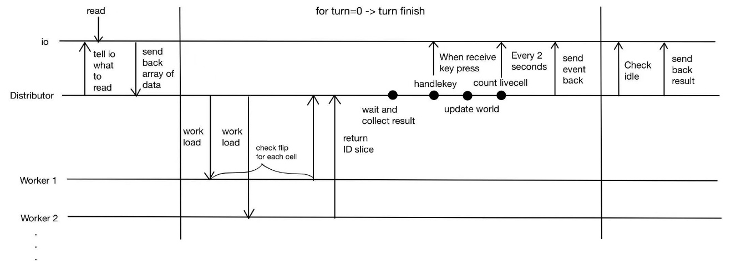
Parallel implementation

Slide 3
Detail implementation (4 workers)
Turn 1
1 Cell
worker1
worker2
worker3
worker4

Slide 4
Detail implementation (4 workers)
Turn 1
Distributor send
Worker return
1 Cell
Cell in this turn need flip
worker1
worker1
worker2
worker3
Each worker will determine this cell flip or not by checking it surrounding and return a slice which contain the cell need to flip in this turn
worker2
worker4
worker3
worker4

Slide 5
Inside Distributor
Detail implementation (4 workers)
Turn 1
Combine multiple slice to 1D
List of Cell that need to flip in this turn
Get neibourgh function get all the neibourgh
And append each cell to a 1D slice
List of neighbour cells
. . .

Slide 6
Turn 1
List of Cell that need to flip in this turn
Apply to whole world

Slide 7
Detail implementation (4 workers)
Next turn(Turn N)
Same List
Cell which is the neighbour of last turn flipped cell
worker1
worker2
worker3
worker4
Worker split this 1D array

Slide 8
Next turn(Turn N)
Distributor send
Worker return
Cell which is the neighbour of last turn flipped cell
Cell in this turn need flip
worker1
worker2
Each worker will determine this cell flip or not by checking it surrounding and return a slice which contain the cell need to flip in this turn
worker3
worker4
worker1
worker2
worker3
worker4

Slide 9
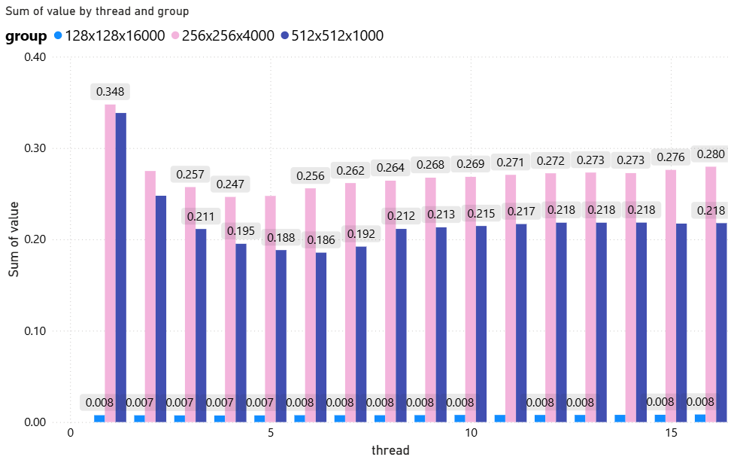
Graph and analyze

Slide 10
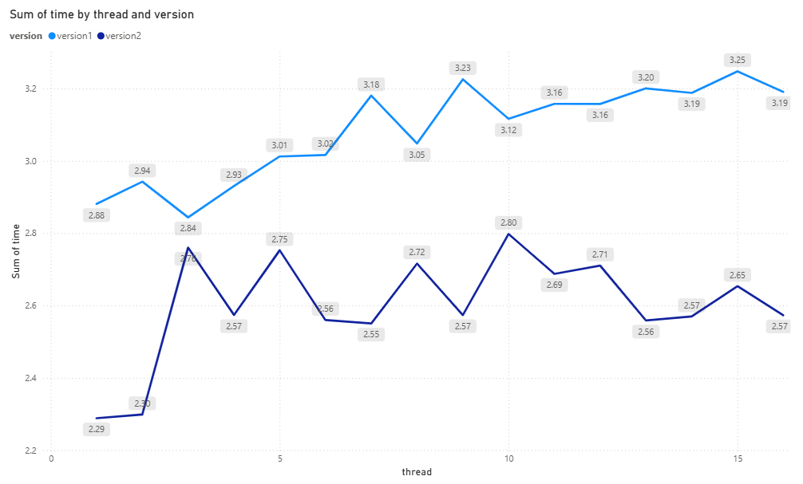
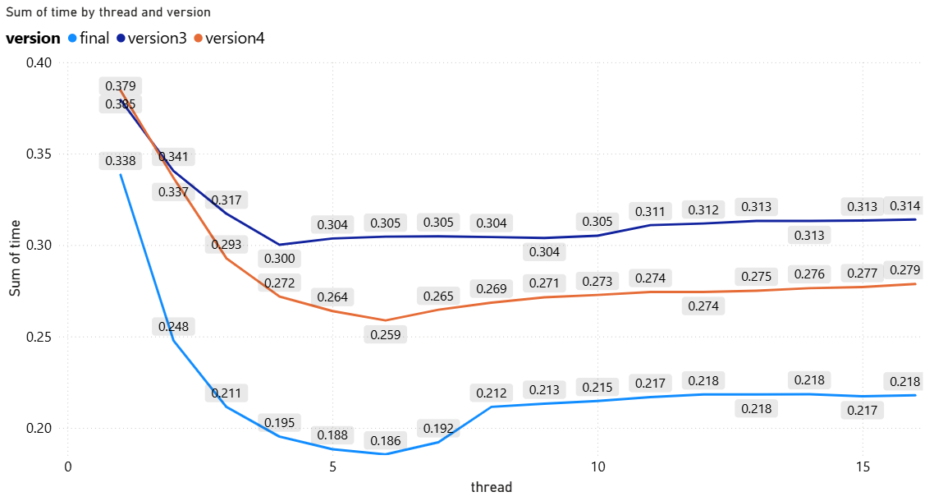
Process of develop
Version1: parallel workers with counting neighbour in every worker
Version2: Parallel workers with enhanced io
Version3: Parallel workers with counting flipped neighbour cell in each worker(relative improvement(88%))
Version4: Parallel workers with efficient use of slice
Final version: Parallel workers excludes “calcchunk” function and substitute mutex lock from IO channel.

Slide 11
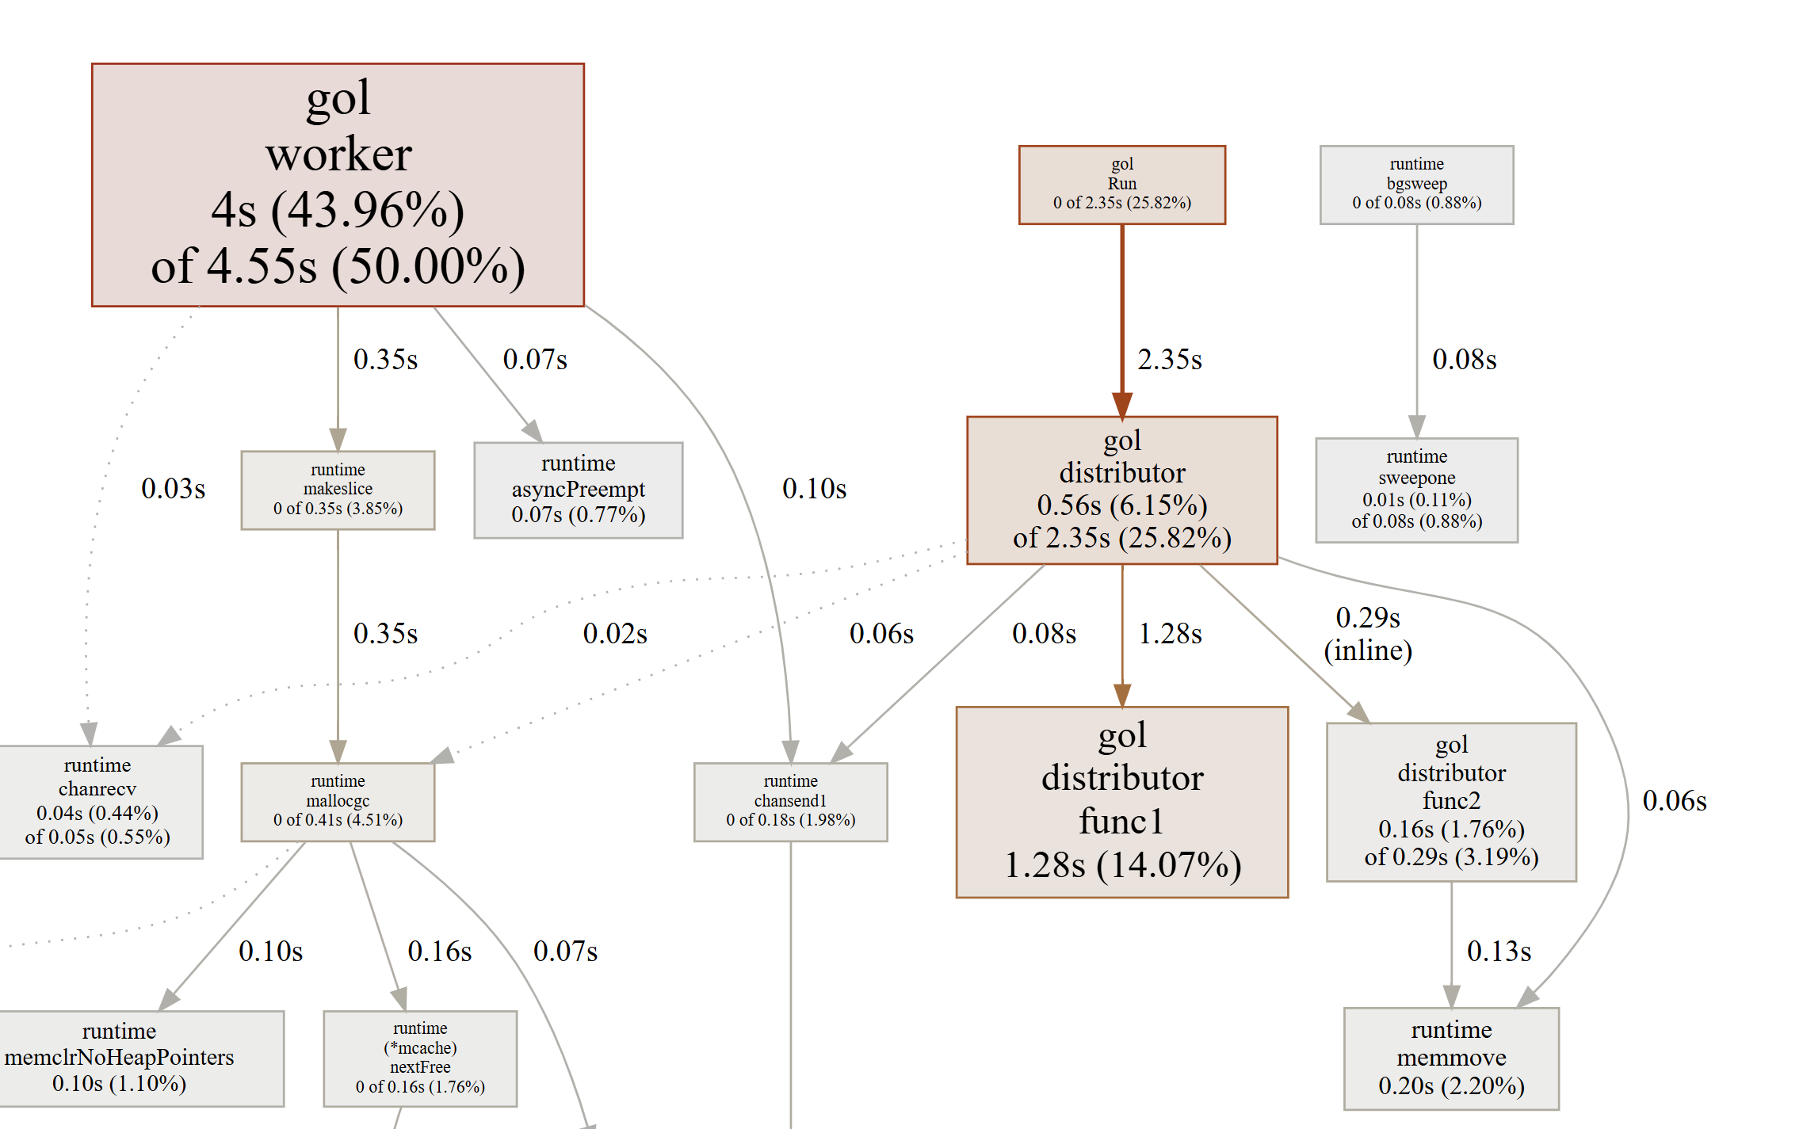
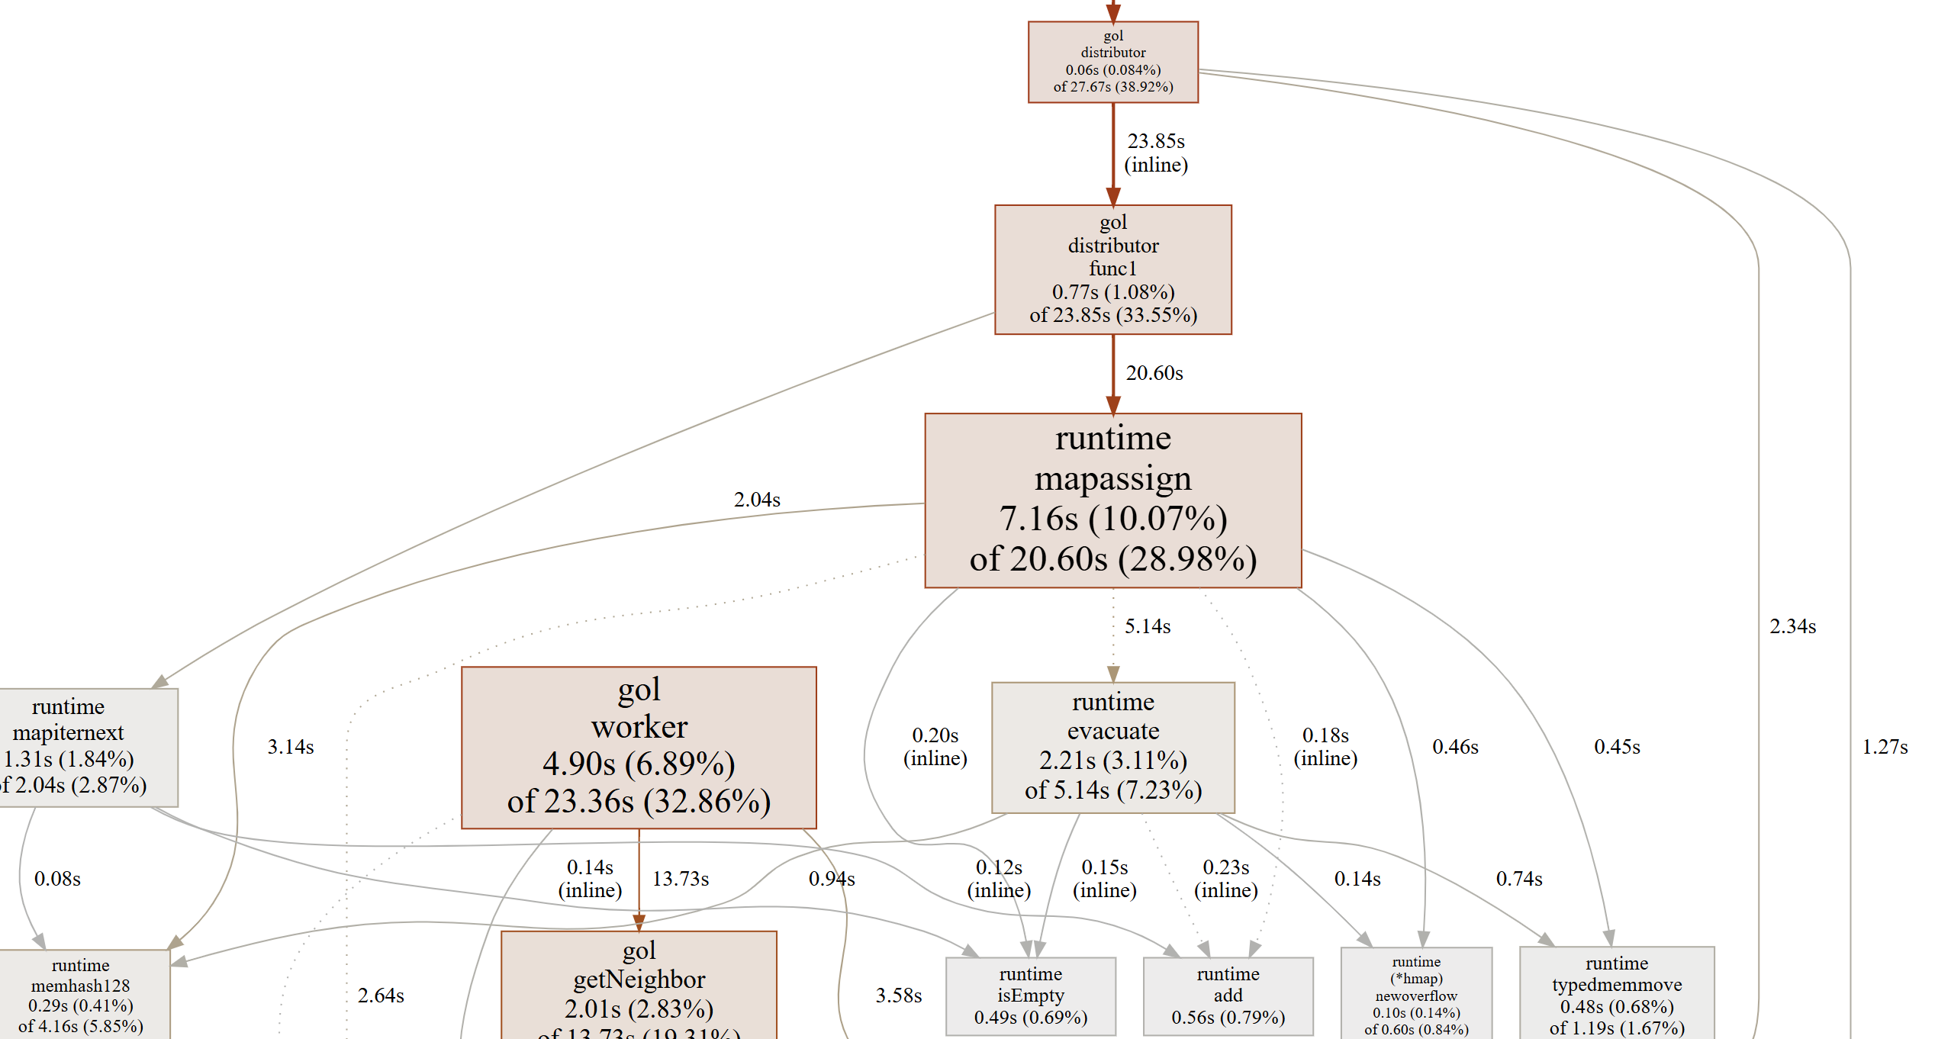
getneighbors function in each worker
getneighbors function in distributor

Slide 13
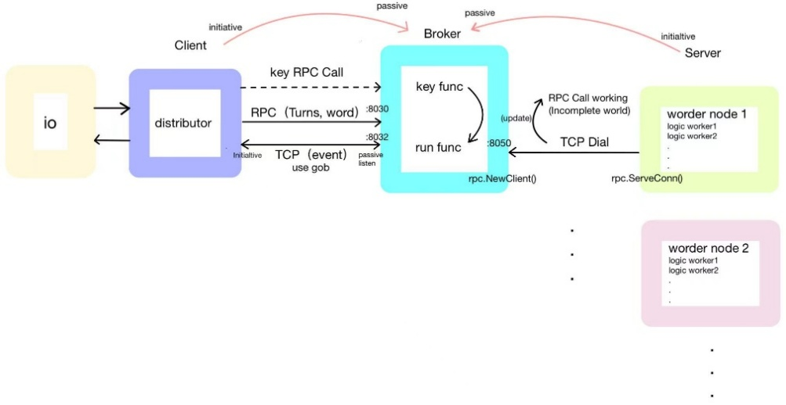
Distributed Implementation

Slide 14
Distributed Adjustment
Turn 1

Slide 15
Worker1
Broker
Startrow:0
Endrow: 1
Worker2
Startrow:2
Endrow:3

Slide 16
Worker1
Return back to Broker
Broker
X | Y
1 | 0
2 | 1
Startrow:0
Endrow: 1
x | y
1 | 0
0 | 2
1 | 2
2 | 1
2 | 2
Cell that need flip in this turn
Worker2
X | Y
1 | 2
0 | 2
2 | 2
Startrow:2
Endrow:3

Slide 17
Neighbour of Cell that need flip in this turn
Broker
x | y
0 | 0
0 | 1
1 | 1
1 | 2
2 | 2
…
Cell that need flip in this turn
x | y
1 | 0
0 | 2
1 | 2
2 | 1
2 | 2
Apply to the world

Slide 18
Turn N
Neighbour of Cell that need flip in last turn
x | y
0 | 0
0 | 1
1 | 1
1 | 2
2 | 2
…

Slide 19
Worker1
Return back to Broker
Neighbour of Cell that need flip in last turn
Halo line
x | y
0 | 0
0 | 1
1 | 1
1 | 2
2 | 2
Line 3
…
Line 0
X | Y
2 | 0
3 | 1
+
Line 1
Halo line
Line 2
Worker2
Cell that need flip in this turn
Neighbour of Cell that need flip in last turn
Halo line
x | y
0 | 0
0 | 1
1 | 1
1 | 2
2 | 2
Line 1
X | Y
3 | 2
1 | 3
2 | 2
…
Line 2
+
Line 3
Halo line
Line 0

Slide 20
Neighbour of Cell that need flip in this turn
Broker
x | y
1 | 0
3 | 1
2 | 1
0 | 2
2 | 2
…
Cell that need flip in this turn
x | y
2 | 0
3 | 1
3 | 2
1 | 3
2 | 2
Apply to the world

Slide 21
Special design
1.High Fault Tolerance
Dynamic allocation
2.Highly reducing communication
3.Privacy

Slide 22
High Fault Tolerance
Live demo

Slide 23
Highly reducing communication
Full World Transfer Only Once Between worker and broker
Persistent TCP Stream
Scalable Worker Pool
One connection between Broker and server

Slide 24
Privacy
Space uncoupling
Local client only need keep track of one address while not need to know other server
Broker don’t know any address until some node dial in
Server don’t know other server address, or local client address
Server address is not expose by any node except broker

Slide 25
