Slide 1
MVC Patterns

Slide 2
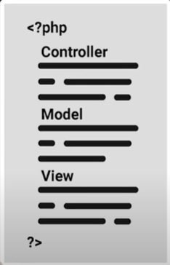
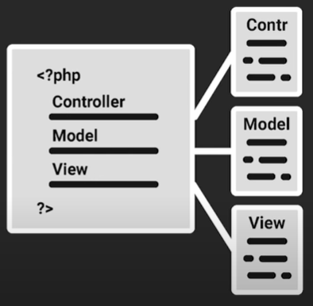
Procedural vs OOP MVC Patterns

Slide 3
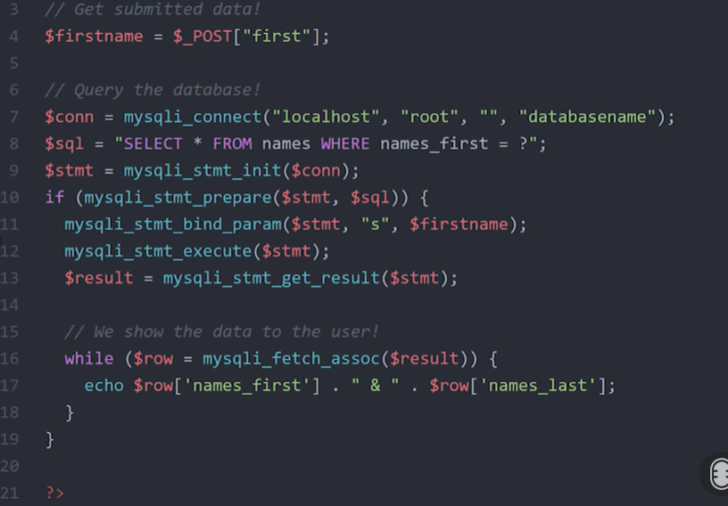
Procedural

Slide 4
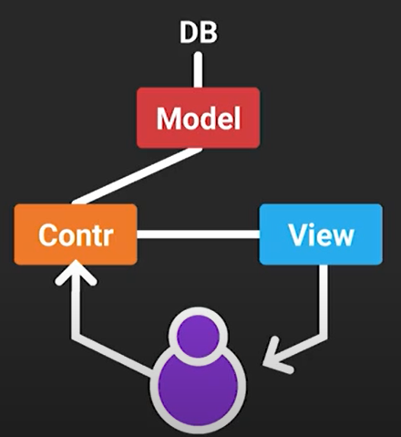
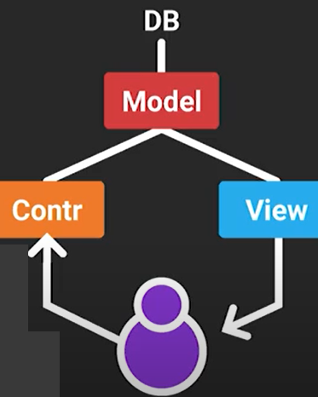

Slide 5
SQL DDL Statements (Data Definition Language)
CREATE TABLE – learn how to create a table.
ALTER TABLE – show you how to modify a table structure.
DROP TABLE – remove a table from database.
TRUNCATE TABLE – allow to delete all rows from a table.

Slide 6
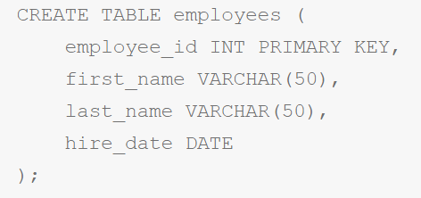
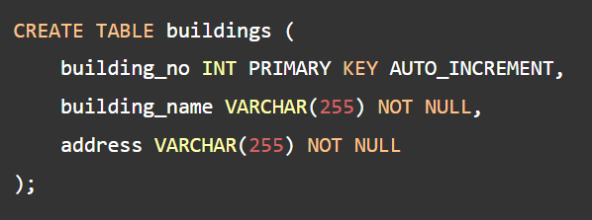
Create Table

Slide 7
Alter Table
The ALTER TABLE statement is used to modify an existing table’s structure.
ALTER TABLE employees
ADD email VARCHAR(100),
DROP COLUMN hire_date;

Slide 8
Drop Table
The DROP TABLE statement is used to delete an entire table and its associated data from the database.
DROP TABLE employees;

Slide 9
Data Manipulation Language
Query
select
insert
update
delete
Conditions
where (and, or , between continuous values)
Functions
orderby
groupby

Slide 10
Select
Select col_names from table_name where condition;
select * from tablename
select col1,col2 from tablename
select * from tablename where colname="colvalue"

Slide 11
Select
Select columns
Select all columns
select column as alias
select column using where clause (Filter)
select column using where clause and order By

Slide 12
Insert
insert into table_name(col1,col2) values (value1,value2);
insert into dept(name,description) values (“IT Sales”, “Sales);

Slide 13
Update
Update table_name set col1=value1,col2=value2 where condition;
Update dept set description=”HR” where id!=1;
update employees set commission=500
where department_id=2
and job_id=2;

Slide 14
Delete
Delete from table_name where condition;
DELETE FROM `jobs` WHERE job_id=5;

Slide 15
Aggregate Functions
max
min
count
avg
sum

Slide 16
max
select max(salary)
from employees;
select *
from employees
where employees.salary =
(select max(salary)
from employees)

Slide 17
Count, Distinct
SELECT count(employee_id) as "Total number of employees" from employees
select count(DISTINCT(job_id))
from employees

Slide 18
Subqueries
Subqueries
ANY (return true if any record matches the condition)
ALL (return true if all records match the condition)
IN (find one), NOT IN
Exists
Not Exists

Slide 19
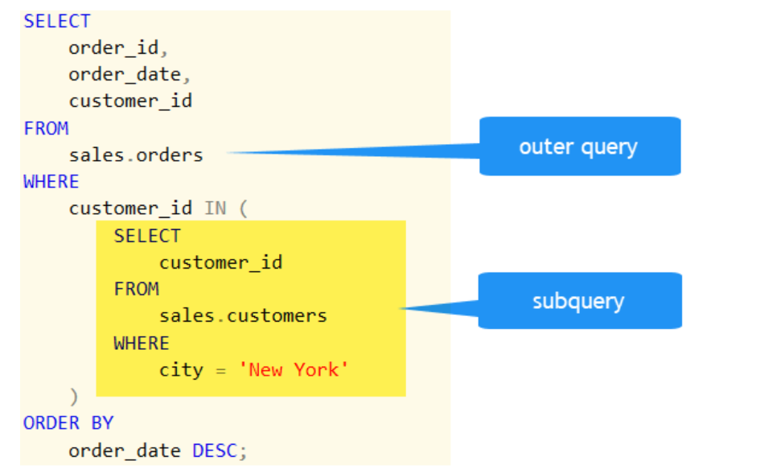
Sub queries

Slide 20
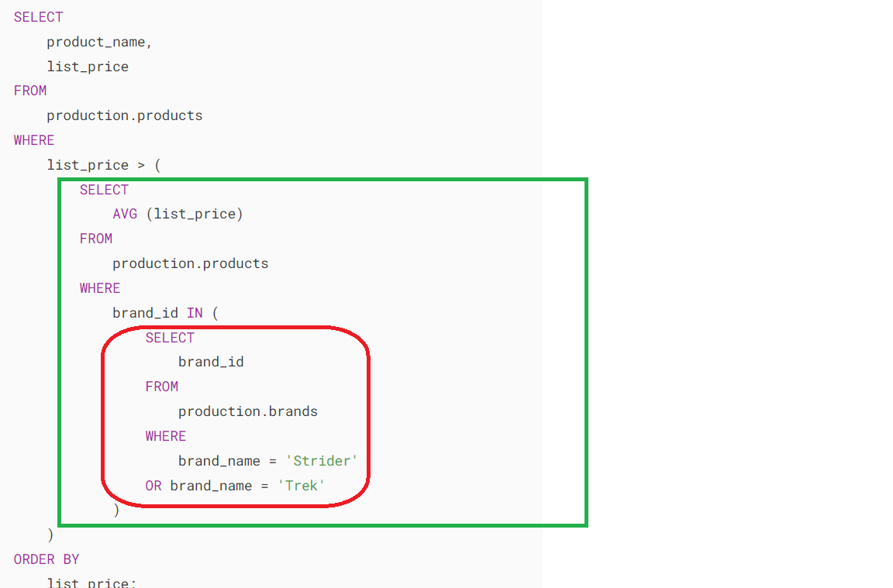

Slide 21
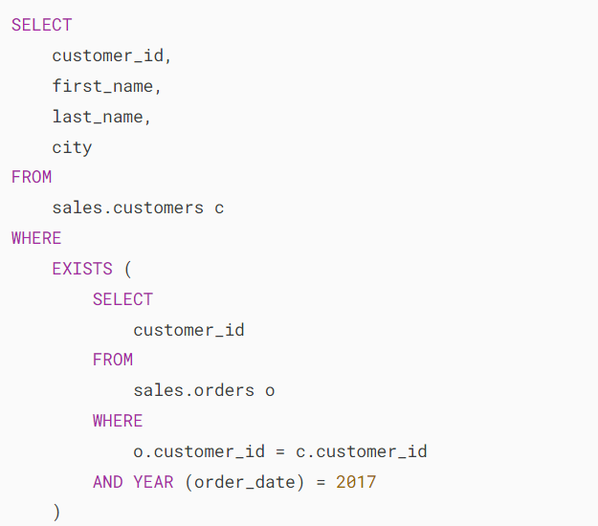
the customers who bought products in 2017

Slide 22
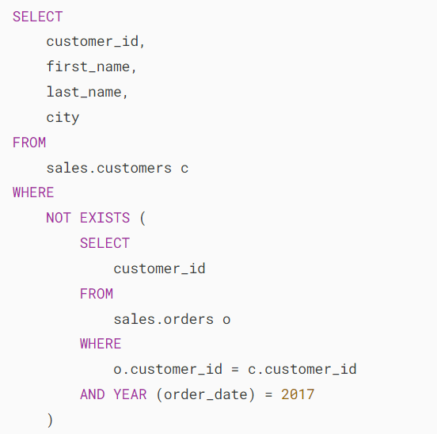
the customers who did not buy any products in 2017

Slide 23
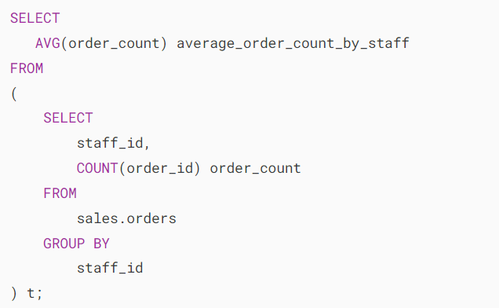
FROM Clause

Slide 24
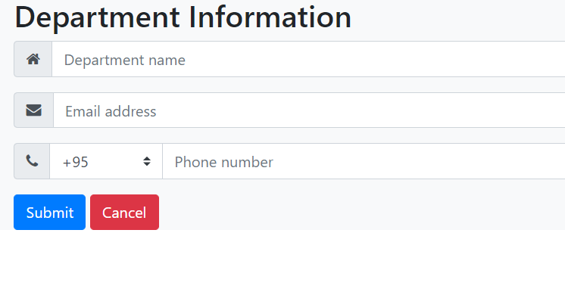
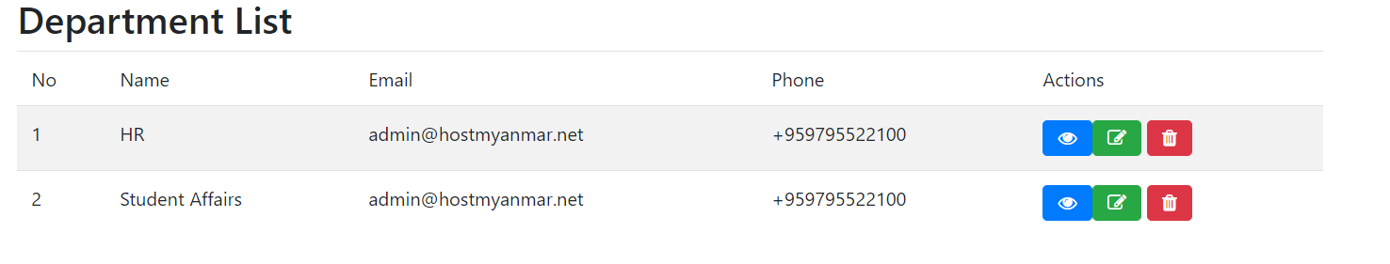
Department
Id | Name | Email | Phone
1 | HR | hr@hostmm.tech | 0987777654

Slide 25
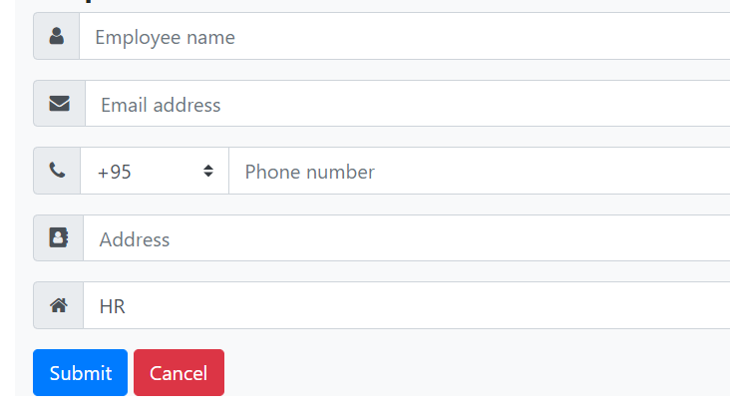
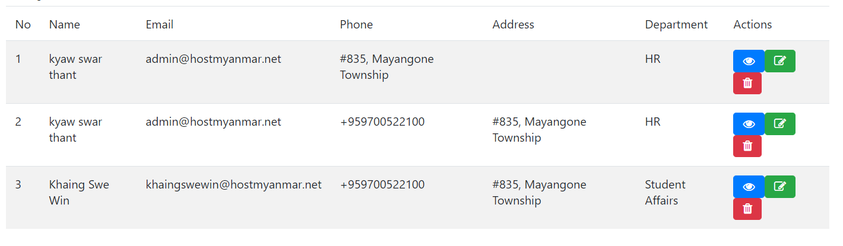
Employee
Id | Name | Email | Phone | Dept_id

Slide 26
Query : Select
SELECT column-name, column-name from table-name;
SELECT * from table-name;

Slide 27
Join
join
inner join
left join
right join
full join

Slide 28
Join
select employees.first_name,employees.first_name,jobs.job_title
from employees join jobs
where employees.job_id =jobs.job_id
and jobs.job_title like “%developer”
select employees.* , jobs.*
from employees inner join jobs
where employees.job_id=jobs.job_id;

Slide 29
Subqueries
select employees.first_name , jobs.job_title
from employees join jobs
where employees.job_id = jobs.job_id
and employees.job_id in
(select jobs.job_id
from jobs
where jobs.job_title like "%developer"
or jobs.job_title like "%manager")
5 in [3,3,2,6,5] ???

Slide 30
Between
SELECT * FROM `employees`
where salary BETWEEN 500000 AND 800000;
salary { 500000-800000} continuous value in range

Slide 31
Subqueries
select employees.first_name , jobs.job_title
from employees join jobs
where employees.job_id = jobs.job_id
and employees.job_id not in
(select jobs.job_id
from jobs
where jobs.job_title like "%developer"
or jobs.job_title like "%manager")

Slide 32
Issue
select products.id , sales.product_id, products.name, sum(qty) from products join sales on products.id=sales.product_id GROUP by sales.product_id having sum(qty) =
ANY ( select sum(qty) from sales group by product_id) OR sum(qty)
> ANY ( select sum(qty) from sales group by product_id);

Slide 33
Server Setting for Database
// localhost,port,username,password,dbname
static $host="localhost";
static $username="root";
static $password='';
static $dbname='bikestore';
static $connection;

Slide 34
PDO
The PHP Data Objects (PDO) extension defines a lightweight, consistent interface for accessing databases in PHP.
It simplifies the database operations including:
Creating database connection
Executing queries
Handling errors
Closing the database connections

Slide 35
DB Connection
When we want to connect PHP and MySQL then we need to follow 3 steps:
Connection with the database
Run SQL Query
Closing the database connection

Slide 36
PDO connection
try{
if(self::$connection==null)
{
self::$connection=new PDO("mysql:host=".self::$host.";port=3309;dbname=".self::$dbname,self::$username,self::$password);
return self::$connection;
}
}
catch(PDOException $e)
{
echo $e->getMessage();
}

Slide 37
Disconnect
public static function disconnect()
{
self::$connection=null;
}

Slide 38
Prepare and fetch
$this->con=Database::connect();
$sql="select * from departments"; //string
$this->statement=$this->con->prepare($sql); //prepare statement
if($this->statement->execute())
{
$results=$this->statement->fetchAll(PDO::FETCH_ASSOC);
//fetch for one row and fetchAll for all rows
return $results;
}

Slide 39
Fetch a row
fetch():Fetches the next row from a result set
Parameters :
PDO::FETCH_ASSOC: returns an array indexed by column name as returned in your result set
PDO::FETCH_BOTH (default): returns an array indexed by both column name and 0-indexed column number as returned in your result set

Slide 40
FetchAll
Fetches the remaining rows from a result set

Slide 41
Fetch Parameter
PDO::FETCH_ASSOC: Return next row as an array indexed by column name
Array
(
[name] => apple
[colour] => red
)
PDO::FETCH_BOTH: Return next row as an array indexed by both column name and number
Array
(
[name] => banana
[0] => banana
[colour] => yellow
[1] => yellow
)

