Slide 1
Tzeng Adversarial Discriminative Domain CVPR 2017 paper
Adversarial Discriminative Domain Adaptation

Slide 2
Outline:
1. Introduction
2. The function of ADDA
3. Results of Adversarial Discriminative Domain Adaptation in paper
4. Code
5.My results

Slide 3
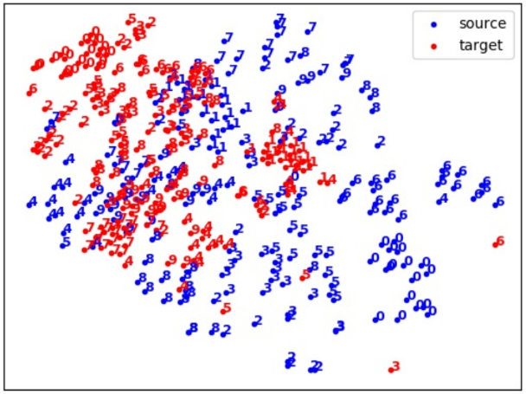
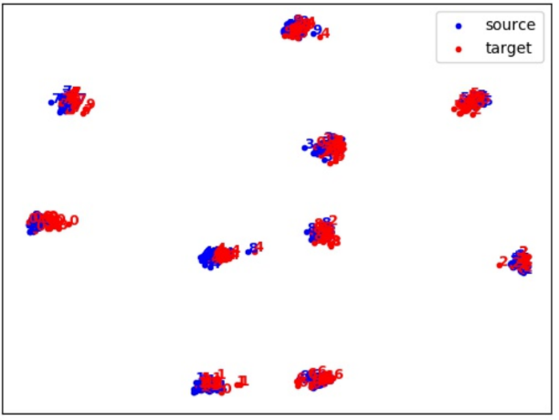
introduction
1. difficult and expensive to fine-tune the parameters
The typical solution is to further fine-tune these networks on task-specific datasets however, it is often prohibitively difficult and expensive to obtain enough labeled data to properly fine-tune the large number of parameters
2. Adversarial adaptation methods
Adversarial adaptation methods have become an increasingly popular incarnation of this type of approach which seeks to minimize an approximate domain discrepancy distance through an adversarial objective with respect to a domain discriminator.

Slide 4
introduction
4. Adversarial adaptation methods in this paper
Base model: discriminative
Weight sharing: unshared
Adversarial loss: GAN
we observe that generative modeling of input image distributions is not necessary, as the ultimate task is to learn a discriminative representation.
asymmetric mappings can better model the difference in low level features than symmetric ones.
Notes:
輸入圖片分布的生成模型是不必要的
ADDA首先使用源域中的標籤來學習區分錶示，
然後使用將目標數據映射到相同域的單獨編碼使用通過域對抗損失學習的非對稱映射的空間。
我們的方法簡單卻出奇的強大

Slide 5
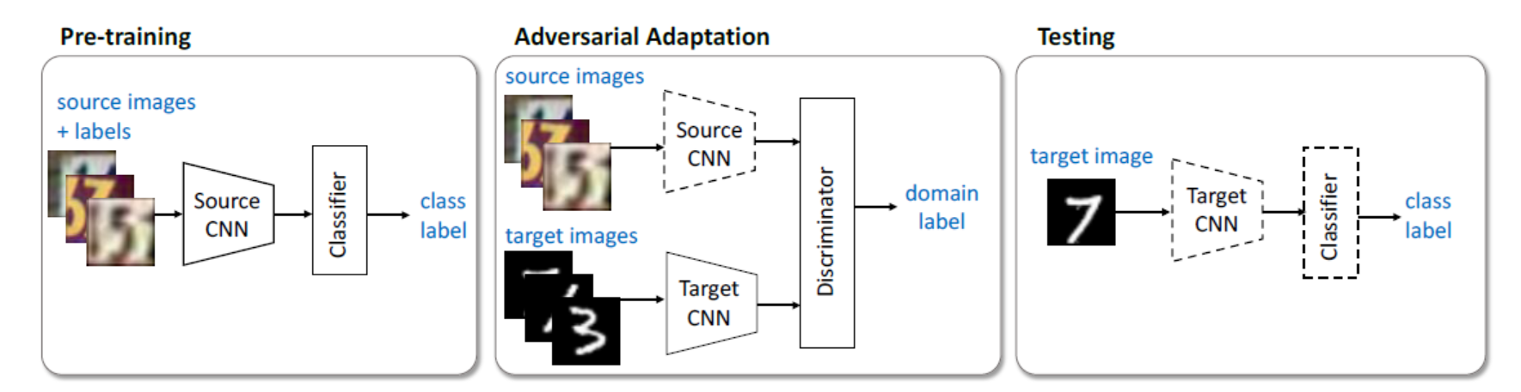
Introduction-ADDA-1
Ms
D()
Ms
Cs
Ct = Cs
Mt
We first pre-train a source encoder CNN using labeled source image examples. Next, we perform adversarial adaptation by learning a target encoder CNN such that a discriminator that sees encoded source and target examples cannot reliably predict their domain label. During testing, target images are mapped with the target encoder to the shared feature space and classified by the source classifier. Dashed lines indicate fixed network parameters.
Notes:
1.先pretrain source encoder CNN 圖片透過這個Ms適映射到新的特徵空間,再從新特徵空間連結到label的過程訓練Cs
第一步產生Ms和Cs
2.
將訓練好的Ms(固定) 將source domain 的照片映射的新空間(空間1特定分布) ,以及新訓練的Mt作用是將target domain 也映射到新空間(空間2)
然後將此兩個映射後的分布 丟到discriminator內 discriminator嘗試去區分兩個新空間的特徵
第二步產生Mt和D()
Mt作用是要優化成使D()區分不出空間2(認為室空間1的分布)
D()作用是要區分兩個分布所屬的Domain
彼此為對抗關西
3.Testing 測試Mt + Cs的效果
此為ADDA的過程
我們提出的對抗性歧視性領域適應（ADDA）方法的概述。我們首先使用標記的源圖像示例對源編碼器CNN進行預訓練。接下來，我們通過學習目標編碼器CNN進行對抗性調整，以使看到編碼
源和目標示例的鑑別器無法可靠地預測其域標籤。在測試期間，目標圖像通過目標編碼器映射到共享特徵空間，並由源分類器分類。虛線表示固定的網絡參數。

Slide 6
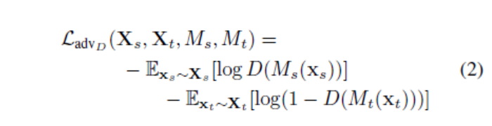
Introduction-ADDA-1
First learn a source domain mapping Ms, a source domain classifier Cs to classify. Since the source domain has tags, we can easily learn both. The question now is how to migrate Ms and Cs to the target domain. The first assumption is that the classifier is shared, that is, Ct=Cs, which is equivalent to the same distribution of the source domain and the target domain in the mapped subspace. Therefore, you only need to learn Mt. In order to obtain Mt, you need to define a domain classifier D. Based on the idea of GAN network.
(The ideal result of D(Mt(xt)) is 0, and the ideal result of D(Ms(Xs)) is 1)
Notes:
先學習一個源域的映射Ms，一個源域的分類器Cs來分類。由於源域有標籤，我們可以輕易地學習到這倆。現在的問題是如何把MS和Cs遷移到目標域。 假設是，分類器是共享的，則Ct = Cs，相當於在映射後的子空間內部，源域和目標域具有相同的分佈。因此，只需要學習Mt，為了獲得Mt，需要定義一個 域分類器D，重組GAN網絡的思想，優化D的目標函數為：
D(Mt(xt))理想的结果是0，D(Ms(Xs))理想的结果是1

Slide 7
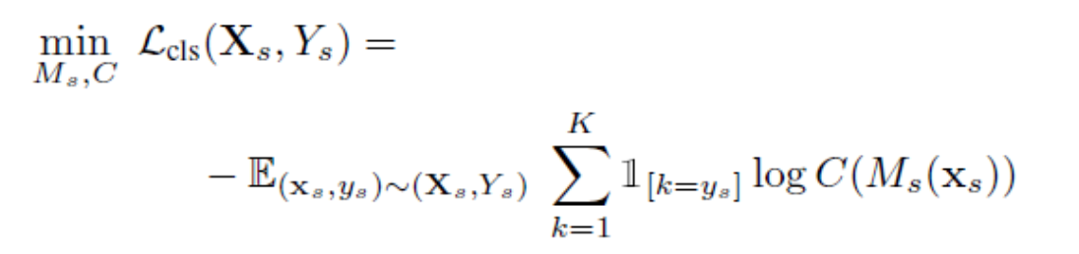
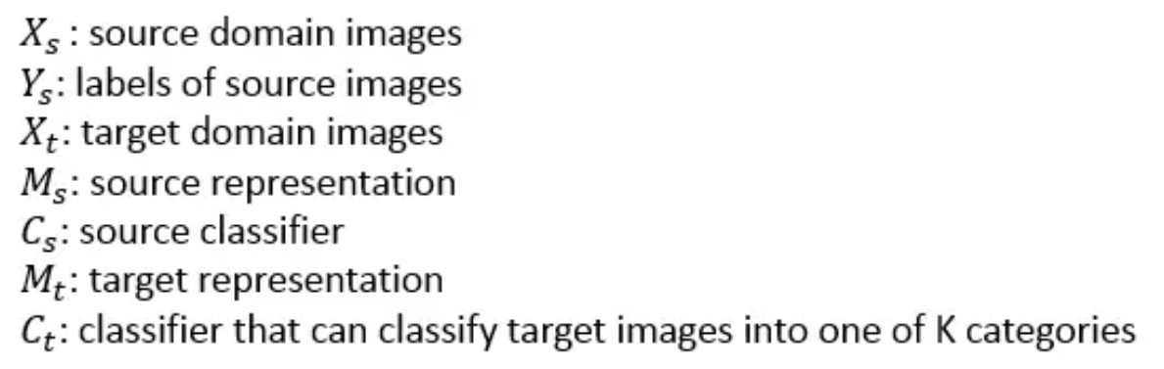
The function of ADDA-1 Loss of Classifier Cs
Notes:
分類器的製作 需要樣本 Xs 和 label Ys 都是來自source的,然後我從log開始說 將樣本帶到Ms裡經過分類器後 C(Ms(Xs))為k個0~1的值
取正確label(Ys)的那個機率 ,越接近1(準)loss整體會變小 log1= 0 最後乘上期望值

Slide 8
The function of ADDA-2 Loss of discriminator
(The ideal result of D(Mt(xt)) is 0, and the ideal result of D(Ms(Xs)) is 1)
Notes:
先介紹D()第一個式子D(Ms(Xs))理想狀況會是1 1判斷為sourse domain 所以上面的理想狀況會是0 log1=0
第二個式子理想狀況是D()有辦法區分Xt來自 target domain 所以D(Mt(Xt))的理想值是0 0表示來自target domain

Slide 9
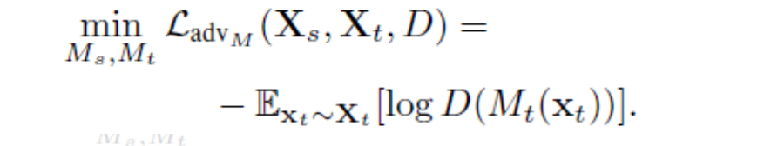
The function of ADDA-3 Loss of target mapping function
Notes:
Mt的loss是為了要使分布像Ms 所以用D(Mt(Xt))來判斷像不像Ms 若不像D(Mt(Xt)) 越接近0 loss越來越大
反之D(Mt(Xt)) =1代表 Mt分布很像Ms log1 → loss小

Slide 10
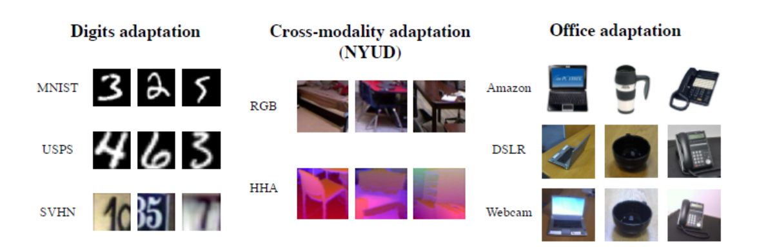
Results of Adversarial Discriminative Domain Adaptation in paper
We evaluate ADDA on unsupervised adaptation across seven domain shifts in three different settings. The first setting is adaptation between the MNIST, USPS, and SVHN datasets (left). The second setting is a challenging cross-modality adaptation task between RGB and depth modalities from the NYU depth dataset (center). The third setting is adaptation on the standard Office adaptation dataset between the Amazon, DSLR, and Webcam domains (right).

Slide 11
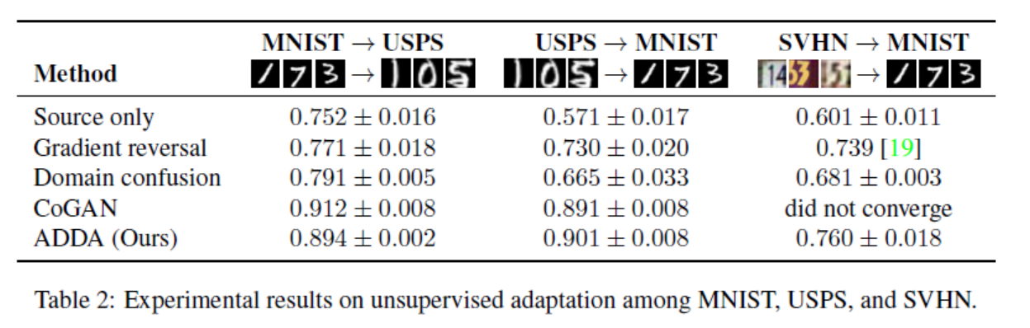

Slide 12
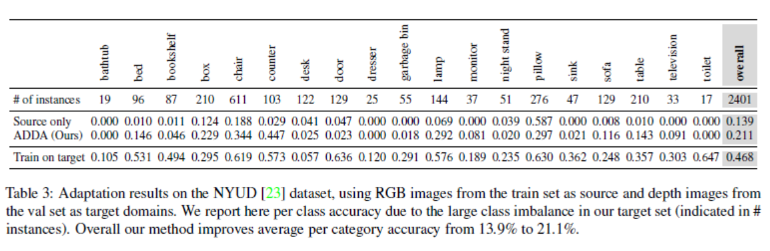
X
X
X
We find that our method, ADDA, greatly improves classification accuracy for this task. For certain categories, like counter, classification accuracy goes from 2.9% under the source only baseline up to 44.7% after adaptation. In general, average accuracy across all classes improves significantly from 13.9% to 21.1%. However, not all classes improve. Three classes have no correctly labeled target images before adaptation, and adaptation is unable to recover performanceon these classes. Additionally, the classes of pillow and night stand suffer performance loss after adaptation.

Slide 13
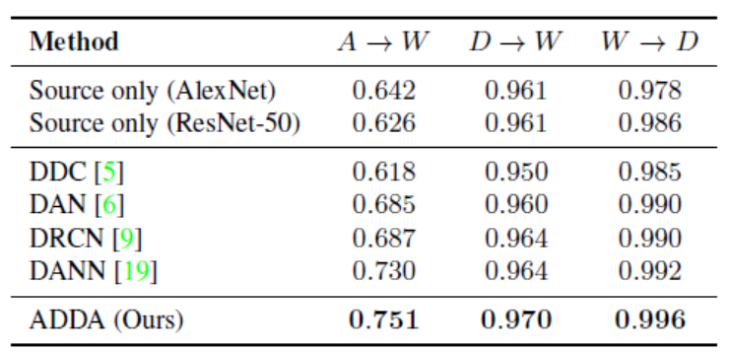

Slide 14
Code
Link of sample code1:https://github.com/jinxiu1983/keras-adda
Link of sample code2:https://github.com/corenel/pytorch-adda

Slide 15
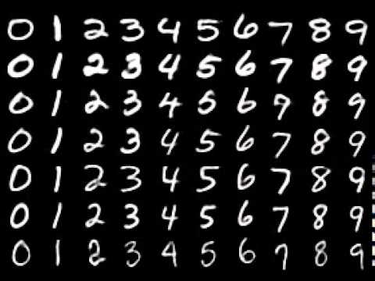
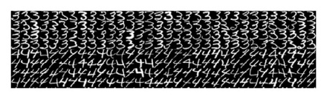
Source_data = mnist
target_data = usps

Slide 16
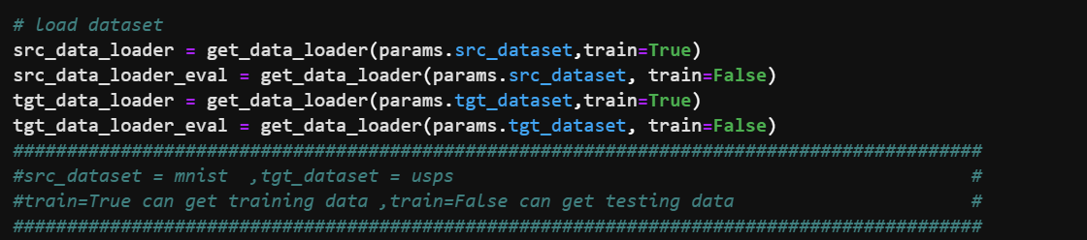
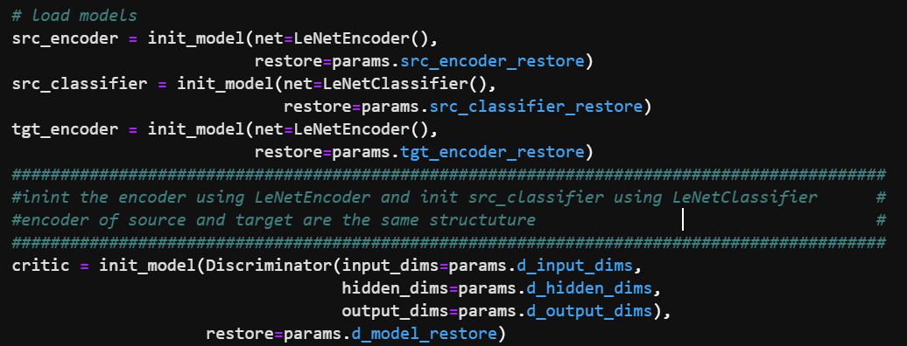
Load_data
Load_model

Slide 17
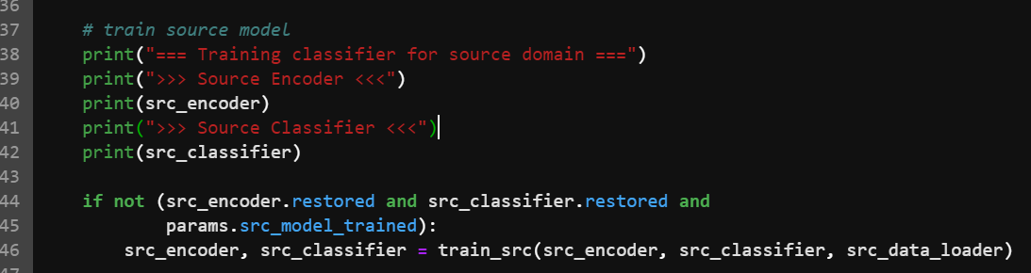
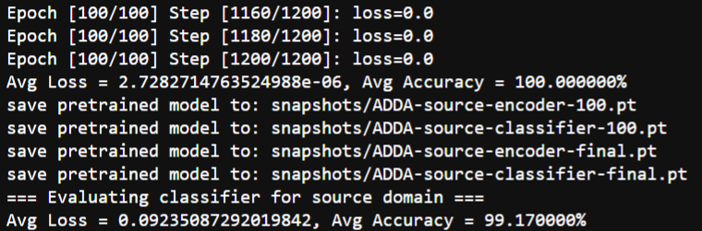
Training source encoder&classifier using sourcedata
Result of training source-data and get accuracy=99.17%

Slide 18
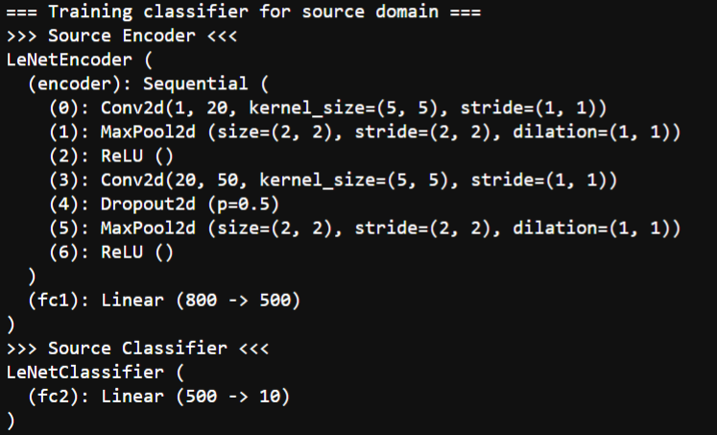
Source_encoder&classifier Model structure

Slide 19
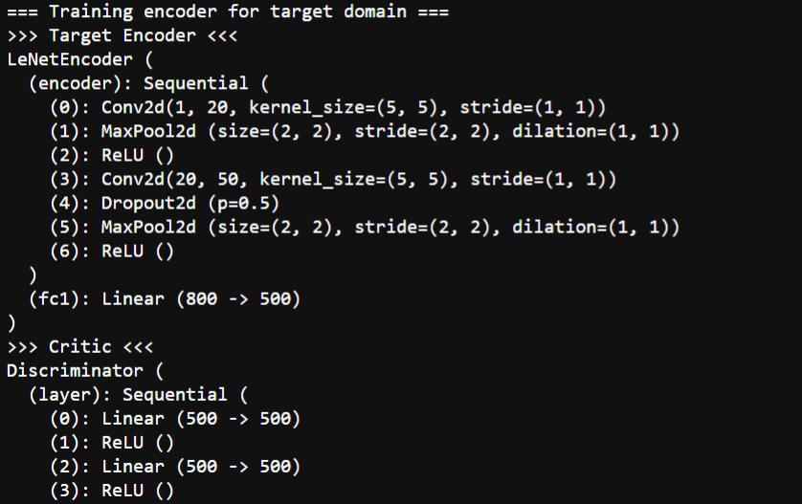
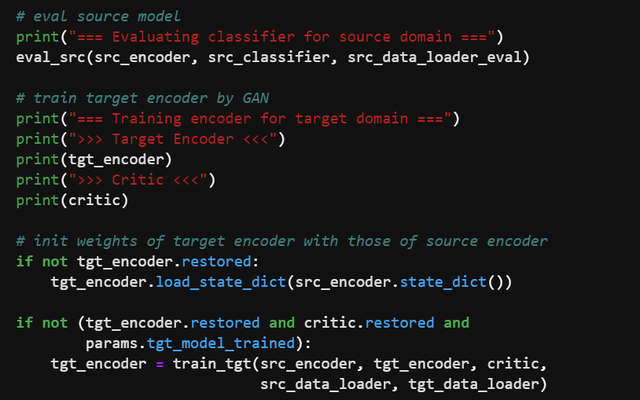
Target_encoder & domain discriminator
Target_encoder & discriminator Model structure

Slide 20
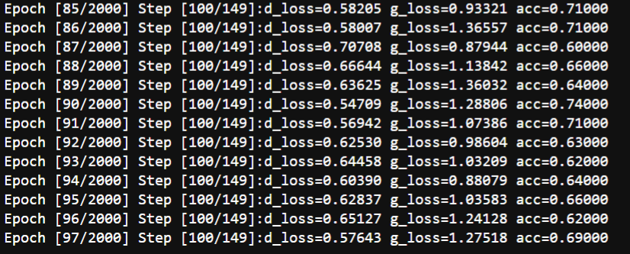
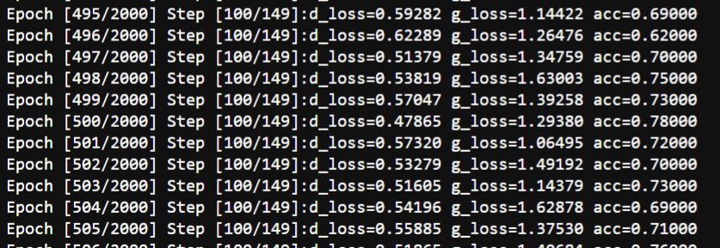
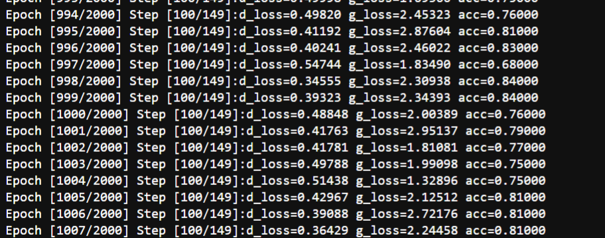
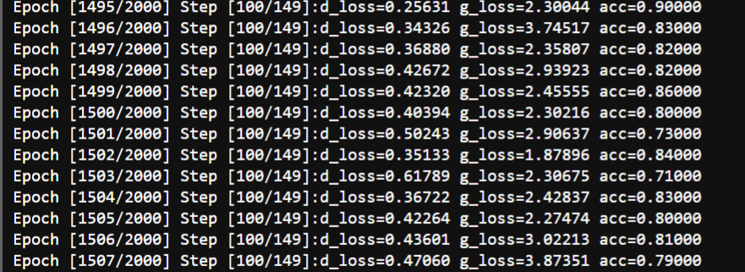
The disc_loss(d_loss) &Ms_loss(g_loss)
In 90 epoch
In 500 epoch
In 1000 epoch
In 1500 epoch

Slide 21
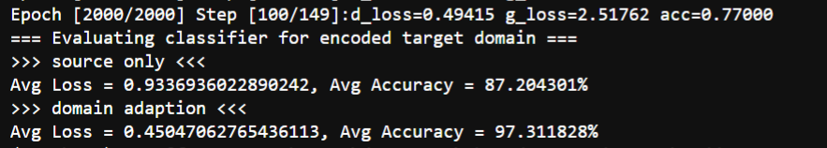
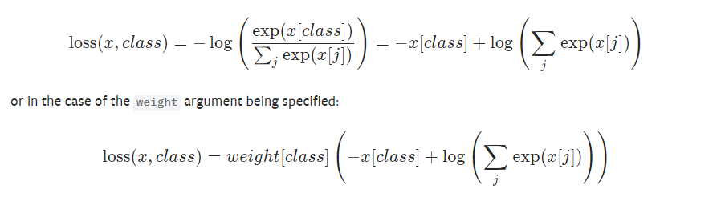
The result of adda from mnist to usps
The loss function of discriminator&target encoder in code
This function is for pytorch to compute the loss between predict label and correct label

