Slide 1
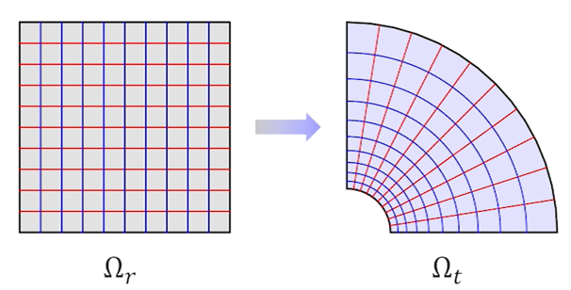
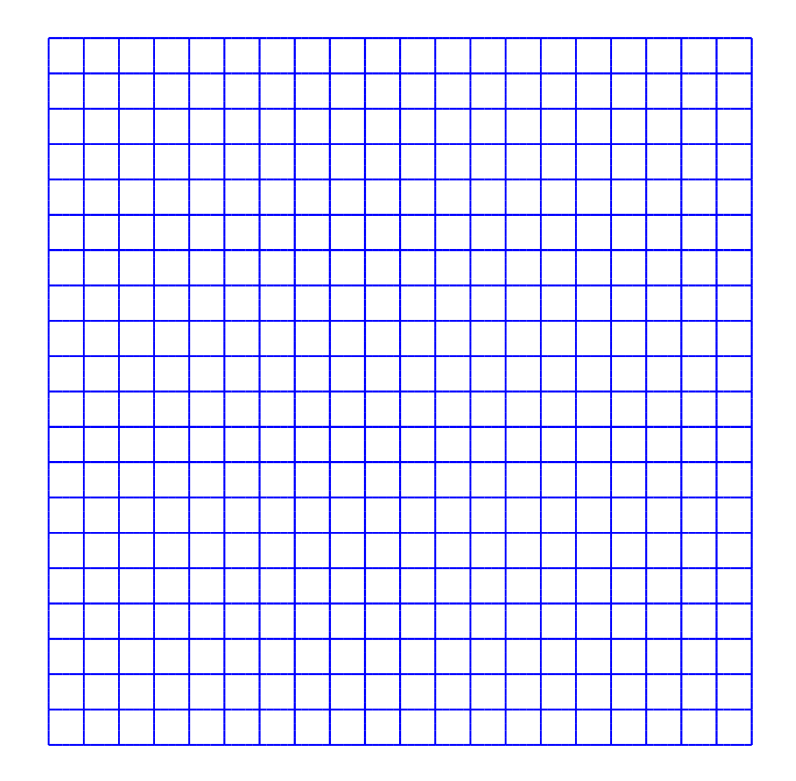
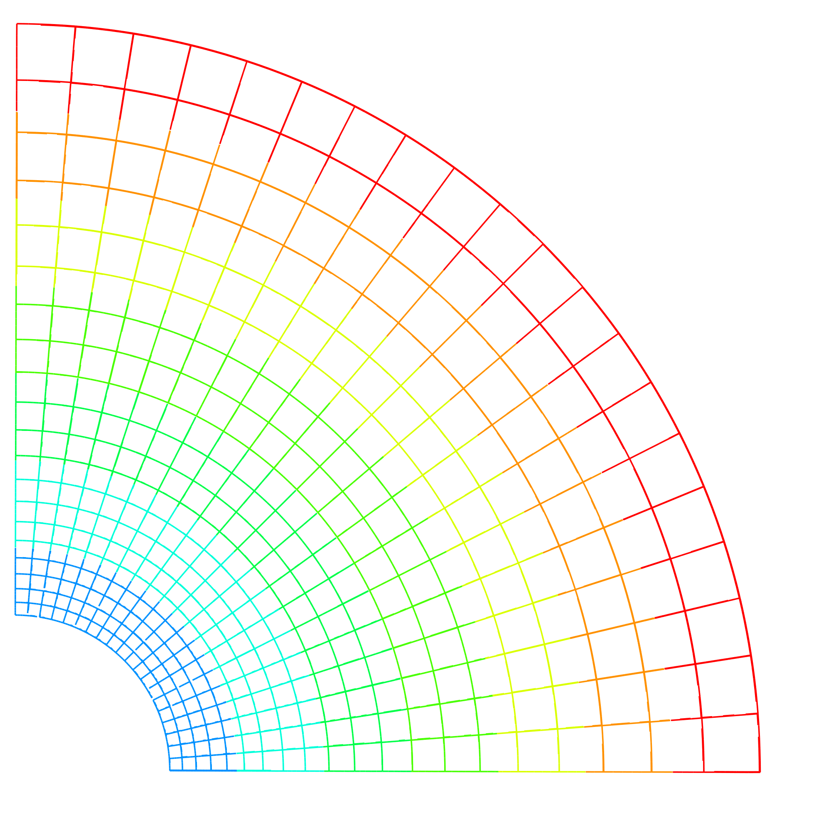


$$elongation$$
1.571
1.415
1.260
1.104
0.949
0.793
0.638
0.482
0.363

