Slide 1

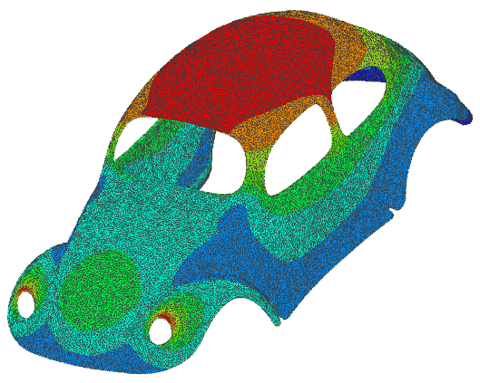



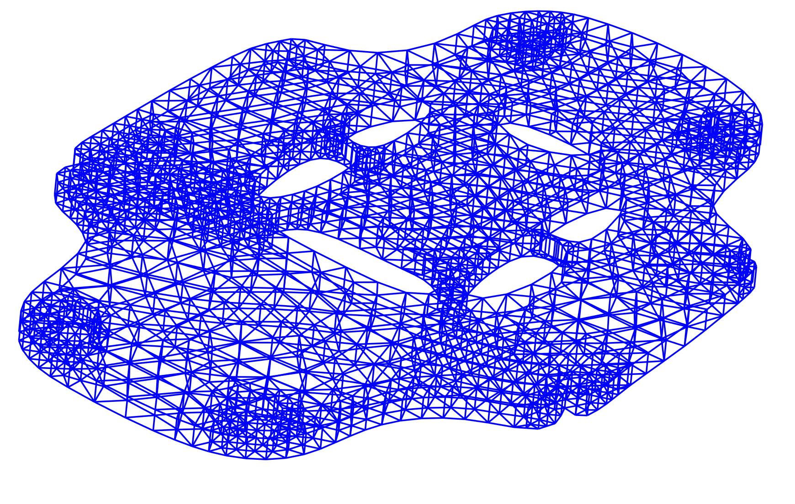
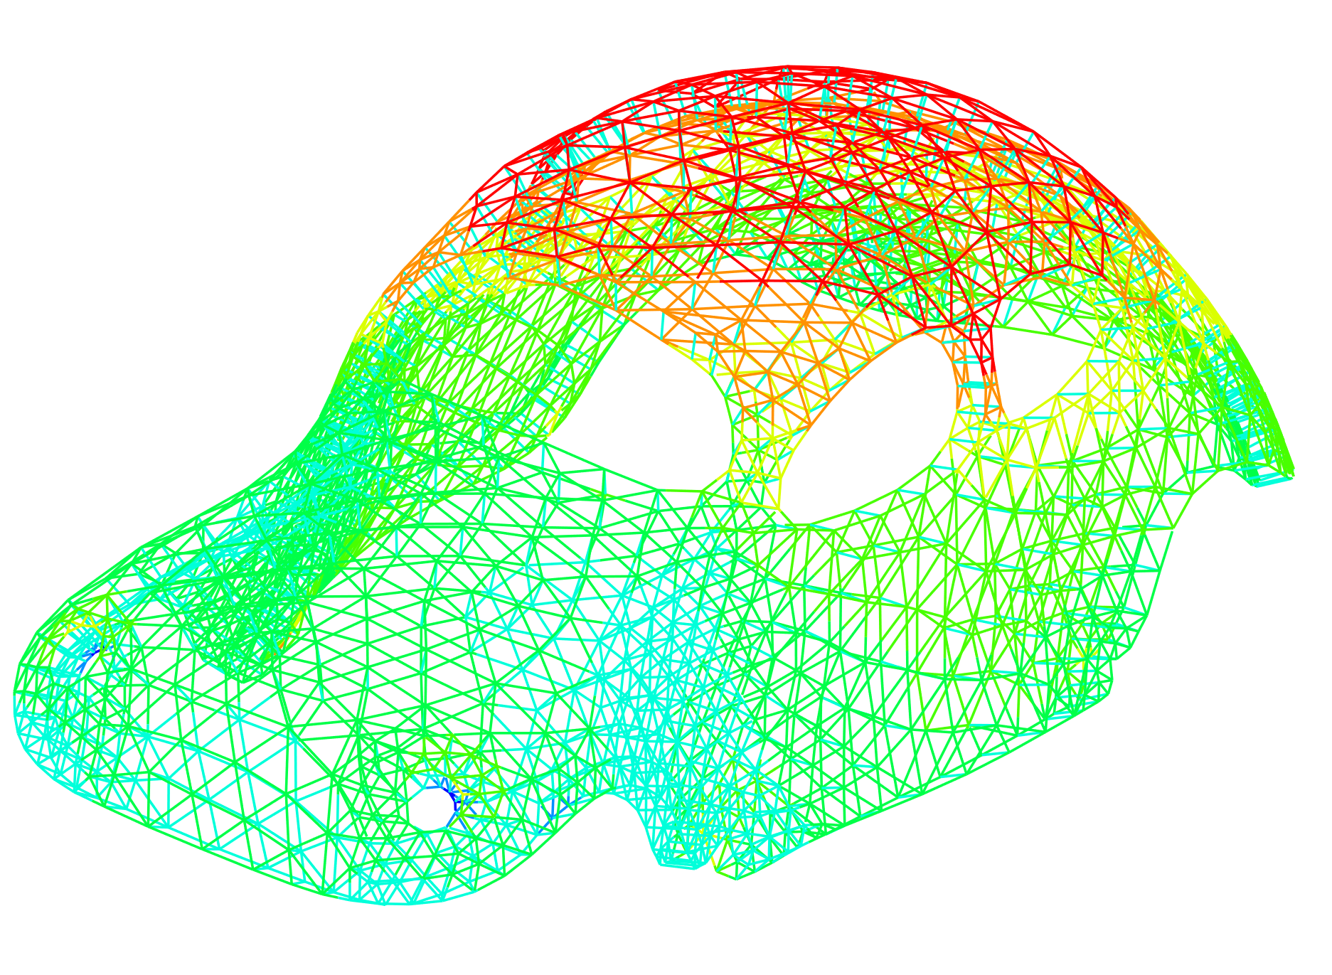

$$elongation$$
1.911
1.756
1.601
1.447
1.292
1.137
0.982
0.827
0.672

