Slide 1

PROFESSIONAL DEVELOPMENT & CONSULTING
AndersonLogic AI
AI-integrated instruction that augments, never replaces.
PD and consulting for schools putting AI in the classroom — built and proven in a real AP course, not a slideshow.
Jeff Anderson, Founder · creator of BeHistorical
01 / 10

Slide 2
THE PROBLEM EVERY SCHOOL SHARES
AI is already in every classroom. A plan isn't.
1
Students use AI as an answer machine
The tools are everywhere and the temptation is one tab away. Bans don't work; "just be careful" isn't a strategy.
2
Rigor and consistency vary
Great practices live in individual classrooms and don't spread. Structure and quality drift teacher to teacher, day to day.
3
Families are disconnected
Parents rarely know what's being taught or how to help — and gaps surface only after the test.
Most AI professional development names these problems. Very little of it shows you a working answer.
AndersonLogic AI · PD & Consulting
02 / 10

Slide 3
WHY THIS IS DIFFERENT
I didn't give a talk about AI. I built a working system with it.
THE TYPICAL AI PD SESSION
WHAT ANDERSONLOGIC AI BRINGS
A slideshow and a few chatbot tricks
"Here's the danger — be careful"
Tools shown, but no method to adopt
Nothing that survives past Friday
A complete platform, run with real students
A repeatable method teachers can copy
Guardrails that make AI a thinking partner
Built like software — made to last and scale
The proof isn't a promise. It's shipped.
AndersonLogic AI · PD & Consulting
03 / 10

Slide 4
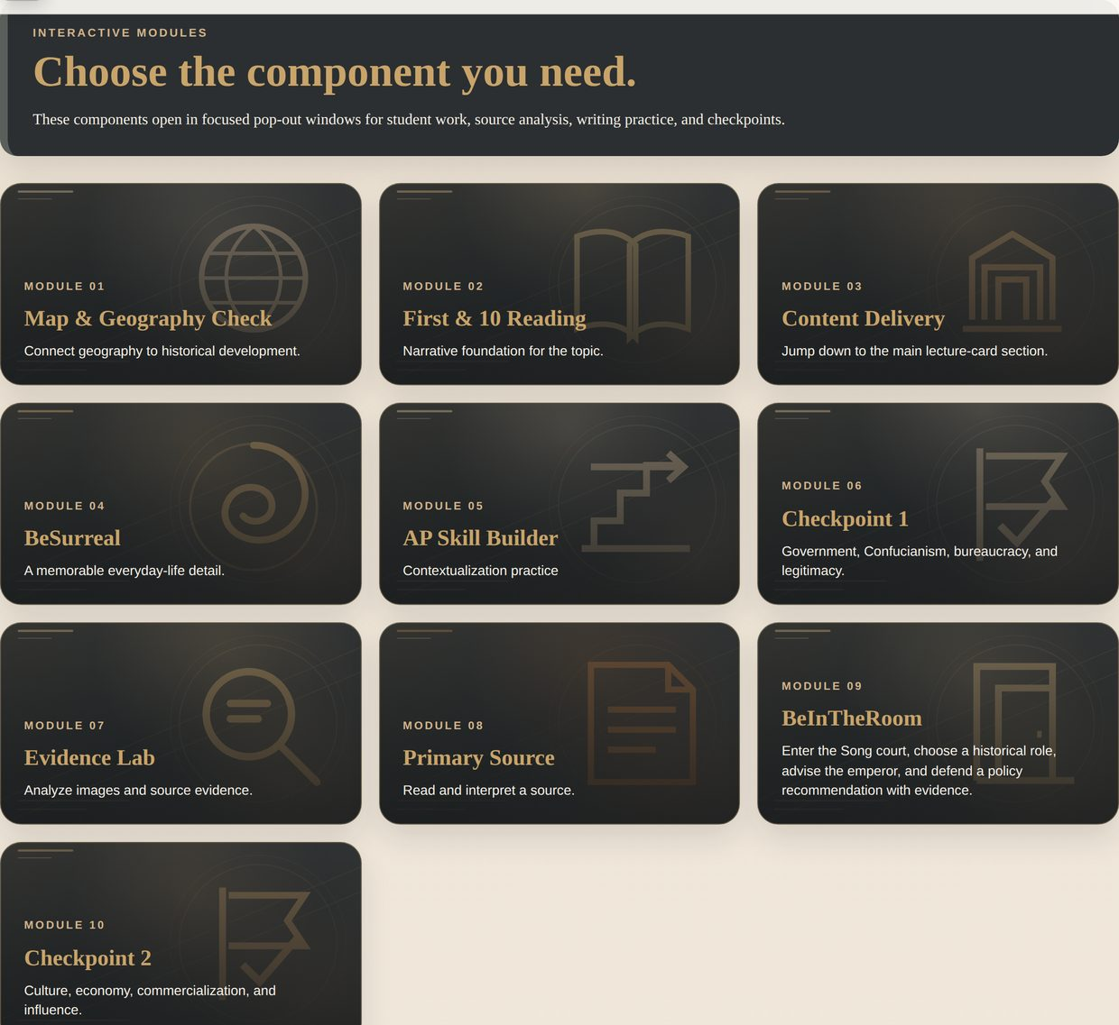
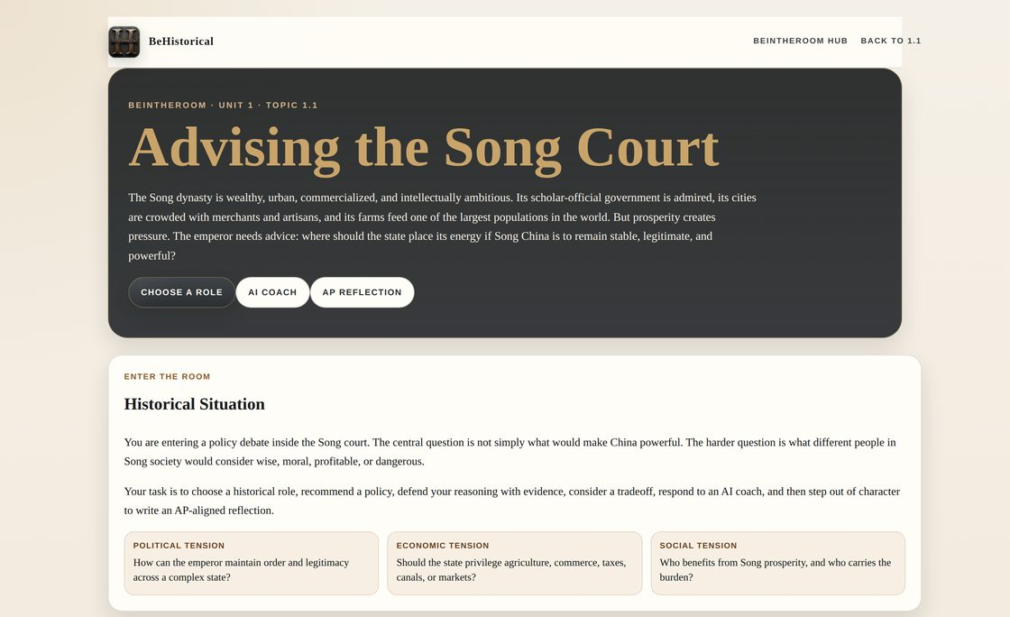
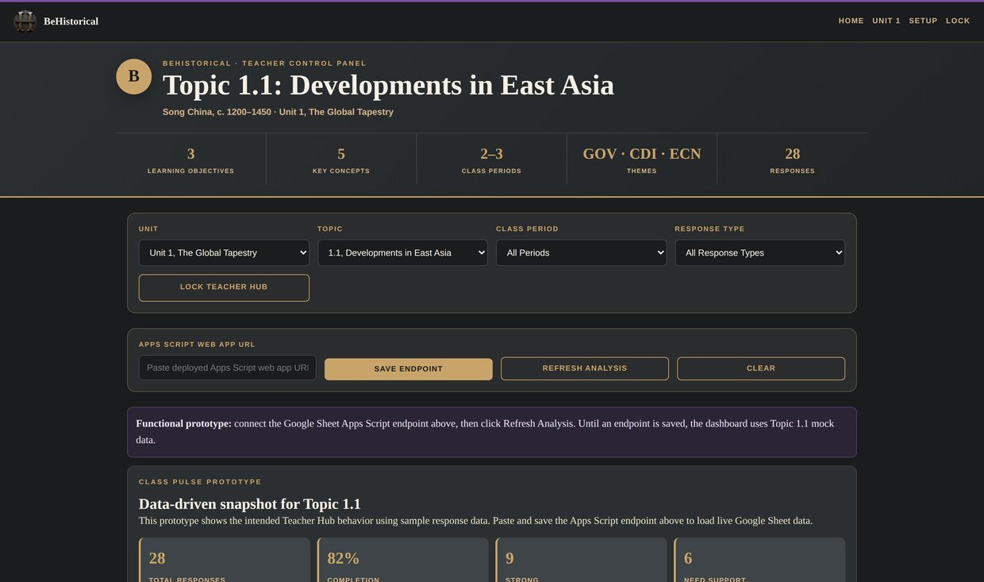
THE PROOF — BEHISTORICAL
A complete, AI-integrated AP World course — already running
77 complete lessons
61 decision simulations
FERPA-safe AI stack
547 files auto-validated
built like software
lesson · 10 modules
beintheroom simulation
teacher hub
I didn't theorize this. I taught with it. BeHistorical is the evidence — the method is what I bring to your staff.
AndersonLogic AI · PD & Consulting
04 / 10

Slide 5
THE TRANSFERABLE FRAMEWORK
The Augment Method (working name)
Four principles, subject-agnostic. History was just the proving ground — the method drops into any course.
1
One consistent lesson spine
2
AI that coaches, never completes
A predictable structure students can navigate on day one — so quality doesn't depend on which teacher, or which day.
Guardrails that make AI ask questions and demand reasoning — a thinking partner, not an answer machine.
3
One data layer, three audiences
4
Built to be maintained & scaled
Student work, captured once, serves the teacher, the student, and the family — automatically.
Structured like software, not a binder — so it survives, spreads, and doesn't rest on one hero teacher.
AndersonLogic AI · PD & Consulting
05 / 10

Slide 6
THE OUTCOME FOR YOUR STAFF
What your teachers will be able to do
1
Design a consistent lesson structure
A repeatable spine students can follow from day one — in their own subject.
2
Put AI guardrails in place
Set up AI so students use it to think and revise — not to cheat — with prompts they can reuse.
3
Turn student work into fast reteach decisions
Read the class in minutes and act before the test, not after.
4
Keep families in the loop — automatically
Send a plain-language, auto-generated update home without adding to the workload.
AndersonLogic AI · PD & Consulting
06 / 10

Slide 7
IT'S NOT JUST HISTORY
The same method, any subject
THE PRINCIPLE
IN AP WORLD HISTORY
IN AP BIOLOGY *
Consistent spine
The 10-module lesson path
Phenomenon → model → investigation → argument, every unit
Coach, never complete
Socratic AI on a historical decision
AI that probes a claim-evidence-reasoning explanation
One data layer
Responses → Teacher Hub, guides, newsletter
Lab claims → misconception flags & reteach
Built to scale
Deterministic builds, quality gates
Same templates, same validation, new content
* Illustrative — the framework is content-agnostic; any course or grade band maps the same four principles.
AndersonLogic AI · PD & Consulting
07 / 10

Slide 8
WHY WORK WITH ME
I teach the class and I ship the software
◆
A builder-teacher hybrid. I teach AP World History and I built a 1,700-file platform to run it — a rare combination that means the method is classroom-real, not consultant theory.
◆
Grounded in tools you already use. The stack runs on MagicSchool and Claude for education, Google Workspace, and Canvas — FERPA-safe and district-ready, not another platform to vet.
◆
Proven, not promised. Every claim in this deck points to something already built and running with students.
◆
[ Add: years teaching · AP experience · credentials · any results or recognition ]
AndersonLogic AI · PD & Consulting
08 / 10

Slide 9
HOW WE'D WORK TOGETHER
Four ways to bring this to your staff
KEYNOTE
WORKSHOP
COHORT
BUILD
The vision session
Hands-on half day
Coaching cohort
Licensing & build
60–90 min · whole staff
3–4 hrs · by department
a semester · small group
custom · school / district
"AI that augments, never replaces" — the case and the guardrail framework that reframes the whole conversation.
Teachers leave with one guardrailed, AI-integrated lesson built in their own subject.
Build a consistent, AI-integrated unit with ongoing coaching and a shared measurement plan.
Bring BeHistorical — or a course built on the method — to your classrooms, implementation included.
Each engagement is scoped to your goals and building. [ add pricing / packages when ready ]
AndersonLogic AI · PD & Consulting
09 / 10

Slide 10
LET'S TALK
Put a real plan behind the AI in your building.
If your teachers are going to use AI anyway, give them a method that makes it rigorous. Let's scope a session that fits your staff.
BOOK A DISCOVERY CALL
AndersonLogic AI Jeff Anderson, Founder [ business email ] [ andersonlogic.ai ]
10 / 10

