Slide 1

ANDERSONLOGIC AI · PRESENTS
BeHistorical
A complete, AI-integrated platform for teaching AP World History.
One learning path. Ten modules. Personalized study guides, a family newsletter, and a teacher command center — all from one system.
Created by Jeff Anderson · A product of AndersonLogic AI
01 / 18

Slide 2
WHY BEHISTORICAL EXISTS
Three problems every AP classroom is facing right now
1
Rigor is uneven
AP World demands document analysis, contextualization, and evidence-based argument — but delivery varies teacher to teacher, topic to topic, and day to day.
2
AI arrived without a plan
Students already use AI. Most classrooms have no structure for it — so it becomes an answer machine instead of a thinking partner.
3
Home is out of the loop
Families rarely know what's being studied, and by the time a unit test reveals a gap, it's too late to reteach or step in.
BeHistorical answers all three — with one repeatable system.
AndersonLogic AI · BeHistorical
02 / 18

Slide 3
SCOPE AT A GLANCE
A finished course — not a demo
The full College Board AP World framework, plus a pre-1200 Foundations bridge — built, wired, and automatically validated.
9
77
61
547
units + Foundations
complete lessons
BeInTheRoom sims
files auto-validated
the complete AP World scope
71 topics + 6 Foundations
26 built to the full quality bar
every deploy, zero errors
~770 module instances · ~231 reading questions · 154 First & 10 files · 1,700+ files in the repository
AndersonLogic AI · BeHistorical
03 / 18

Slide 4
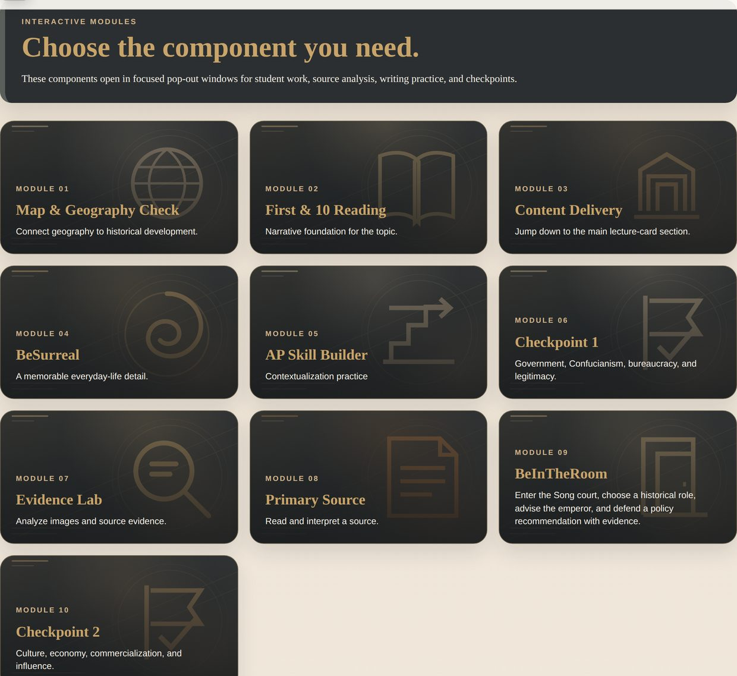
THE SIGNATURE SYSTEM
One learning path. Ten modules. Every single lesson.
behistorical · unit 1 · topic 1.1 — interactive modules
The same pedagogical spine runs through all 77 lessons — every lesson opens the same ten modules in the same order, so students always know where they are and quality never drifts.
1. Build Context
2. Learn & Practice
3. Check Understanding
Modules 04, 07, 08 & 09 carry the features that make BeHistorical distinctive.
Live screenshot · Topic 1.1, Song China
AndersonLogic AI · BeHistorical
04 / 18

Slide 5
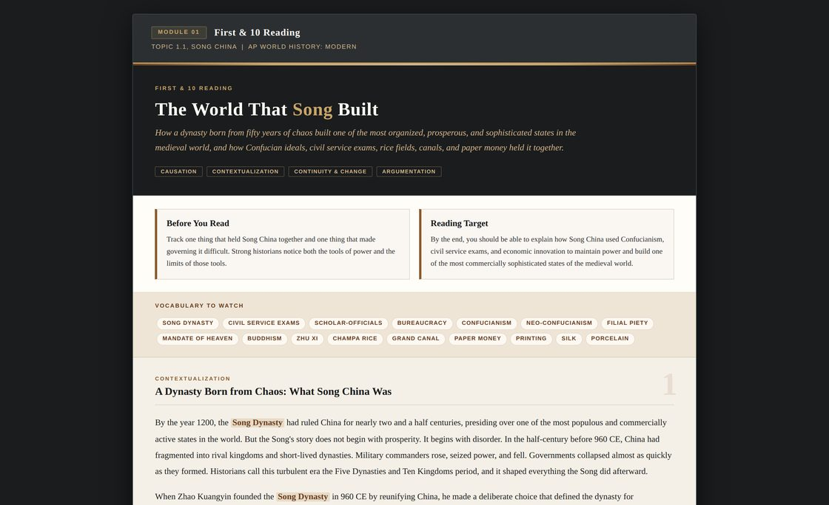
WHAT MAKES IT DIFFERENT
Named modules students remember
behistorical · first-and-10 · topic 1.1
First & 10
A designed, textbook-quality reading with vocab chips, AP-skill callouts, and three open-response questions.
BeSurreal
A surprising, human detail that makes history concrete and memorable.
Evidence Lab
Students connect real evidence to a larger political, cultural, or economic claim.
Primary Source
An authentic excerpt with a HIPP analysis prompt.
AP Skill Builder
Focused practice on one AP reasoning skill per topic.
First & 10 Reading — "The World That Song Built"
BeReady
A ten-second takeaway that synthesizes the whole reading.
AndersonLogic AI · BeHistorical
05 / 18

Slide 6
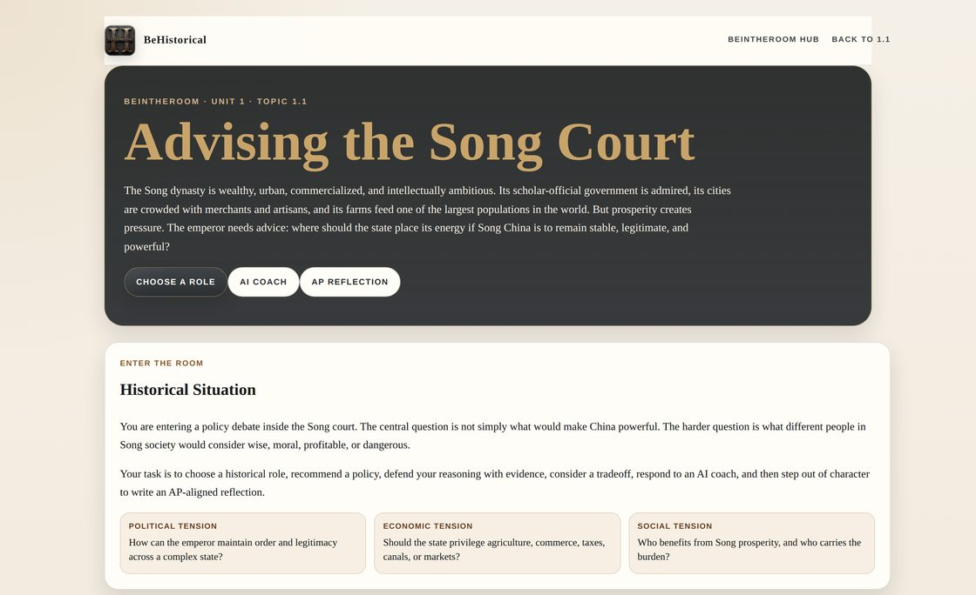
THE FLAGSHIP MODULE
BeInTheRoom — decision simulations, not costume roleplay
behistorical · beintheroom · unit 1 · topic 1.1
1
Enter a real historical decision point
2
Adopt a role with goals, fears, constraints
3
Decide a defensible recommendation
4
Defend with evidence; AI coaching probes it
5
Reflect out of character, AP-style
4+ roles
8–12 evidence chips
3 trade-offs
61 live & linked
Live scenario — "Advising the Song Court"
AndersonLogic AI · BeHistorical
06 / 18

Slide 7
AI, WITH GUARDRAILS
AI that coaches — never completes
Every reading and simulation builds a ready-to-paste coaching prompt and hands it to the class MagicSchool bot. The AI asks one question at a time — and is explicitly forbidden from writing the answer.
THE 6-STAGE SOCRATIC DIALOGUE
HOW WORK FLOWS
1
Role understanding
1. Think in BeHistorical
Evidence check
students draft and reason inside the platform
2
Trade-off
2. Coach in MagicSchool
3
the built prompt drives one-question-at-a-time dialogue
4
Opposing perspective
3. Capture to Google Forms
5
Historical thinking
responses auto-fill a prefilled form — unit, topic, skills tagged
6
Revision
4. Submit in Canvas
assessed work lands where teachers already grade
AndersonLogic AI · BeHistorical
07 / 18

Slide 8
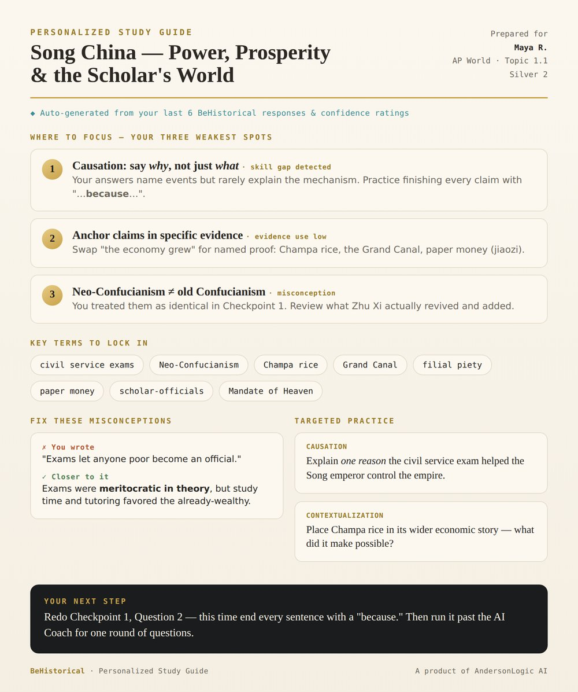
PERSONALIZED STUDY GUIDES
IN DEVELOPMENT
A study guide built from each student's own work
behistorical · study-guide · auto-generated · PDF
No two guides are the same. Each one reads a student's own responses and confidence ratings, then targets exactly what they need next — using the same analysis engine that powers the Teacher Hub.
Your three weakest spots
Pulled from detected skill gaps, low-confidence answers, and flagged misconceptions.
Targeted practice
Questions tuned to the exact AP skill the student is missing — not generic review.
One clear next step
A single, doable action — then a round with the AI Coach. Augment, never replace.
Design concept · generated per student, per topic
◆ Same data → personalized for every student
AndersonLogic AI · BeHistorical
08 / 18

Slide 9
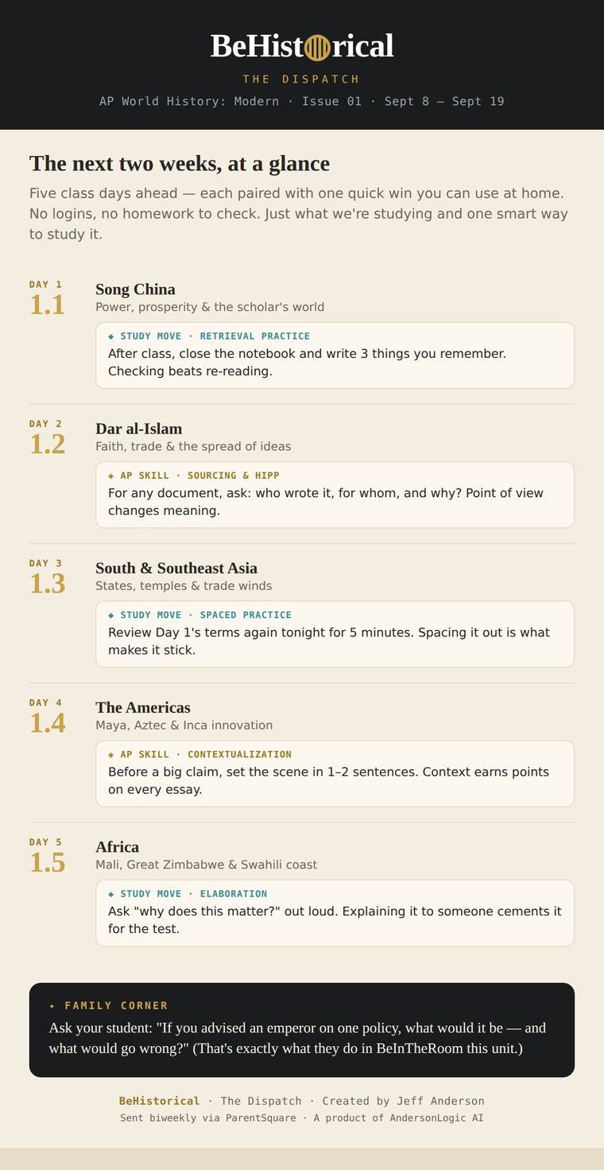
THE DISPATCH — FAMILY NEWSLETTER
IN DEVELOPMENT
Every family, in the loop — automatically
the dispatch · issue 01
A biweekly email that forecasts the next five class days and pairs each topic with one "Tip of the Day" — a study-science move or an AP exam skill. For students and their families, in plain language.
Auto-generated from the course
Topics, tips, and Family Corner prompts merge from a Google Sheet into a branded HTML email.
A rotating coaching library
6 learning-science Study Moves + 8 AP Skill Spotlights cycle so tips never go stale.
Delivered where families already are
Sent biweekly through the school's ParentSquare platform — no new app, no logins.
◆ Turns the classroom into a home conversation
Issue 01 mockup · template & content library built
AndersonLogic AI · BeHistorical
09 / 18

Slide 10
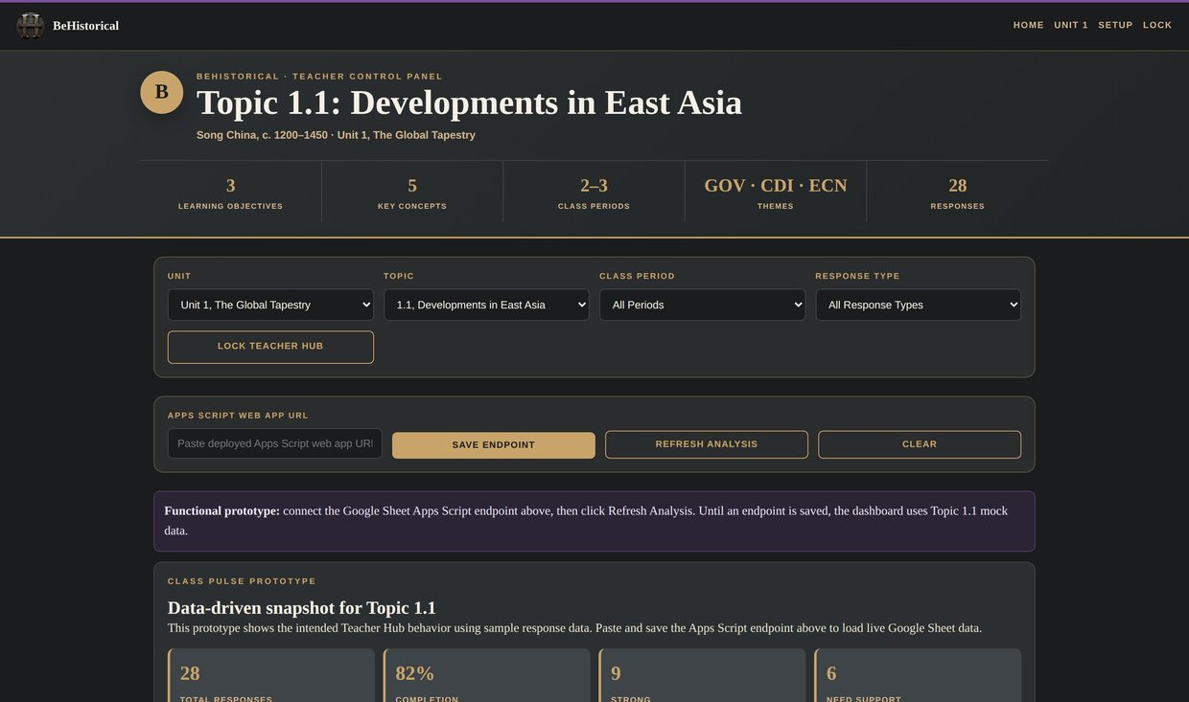
FOR THE TEACHER
LIVE PROTOTYPE
The Teacher Hub — a live read on the class
behistorical · teacher hub · topic 1.1
Class Pulse
Response count, average confidence, and how many students need support — at a glance.
Students needing follow-up
Per-student cards with the issue, next step, and a High / Medium / Low risk badge.
Reteach recommendations
Common misconceptions and skill gaps turned into prioritized, actionable focus.
Lesson delivery tools
Pacing guide, answer keys, KC-coded objectives, and copy-ready AI analysis prompts.
Working prototype · Topic 1.1 · rule-based Apps Script backend
AndersonLogic AI · BeHistorical
10 / 18

Slide 11
THE ENGINE UNDERNEATH
From raw answers to teaching decisions
One analysis engine reads every student response and turns it into insight — and it's what powers the Teacher Hub, the study guides, and The Dispatch alike.
→
→
01 · CAPTURE
02 · ANALYZE
03 · ACT
Every response, structured
Rule-based, transparent
One engine, three outputs
Prefilled Google Form → Sheet
Tagged by unit, topic & AP skill
Confidence rating on every answer
Flags blank, short & low-confidence work
Detects evidence use & misconceptions
Spots missing reasoning (skill gaps)
Teacher Hub — class & per-student
Study guides — personalized
The Dispatch — family-facing
AndersonLogic AI · BeHistorical
11 / 18

Slide 12
STUDENT PRIVACY, BUILT IN
The AI students use is FERPA-safe — and already district-approved
STUDENT-FACING · DISTRICT-APPROVED
TEACHER-FACING · FERPA-ALIGNED
MagicSchool AI
Claude for Teachers
Student coaching runs inside MagicSchool — adopted by our district as a FERPA-safe AI tool. Not a personal chatbot, not a consumer account.
Teacher-side analysis uses Claude, Anthropic's education AI — built to support FERPA compliance, with student inputs not used to train models.
✓ District-vetted · FERPA-safe
✓ Education-grade · Not trained on student work
Coaches, never completes — and never trains on a student's thinking.
AndersonLogic AI · BeHistorical
12 / 18

Slide 13
HOW STUDENT DATA IS PROTECTED
Student data stays inside district-approved systems
WHERE IT RUNS
NO TRAINING
Tools the district already governs
Never used to train an AI
Students draft in BeHistorical, are coached in district-approved MagicSchool, and submit in Canvas — no new data destinations to vet.
Both AI tools are education-grade and vetted; a student's work is never used to train or improve an AI model.
PATTERNS, NOT EXPOSURE
SECURE BY ROADMAP
Aggregate by default
Authenticated access next
The Teacher Hub summarizes class-level trends; identifiable student data is never published to the public site.
A secure teacher sign-in replaces the prototype access code before any live student data flows through the Hub.
Privacy isn't bolted on — it's the boundary the whole system is built around.
AndersonLogic AI · BeHistorical
13 / 18

Slide 14
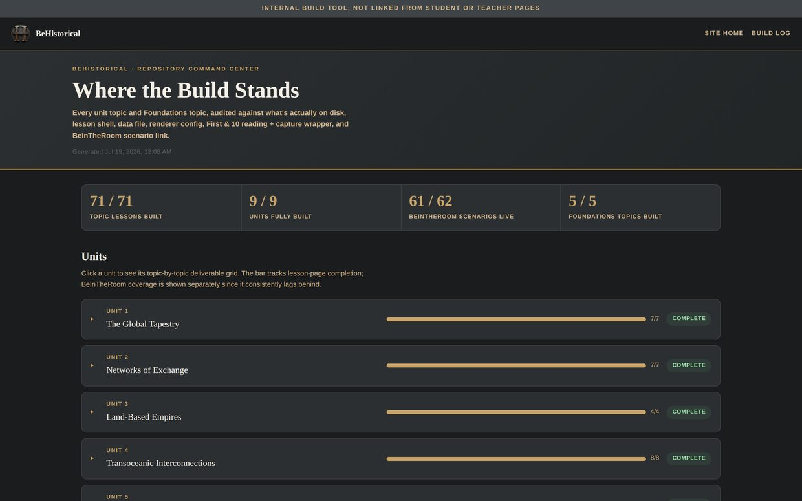
WHY IT SCALES
Built like software, not a slide folder
behistorical · repository command center
Automated validation
A 547-file audit runs on every change — module order, form wiring, and simulation quality gates. Zero-error deploys.
Deterministic builders
Whole units are generated from data by scripts — so a fix rolls out everywhere, consistently, at once.
Codified quality gates
Design rules live in blueprints and are enforced by machine before anything ships.
The difference between a teacher's materials and a product a district can adopt.
The Command Center — audited against what's actually on disk
AndersonLogic AI · BeHistorical
14 / 18

Slide 15
HOW IT ALL CONNECTS
One platform, one data layer, three audiences
→
→
Teacher Hub
STUDENTS LEARN
ONE DATA LAYER
→ teachers act in real time
The lesson platform
Every response, analyzed
10-module lessons, First & 10 readings, BeInTheRoom simulations, and an AI coach that questions rather than answers.
Answers, confidence, evidence, misconceptions, and skill gaps — captured and read by a single engine.
Study Guides
→ students get a targeted plan
The Dispatch
→ families stay in the loop
Build the lesson once — and everyone around the student is served automatically.
AndersonLogic AI · BeHistorical
15 / 18

Slide 16
WHERE THE BUILD STANDS
What's live, and what's next
LIVE NOW
IN DEVELOPMENT
EXPLORING
› 77 complete lessons · all 9 units + Foundations
› Personalized study guides
› Auto-sent study guides
› 61 BeInTheRoom simulations
› The Dispatch · template + Issue 01 built
› Other AP courses & subjects
› AI coach + MagicSchool workflow
› Teacher Hub across all units
› District rollout & PD
› Command Center & validation
› Live data pipeline · Form → Sheet → Hub
› Consulting & licensing
› Teacher Hub · Topic 1.1 prototype
AndersonLogic AI · BeHistorical
17 / 18

Slide 17
MEASURING IMPACT
How we'll know it's working
Year one is the baseline. Here's what BeHistorical already lets us see — and the outcomes we'll measure against it.
✓ WHAT WE CAN ALREADY SEE
◎ WHAT WE'LL PROVE
Participation & completion, per lesson and module
Confidence trends across a unit (1–5 self-ratings)
AI-coaching engagement — coaching rounds per student
Response-quality signals — evidence use & reasoning language
AP exam 3+ rate vs. prior years
SAQ / DBQ rubric growth, pre → post
MCQ mastery by Key Concept
Family engagement — Dispatch open & click rates
Method: pre/post on CED-aligned items · section-to-section comparison · tracked in the Teacher Hub · baseline year 2026–27
AndersonLogic AI · BeHistorical
16 / 18

Slide 18
WHERE THIS GOES
A method — not just a course
BeReady
BeSurreal
A repeatable framework
The 10-module path, the AI guardrails, the analytics engine, and the build system are subject-agnostic — ready to lift into any AP or core course.
BeInTheRoom
Professional development
The system itself is the curriculum: a concrete model for teaching with AI responsibly, backed by working proof.
BeHistorical
A platform to grow on
BeHistorical is the first product under AndersonLogic AI — a foundation for a family of AI-integrated learning tools.
AndersonLogic AI · BeHistorical · Created by Jeff Anderson
18 / 18

