Slide 1

Taggle

Slide 2
Introduction
Meet Team 404
Kyler Sousley
Creed Maxwell
Jordan Coleman
Moustafa Bendari
Jacob Dahl
Everyone

Slide 3

The problem
Modern day algorithms show you what it thinks you may be interested in.
Most posts you see may be relevant to what you want to see, but users are still subjected to an excess of unrelated posts.
Wouldn’t it be nice to control what you see?
Kyler S, Creed M
Notes:
Kyler Sousley

Slide 4

Introducing: Tags!
Not the usual tag system
Music
The application will filter out any posts that don’t have the tags attached to users profile.
User selects one or more tags that is attached to their profile
Astronomy
The same will happen when searching for other users profiles.
When posting, user must select one or more tags that are relevant to the topic of their post
Gaming
Can be changed anytime!!
Kyler S, Creed M

Slide 5

In-Scope
We will start on the Web
Upload sizes will be limited so that we can ensure that our server will not get bogged down
We will start with three tags to allow for as much to get done as possible with the limited amount of time that we have.
A login system will be feasible, and will be implemented
Jordan

Slide 6
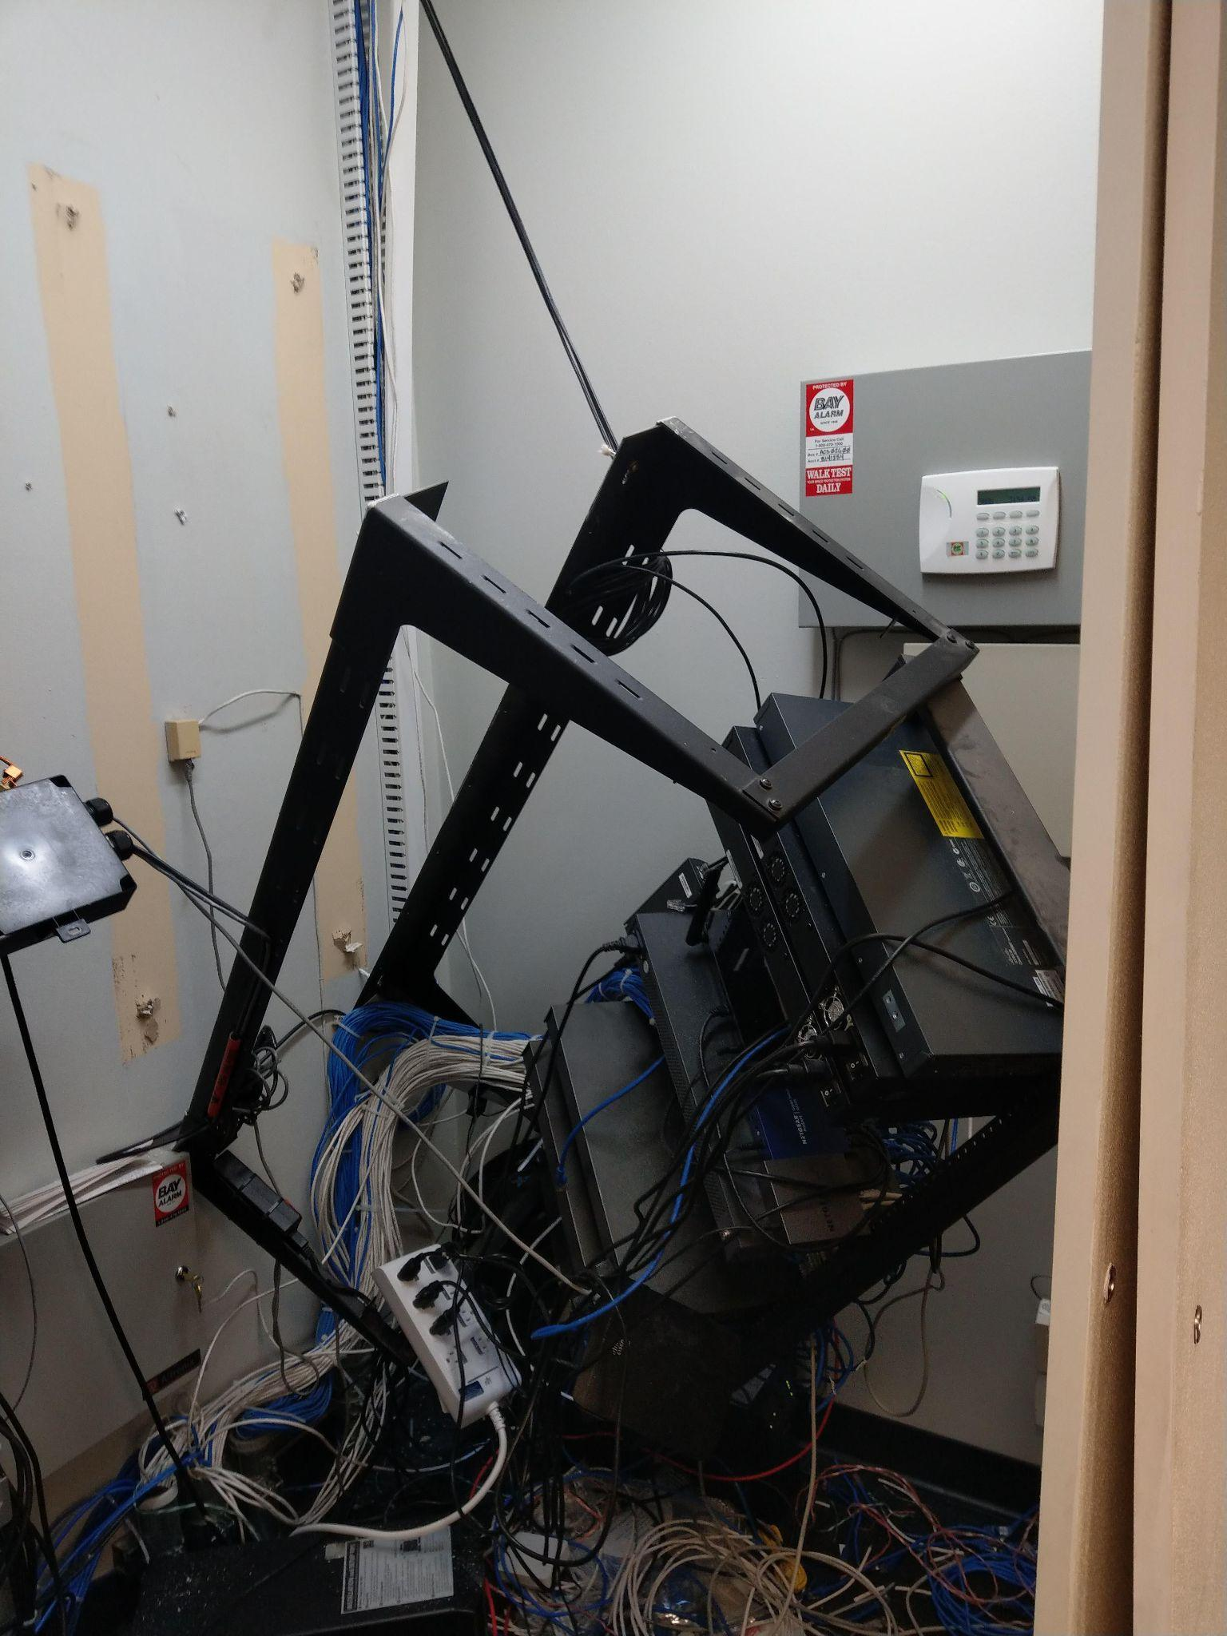

Out-of-Scope
Start on the web, no mobile or desktop app unless time permits
Doing a full scale search system may take some time, but will be taken into consideration
We may consider doing more than three tags, but that will be the starting point
Jordan

Slide 7
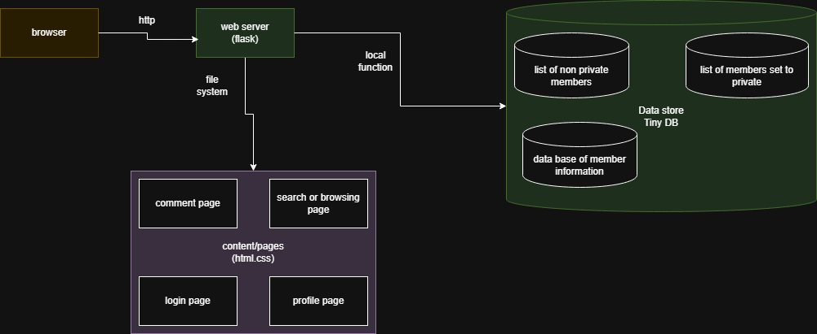
Solution Architecture

Slide 8
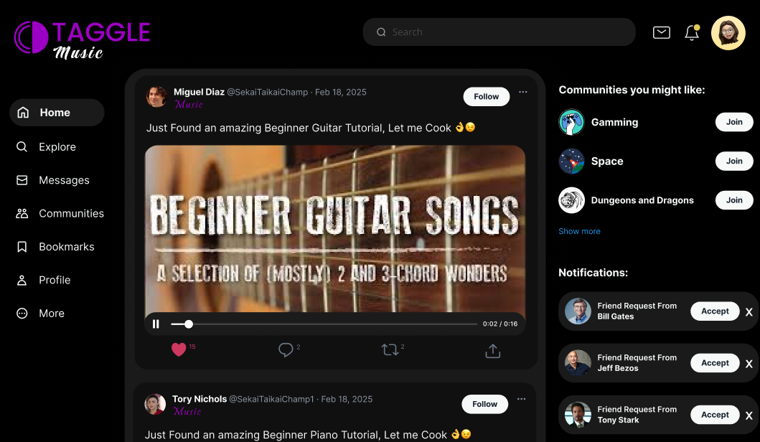
Moustafa

Slide 9
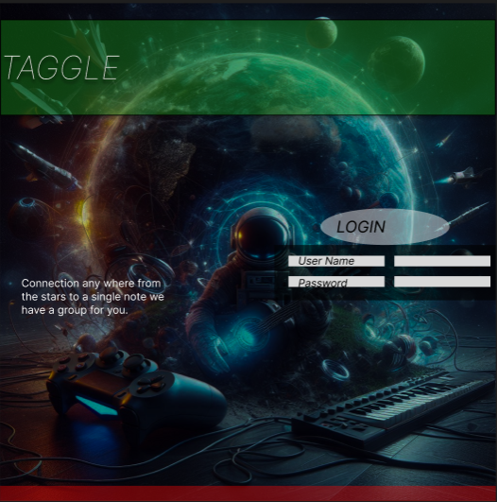
Login page
Taggle.
Connection anywhere from the
Stars to a single note we have
A group for you.
Jacob Dahl

Slide 10
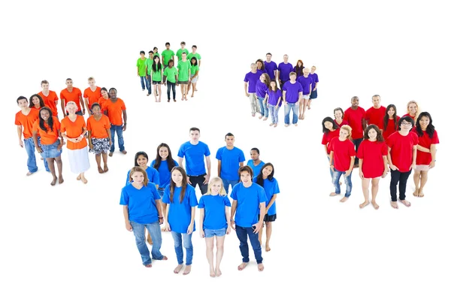
Summary and Conclusion
Most social media apps have too much clutter
We want to show you only what you want to see
Taggle offers a seamless, clean, and uncluttered social media experience
Chat, follow, and post with people that share YOUR interests
Separate yourself from the rest of the crowd, join Taggle
Notes:
Creed Maxwell

Slide 11

Questions?
Notes:
Creed Maxwell

