Slide 1
Portfolio
Jeff Dorling
27/5/19

Slide 2
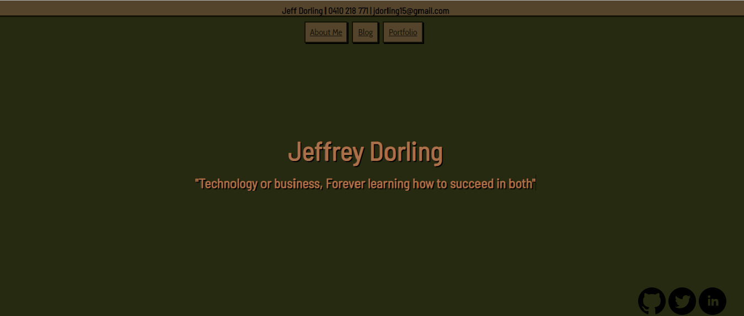
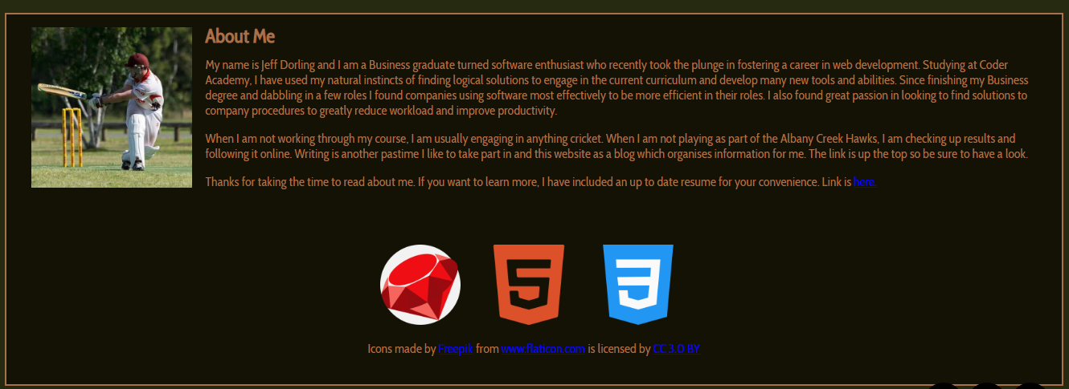
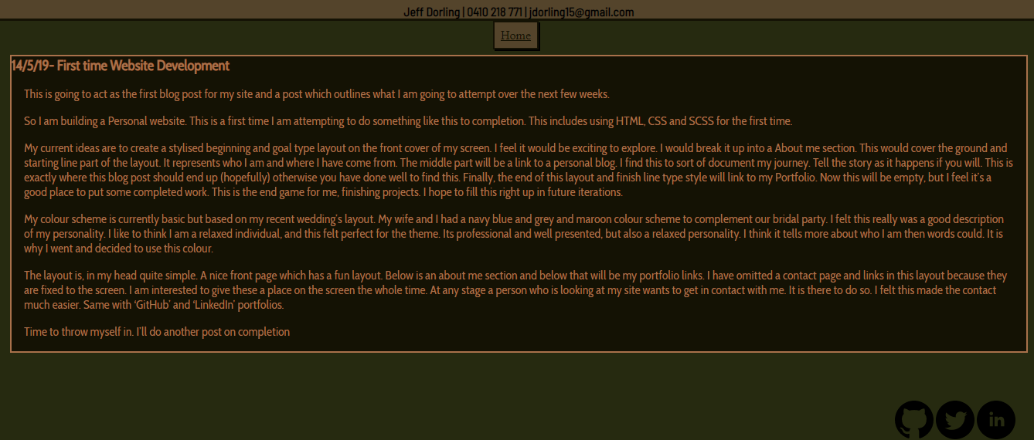

Website Walkthrough https://jeffdorling.github.io/jeff-dorling.github.io/

Slide 3
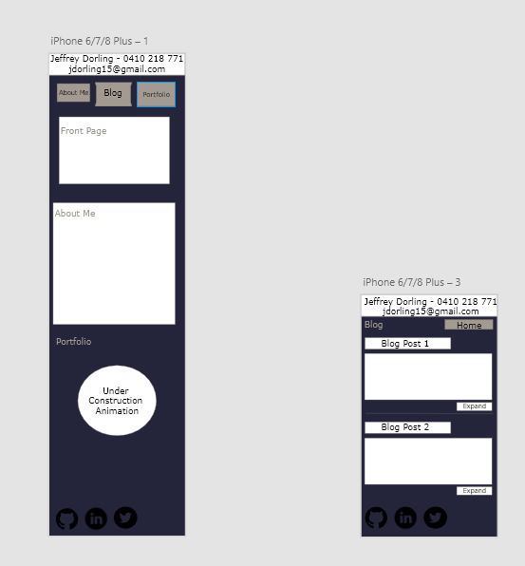
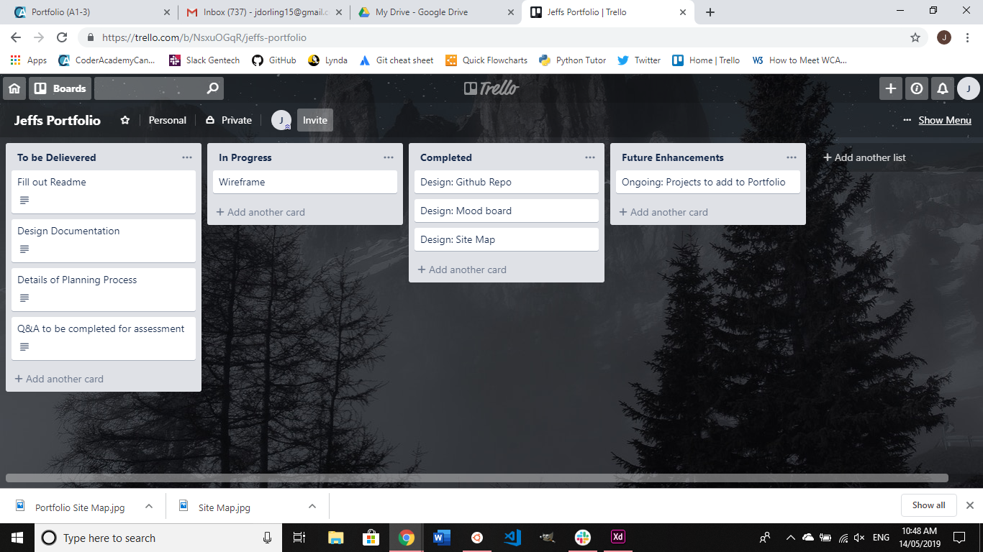
Design Process
Trello and ADOBE XD were Utilized

Slide 4

Challenges and Development
Challenges include
-Initial Scope was too large
-CSS for first time user was difficult at times to grasp
-Implementing for phone before desktop and having them both work well together
-Bragging about myself while very aware I am new to this

Slide 5
Questions?

