Slide 1
Parallel Programming
Lab1
2019/9/26

Slide 2
Conventions used in this slide
Descriptive text is serif.
Commands and codes are monospaced.
Codes that require modifications to work are italic.
You do not need to turn in "Practice"s.

Slide 3
Useful commands
Login: ssh pp19s56@apollo.cs.nthu.edu.tw
File transfer: rsync -ahP mydir/ pp19s56@apollo.cs.nthu.edu.tw:mydir/
Editors: vim emacs nano
SLURM usage: smap -i 1
Disk quota: quota -s
Change password: passwd
Navigation: cd ls vim mv rm cp
Compilers: gcc g++ mpicc mpicxx
Download a file: aria2c

Slide 4
Outline
Platform introduction - apollo
Login to apollo
Compile & execute program on apollo
Lab - Approximate the value of π using MPI

Slide 5
Platform introduction
20 nodes:
Intel X5670 2x6 cores @ 2.93GHz
96GB RAM
5.5TB shared RAID5 disk
QDR Infiniband
workload scheduler: SLURM

Slide 6
Software
OS: Arch Linux
Compilers: GCC 9.1.0, Clang 8.0.0
MPI: MVAPICH-2.3.1
Workload scheduler: 18.08.3

Slide 7
Available resources
1 login node (200%CPU max)
16 compute nodes (1200% CPU max)
Use smap -i 1 to view SLURM usage
Cluster monitor: http://apollo.cs.nthu.edu.tw/monitor
48GB disk space per user
Use quota -s to view disk quota

Slide 8
Outline
Platform introduction - apollo
Login to apollo
Compile & execute program on apollo
Lab - Approximate the value of π using MPI

Slide 9
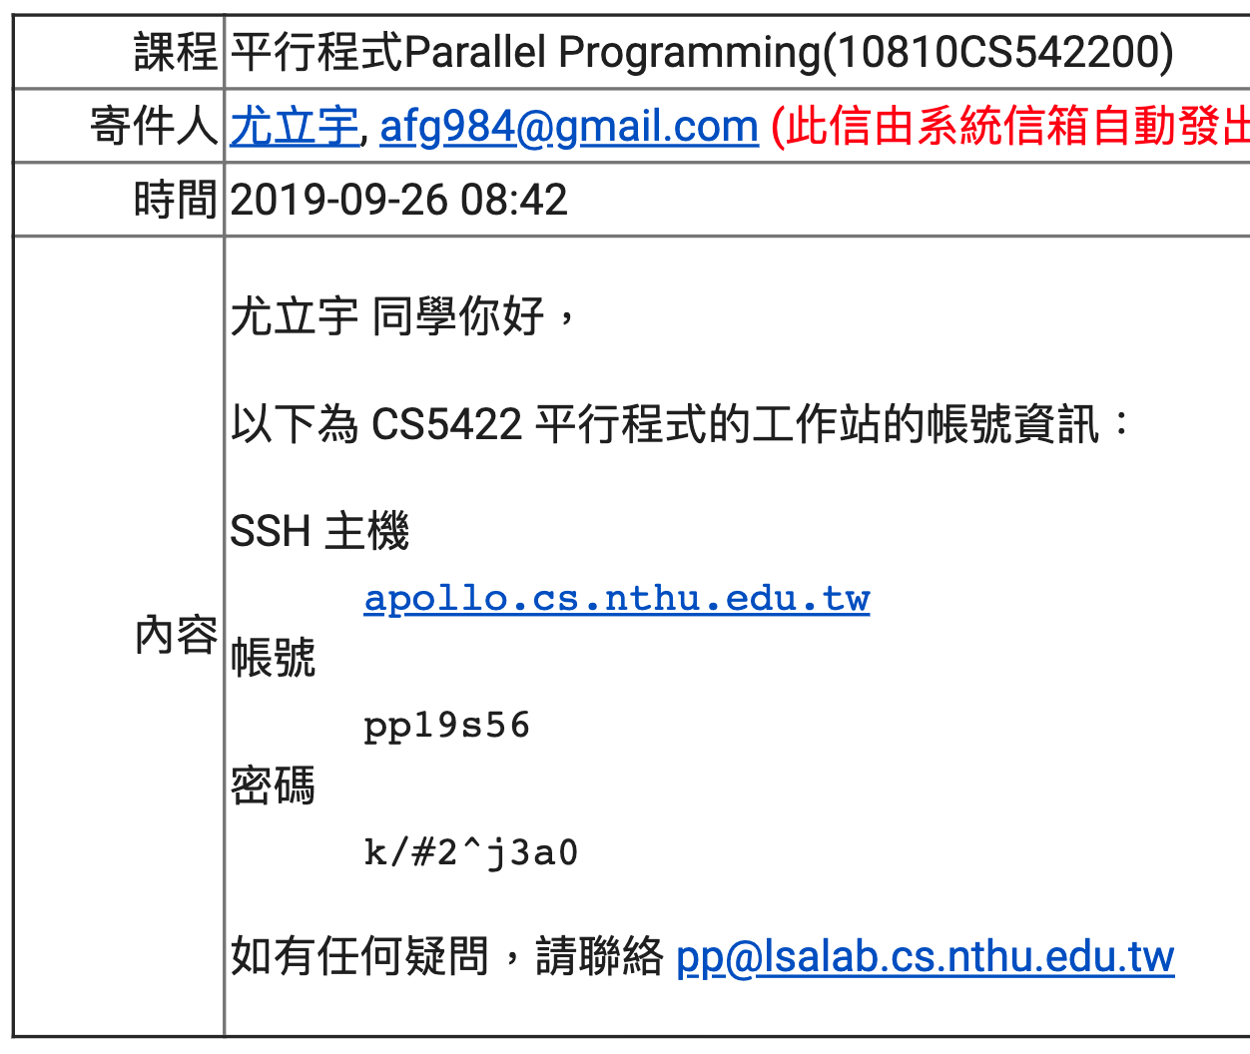
Login information
工作站：apollo.cs.nthu.edu.tw
帳號：已經寄信給同學
密碼：已經寄信給同學

Slide 10
SSH with Unix systems {Linux,BSD,macOS}
Open the terminal
ssh pp19s56@apollo.cs.nthu.edu.tw
You will be asked to change password on the first login
File transfer
rsync -ahP mydir/ pp19s56@apollo.cs.nthu.edu.tw:mydir/

Slide 11
SSH from windows
MobaXterm http://mobaxterm.mobatek.net/download-home-edition.html
Putty https://www.putty.org/
Windows 10 built-in You can directly type ssh in cmd / powershell

Slide 12
Practice
Login to the server
Notes:
On first login, you will be forced to reset your password
If you want to change your password again, you can use: passwd

Slide 13
Outline
Platform introduction - apollo
Login to apollo
Compile & execute program on apollo
Lab - Approximate the value of π using MPI

Slide 14
Compilers on apollo
gcc -- C compiler
g++ -- C++ compiler
mpicc -- MPI C compiler wrapper
mpicxx -- MPI C++ compiler wrapper

Slide 15
Compile a hello world MPI program
To compile a program, use: mpicc hello.c -O3 -o hello
You can download the code at: https://www.open-mpi.org/papers/workshop-2006/hello.c
Command: aria2c https://www.open-mpi.org/papers/workshop-2006/hello.c

Slide 16
Run a hello world MPI program
Use srun / sbatch / salloc:
$ srun -n 4 ./hello
Hello, World. I am 1 of 4
Hello, World. I am 3 of 4
Hello, World. I am 0 of 4
Hello, World. I am 2 of 4

Slide 17
Practice
Run the MPI hello world program.

Slide 18
Job priority
SLURM will favor:
short running jobs (you can set time limit)
less resource demanding jobs
jobs queued for a long time
users that haven't run a lot of jobs recently

Slide 19
Job submission (srun)
srun options ./executable args…
options | usage
-N NODES | NODES is the number of nodes to run the job
-n PROCESSES | PROCESSES is number of total processes to launch
-c CPUS | CPUS is the number of cpus available to each process
-t TIME | The time limit in "minutes" or "minutes:seconds"
-J NAME | The name of the job. Will be displayed on squeue

Slide 20
Job submission (sbatch)
Using sbatch command to submit jobs in the background
You can write a simple script to do that
After writing the script, run the command $ sbatch job.sh
#!/bin/bash
#SBATCH -n 4
#SBATCH -N 2
srun ./hello_world

Slide 21
Job submission (sbatch)
sbatch also works without a script with the --wrap option: $ sbatch -N 2 -n 4 --wrap="srun ./hello_world"
#!/bin/bash
#SBATCH -n 4
#SBATCH -N 2
srun ./hello_world

Slide 22
Job control
sinfo view status of nodes
squeue view submitted jobs in queue
scancel JOBID cancel a submitt job with its JOBID
smap -i 1 view the jobs and partitions

Slide 23
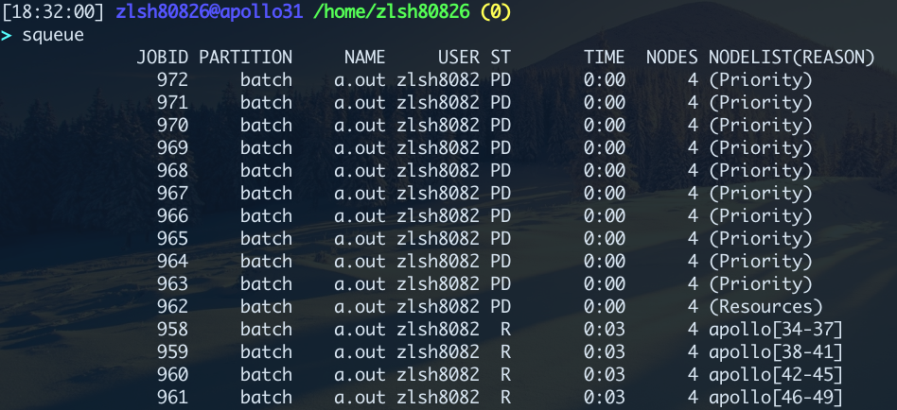
squeue

Slide 24
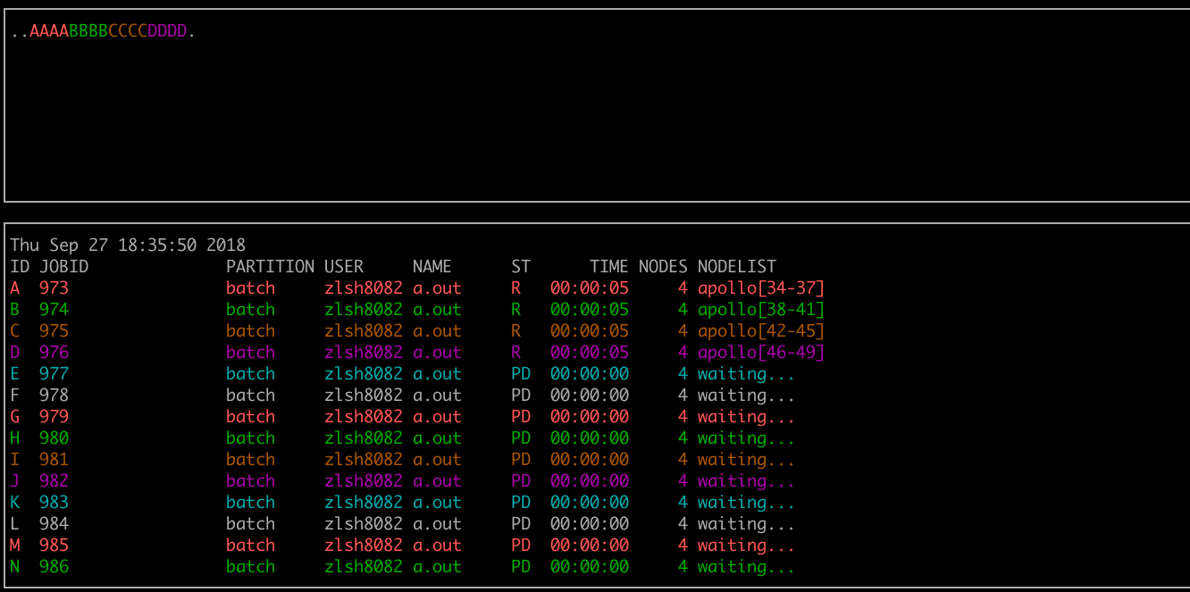
smap -i 1

Slide 25
Practice
Run MPI with sbatch with sbatch, using 4 nodes and 8 processes per node

Slide 26
Outline
Platform introduction - apollo
Login to apollo
Compile & execute program on apollo
Lab - Approximate the value of π using MPI

Slide 27
MPI_Send
int MPI_Send(const void *buf, int count, MPI_Datatype datatype, int dest, int tag, MPI_Comm comm)

Slide 28
MPI_Recv
int MPI_Recv(void *buf, int count, MPI_Datatype datatype, int source, int tag, MPI_Comm comm, MPI_Status *status)

Slide 29
MPI_Reduce
int MPI_Reduce(const void *sendbuf, void *recvbuf, int count, MPI_Datatype datatype, MPI_Op op, int root, MPI_Comm comm)

Slide 30
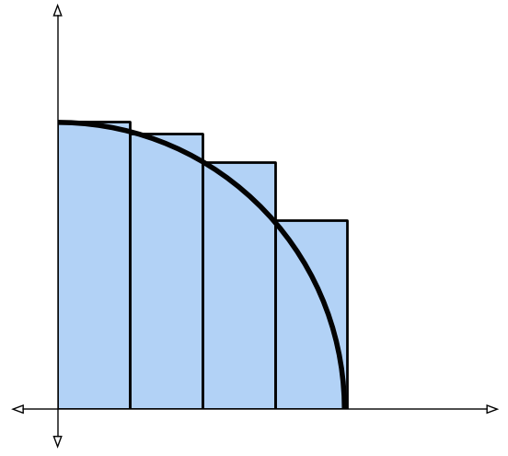
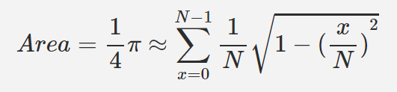
Approximate the value of π using MPI
We can approximate the value of π using Riemann sum
N rectangles
1
1

Slide 31
Lab spec
Your pi program should locate at ~/homework/lab1
Example code & Makefile locate at /home/pp19/share/lab1
You can write with C/C++ (pi.c or pi.cc)
Your program should accept an argument N, which is the number of slices ( 1≤N≤10¹⁰ ) $ srun options... ./pi N
Output your value of π once
Use lab1-judge to submit your code
Visit http://apollo.cs.nthu.edu.tw/scoreboard/lab1 for results

