Slide 1
DBI
Intro to DBI with DynamoRIO

Slide 2
What’s a binary?
A compact bunch of data
Exist in two forms
  On disk
  In memory (process)
ELF file
  Header
  Program headers
  Section headers/section data
PE/COFF etc.

Slide 3
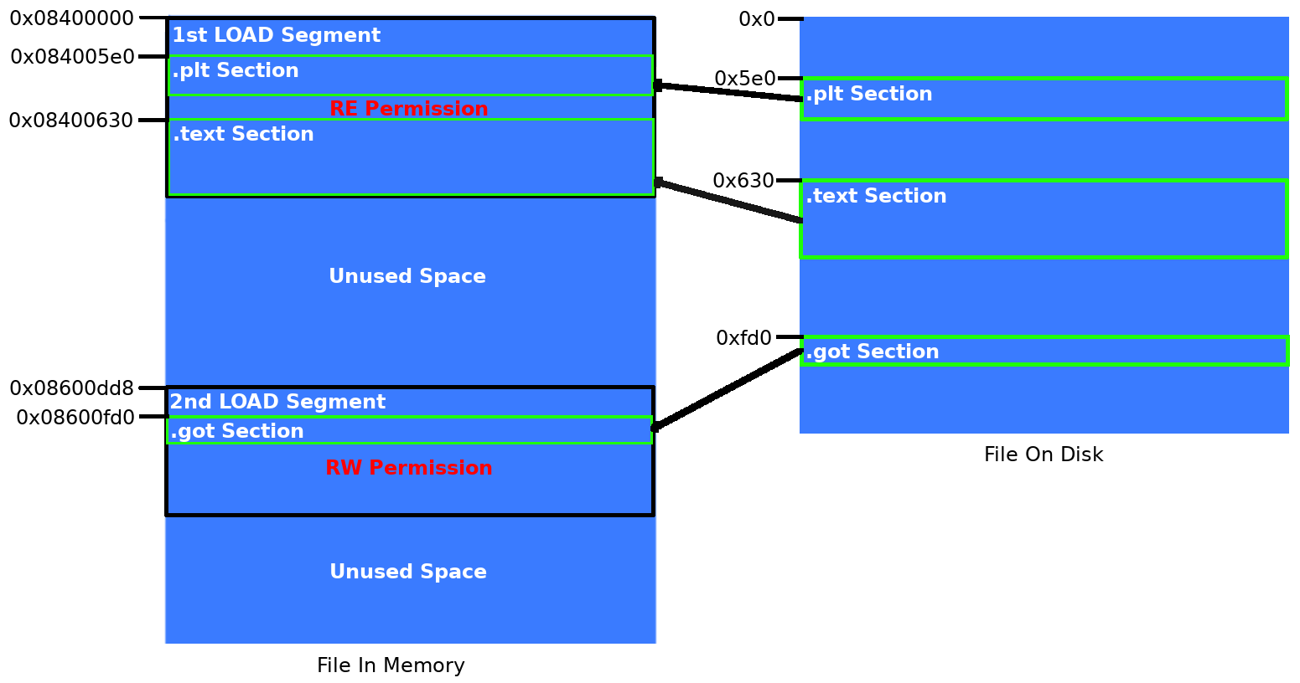
What’s loading?
Process of going from on-disk to in-memory
Segments are created from ELF program headers
Sections contain the data

Slide 4
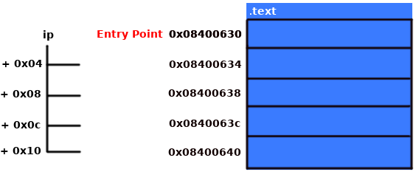
First execution
Instruction pointer set to entry point
Keeps incrementing by instruction length
Continues until exit/stop/halt condition
Memory assigned
Permissions set
.text section loaded to .text offset

Slide 5
Process lifetime
Entry point or _start
Loads libc and jumps to __libc_start_main
Sets up the environment
__libc_start_main jumps to main, an offset within process
Returns to __libc_start_main
Exits
on-disk - in-memory - _start - libc - main – libc – exit

Slide 6
The problem

