Slide 1
Fuzzing Fundamentals with AFL
WTF – What the Fuzz?

Slide 2
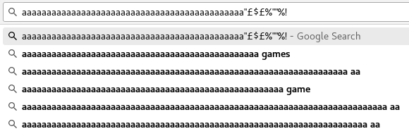
What’s a fuzzer?
Throw s#!t at a wall and see what sticks
Entering malformed inputs into things

Slide 3
Old Fuzzing Process
Dumb/mutation fuzzing
  Simple
  More random
  Less code coverage (in short term)
Generational
  Lots of overhead
  Better code coverage
Throw it, did it crash?

Slide 4
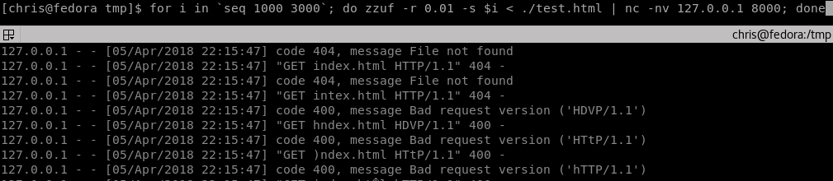
Dumb fuzzing
zzuf/radamsa
Takes some input, applies a seed and mutates
Example

Slide 5
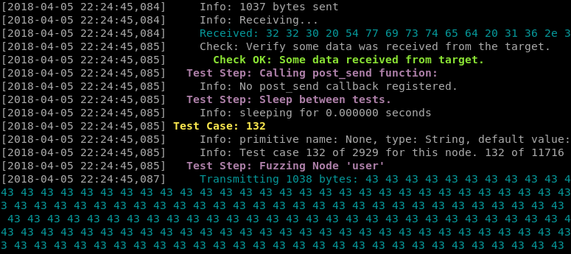
Generational Fuzzing
You describe language e.g. protocol structure
boofuzz
Example

Slide 6
New Fuzzing Process
Instrumented
Inputs feedback into mutator
  Tracing
Minimization
Sanitization
  Crash handling
In memory vs process

Slide 7
Generalised View
Input corpus
  Test cases
Mutator (dumb)
Instrumented binary e.g. stdin/file
Crash?
Generated new code path?
Save into queue
Diagram

Slide 8
AFL – American Fuzzy Lop
Compiler instrumentation
Dynamic binary instrumentation
  Qemu
  DynamoRIO
  DynInst
Test case minimization, tracing, corpus minization, optional sanitizers, process/fork based
Diagram

Slide 9
AFL Compiler Usage
Get binary/source
  Ensure exits after one loop
  Remove randomness/checksums
  Remove signal handlers
  Test harness
Compile
  Instruments .s assembly files
Example

Slide 10
AFL Fuzzer Usage
Specify options e.g. sanitizers
Input files, output directory
Run
Example

Slide 11
Execution tracer
Some xor’ing/counting things
  Edge vs basic block
Bloom filter
Named after maths guy with second name bloom
Sacrifices speed for collisions
Diagram

Slide 12
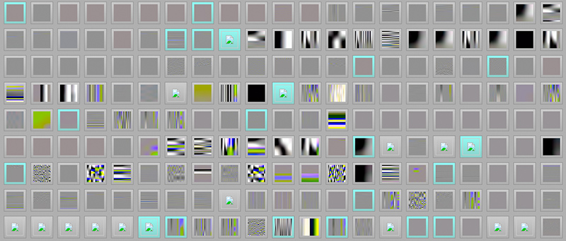
Hill Climbing
Biometrics term
Almost like machine learning
Trigger as much code coverage
Implies you have a valid input

Slide 13
Tips
Less but major bugs without sanitizers
More but minor bugs with sanitizers
Use a ramdisk
Periodically save the queue/crash/hang files
Persistent mode
Test case minimization
Example

Slide 14
Sanitizers 101
Compiler time
  Address Sanitizer
  Leak Sanitizer
  Undefined
Runtime
  Umbra
Shadow memory
Diagram

Slide 15
Triage
Run with address sanitizer
User debugging information
Don’t optimize
GDB/debugger
IDA Lighthouse
Example

Slide 16
Future
libFuzzer/LLVMFuzzerTestOneInput
  Build process
  Cluster fuzz
Concolic execution
Taint analysis
Diagram

Slide 17
Stuff

