Slide 1
Predictive Analytics: Image Detection
Group 4 Chai, Nyu nc2774@columbia.edu
Fang, Dingyi df2709@columbia.edu
Gao, Zun zg2307@columbia.edu
Mbithe, Nicole ncm2144@columbia.edu
Sohn, Jongyoon js5342@columbia.edu
Wu, Qiqi qw2273@columbia.edu

Slide 2
Data
2500 images in total
2000 images used for train purpose
500 images used for test purpose

Slide 3
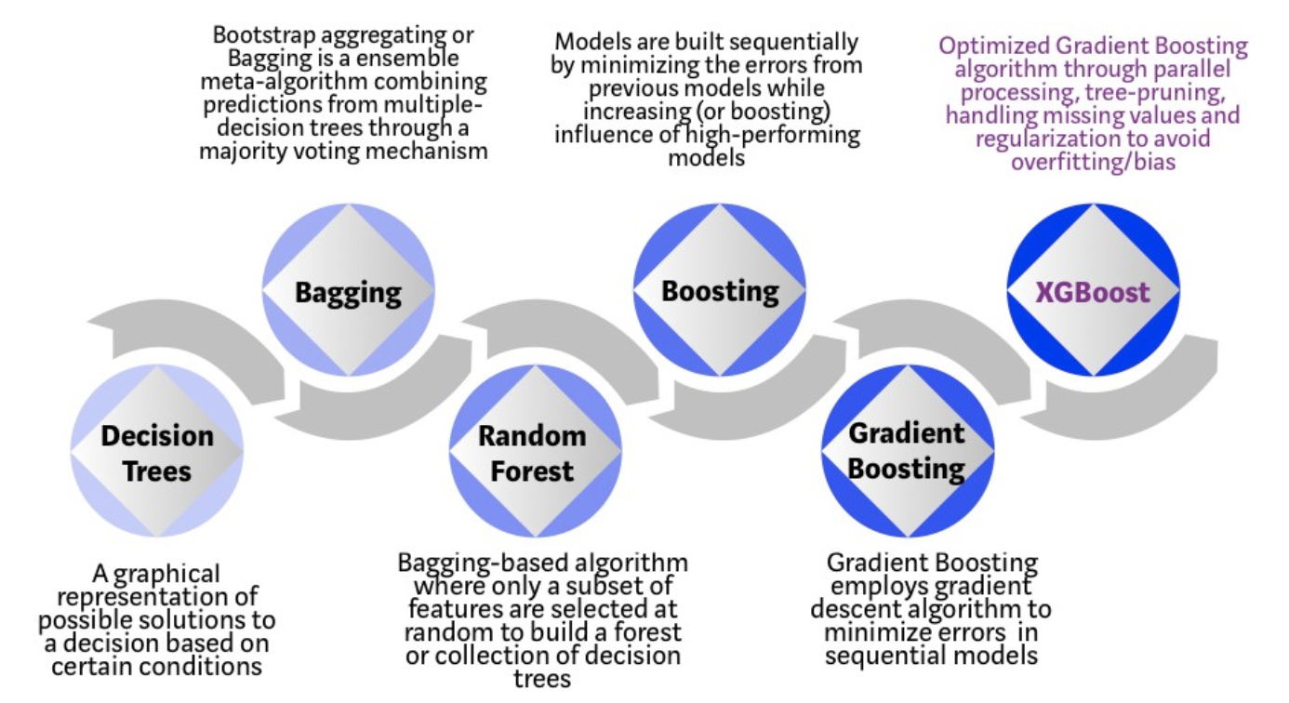
Model

Slide 4
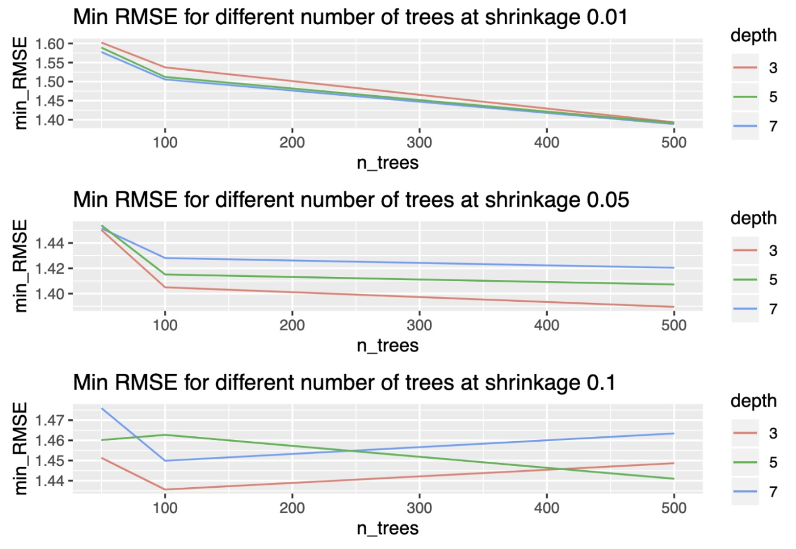
Baseline(Cont.)

Slide 5
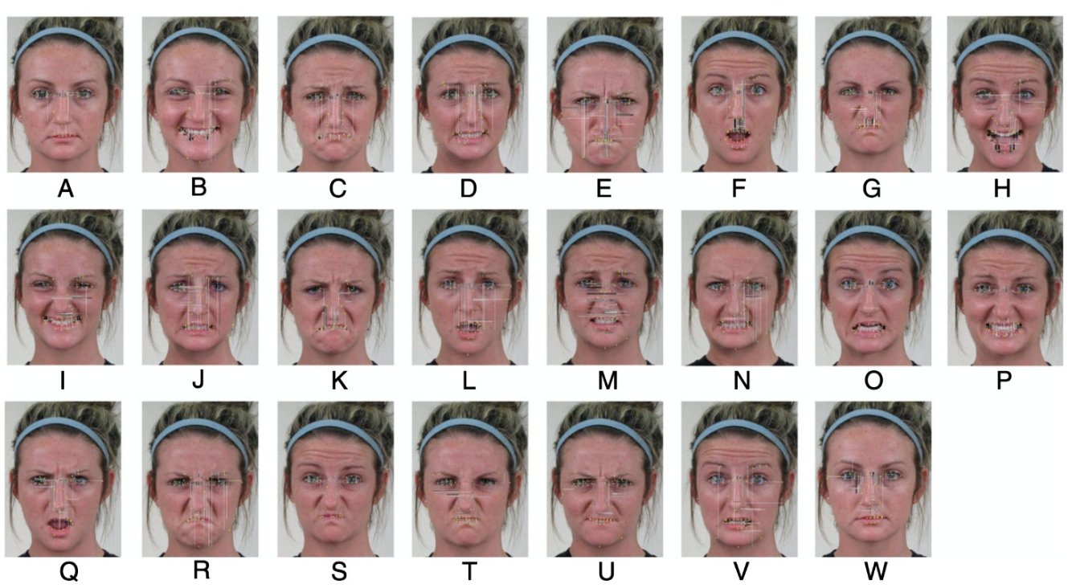
Feature Selection
Reduction of fiducial points
https://www.pnas.org/content/111/15/E1454

Slide 6
XGBoost
Extreme Gradient Boosting
Uses decision trees and gradient boosting to predict structured data
Tuned with learning rate(=0.01) and number of estimator(=500)
Results show great performance improvement in prediction. XGBoost improves on the original GBM model so this is to be expected
Notes:
#we used to have different feature with angles, but we don’t need angles anymore, so we didn’t tune gamma.

Slide 7
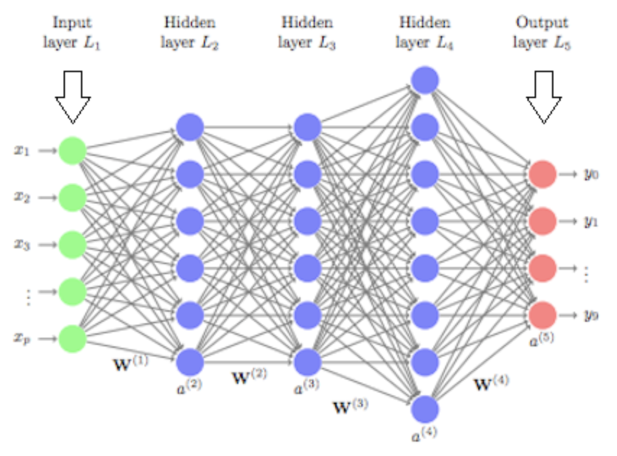
Neural Network Algorithm
HL
22*20
HL
22*10
HL
22*6
HL
22*2
Feature
Data
2450
22
classes
➯
➯
➯
Dropout
➯
Dropout
➯
Dropout

Slide 8
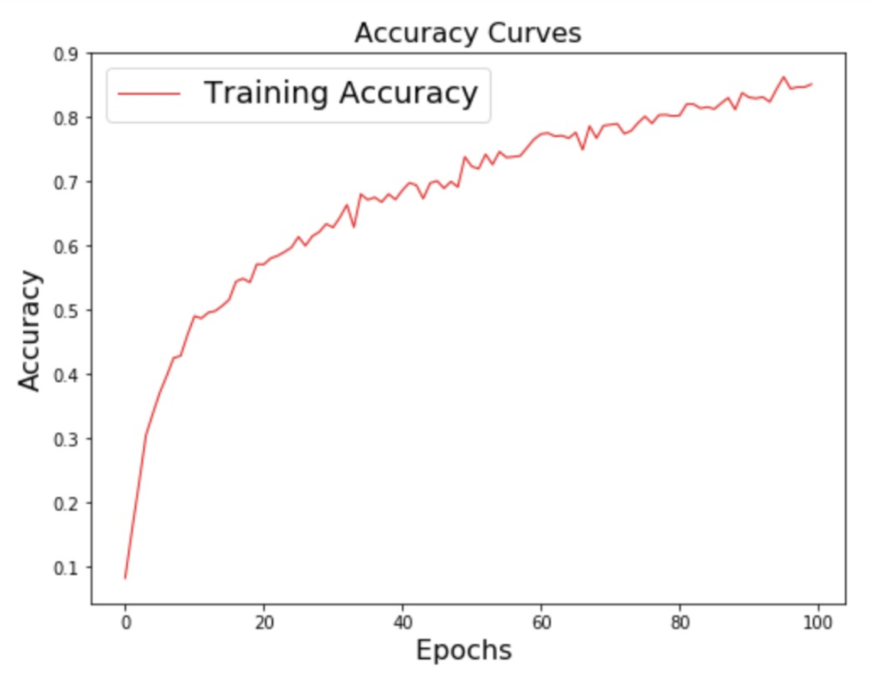
Neural Network(Cont.)

Slide 9
summary
 | Training Accuracy | Training Time | Test Accuracy | Test Time
Gradient Boosting | 85.7% | 2000s | 40.2% | 14s
XGBoost | 98.15% | 1014s | 49.4% | 1.56s
Neural Network | 85.1% | 91.207s | 54.4% | 0.125s
Gradient vs XGB => 23% increases in accuracy
Gradient vs NN => 36% increases in accuracy
XGB vs NN => 10% increases in accuracy

