Slide 1

G2M Insight For Cab Investment
Junfei Liu
Dec 21th 2022

Slide 2

Agenda
Problem Statement
Data Insights
EDA
Hypothesis Testing

Slide 3
Problem Statement:
XYZ is a private equity firm in US. Due to remarkable growth in the Cab Industry in last few years and multiple key players in the market, it is planning for an investment in Cab industry.
Objective: Provide actionable insights to help XYZ firm in identifying the right company for making investment.
Based on existing Cab Companies: Yellow Cab and Pink Cab
The Analysis include :
Data understanding,
Data visualization,
Multiple hypothesis

Slide 4
Dataset Information:
Cab_Data.csv – this file includes details of transaction for 2 cab companies.
Customer_ID.csv – this is a mapping table that contains a unique identifier which links the customer’s demographic details.
Transaction_ID.csv – this is a mapping table that contains transaction to customer mapping and payment mode.
City.csv – this file contains list of US cities, their population and number of cab users.

Slide 5
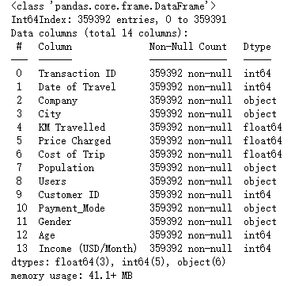
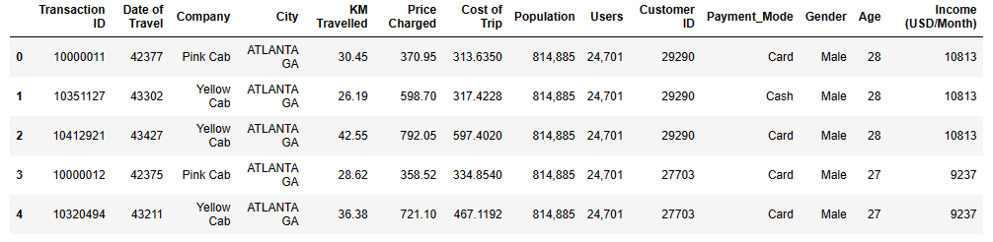
Dataset Merged
All four datasets can be merged into one dataframe for better analysis.

Slide 6
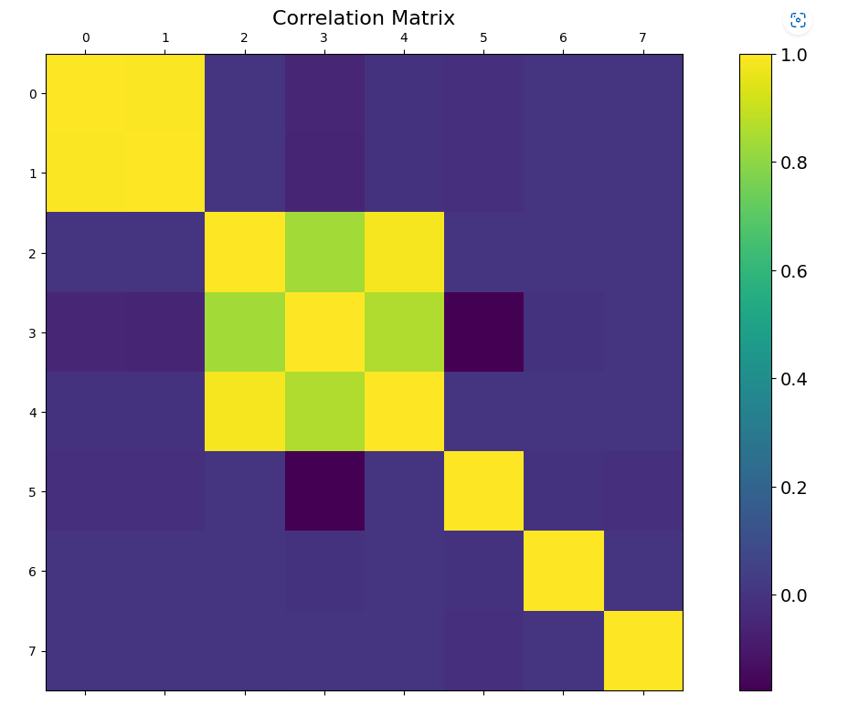
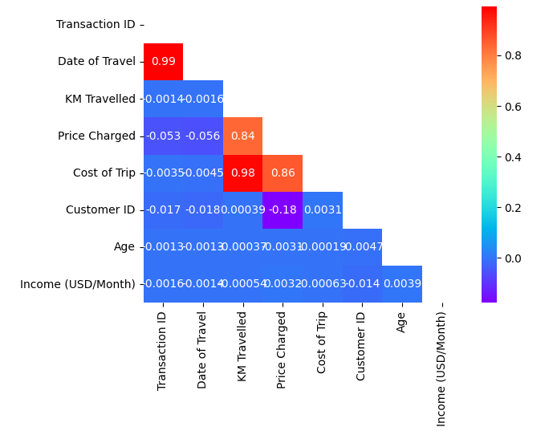
Correlation Investigation
Two groups of strong correlations:
Date of travel v.s. Transaction ID
Price charged v.s. KM Travelled v.s. Cost of Trip

Slide 7
EXPLORATORY DATA
ANALYSIS

Slide 8
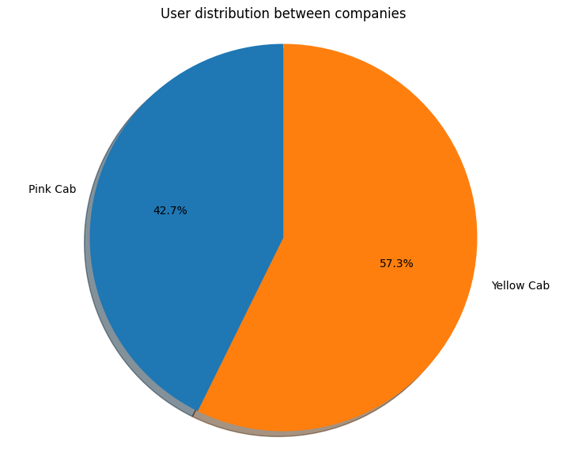
1. Distribution of Users between Cabs Companies:
From the figure above, we can see that yellow cab is more popular among customers.

Slide 9
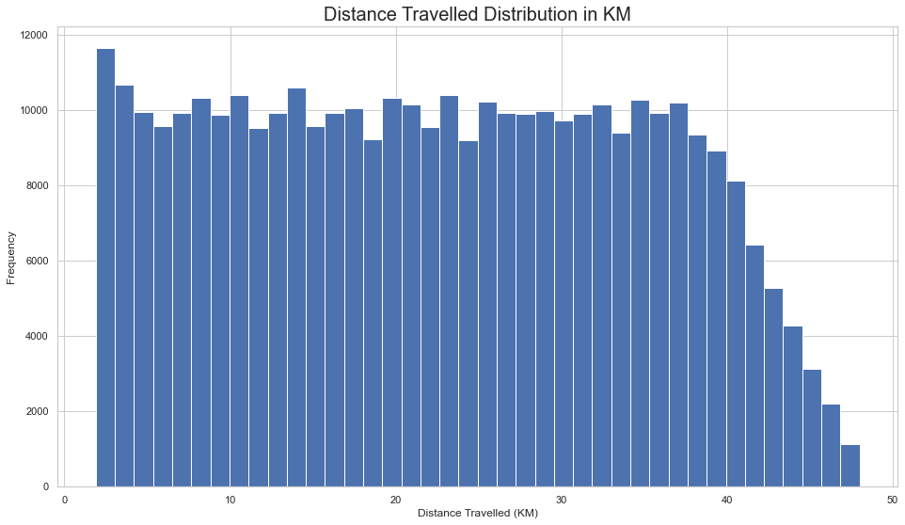
2. Distribution of Distance Travelled in KM:
From the figure above, most people have travelled between 2km and 40km, and we have
a decreasing number of users with increasing distance travelled with over 40 km distance travelled.

Slide 10
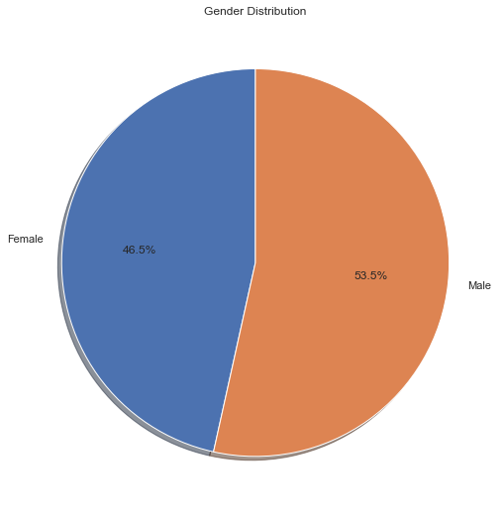
3. Distribution of Genders (total):
From the figure above, there are close percentage of male and female users based on the user
pool of both companies.

Slide 11
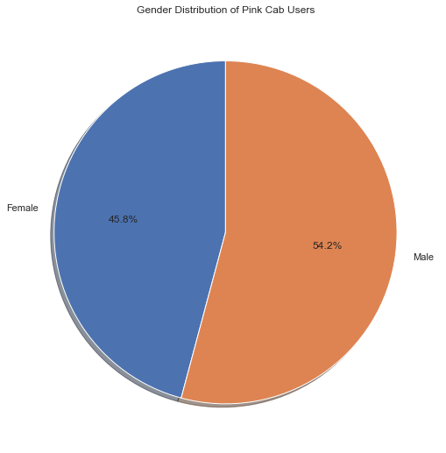

3.1. Distribution of Genders between Companies:
As we can see, the gender distributions are similar for both companies.

Slide 12
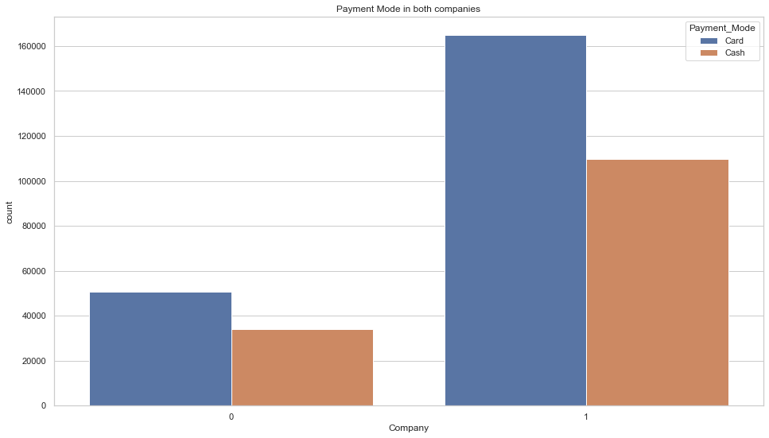
4. Distribution of Payment Type:
From the figure above, we can see users prefer to pay with card than cash for both companies.

Slide 13
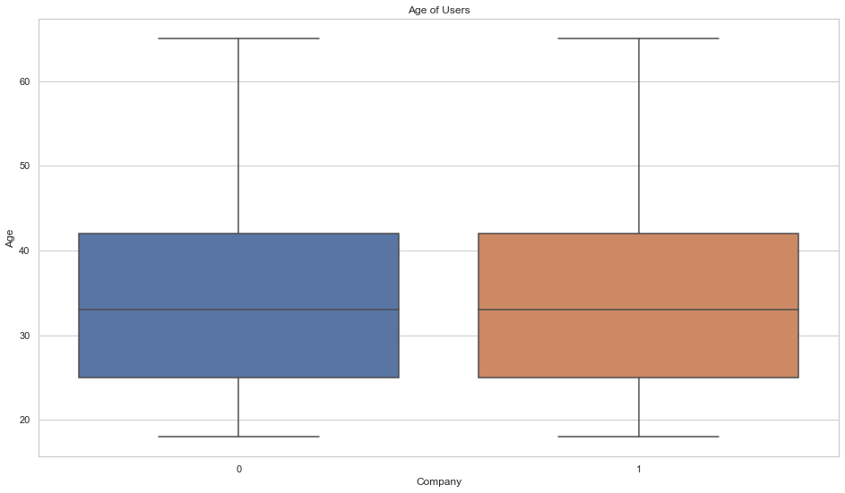
5. Distribution of User Age:
The distribution of user ages are similar for both companies with a range from under 20 to over 60
and an average of around 35.

Slide 14
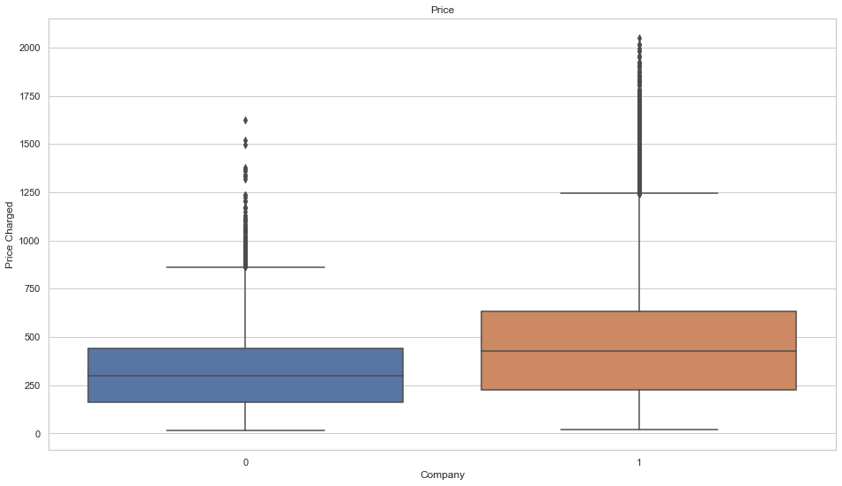
6. Distribution of Price Charged:
From the figure above, most people have travelled between 2km and 40km, and we have
a decreasing number of users with increasing distance travelled with over 40 km distance travelled.

Slide 15
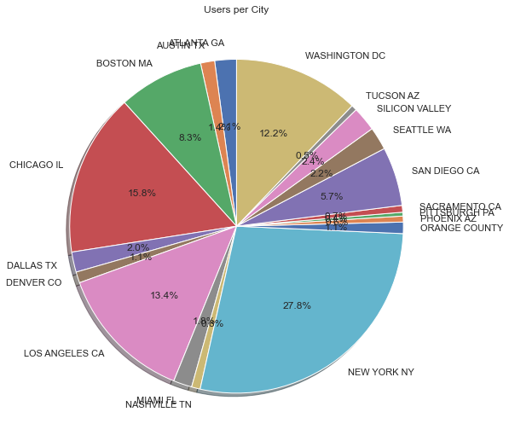
7. Distribution of Cities:
From the figure above, we can see the most users come from New York city, Chicago, Los Angeles,
and Washington DC.

Slide 16
HYPOTHESIS
TESTING

Slide 17

Hypothesis 1: will the profits be different for different genders?
H0: The profits will not be different for genders.
H1: The profits will be different for genders.
We can see that the profits are indeed different for two genders.
Is it because both firms employ different price strategies for different genders,
or is one company's strategy dominating the result?

Slide 18


Hypothesis 1.1: Will the test results for hypotheses 1 be different for two cab companies?
Test on Yellow Cab:
Test on Pink Cab:
We can see the profits earned by yellow cab are different for two genders, yet
the profits earned by yellow cab are not significantly different for two genders.
Through hypothesis 1, we found out different strategies of two companies on
different genders.

Slide 19

Hypothesis2: will the profits be different for different payment modes?
H0: The profits will not be different for payment modes.
H1: The profits will be different for payment modes.
We can see that the profits are not significantly different for two payment modes.

Slide 20
Thank You

