Slide 1
Rethinking Support for Region Conflict Exceptions
Swarnendu Biswas, Rui Zhang, Michael D. Bond, and Brandon Lucia
IPDPS 2019
Notes:
Thank you for coming to one of the last talk of the main conference.
I am happy to share with you our work on efficient architecture support for providing region conflict exceptions.

Slide 2
C++ Program with Data Race
X* x = NULL;
bool done= false;
Thread T1
Thread T2
x = new X();
done = true;
if (done) {
x->func();
}
Notes:
This is a simple C++ program, with two threads accessing a shared-memory location done. We say there is a data race on the shared-memory location done, because the accesses are conflicting and concurrent. By conflicting, I mean that at least one access is a write, and by concurrent I mean that the two accesses are incorrectly synchronized.

Slide 3
Catch-Fire Semantics in C++
C++ treats data races as errors
X* x = NULL;
bool done= false;
Thread T1
Thread T2
x = new X();
done = true;
if (done) {
x->func();
}
Notes:
What is interesting is C++ treats all data races as errors.

Slide 4
Catch-Fire Semantics in C++
ANYTHING
BAD CAN
HAPPEN!
Notes:
The problem is that C++ gives absolutely no semantics to racy program executions, which is referred to as catch-fire semantics. So ANYTHING BAD CAN HAPPEN!

Slide 5
X *x = NULL;
bool done= false;
Thread T1
Thread T2
x = new X();
done = true;
while (!done) {}
x->func();
Notes:
Here is the same racy C++ example that we saw earlier. What can go wrong with this simple program in presence of data races?
Compilers perform reorderings assuming data race freedom, and optimizations in presence of data races can lead to bad consequences.

Slide 6
X *x = NULL;
bool done= false;
Thread T1
Thread T2
x = new X();
done = true;
while (!done) {}
x->func();
Thread T1
Thread T2
Infinite loop
x = new X();
done = true;
temp = done;
while (!temp) {}
LICM
Notes:
This racy code snippet can lead to an infinite loop, NPE, or can see a partially initialized object, all because of compiler and hardware reorderings in the presence of data races.
So you see, presence of data races can lead to nondeterministic and erroneous behavior for even simple programs.

Slide 7
X *x = NULL;
bool done= false;
Thread T1
Thread T2
x = new X();
done = true;
while (!done) {}
x->func();
Thread T1
Thread T2
done = true;
x = new X();
while (!done) {}
x->func();
NPE
Notes:
This racy code snippet can lead to an infinite loop, NPE, or can see a partially initialized object, all because of compiler and hardware reorderings in the presence of data races.
So you see, presence of data races can lead to nondeterministic and erroneous behavior for even simple programs.

Slide 8
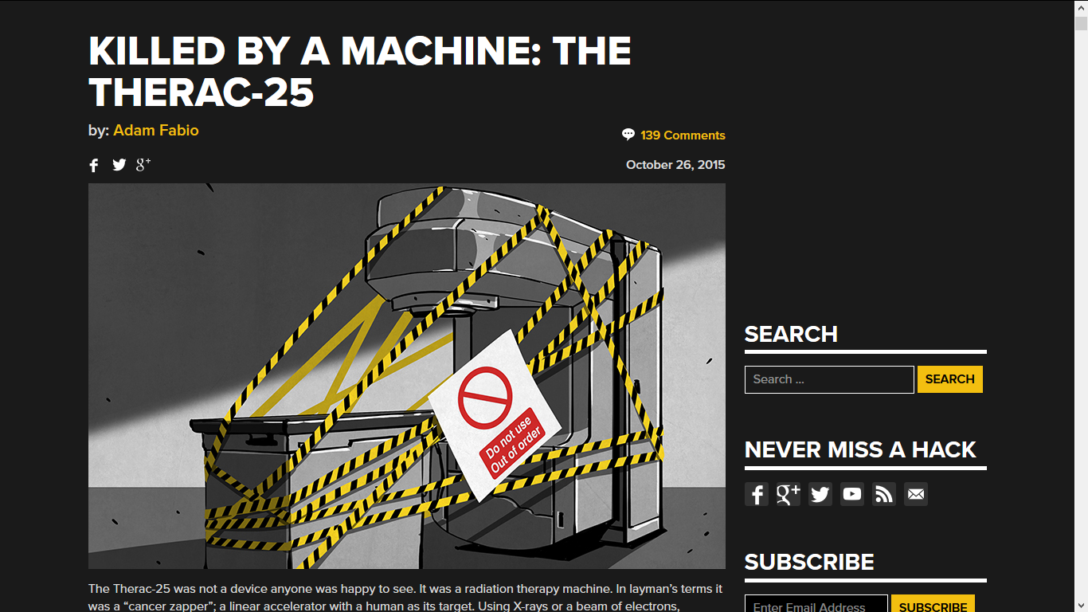
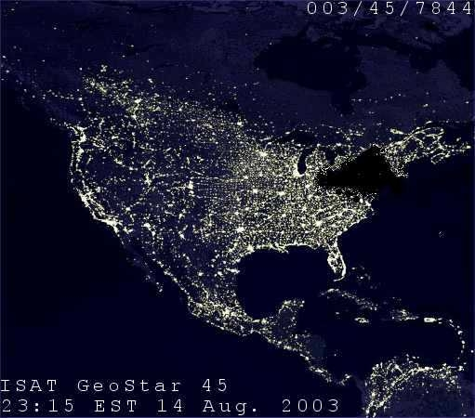

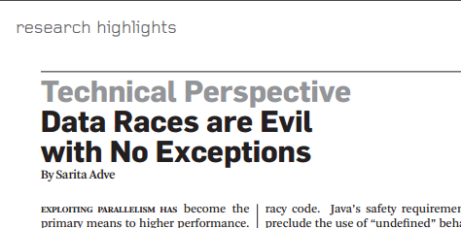
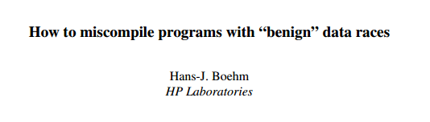
Notes:
In fact dealing with racy programs is important, since data races have led to many real-world failures leading to loss of property, loss of finance, and even loss of lives.

Slide 9
Need for Stronger Semantics for Programs with Data Races
Adve and Boehm, CACM’10
“The inability to define reasonable semantics for programs with data races is not just a theoretical shortcoming, but a fundamental hole in the foundation of our languages and systems.”
“We call upon software and hardware communities to develop
languages and systems that enforce data-race-freedom, ...”
Notes:
Thus, there is a need for stronger end-to-end memory models. I quote from Adve and Boehm…
They claim …
Furthermore, they encourage researchers to develop languages …

Slide 10
What Do We Mean by Strong Semantics?
End-to-end guarantees even for programs with data races
Notes:
We will talk more about this in the next few slides.

Slide 11
Outline
Strong Semantics with Region Conflict Exceptions
Providing Region Conflict Exceptions
ARC: Practical Architecture Support for Region Conflict Exceptions
Comparison of ARC with Related Approaches
Impact of Data Races on Language Models
Notes:
So far, we have discussed and understand a little bit about data races and the fact that many languages provide insufficient guarantees to programs with data races.

Slide 12
Strong Execution Semantics with Region Conflict Exceptions
Notes:
We will now discuss region conflict exceptions which is one way to provide strong execution semantics for programs with data races.

Slide 13
C++ Program with Data Race
X* x = NULL;
bool done= false;
Thread T1
Thread T2
x = new X();
done = true;
if (done) {
x->func();
}
Notes:
This is the same racy C++ example we were discussed earlier.

Slide 14
Data Race Exceptions
X* x = NULL;
bool done= false;
EXCEPTION
Thread T1
Thread T2
x = new X();
done = true;
if (done) {
x->func();
}
Notes:
Wouldn’t it be nice if we had a runtime system that would detect all data races and raise an exception whenever a racy access is about to happen? The primary benefit of such a system would be improved debuggability, ultimately leading to improved software reliability.
Unfortunately, we do not know of efficient dynamic techniques that can detect all data races and raise exceptions. Avoiding and eliminating data races efficiently has been a challenging problem! Given that, what other alternatives do we have?
We could certainly do with a system that could detect all the “bad” data races -- i.e., data races that could violate region serializability.

Slide 15
Region Conflicts
Thread T1
Thread T2
wr x
time
Conflict
rd x
Notes:
Wr x as well
One way is to check for region conflicts. Instead, region conflict exceptions is another way to assign strong semantics to deal with racy executions.

Slide 16
Synchronization Free Regions (SFRs)
Thread T1
Thread T2
lock m
unlock n
time
lock n
Notes:
So what are synchronization free regions? Synchronization-free regions are dynamic blocks of code per-thread demarcated by synchronization operations.

Slide 17
Region Conflicts
Thread T1
Thread T2
Report a subset of true data races that can potentially violate region serializability
wr x
time
Conflict
rd x
Notes:
Wr x as well
One way is to check for region conflicts. Instead, region conflict exceptions is another way to assign strong semantics to deal with racy executions.

Slide 18
Semantics with Region Conflict Exceptions
lock(l)
SFR
Conflict-free execution
SFR serializability
lock(m)
SFR
time
Synchronization-free regions (SFRs) execute atomically
lock(l)
SFR
unlock(l)
Notes:
Remember, SFR serializability is the same guarantee that languages give for data race free programs. The problem is that these languages provide a strong semantic guarantee serializability of SFRs only for data race free executions.
SFR serializability is a desirable property of an execution.
Some operations that many programmers expect to execute atomically do not execute atomically under many other memory models like SC (e.g., 64-bit integer accesses in Java; multi-access operations such as x++ or buffer[index++] = . . . )
No restriction on optimization within SFRs

Slide 19
Semantics with Region Conflict Exceptions
Conflict-free execution
SFR serializability
true data
races
Region conflict
Potential serializability violation

Slide 20
Semantics with Region Conflict Exceptions
Conflict-free execution
SFR serializability
true data
races
Region conflict
Exception
Notes:
We formulate these requirements with the memory model called SFRSx.
If there is a region conflict in an execution, it is definitely due to a true data races and can potentially lead to a serializability violation.
So now you get strong guarantees for all executions, both with and without data races.

Slide 21
Providing Region Conflict Exceptions
Notes:
Now that we understand that region conflict exceptions is a nice alternative, let us look at existing work on proving region conflict exceptions.

Slide 22
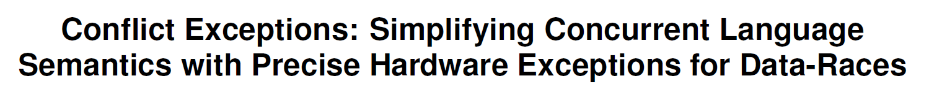
Providing Region Conflict Exceptions
Biswas et al. Valor: Efficient, Software-Only Region Conflict Exceptions. OOPSLA 2015.
Lucia et al. Conflict Exceptions: Simplifying Concurrent Language Semantics With Precise Hardware Exceptions for Data-Races. ISCA 2010.
Notes:
It is possible to detect region conflicts with only software support. However, such techniques suffer from overheads in excess of 50%.
Hardware support can speed up region conflict detection, where the notion of regions range from a few instructions to unbounded regions like SFRs. Conflict exceptions is the current state of art technique to check for region conflicts for unbounded regions.

Slide 23
Drawbacks with Conflict Exceptions
Builds on top of M(O)ESI-style cache coherence
Introduces hardware on top existing structures
Inter-core communication at region boundaries
Metadata in private cache lines are forwarded to other cores
Private line evictions communicate with memory
Increases complexity
Increases on-chip interconnect bandwidth requirement
Relies on in-memory backup for evicted metadata
Increases off-chip memory bandwidth requirement
Lucia et al. Conflict Exceptions: Simplifying Concurrent Language Semantics With Precise Hardware Exceptions for Data-Races. ISCA 2010.

Slide 24
Outline
Region Conflict Exceptions Semantics
Providing Region Conflict Exceptions
ARC: Practical Architecture Support for Region Conflict Exceptions
Comparison of ARC with Related Approaches
Impact of data races on language models

Slide 25
ARC: Practical Architecture Support for Region Conflict Exceptions
Design Overview
Architectural Modifications
Example Executions with ARC
Notes:
We propose ARC, which is our attempt to provide practical architecture support for region conflict exceptions.

Slide 26
ARC: Practical Architecture Support for Region Conflict Exceptions
Design Overview
Architectural Modifications
Example Executions with ARC

Slide 27
Baseline Architecture in ARC
Main memory
LLC
Core 1
Core 2
Core n
Controller
L2
Controller
L2
Controller
L2
L1
L1
L1
Notes:
This slide shows the baseline architecture. We assume a two-level private cache hierarchy, and a shared last level cache or the LLC.

Slide 28
Baseline Architecture in ARC
Main memory
no coherence protocol + directory
LLC
no core-to-core communication
Core 1
Core 2
Core n
Controller
L2
Controller
L2
Controller
L2
L1
L1
L1
Notes:
No core-to-core connection, and no directory support.

Slide 29
Key Insights in ARC
Release consistency
No M(O)ESI
Self invalidation
Notes:
In the absence of a MESI style protocol, the key insight in ARC is a synergistic use of release consistency and self-invalidation to provide efficient conflict detection.

Slide 30
Release Consistency
core’s private cache waits to write back its dirty data until a synchronization release operation
X = new Object();
done = true;
unlock(m);
time
lock(m);
while (!done) {}
X.compute();
Notes:
In release consistency, a core’s private cache waits to write back its dirty writes until a synchronization release operations.
Assumes explicit acquire and release synchronization operations.
All previous reads and writes must complete before a release can complete
All subsequent reads and writes must wait till a previous acquire completes
All synchronization operations must be SC, where an acquire is equivalent to a read and a release is equivalent to a write.

Slide 31
Self-Invalidation
core invalidates private cache lines that may be out-of-date at synchronization acquire operations
Notes:
Self-invalidation cannot make a program incorrect. It can however cause cache misses hurting performance.
Release consistency and self-invalidation mechanisms were studied in detail a few years back, but are not very widely-used on recent shared-memory systems.

Slide 32
ARC: Our Proposed Technique for Region Conflict Detection
Explore whether synergistic use of release consistency and self-invalidation can be competitive
Provide consistency and coherence at SFR boundaries and on private cache line evictions
Notes:
We actually take this opportunity to try out a design which eliminates coherence at the granularity of memory accesses. In contrast with M(O)ESI coherence, release consistency and self-invalidation do not eagerly invalidate lines when they are written by another core. Such “lazy” invalidation allows an ARC core to execute regions mostly in isolation, performing coherence and conflict detection only at region boundaries (synchronization operations) and on evictions to the shared cache.
We also explore a cache design to optimize metadata movement.

Slide 33
Understanding how ARC Works
Last Level Cache (LLC)
ARC Core
Line is fetched
Check for conflicts with the LLC
time
private cache line
Line is evicted LLC
Check for conflicts with the LLC
private cache line
Notes:
The high level idea is that conflicts on accesses to private cache lines that have been evicted are detected eagerly.

Slide 34
Understanding how ARC Works
Last Level Cache (LLC)
ARC Core
Line is fetched
Check for conflicts with the LLC
time
private cache line
Line is evicted LLC
Check for conflicts with the LLC
private cache line
Region boundary operations
Notes:
Ensure write atomicity and consistency of reads for private lines at region boundaries
Conflicts on accesses to private cache lines that are not evicted are detected lazily at region boundaries.

Slide 35
Serializability of Regions
A region appears serializable if:
There were no conflicts
Writes appear atomic
Values read are consistent

Slide 36
Region Boundary Operations in ARC
A region appears serializable if:
There were no conflicts
Writes appear atomic
Values read are consistent
At a region boundary, an ARC core executes:
provide coherence
Pre-commit – Write back dirty lines to the LLC
Notes:
A RCC core performs several steps when it executes a synchronization operation: First it writes back the dirty private lines to the LLC, thereby making the writes globally visible. Then it validates the private reads using value validation. Then, private cache lines are invalidated and the metadata is cleared.

Slide 37
Region Boundary Operations in ARC
A region appears serializable if:
There were no conflicts
Writes appear atomic
Values read are consistent
At a region boundary, an ARC core executes:
Pre-commit – Write back dirty lines to the LLC
Read validation – Validate reads using version and value validation
ensure consistency
Notes:
A RCC core performs several steps when it executes a synchronization operation: First it writes back the dirty private lines to the LLC, thereby making the writes globally visible. Then it validates the private reads using value validation. Then, private cache lines are invalidated and the metadata is cleared.

Slide 38
Region Boundary Operations in ARC
A region appears serializable if:
There were no conflicts
Writes appear atomic
Values read are consistent
At a region boundary, an ARC core executes:
Pre-commit – Write back dirty lines to the LLC
Read validation – Validate reads using version and value validation
Post-commit – Clear per-core metadata, self-invalidate private lines
provide coherence
Notes:
A RCC core performs several steps when it executes a synchronization operation: First it writes back the dirty private lines to the LLC, thereby making the writes globally visible. Then it validates the private reads using value validation. Then, private cache lines are invalidated and the metadata is cleared.
ARC’s novel approach for committing writes and version- and value-validating reads minimizes communication required for detecting conflicts and avoids most self-invalidation costs.

Slide 39
ARC: Practical Architecture Support for Region Conflict Exceptions
Design Overview
Architectural Modifications
Example Executions with ARC
Notes:
We will now look at the architecture modifications introduced by ARC.

Slide 40
Detecting Sound and Precise Conflicts
R
W
read/write bits
per-byte metadata
Byte offset i
Private cache line
Notes:
Sound and precise conflict detection requires precise tracking of accesses performed by a core.
To precisely detect conflicts, a cache needs to maintain precise read/write bits for each byte in a cache line.
This is generally done by extending private cache lines to add metadata bits to precisely track which cores access the byte offsets.

Slide 41
Modifications Introduced by ARC
Main memory
consistency
controller
LLC
Core 1
Core 2
Core n
Controller
L2
Controller
L2
Controller
L2
L1
L1
L1
access metadata
Notes:
The private caches are now extended to hold the access metadata, and there is a consistency controller which checks for region conflicts.

Slide 42
Metadata Management
R
W
read/write bits
per-byte metadata
LLC
Byte offset i
Private cache
line + metadata evicted to memory
evicted line + metadata
incoming line
line to be evicted
Notes:
When a private cache line is evicted, the line is written back to the LLC along with the metadata. In case the same line is evicted from multiple cores, the LLC maintains precise access information from each core.
Once a line is evicted to the LLC, the LLC controller can eagerly check for conflicts for concurrent accesses from other cores.

Slide 43
Access Information Memory (AIM)
AIM is a dedicated metadata cache adjacent to the LLC
AIM lines in ARC can be large
Impractical to have large AIM cache structures
ARC assumes a realistic AIM design with 32K entries
100 bytes for 8 cores, 178 bytes for 16 cores, and 308 bytes for 32 cores
Notes:
Impractical for the LLC to store information, so we introduce a metadata cache.

Slide 44
ARC Architecture with AIM Cache
Access information buffer
AIM
Main memory
consistency
controller
LLC
Core 1
Core 2
Core n
Controller
L2
Controller
L2
Controller
L2
L1
L1
L1
access metadata

Slide 45
ARC: Practical Architecture Support for Region Conflict Exceptions
Design Overview
Architectural Modifications
Example Executions with ARC
Notes:
We will now show how ARC is able to check for precise region conflicts under different situations.

Slide 46
Example Execution with ARC: No Conflict
Last Level Cache (LLC)
Core 1
Core 2
-
R
W
-
R
W
-
R
W
X
0
0
Y
0
0
P
0
0
Q
0
0
Notes:
Explain the figures and the notations.

Slide 47
Example Execution with ARC: No Conflict
Last Level Cache (LLC)
Core 1
Core 2
-
R
W
-
R
W
-
R
W
X = …
P = …
X
0
1
P
0
1
X
0
0
Y
1
0
Y
0
0
Q
0
1
Q = …
… = Y
P
0
0
Q
0
0

Slide 48
Example Execution with ARC: No Conflict
Last Level Cache (LLC)
Core 1
Core 2
-
R
W
-
R
W
-
R
W
X = …
P = …
X
0
0
X
0
0
P
0
1
Y
0
0
Y
0
0
Q
0
1
Q = …
… = Y
P
0
0
R
1
0
… = R
Q
0
0
no region conflict, Core 1 writes back local updates to shared memory

Slide 49
Example Execution with ARC: No Conflict
Last Level Cache (LLC)
Core 1
Core 2
-
R
W
-
R
W
-
R
W
X = …
P = …
X
0
0
X
0
0
P
0
0
Y
0
0
Y
0
0
Q
0
0
Q = …
… = Y
P
0
0
R
0
0
… = R
Q
0
0
no region conflict, Core 2 writes back local updates to shared memory

Slide 50
Eager Conflict Detection with ARC: Conflict on Evicted Line
Last Level Cache (LLC)
Core 1
Core 2
-
R
W
-
R
W
-
R
W
X
0
0
Y
0
0
P
0
0
Q
0
0

Slide 51
Eager Conflict Detection with ARC: Conflict on Evicted Line
Last Level Cache (LLC)
Core 1
Core 2
-
R
W
-
R
W
-
R
W
X = …
P = …
X
0
1
X
0
0
P
0
1
… = Y
Y
1
0
Y
0
0
Q
0
1
Q = …
P
0
0
Q
0
0

Slide 52
Eager Conflict Detection with ARC: Conflict on Evicted Line
Last Level Cache (LLC)
Core 1
Core 2
-
R
W
-
R
W
-
R
W
X = …
P = …
Y
1
0
X
0
1
P
0
1
… = Y
Y
0
0
Q
0
1
Q = …
cache line containing X gets evicted
P
0
0
Q
0
0

Slide 53
Eager Conflict Detection with ARC: Conflict on Evicted Line
Last Level Cache (LLC)
Core 1
Core 2
-
R
W
-
R
W
-
R
W
X = …
P = …
Y
1
0
X
0
1
P
0
1
… = Y
Y
0
0
Q
0
1
Q = …
P
0
0
X
1
0
Q
0
0
… = X
eager conflict

Slide 54
Lazy Conflict Detection with ARC: Conflict on Private Lines
Last Level Cache (LLC)
Core 1
Core 2
-
R
W
-
R
W
-
R
W
X
0
0
Y
0
0
P
0
0
Q
0
0

Slide 55
Lazy Conflict Detection with ARC: Conflict on Private Lines
Last Level Cache (LLC)
Core 1
Core 2
-
R
W
-
R
W
-
R
W
… = X (5)
X
0
1
X
0
0
X
1
0
X = 20
Y
0
0
P
0
0
Q
0
0
no eager invalidation in Core 2 on write

Slide 56
Lazy Conflict Detection with ARC: Conflict on Private Lines
Last Level Cache (LLC)
Core 1
Core 2
-
R
W
-
R
W
-
R
W
… = X (5)
X
0
1
X
0
0
X
1
0
Y
1
0
X = 20
Q
0
1
Y
0
0
Q = …
… = Y
P
0
0
Q
0
0

Slide 57
Lazy Conflict Detection with ARC: Conflict on Private Lines
Last Level Cache (LLC)
Core 1
Core 2
-
R
W
-
R
W
-
R
W
… = X (5)
X
0
0
X
0
0
X
1
0
Y
0
0
X = 20
Q
0
1
Y
0
0
Q = …
… = Y
P
0
0
Q
0
0
no region conflict, Core 1 writes back local updates to shared memory

Slide 58
Lazy Conflict Detection with ARC: Conflict on Private Lines
Last Level Cache (LLC)
Core 1
Core 2
-
R
W
-
R
W
-
R
W
… = X (5)
X
0
0
X
0
0
X
1
0
Y
0
0
X = 20
Q
0
1
Y
0
0
Q = …
… = Y
P
0
0
Q
0
0
no region conflict, Core 1 writes back local updates to shared memory
lazy conflict on X
fails to ensure consistency of reads

Slide 59
Comparison of ARC with Related Approaches
Implementation and Evaluation

Slide 60
Comparing Conflict Exceptions and ARC
Conflict Exceptions
ARC
Builds on M(O)ESI
Coherence at granularity of memory accesses
Requires support for a Directory and point-to-point communication
Detects conflicts eagerly
Adapts release consistency and self-invalidation schemes
Coherence at region granularity
Requires a AIM cache, write signatures, and consistency controllers
Uses a mix of eager and lazy conflict detection
Lucia et al. Conflict Exceptions: Simplifying Concurrent Language Semantics With Precise Hardware Exceptions for Data-Races. ISCA 2010.

Slide 61
Implementation and Evaluation
Simulation
A Pintool generates a stream of memory and synchronization events
Events are processed by model implementations of Conflict Exceptions (CE) and ARC
Use McPAT to estimate energy usage
https://github.com/PLaSSticity/ce-arc-simulator-ipdps19
Notes:
We implement and evaluate ARC with simulation.
We simulate the performance of Viser via Intel Pin and Java backends that model a directory-based MESI system and the Viser core.

Slide 62
Run-time Performance
normalized to CE-4
Run-time normalized to CE-4

Slide 63
Run-time Performance
normalized to CE-4
Run-time normalized to CE-4

Slide 64
Run-time Performance
normalized to CE-4
Run-time normalized to CE-4

Slide 65
Energy Usage
normalized to CE-4

Slide 66
Overhead of Providing Region Conflict Detection
Current shared-memory systems provide undefined semantics for racy programs
Approaches | Overhead comparison at 32 cores
 | Run-time performance (%) | Energy usage (%)
CE | 26.7 | 41.4
ARC | 12.5 | 27.8
Notes:
Though hardware memory models (e.g., [3], [46], [50]) are generally stronger than language models, they apply only to the compiled code, thereby failing to provide end-to-end guarantees with respect to the source program.

Slide 67
Release consistency and self-invalidation techniques can be a good fit for detecting region conflicts
Small metadata cache provides reasonable tradeoffs between performance and complexity
Compared to state-of-art, ARC shows promise in making region conflict detection practical
Key Takeaways!

Slide 68
Rethinking Support for Region Conflict Exceptions
Swarnendu Biswas, Rui Zhang, Michael D. Bond, and Brandon Lucia
IPDPS 2019

