Slide 1
Correcting the Dynamic Call Graph Using Control Flow Constraints
Byeongcheol (BK) Lee
Kevin Resnick
Michael Bond
Kathryn McKinley
UT Austin
Notes:
This is a joint work with three coauthors.
Kathryn: Memorize & Say something.

Slide 2
Motivation
Complexity of large object oriented programs
  Decompose the program into small methods
  Method boundary becomes performance-bottleneck
Dynamic interprocedural optimization
  Solve the method boundary problem
  Inlining and specialization vary the performance by factor of 2
  Dynamic call graph (DCG) is critical input!
b
w₁
a
c
w₂
Dynamic call graph
Notes:
The motivation for this work is that OOP programs are becoming large and complex. To manage this complexity, programmers tend to decompose the program into smaller modules until each module becomes managable. This increases the number of virtual calls to small methods. This is really good in terms of software maintenance, but this is really bad in terms of performance.
Inter-procedural optimizations such as inlining and specialization solve this problem. These optimizations can impact the performance by factor of 2, and the dynamic call graph is critical input.
But what if this call graph contains error? Or what if the call graph gives wrong information? This may degrade performance by fact of 2. This is real problem in the online optimization system.
Points
* In Large and complex OOP, Inter-procedural OPT is important.
* Inter-procedural OPT needs DCG.
* DCG could be wrong and misleading in online system.

Slide 3
Inaccurate call graph
b
1,000
call b
a
c
call c
500
DCG_{Sample}
Error
method a
Notes:
Let me talk about call graph. Suppose there is a method a like here.
Suppose that this method a calls a method b 5,000 times and a method c 10,000 times.
This method call statistics is represented by labeled graph here, and this is the call graph for the example program. This call graph says that there are three methods a, b, and c. There are 5,000 calls from a to b, and 10.000 calls from a to c.
Now, the question is how we get this call graph and how we use this call graph in online optimization system

Slide 4
Timer-based sampling and timing bias
Call stack
…
c
b
c
c
b
c
c
b
c
c
…
c
c
b
a
a
t
Notes:
Let’s talk about how call graph sampling loses its accuracy.
For each 10-20ms time tick, the program stops its normal execution, and looks at its current call stack.
For instance, this timer tick here takes a call sample from the procedure a to the procedure b, and increments a counter in the call graph. The program repeats this sampling continuously until the end of the program.
However, since the program spends more time on the procedure b than the procedure c, the call to b has higher chance of being sampled than call to c

Slide 5
Timer-based sampling and timing bias
Call stack
…
c
b
c
c
b
c
c
b
c
c
…
c
c
b
a
a
t
Notes:
Let’s talk about how call graph sampling loses its accuracy.
For each 10-20ms time tick, the program stops its normal execution, and looks at its current call stack.
For instance, this timer tick here takes a call sample from the procedure a to the procedure b, and increments a counter in the call graph. The program repeats this sampling continuously until the end of the program.
However, since the program spends more time on the procedure b than the procedure c, the call to b has higher chance of being sampled than call to c

Slide 6
Timer-based sampling and timing bias
Call stack
…
c
b
c
c
b
c
c
b
c
c
…
c
c
b
a
a
t
Notes:
Let’s talk about how call graph sampling loses its accuracy.
For each 10-20ms time tick, the program stops its normal execution, and looks at its current call stack.
For instance, this timer tick here takes a call sample from the procedure a to the procedure b, and increments a counter in the call graph. The program repeats this sampling continuously until the end of the program.
However, since the program spends more time on the procedure b than the procedure c, the call to b has higher chance of being sampled than call to c

Slide 7
Timer-based sampling and timing bias
Call stack
…
c
b
c
c
b
c
c
b
c
c
…
c
c
b
a
a
t
Notes:
Let’s talk about how call graph sampling loses its accuracy.
For each 10-20ms time tick, the program stops its normal execution, and looks at its current call stack.
For instance, this timer tick here takes a call sample from the procedure a to the procedure b, and increments a counter in the call graph. The program repeats this sampling continuously until the end of the program.
However, since the program spends more time on the procedure b than the procedure c, the call to b has higher chance of being sampled than call to c

Slide 8
Timer-based sampling and timing bias
timer tick
timer tick
timer tick
timer tick
Call stack
…
c
b
c
c
b
c
c
b
c
c
…
c
c
b
a
a
t
DCG_{Sample}
…
…
b
b
b
b
9→10
10→11
11
999→1000
a
c
a
c
a
c
a
c
5
5
5→6
500
Notes:
Let’s talk about how call graph sampling loses its accuracy.
For each 10-20ms time tick, the program stops its normal execution, and looks at its current call stack.
For instance, this timer tick here takes a call sample from the procedure a to the procedure b, and increments a counter in the call graph. The program repeats this sampling continuously until the end of the program.
However, since the program spends more time on the procedure b than the procedure c, the call to b has higher chance of being sampled than call to c

Slide 9
Overhead and accuracy in call graph profiling
Full instrumentation
25
Overhead (%)
20
15
Arnold-Grove sampling
[2005]
10
5
Timer-based
sampling [2000]
Correction
[2007]
0
40
60
80
100
Accuracy (%)
Notes:
The full instrumentation has the perfect accuracy, but it’s too expensive for the dynamic compilation. So, dynamic compilation typically uses timer-based sampling to keep the overhead low, but it loses accuracy up to 60%. To improve this accuracy, timer-based sampling was extended to Arnold-Grove sampling. For 70% accuracy, the overhead is minimal, but for more than 80% accuracy, the overhead suddenly increases more than 10%, which is unacceptable in dynamic compilation Our call graph correction improves the accuracies of these samplings with minimal overhead, achieving up to 85% accuracy.

Slide 10
Outline
Motivation
Call graph correction
Evaluation

Slide 11
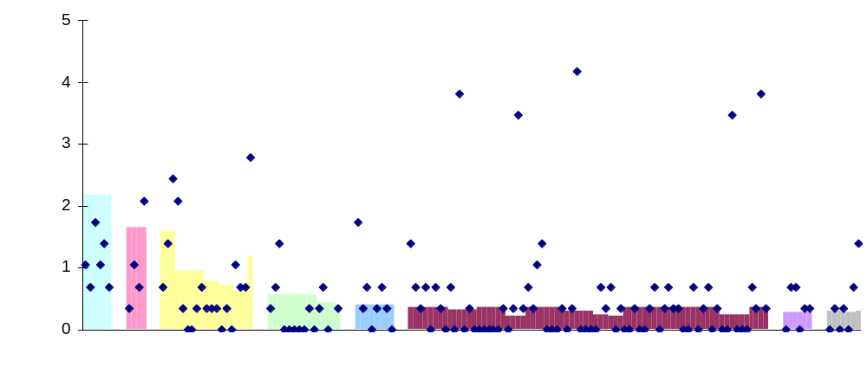
Timing bias in SPEC JVM98 raytrace
Sampling
Normalized frequency(%)
Method calls grouped by source method
Notes:
This is a timing bias in the raytrace benchmark.
This graph presents call edge frequencies in the raytrace.
The area shows the actual values, which are grouped by their source method with different colors.
The diamonds are information from sampling.
We can observe that some have too many samples than the actual value and others have less.
Also, we can observe that many calls within the source method have the same actual frequencies, perhaps because they are in the same basic block. This implies that the basic block profiles constraint the call graph frequencies.

Slide 12
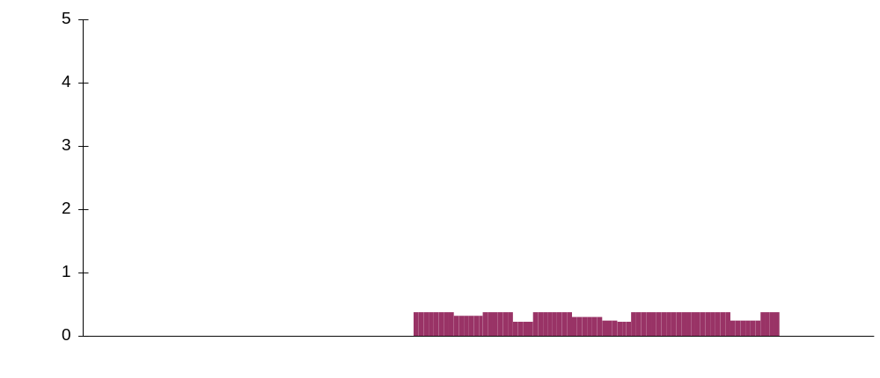
Timing bias in SPEC JVM98 raytrace
Normalized frequency(%)
Method calls grouped by source method
Notes:
This is a timing bias in the raytrace benchmark.
This graph presents call edge frequencies in the raytrace.
The area shows the actual values, which are grouped by their source method with different colors.
The diamonds are information from sampling.
We can observe that some have too many samples than the actual value and others have less.
Also, we can observe that many calls within the source method have the same actual frequencies, perhaps because they are in the same basic block. This implies that the basic block profiles constraint the call graph frequencies.

Slide 13
Correction algorithms
Detect and correct DCG error
  DCG constraint
Static and dynamic approaches
  Static FDOM (Frequency dominator) correction
    Static approach
    Uses static FDOM constraint on DCG
  Dynamic basic block profile correction
    Dynamic approach
    Uses dynamic basic block profile constraint on DCG
New
Notes:
All of our correction algorithms modify the call graph frequencies to satisfy CFG constraints. This works because the CFG restricts possible call graph.
We have static and dynamic approaches.
Static FDOM correction uses our novel FDOM constraint on DCG. FDOM is the abbreviation frequency dominator, which we defined to capture relative basic block frequency.
Dynamic basic block profile correction is dynamic approach to exploit dynamic CFG edge profiles.

Slide 14
Static FDOM constraint
FDOM constraint on CFG
  call c is executed at least as many times as call b
  call c FDOM call b
FDOM constraint on DCG
  f( ) ≥ f( )
call b
call c
a
c
a
b
method a
Notes:
Let me start with the static approach
When we look at the control flow graph for the procedure a, we notice that the red basic block executes at least as many times as the yellow block.
Intuitively, this is because whenever yellow block executes, the red block executes before or after.
This constraint is formally presented as a binary relation on basic blocks or call sites. We have a near-linear algorithm to compute this relation in our technical report.
This static control flow graph constraints implies another constraint on the call graph.
The call edge count from a to c is at least as many times as the count from a to b.

Slide 15
Static FDOM correction
FDOM constraint: f( ) ≥ f( )
a
c
a
b
b
b
Correction
750
1,000
a
c
a
c
500
750
DCG_{Sample}
DCG_{FDOMCorrection}
Detect error and assign the same average frequency
  One possible solution to the FDOM constraint
  Preserve total frequency sum
Notes:
To satisfy the static constraint, We use a simple solution of taking the max frequency if there is a conflict. Then we scale the frequency to reserve the total count before and after the correction.
In the call graph from sampling on the left side, the FDOM constraint says that call counts to c is as least the counts to b. So, there is a conflict.
Assigning 1,000 to the call to c resolves the conflict. Then, we scale the resulting counts by the scale factor 0.75, which was chosen to preserve total counts before and after the correction.
Both calls to b and c have the same frequency, which is 750. Now, the corrected DCG is more similar to the perfect call graph.

Slide 16
Dynamic basic block profile constraint
Some dynamic optimization systems do edge profiling
  Baseline compiler in Jikes RVM
Dynamic basic block profile constraint on CFG
  f(call c) = 2 * f(call b)
Dynamic basic block profile constraint on DCG
  f( ) = 2 * f( )
50%
50%
call b
call c
a
c
a
b
method a
Notes:
We also use the edge profiles, and part of these profiles are available in the dynamic optimizers.
In the procedure a annotated with the branch probability, the edge profiles say that
that the red block executes 2 times as many as the yellow block.
This CFG constraint implies that the call to c happened 2 times as many as the call to b.

Slide 17
Dynamic basic block profile correction
Constraint: f( ) = 2* f( )
a
c
a
b
b
b
Correction
1,000
500
a
500
c
a
1,000
c
DCG_{Sample}
DCG_{EdgeProfileCorrection}
f_{New}( ) = 1/(1+2) * (1,000+500) = 500
f_{New}( ) = 2/(1+2) * (1,000+500) = 1,000
a
b
a
c
Notes:
Now, our goal is to satisfy the dynamic basic block profile constraint and preserve the total count sum.
We compute normalized ratio for each call edge from the basic block profile constraint. This ratio for call to c is 2/3, and the call to b has 1/3.
Finally, we multiply the normalized ratio and the total frequency and for each call. The corrected call count for the call to c is 1,000, and the call to b has 500.
Now, the call graph has perfect match with the perfect call graph.

Slide 18
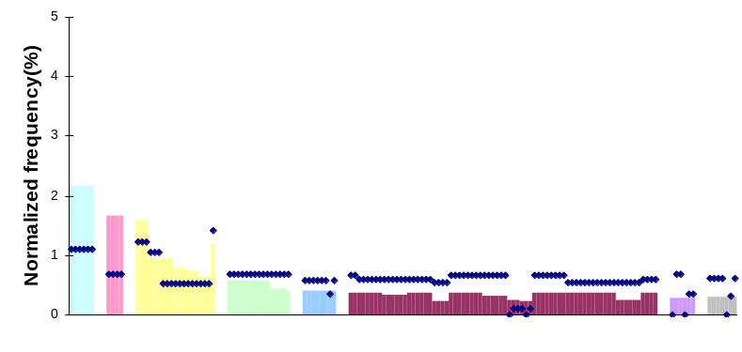
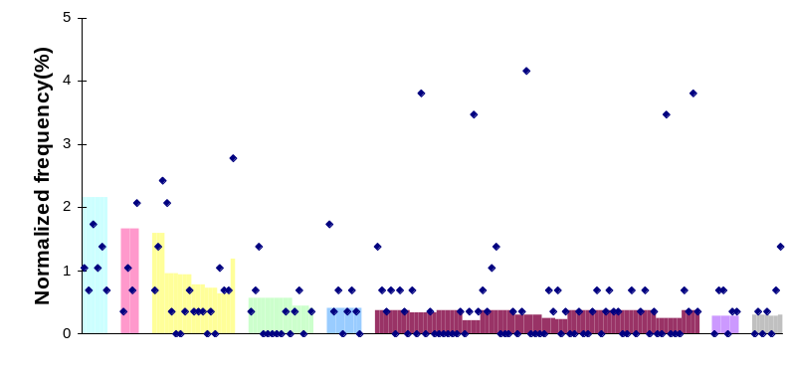
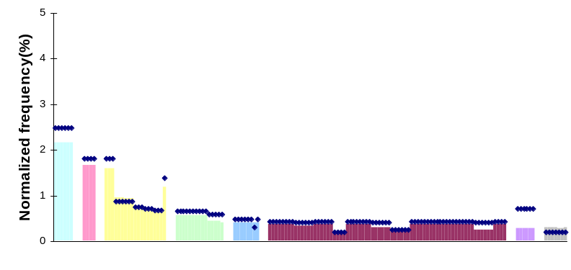
Best result: raytrace
Static FDOM correction
Sampling
Dynamic basic block profile correction
Notes:
Here is the result with the static and dynamic approaches for raytrace
Static approach was effective at correcting errors within the same callers. But the errors across the different callers still exist.
Dynamic approach corrected this type of errors, and achieves better call graph.

Slide 19
Outline
Motivation
Call graph correction
Evaluation

Slide 20
Experimental methodology
Jikes RVM 2.4.5 on 3.2G Pentium 4
Replay methodology [Blackburn et al. ‘06]
  Deterministic run
  1st iteration – compilation + application run
  2nd iteration – application run
Measurement
  Accuracy
    Use overlap accuracy [Arnold & Grove ’05]
  Overhead
    1st iteration includes call graph correction
  Performance
    2nd iteration is application-only
SPECJVM98 and DaCapo benchmarks
Notes:
To evaluate our correction algorithms in dynamic optimization, we use Jikes RVM 2.4.5 on 3.2 Pentinum 4 machine.
we take the overlap accuracy, which compares the resulting call graph with the one from full instrumentation.
Then, we use the replay methodology to measure the overhead and performance improvement.
This replay methodology eliminates the nodeterminstic optimization decisions in the adaptive system.
We use SPEJVM98 and DaCapo benchmarks, which are extensively used in other dynamic optimization researches.

Slide 21
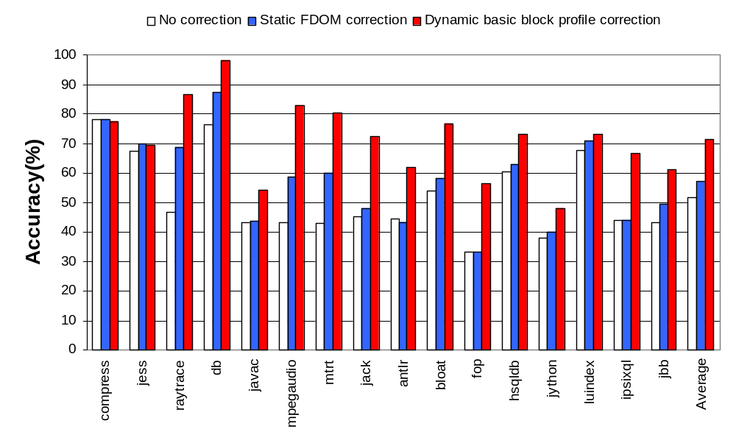
Accuracy
Notes:
Here is the accuracy result. The static approach improves the average accuracy by 6% over the timer based sampling.
The dynamic approach adds 13% improvement, resulting in 21% over the baseline.

Slide 22
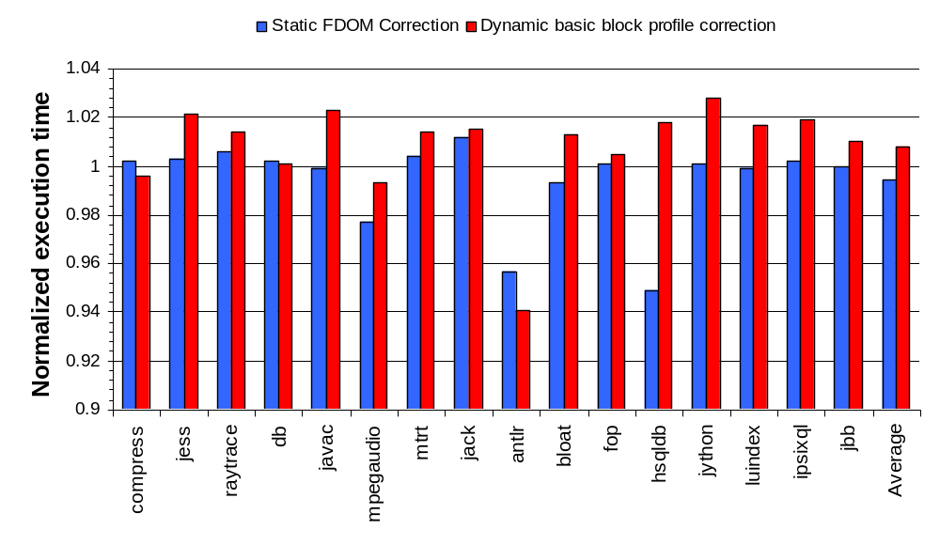
Overhead
Notes:
This is the overhead of call graph corrections.
For both cases, we did not observe any outstanding overhead. Antlr and hsqldb have up to 5% speedup, which is abnormal. We found that this is related to different heap exercising behavior during the correction.
The dynamic approach has 1% average overhead, and this is mostly from the additional instrumentation to improve the edge profiles in our framework.
Note that the correction happens only during the code optimization not in the normal execution.
Therefore, the call graph correction overhead itself is very minial.

Slide 23
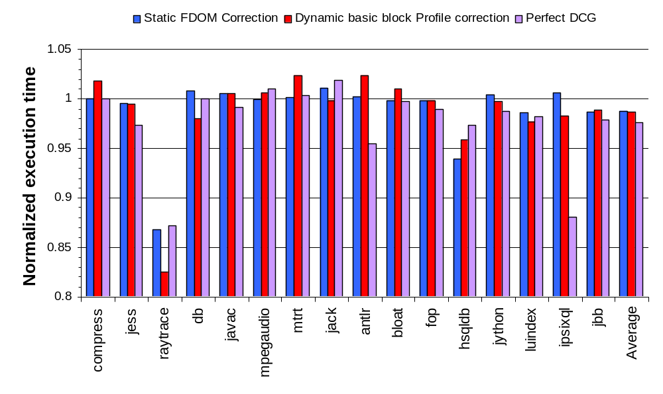
Inlining performance
Baseline: profile-guided inlining with default call graph sampling
Notes:
Static and dynamic approaches had 2% modest performance improvement. To measure the performance upper bound, we ran the experiment with the perfect call graph, and this improves performance by only 3%.
This is because the inlining is the only client in our system and this inlining heustrictics have been developed with the inprecise call graph.
The raytrace shows the best improvement. The raytrace contains many small virtual calls, and small variation in the inlining decision has large impact on the performance.

Slide 24
Summary
CFG constraint improves the DCG
Inlining has been tuned for bad call graph
Advantages
  Can be easily combined with other DCG profiling
  Minimal overhead only during the compilation
Future work
  More inter-procedural optimizations with high accuracy DCG

Slide 25
Question and comment
Thank you!
Notes:
Thank you for your attention

Slide 30
Timing bias misleads optimizer
b
b
5,000
times
Sampling with timing bias
1,000
samples
a
c
a
c
10,000 times
500
samples
DCG_{Perfect}
DCG_{Sample}
DCG_{Sample}
  Edge frequencies were reversed!
Inlining decision
  Inliner may inline b instead of c
Notes:
This timing bias may cause wrong optimization decision.
In the perfect call graph on the left side, call to c is more frequent than the call to b, but this is reversed by the sampling.
With this wrong information, the optimizer would make mistake. For instance, the optimizer may inline a call to b instead of the call to c by relying on the sampling.

Slide 31
Call graph profiling
in online optimization system
Source
program
e.g. Java
byte code
Compile
& instrument
Machine
code
Dynamic
call graph
Online optimization system
Profiling and program run at the same time
Minimize profiling overhead
Corollary: sacrifice profiling accuracy
Notes:
Point
DCG is inaccurate in online system
This is because the performance include the DCG profiling overhead

