Slide 1

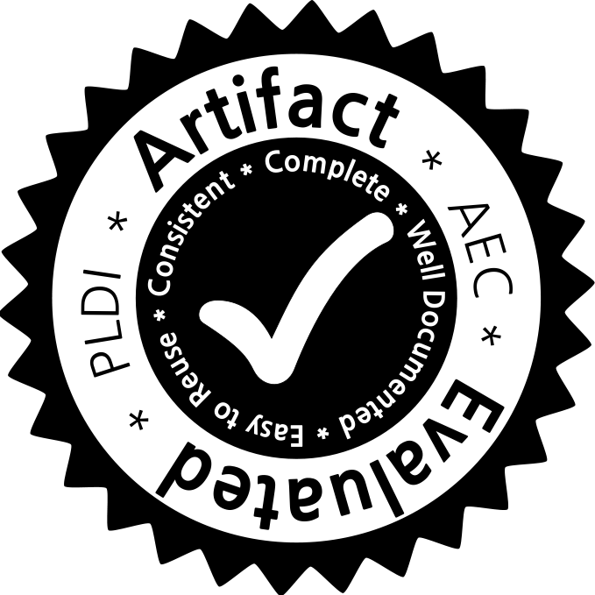
DoubleChecker: Efficient Sound and Precise Atomicity Checking
Swarnendu Biswas,
Jipeng Huang, Aritra Sengupta, and Michael D. Bond
The Ohio State University
PLDI 2014

Slide 2
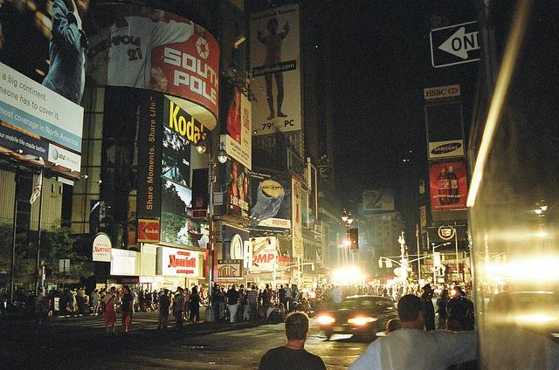

Impact of Concurrency Bugs
Notes:
Say it is northeastern blackout 2003

Slide 3
Impact of Concurrency Bugs
Northeastern blackout, 2003
Notes:
Say it is northeastern blackout 2003

Slide 4

Impact of Concurrency Bugs

Slide 5
Atomicity Violations
Constitute 69%¹ of all non-deadlock concurrency bugs
1. S. Lu et al. Learning from Mistakes: A Comprehensive Study on Real World Concurrency Bug Characteristics. In ASPLOS, 2008.

Slide 6
Atomicity
Concurrency correctness property
Synonymous with serializability
Program execution must be equivalent to some serial execution of the atomic regions

Slide 7
Thread 1
Thread 2
void execute() {
while (...) {
prepareList();
processList();
resetList();
}
}
void execute() {
while (...) {
prepareList();
processList();
resetList();
}
}
Atomicity Violation Example

Slide 8
Thread 1
Thread 2
void prepareList() {
synchronized (l1) {
list.add(new Object());
}
}
void processList() {
synchronized (l1) {
Object head = list.get(0);
}
}
void resetList() {
synchronized (l1) {
list = null;
}
}
Atomicity Violation Example
Notes:
This example shows a contrived atomicity violation. Thread 1 is preparing a list of objects, and after that would iterate over the contents of the list and process the objects. Ideally, the prepareList() and processList() both should be executed together atomically.
Ideally, the prepareList() and processList() both should be executed together atomically.

Slide 9
Thread 1
Thread 2
void prepareList() {
synchronized (l1) {
list.add(new Object());
}
}
void processList() {
synchronized (l1) {
Object head = list.get(0);
}
}
void resetList() {
synchronized (l1) {
list = null;
}
}
Null pointer dereference
Data-race-free program
Atomicity Violation Example

Slide 10
Thread 1
Thread 2
void execute() {
while (...) {
prepareList();
processList();
resetList();
}
}
void execute() {
while (...) {
prepareList();
processList();
resetList();
}
}
atomic
Atomicity Violation Example

Slide 11
Detecting Atomicity Violations
Check for conflict serializability
Build a transactional dependence graph
Check for cycles
Existing work
Velodrome, Flanagan et al., PLDI 2008
Farzan and Parthasarathy, CAV 2008
Notes:
A common approach to detect atomicity violations is to check for conflict serializability. Where transactions are atomic regions.

Slide 12
acq lock
wr o.f
transaction
wr o.g
time
wr o.f
rel lock
Thread 1
Thread 2
Thread 3
Transactional Dependence Graph

Slide 13
acq lock
wr o.f
transaction
wr o.g
time
wr o.f
rel lock
Thread 1
Thread 2
Thread 3
Transactional Dependence Graph

Slide 14
acq lock
wr o.f
transaction
wr o.g
time
wr o.f
rd o.f
rel lock
Thread 1
Thread 2
Thread 3
Cycle means Atomicity Violation

Slide 15
Velodrome¹
Paper reports 12.7X overhead
6.1X in our experiments
1. C. Flanagan et al. Velodrome: A Sound and Complete Dynamic Atomicity Checker for Multithreaded Programs. In PLDI, 2008.
Prior Work is Slow

Slide 16
High Overheads of Prior Work
Precise tracking is expensive
“last transaction(s) to read/write” for every field
Need atomic updates in instrumentation

Slide 17
Instrumentation Approach
Program access
Program access
Uninstrumented program
Instrumented program

Slide 18
Precise Tracking is Expensive!
Precise tracking of dependences
Analysis-specific work
Program access
Update metadata
Can lead to remote cache misses for mostly read-only variables
Program access
Uninstrumented program
Instrumented program

Slide 19
Synchronized Updates are Expensive!
Lock metadata access
Program access
atomic
atomic
Program access
Unlock metadata access
Uninstrumented program
Instrumented program
Notes:
Slows programs is misleading since points to unlock

Slide 20
Synchronized Updates are Expensive!
synchronization on every access
Lock metadata access
Program access
atomic
atomic
Program access
slows programs
Unlock metadata access
Uninstrumented program
Instrumented program

Slide 21
DoubleChecker

Slide 22
DoubleChecker’s Contributions
Dynamic atomicity checker based on conflict serializability
Precise
Sound and unsound operation modes
Incurs 2-4 times lower overheads
Makes dynamic atomicity checking more practical

Slide 23
Key Insights
Avoid high costs of precise tracking of dependences at every access
Common case: no dependences
Most accesses are thread local
Notes:
Give high level description: By over approximation, we mean object level tracking. O.f and o.g constitute a dependence.
We hypothesize that over-approximating dependences can be cheaper.
Use of two analysis - over approximation and recover - plays or structures nicely

Slide 24
Key Insights
Tracks dependences imprecisely
Soundly over-approximates dependences
Recovers precision when required
Turns out to be a lot cheaper

Slide 25
Staged Analysis
Imprecise cycle detection (ICD)
Precise cycle detection (PCD)
Notes:
This calls for a judicious separation of work, or staging the analysis.

Slide 26
Imprecise Cycle Detection
Processes every program access
Soundly overapproximates dependences, is cheap
Could have false positives
Program execution
ICD
Imprecise cycles
atomicity
specifications
sound
tracking

Slide 27
Precise Cycle Detection
Processes a subset of program accesses
Performs precise analysis
No false positives
static program
locations
Imprecise cycles
PCD
Precise violations
access
information

Slide 28
Program execution
ICD
Imprecise cycles
atomicity
specifications
sound
tracking
static program locations
Precise violations
PCD
access
information
Staged Analyses: ICD and PCD
Notes:
ICD stage generates a set of transactions that are part of a potentially imprecise cycle. In addition, it stores additional information such as read/write logs for recovering precision.
An imprecise cycle is always a superset of true atomicity violations.
The PCD cannot run by itself, since its input is a set of transactions.
ICD input program and output is potentially imprecise cycles
PCD cycles is always a subset of ICD. add venn diagrams or cycles

Slide 29
Program execution
ICD
Imprecise cycles
atomicity
specifications
sound
tracking
true atomicity violations
static program locations
Precise violations
PCD
access
information
ICD is Sound
Notes:
An imprecise cycle is always a superset of true atomicity violations.

Slide 30
Role of ICD
Imprecise cycles
Most accesses in a program are thread-local
Uses Octet¹ for tracking cross-thread dependences
Acts as a dynamically sound transaction filter
Program execution
atomicity
specifications
ICD
sound
tracking
1. M. Bond et al. Octet: Capturing and Controlling Cross-Thread Dependences Efficiently. In OOPSLA, 2013.
Notes:
ICD is sound, finds all transactions involved in precise + potentially imprecise
Transactions are always a superset, and sound. Edges in the ICD could be completely wrong.

Slide 31
Role of PCD
static program
locations
Processes transactions involved in an ICD cycle
Performs precise serializability analysis
PCD has to do much less work
Program conforming to its atomicity specification will have very few cycles
Imprecise cycles
PCD
Precise violation
access
information
Notes:
PCD cycles is always a subset of ICD. add venn diagrams or cycles
ICD is sound, finds all transactions involved in precise + potentially imprecise
Transactions are always a superset, and sound. Edges in the ICD could be completely wrong.

Slide 32
Different Modes of Operation
Single-run mode
Multi-run mode
Notes:
The multi-run mode is an attempt to divide the work across multiple program runs to reduce the overheads even further.
Why are there two runs? Testing during production runs, applications are run over and over again, so we can distribute the runs into these two modes. Emphasize

Slide 33
Program execution
ICD+PCD
Atomicity violations
atomicity
specifications
ICD cycles
ICD
PCD
read/write logs
Single-Run Mode
Notes:
Talk about read/write logs more, and logging that is required in some cases.

Slide 34
Program execution
atomicity
specifications
ICD
sound
tracking
Potentially
imprecise cycles
First run
Static transaction
information
Program execution
monitored
transactions
ICD+PCD
Atomicity violations
Second run
Multi-run Mode
Notes:
Say that the first does not require any logging, but is this a good place? Moreover there are more nuances over here.
Say that the first run passes static site information.
Also say that the multi run mode can be unsound - because of two reasons. Violations appearing in the second run for the first time may not be detected

Slide 35
Design Choices
Multi-run mode
Conditionally instruments non-transactional accesses
Otherwise overhead increases by 29%
Could use Velodrome for the second run
But performance is worse
Second run has to process many accesses
ICD is still effective as a dynamic transaction filter
Notes:
Talk about the design decisions briefly.
Static to dynamic mapping
Maybe use a diagram

Slide 36
Examples
Imprecise analysis
Precise analysis
Notes:
The multi-run mode is an attempt to divide the work across multiple program runs to reduce the overheads even further.
Say that you won’t explain Octet states in detail, and they are not critical for understanding.

Slide 37
wr o.f
(WrEx_{T1})
transaction
time
Thread 1
Thread 2
Thread 3
Thread 4
Imprecise Analysis
Notes:
Cycle is formed. Note that the transaction in Thread 2 is not involved in a precise analysis.
Describe the Octet states briefly, and it is like cache coherence states.
ICD edges could be wrong completely. Spend more time on this.
MB: Mention that the stuff in () are Octet states, that they are like cache coherence states, and that you won’t go into the detail.
Say that you won’t explain Octet states in detail, and they are not critical for understanding.

Slide 38
wr o.f
(WrEx_{T1})
time
Thread 1
Thread 2
Thread 3
Thread 4
Imprecise Analysis
Notes:
Cycle is formed. Note that the transaction in Thread 2 is not involved in a precise analysis.
Describe the Octet states briefly, and it is like cache coherence states.
ICD edges could be wrong completely. Spend more time on this.
MB: Mention that the stuff in () are Octet states, that they are like cache coherence states, and that you won’t go into the detail.
Say that you won’t explain Octet states in detail, and they are not critical for understanding.

Slide 39
wr o.f
(WrEx_{T1})
rd o.g
(RdEx_{T2})
time
Thread 1
Thread 2
Thread 3
Thread 4
Imprecise Analysis
Notes:
Cycle is formed. Note that the transaction in Thread 2 is not involved in a precise analysis.
Describe the Octet states briefly, and it is like cache coherence states.
ICD edges could be wrong completely. Spend more time on this.
MB: Mention that the stuff in () are Octet states, that they are like cache coherence states, and that you won’t go into the detail.
Say that you won’t explain Octet states in detail, and they are not critical for understanding.

Slide 40
wr o.f
(WrEx_{T1})
rd o.g
(RdEx_{T2})
rd o.f
(RdSh_{c})
time
Thread 1
Thread 2
Thread 3
Thread 4
Imprecise Analysis
Notes:
Cycle is formed. Note that the transaction in Thread 2 is not involved in a precise analysis.
Describe the Octet states briefly, and it is like cache coherence states.
ICD edges could be wrong completely. Spend more time on this.
MB: Mention that the stuff in () are Octet states, that they are like cache coherence states, and that you won’t go into the detail.
Say that you won’t explain Octet states in detail, and they are not critical for understanding.

Slide 41
wr o.f
(WrEx_{T1})
rd o.g
(RdEx_{T2})
rd o.f
(RdSh_{c})
time
rd o.h
(fence)
Thread 1
Thread 2
Thread 3
Thread 4
Imprecise Analysis
Notes:
Cycle is formed. Note that the transaction in Thread 2 is not involved in a precise analysis.
Describe the Octet states briefly, and it is like cache coherence states.
ICD edges could be wrong completely. Spend more time on this.
MB: Mention that the stuff in () are Octet states, that they are like cache coherence states, and that you won’t go into the detail.
Say that you won’t explain Octet states in detail, and they are not critical for understanding.

Slide 42
wr o.f
(WrEx_{T1})
rd o.g
(RdEx_{T2})
rd o.f
(RdSh_{c})
time
rd o.h
(fence)
wr o.f
(WrEx_{T1})
Thread 1
Thread 2
Thread 3
Thread 4
Imprecise Analysis
Notes:
Cycle is formed. Note that the transaction in Thread 2 is not involved in a precise analysis.
Describe the Octet states briefly, and it is like cache coherence states.
ICD edges could be wrong completely. Spend more time on this.
MB: Mention that the stuff in () are Octet states, that they are like cache coherence states, and that you won’t go into the detail.
Say that you won’t explain Octet states in detail, and they are not critical for understanding.

Slide 43
rd o.g
rd o.f
time
rd o.h
wr o.f
Thread 1
Thread 2
Thread 3
Thread 4
Precise Analysis
Notes:
Cycle is formed. Note that the transaction in Thread 2 is not involved in a precise analysis.
Describe the Octet states briefly, and it is like cache coherence states.
ICD edges could be wrong completely. Spend more time on this.
MB: Mention that the stuff in () are Octet states, that they are like cache coherence states, and that you won’t go into the detail.
Say that you won’t explain Octet states in detail, and they are not critical for understanding.

Slide 44
rd o.g
rd o.f
time
rd o.h
wr o.f
Thread 1
Thread 2
Thread 3
Thread 4
No Precise Violation
Notes:
Cycle is formed. Note that the transaction in Thread 2 is not involved in a precise analysis.
Describe the Octet states briefly, and it is like cache coherence states.
ICD edges could be wrong completely. Spend more time on this.
MB: Mention that the stuff in () are Octet states, that they are like cache coherence states, and that you won’t go into the detail.
Say that you won’t explain Octet states in detail, and they are not critical for understanding.

Slide 45
wr o.f
(WrEx_{T1})
rd o.g
(RdEx_{T2})
rd o.h
(RdEx_{T2})
time
rd o.f
(RdSh_{c})
rd o.h
(fence)
wr o.f
(WrEx_{T1})
Thread 1
Thread 2
Thread 3
Thread 4
ICD Cycle
Notes:
Cycle is formed. Note that the transaction in Thread 2 is not involved in a precise analysis.
Describe the Octet states briefly, and it is like cache coherence states.
Animate this, and show it for PCD
ICD edges could be wrong completely. Spend more time on this.
Move it earlier
MB: Mention that the stuff in () are Octet states, that they are like cache coherence states, and that you won’t go into the detail.

Slide 46
wr o.f
rd o.g
rd o.h
time
rd o.f
rd o.h
wr o.f
Thread 1
Thread 2
Thread 3
Thread 4
Precise analysis
Notes:
Cycle is formed. Note that the transaction in Thread 2 is not involved in a precise analysis.
Describe the Octet states briefly, and it is like cache coherence states.
Animate this, and show it for PCD
ICD edges could be wrong completely. Spend more time on this.
Move it earlier
MB: Mention that the stuff in () are Octet states, that they are like cache coherence states, and that you won’t go into the detail.

Slide 47
wr o.f
rd o.g
rd o.h
time
rd o.f
rd o.h
wr o.f
Thread 1
Thread 2
Thread 3
Thread 4
Precise Violation
Notes:
Cycle is formed. Note that the transaction in Thread 2 is not involved in a precise analysis.
Describe the Octet states briefly, and it is like cache coherence states.
Animate this, and show it for PCD
ICD edges could be wrong completely. Spend more time on this.
Move it earlier
MB: Mention that the stuff in () are Octet states, that they are like cache coherence states, and that you won’t go into the detail.

Slide 48
Evaluation Methodology
Implementation
Atomicity specifications
Experiments

Slide 49
Implementation
DoubleChecker and Velodrome
Developed in Jikes RVM 3.1.3
Artifact successfully evaluated
Code shared on Jikes RVM Research Archive
Notes:
Three modes of DoubleChecker in fact
What about applying a data race detector? FastTrack helps Velodrome by 5X.

Slide 50
Experimental Methodology
Benchmarks
DaCapo 2006, 9.12-bach, Java Grande, other benchmarks used in prior work¹
Platform: 3.30 GHz 4-core Intel i5 processor
1. C. Flanagan et al. Velodrome: A Sound and Complete Dynamic Atomicity Checker for Multithreaded Programs. In PLDI, 2008.
Notes:
4 core is important, possibly include it in the performance graph
People might ask why did we not use more cores?

Slide 51
Atomicity Specifications
Assume provided by the programmers
We reuse prior work’s approach to infer the specifications
new violations
reported?
All methods except main(), run(),
callers of join(),
wait(), etc.
DoubleChecker/
Velodrome
No
atomicity
specification
Yes
considered non-atomic
Notes:
Assumptions
Benchmarks are well tested, they won’t have many bugs in the real world.
We assume that the programmers tell us which methods are atomic.
Tell that the programmer has annotated with atomicity specifications, and we reuse prior works approach to automatically infer atomicity specifications

Slide 52
Soundness Experiments
Generated atomicity violations with
Velodrome - sound and precise
DoubleChecker
Single-run mode - sound and precise
Multi-run mode - unsound
Results match closely for Velodrome and the single-run mode
Multi-run mode finds 83% of all violations
Notes:
What is the problem we are solving? What is the need for this?
The percentage for the multi-run mode is actually an upper bound on the soundness since the inputs remain the same across runs.

Slide 53
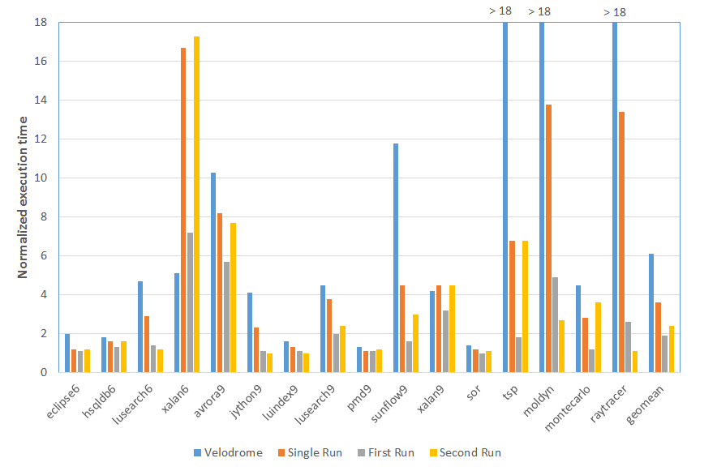
Performance Experiments
Notes:
Base is unmodified Jikes RVM. The four configurations are … GC Overheads, and need for logging

Slide 54
Performance Experiments
Single-run mode - 1.9 times faster than Velodrome
Multi-run mode
First run - 5.6 times faster
Second run - 3.7 times faster
Notes:
GC Overheads, and need for logging

Slide 55
DoubleChecker
2-4 times lesser overhead than current state-of-art
Makes dynamic atomicity checking more practical

Slide 56
Related Work
Type systems
Flanagan and Qadeer, PLDI 2003
Flanagan et al., TOPLAS 2008
Model checking
Farzan and Madhusudan, CAV 2006
Flanagan, SPIN 2004
Hatcliff et al., VMCAI 2004

Slide 57
Related Work
Dynamic analysis
Conflict-serializability-based approaches
Flanagan et al., PLDI 2008; Farzan and Madhusudan, CAV 2008
Inferring atomicity
Lu et al., ASPLOS 2006; Xu et al., PLDI 2005; Hammer et al., ICSE 2008
Predictive approaches
Sinha et al., MEMOCODE 2011; Sorrentino et al., FSE 2010
Other approaches
Wang and Stoller, PPoPP 2006; Wang and Stoller, TSE 2006
Notes:
We have a detailed discussion of related work in our paper.

Slide 58
What Has DoubleChecker Achieved?
Improved overheads over current state-of-art
Makes dynamic atomicity checking more practical
Cheaper to over-approximate dependences
Showcases a judicious separation of tasks to recover precision

