Slide 1
Leak Pruning
Michael Bond Kathryn McKinley
The University of Texas at Austin

Slide 2

Deployed Software Fails

Slide 3
Deployed Software Fails
Driverless truck
10,000 lines of C#
http://www.codeproject.com/KB/showcase/IfOnlyWedUsedANTSProfiler.aspx

Slide 4
Deployed Software Fails
Driverless truck
10,000 lines of C#
Leak: past obstacles remained reachable
http://www.codeproject.com/KB/showcase/IfOnlyWedUsedANTSProfiler.aspx

Slide 5
Deployed Software Fails
Driverless truck
10,000 lines of C#
Leak: past obstacles remained reachable
No immediate symptoms
“This problem was pernicious because it only showed up after 40 minutes to an hour of driving around and collecting obstacles.”
http://www.codeproject.com/KB/showcase/IfOnlyWedUsedANTSProfiler.aspx

Slide 6
Deployed Software Fails
Driverless truck
10,000 lines of C#
Leak: past obstacles remained reachable
No immediate symptoms
“This problem was pernicious because it only showed up after 40 minutes to an hour of driving around and collecting obstacles.”
Quick “fix”: restart after 40 minutes
http://www.codeproject.com/KB/showcase/IfOnlyWedUsedANTSProfiler.aspx

Slide 7
Deployed Software Fails
Driverless truck
10,000 lines of C#
Leak: past obstacles remained reachable
No immediate symptoms
“This problem was pernicious because it only showed up after 40 minutes to an hour of driving around and collecting obstacles.”
Quick “fix”: restart after 40 minutes
Environment sensitive
More obstacles in deployed setting
Unresponsive after 28 minutes
http://www.codeproject.com/KB/showcase/IfOnlyWedUsedANTSProfiler.aspx

Slide 8
Deployed Software Fails
Driverless truck
10,000 lines of C#
Leak: past obstacles remained reachable
No immediate symptoms
“This problem was pernicious because it only showed up after 40 minutes to an hour of driving around and collecting obstacles.”
Quick “fix”: restart after 40 minutes
Environment sensitive
More obstacles in deployed setting
Unresponsive after 28 minutes
Different environments & inputs → different behavior
Hard to fix before deployment
Uncertainty in deployed systems

Slide 9
Tolerating Memory Leaks
Deployed systems have leaks
Critical systems need immediate help
Leak pruning tolerates bad effects
Reclaims memory automatically
High precision & low overhead
Bounds resources
Preserves semantics

Slide 10
Outline
Why tolerate leaks
Why leaks are so bad
How leak pruning works
How leak pruning predicts leaked objects
Evaluation

Slide 11
Memory Leaks in Deployed Systems
Memory leaks are a real problem
Managed languages do not eliminate them

Slide 12
Memory Leaks in Deployed Systems
Memory leaks are a real problem
Managed languages do not eliminate them
Unreachable
Reachable

Slide 13
Memory Leaks in Deployed Systems
Memory leaks are a real problem
Managed languages do not eliminate them
Reachable

Slide 14
Memory Leaks in Deployed Systems
Memory leaks are a real problem
Managed languages do not eliminate them
Dead
Live
Reachable

Slide 15
Memory Leaks in Deployed Systems
Memory leaks are a real problem
Managed languages do not eliminate them
Live
Dead
Reachable

Slide 16
Memory Leaks in Deployed Systems
Memory leaks are a real problem
Managed languages do not eliminate them
Live
Reachable
Dead

Slide 17
Memory Leaks in Deployed Systems
Memory leaks are a real problem
Managed languages do not eliminate them
Reachable
Live
Dead

Slide 18
Memory Leaks in Deployed Systems
Memory leaks are a real problem
Managed languages do not eliminate them
Slow & crash real programs
Live
Dead

Slide 19
Memory Leaks in Deployed Systems
Memory leaks are a real problem
Managed languages do not eliminate them
Slow & crash real programs
Unacceptable for some applications

Slide 20
Memory Leaks in Deployed Systems
Memory leaks are a real problem
Managed languages do not eliminate them
Slow & crash real programs
Unacceptable for some applications
Fixing leaks is hard
Leaks take time to materialize
Failure far from cause

Slide 21
Outline
Why tolerate leaks
Why leaks are so bad
How leak pruning works
How leak pruning predicts leaked objects
Evaluation

Slide 22
Reclaiming Memory while Preserving Semantics
Garbage collection based on liveness
Live
Dead
Reachable

Slide 23
Reclaiming Memory while Preserving Semantics
Garbage collection based on liveness
Take action when memory exhausted
Live
Dead
Reachable

Slide 24
Reclaiming Memory while Preserving Semantics
Garbage collection based on liveness
Take action when memory exhausted
Live
Dead
Reachable

Slide 25
Reclaiming Memory while Preserving Semantics
Garbage collection based on liveness
Take action when memory exhausted
Out of memory!
Live
Throw OOM error
Dead

Slide 26
Reclaiming Memory while Preserving Semantics
Garbage collection based on liveness
Take action when memory exhausted
Out of memory!
Live
Throw OOM error
Dead
Reclaim some objects

Slide 27
Reclaiming Memory while Preserving Semantics
Garbage collection based on liveness
Reclaim predicted dead objects
Reclaimed
Live

Slide 28
Reclaiming Memory while Preserving Semantics
Garbage collection based on liveness
Reclaim predicted dead objects
Reclaimed
Live

Slide 29
Reclaiming Memory while Preserving Semantics
Garbage collection based on liveness
Reclaim predicted dead objects
Reclaimed
Live
B
A

Slide 30
Reclaiming Memory while Preserving Semantics
Garbage collection based on liveness
Reclaim predicted dead objects
Live
?
A

Slide 31
Reclaiming Memory while Preserving Semantics
Garbage collection based on liveness
Reclaim predicted dead objects
Poison references to reclaimed objects
Live
X
A

Slide 32
Reclaiming Memory while Preserving Semantics
Garbage collection based on liveness
Reclaim predicted dead objects
Poison references to reclaimed objects
Live
Throw InternalError with OOMError attached
X
A

Slide 33
Reclaiming Memory while Preserving Semantics
Garbage collection based on liveness
Reclaim predicted dead objects
Poison references to reclaimed objects
Live
Worst case: defers fatal errors
Best case: keeps leaky programs running much longer or indefinitely
Throw InternalError with OOMError attached
X
A

Slide 34
Outline
Why tolerate leaks
Why leaks are so bad
How leak pruning works
How leak pruning predicts leaked objects
Evaluation

Slide 35
Predicting Dead Objects
Predicting the future
Leaked objects → not used again
Highly stale objects → likely leaked
[Chilimbi & Hauswirth ’04] [Qin et al. ’05] [Bond & McKinley ’06]

Slide 36

Predicting Dead Objects
Predicting the future
Leaked objects → not used again
Highly stale objects → likely leaked
Alternative: offload to disk [Melt, Bond & McKinley ’08] [LeakSurvivor, Tang et al. ’08] [Panacea, Goldstein et al. ’07, Breitgand et al. ’07]
Tolerates mispredictions
Eventually exhausts disk (if disk at all)

Slide 37
Predicting Dead Objects
Predicting the future
Leaked objects → not used again
Highly stale objects → likely leaked
Alternative: offload to disk [Melt, Bond & McKinley ’08] [LeakSurvivor, Tang et al. ’08] [Panacea, Goldstein et al. ’07, Breitgand et al. ’07]
Tolerates mispredictions
Eventually exhausts disk (if disk at all)
Need high precision
One misprediction: program terminates

Slide 38
Predicting Dead Data Structures
Identify references to prune
Roots of leaked data structures
Categorize by reference type
PreparedStatement
ParserInfo

Slide 39
Predicting Dead Data Structures
Identify references to prune
Roots of leaked data structures
Categorize by reference type
Criteria
Highly stale references
More stale than most stale instance accessed previously
MaxS&U
PreparedStatement
ParserInfo
2-4 GCs

Slide 40
Predicting Dead Data Structures
Identify references to prune
Roots of leaked data structures
Categorize by reference type
Criteria
Highly stale references
More stale than most stale instance accessed previously
Reference type keeping most bytes reachable
MaxS&U
Size
PreparedStatement
ParserInfo
2-4 GCs
132MB

Slide 41
Predicting Dead Data Structures
Identify references to prune
Roots of leaked data structures
Categorize by reference type
Criteria
Highly stale references
More stale than most stale instance accessed previously
Reference type keeping most bytes reachable
MaxS&U
Size
PreparedStatement
ParserInfo
2-4 GCs
132MB
Piggyback on GC: two-phase transitive closure

Slide 42
MySQL Leak
Based on colleague’s JDBC application
Leak: SQL statements remain in set

Slide 43
MySQL Leak
Parser
Info
byte[][]
byte[]
HashSet
Prepared
Statement
Result
Set
Hash
Entry
Field[]

Slide 44
MySQL Leak
Parser
Info
byte[][]
byte[]
HashSet
Prepared
Statement
Result
Set
Hash
Entry
Field[]
Parser
Info
byte[][]
byte[]
Prepared
Statement
Hash
Entry
Result
Set
Field[]
…
…
…
Parser
Info
byte[][]
byte[]
Prepared
Statement
Hash
Entry
Result
Set
Field[]

Slide 45
Transitive Closure: Phase One
Parser
Info
byte[][]
byte[]
HashSet
Prepared
Statement
Result
Set
Hash
Entry
Field[]
Parser
Info
byte[][]
byte[]
Prepared
Statement
Hash
Entry
Result
Set
Field[]
…
…
…
Parser
Info
byte[][]
byte[]
Prepared
Statement
Hash
Entry
Result
Set
Field[]

Slide 46
Transitive Closure: Phase One
MaxS&U
16-32
HashEntry
PreparedStatement
PreparedStatement
ParserInfo
0-1
PreparedStatement
ResultSet
0-1
Parser
Info
byte[][]
byte[]
HashSet
Prepared
Statement
Result
Set
Hash
Entry
Field[]
Parser
Info
byte[][]
byte[]
Prepared
Statement
Hash
Entry
Result
Set
Field[]
…
…
…
Parser
Info
byte[][]
byte[]
Prepared
Statement
Hash
Entry
Result
Set
Field[]

Slide 47
Transitive Closure: Phase One
MaxS&U
16-32
HashEntry
PreparedStatement
PreparedStatement
ParserInfo
0-1
PreparedStatement
ResultSet
0-1
Parser
Info
byte[][]
byte[]
HashSet
Prepared
Statement
Result
Set
Hash
Entry
Field[]
Parser
Info
byte[][]
byte[]
Prepared
Statement
Hash
Entry
Result
Set
Field[]
…
…
…
Parser
Info
byte[][]
byte[]
Prepared
Statement
Hash
Entry
Result
Set
Field[]

Slide 48
Transitive Closure: Phase One
MaxS&U
16-32
HashEntry
PreparedStatement
PreparedStatement
ParserInfo
0-1
PreparedStatement
ResultSet
0-1
Parser
Info
byte[][]
byte[]
HashSet
Prepared
Statement
Result
Set
Hash
Entry
Field[]
Parser
Info
byte[][]
byte[]
Prepared
Statement
Hash
Entry
Result
Set
Field[]
…
…
…
Parser
Info
byte[][]
byte[]
Prepared
Statement
Hash
Entry
Result
Set
Field[]

Slide 49
Transitive Closure: Phase One
MaxS&U
16-32
HashEntry
PreparedStatement
PreparedStatement
ParserInfo
0-1
PreparedStatement
ResultSet
0-1
Parser
Info
byte[][]
byte[]
HashSet
enqueued
Prepared
Statement
enqueued
Result
Set
Hash
Entry
Field[]
Parser
Info
byte[][]
byte[]
Prepared
Statement
Hash
Entry
Result
Set
Field[]
…
…
…
Parser
Info
byte[][]
byte[]
Prepared
Statement
Hash
Entry
Result
Set
Field[]

Slide 50
Transitive Closure: Phase One
MaxS&U
16-32
HashEntry
PreparedStatement
PreparedStatement
ParserInfo
0-1
PreparedStatement
ResultSet
0-1
Parser
Info
byte[][]
byte[]
HashSet
enqueued
Prepared
Statement
enqueued
Result
Set
Hash
Entry
Field[]
Parser
Info
enqueued
byte[][]
byte[]
Prepared
Statement
Hash
Entry
enqueued
Result
Set
Field[]
…
…
…
Parser
Info
byte[][]
byte[]
enqueued
Prepared
Statement
Hash
Entry
enqueued
Result
Set
Field[]

Slide 51
Transitive Closure: Phase Two
MaxS&U
Bytes
16-32
0
HashEntry
PreparedStatement
PreparedStatement
ParserInfo
0-1
0
PreparedStatement
ResultSet
0-1
0
Parser
Info
byte[][]
byte[]
HashSet
enqueued
Prepared
Statement
enqueued
Result
Set
Hash
Entry
Field[]
Parser
Info
enqueued
byte[][]
byte[]
Prepared
Statement
Hash
Entry
enqueued
Result
Set
Field[]
…
…
…
Parser
Info
byte[][]
byte[]
enqueued
Prepared
Statement
Hash
Entry
enqueued
Result
Set
Field[]

Slide 52
Transitive Closure: Phase Two
MaxS&U
Bytes
16-32
0
HashEntry
PreparedStatement
PreparedStatement
ParserInfo
0-1
20
PreparedStatement
ResultSet
0-1
0
Parser
Info
byte[][]
byte[]
HashSet
Prepared
Statement
enqueued
Result
Set
Hash
Entry
Field[]
Parser
Info
enqueued
byte[][]
byte[]
Prepared
Statement
Hash
Entry
enqueued
Result
Set
Field[]
…
…
…
Parser
Info
byte[][]
byte[]
enqueued
Prepared
Statement
Hash
Entry
enqueued
Result
Set
Field[]

Slide 53
Transitive Closure: Phase Two
MaxS&U
Bytes
16-32
0
HashEntry
PreparedStatement
PreparedStatement
ParserInfo
0-1
60
PreparedStatement
ResultSet
0-1
0
Parser
Info
byte[][]
byte[]
HashSet
Prepared
Statement
enqueued
Result
Set
Hash
Entry
Field[]
Parser
Info
enqueued
byte[][]
byte[]
Prepared
Statement
Hash
Entry
enqueued
Result
Set
Field[]
…
…
…
Parser
Info
byte[][]
byte[]
enqueued
Prepared
Statement
Hash
Entry
enqueued
Result
Set
Field[]

Slide 54
Transitive Closure: Phase Two
MaxS&U
Bytes
16-32
0
HashEntry
PreparedStatement
PreparedStatement
ParserInfo
0-1
572
PreparedStatement
ResultSet
0-1
0
Parser
Info
byte[][]
byte[]
HashSet
Prepared
Statement
enqueued
Result
Set
Hash
Entry
Field[]
Parser
Info
enqueued
byte[][]
byte[]
Prepared
Statement
Hash
Entry
enqueued
Result
Set
Field[]
…
…
…
Parser
Info
byte[][]
byte[]
enqueued
Prepared
Statement
Hash
Entry
enqueued
Result
Set
Field[]

Slide 55
Transitive Closure: Phase Two
MaxS&U
Bytes
16-32
0
HashEntry
PreparedStatement
PreparedStatement
ParserInfo
0-1
572
PreparedStatement
ResultSet
0-1
0
Parser
Info
byte[][]
byte[]
HashSet
Prepared
Statement
Result
Set
Hash
Entry
Field[]
Parser
Info
enqueued
byte[][]
byte[]
Prepared
Statement
Hash
Entry
enqueued
Result
Set
Field[]
…
…
…
Parser
Info
byte[][]
byte[]
enqueued
Prepared
Statement
Hash
Entry
enqueued
Result
Set
Field[]

Slide 56
Transitive Closure: Phase Two
MaxS&U
Bytes
16-32
0
HashEntry
PreparedStatement
PreparedStatement
ParserInfo
0-1
572
PreparedStatement
ResultSet
0-1
244
Parser
Info
byte[][]
byte[]
HashSet
Prepared
Statement
Result
Set
Hash
Entry
Field[]
Parser
Info
enqueued
byte[][]
byte[]
Prepared
Statement
Hash
Entry
enqueued
Result
Set
Field[]
…
…
…
Parser
Info
byte[][]
byte[]
enqueued
Prepared
Statement
Hash
Entry
enqueued
Result
Set
Field[]

Slide 57
Transitive Closure: Phase Two
MaxS&U
Bytes
16-32
0
HashEntry
PreparedStatement
PreparedStatement
ParserInfo
0-1
420M
PreparedStatement
ResultSet
0-1
180M
Parser
Info
byte[][]
byte[]
HashSet
Prepared
Statement
Result
Set
Hash
Entry
Field[]
Parser
Info
byte[][]
byte[]
Prepared
Statement
Hash
Entry
Result
Set
Field[]
…
…
…
Parser
Info
byte[][]
byte[]
Prepared
Statement
Hash
Entry
Result
Set
Field[]

Slide 58
Select Best Reference Type
MaxS&U
Bytes
16-32
0
HashEntry
PreparedStatement
PreparedStatement
ParserInfo
0-1
420M
PreparedStatement
ResultSet
0-1
180M
Parser
Info
byte[][]
byte[]
HashSet
Prepared
Statement
Result
Set
Hash
Entry
Field[]
Parser
Info
byte[][]
byte[]
Prepared
Statement
Hash
Entry
Result
Set
Field[]
…
…
…
Parser
Info
byte[][]
byte[]
Prepared
Statement
Hash
Entry
Result
Set
Field[]

Slide 59
Prune Selected Reference Type
MaxS&U
Bytes
16-32
0
HashEntry
PreparedStatement
PreparedStatement
ParserInfo
0-1
420M
PreparedStatement
ResultSet
0-1
180M
Parser
Info
byte[][]
byte[]
HashSet
Prepared
Statement
Result
Set
Hash
Entry
Field[]
Parser
Info
byte[][]
byte[]
Prepared
Statement
Hash
Entry
Result
Set
Field[]
…
…
…
Parser
Info
byte[][]
byte[]
Prepared
Statement
Hash
Entry
Result
Set
Field[]

Slide 60
Prune Selected Reference Type
MaxS&U
Bytes
16-32
0
HashEntry
PreparedStatement
PreparedStatement
ParserInfo
0-1
420M
PreparedStatement
ResultSet
0-1
180M
HashSet
Prepared
Statement
Result
Set
Hash
Entry
Field[]
Prepared
Statement
Hash
Entry
Result
Set
Field[]
…
…
…
Prepared
Statement
Hash
Entry
Result
Set
Field[]

Slide 61
Leak Partially Eliminated
MaxS&U
Bytes
16-32
0
HashEntry
PreparedStatement
PreparedStatement
ParserInfo
0-1
0
PreparedStatement
ResultSet
0-1
0
HashSet
Prepared
Statement
Result
Set
Hash
Entry
Field[]
Prepared
Statement
Hash
Entry
Result
Set
Field[]
…
…
…
Prepared
Statement
Hash
Entry
Result
Set
Field[]

Slide 62
Transitive Closure: Phase One
MaxS&U
Bytes
16-32
0
HashEntry
PreparedStatement
PreparedStatement
ParserInfo
0-1
0
PreparedStatement
ResultSet
0-1
0
HashSet
Prepared
Statement
enqueued
Result
Set
Hash
Entry
Field[]
Prepared
Statement
Hash
Entry
enqueued
Result
Set
Field[]
…
…
…
Prepared
Statement
Hash
Entry
enqueued
Result
Set
Field[]

Slide 63
Transitive Closure: Phase Two
MaxS&U
Bytes
16-32
0
HashEntry
PreparedStatement
PreparedStatement
ParserInfo
0-1
50M
PreparedStatement
ResultSet
0-1
220M
HashSet
Prepared
Statement
Result
Set
Hash
Entry
Field[]
Prepared
Statement
Hash
Entry
Result
Set
Field[]
…
…
…
Prepared
Statement
Hash
Entry
Result
Set
Field[]

Slide 64
Select Best Reference Type
MaxS&U
Bytes
16-32
0
HashEntry
PreparedStatement
PreparedStatement
ParserInfo
0-1
50M
PreparedStatement
ResultSet
0-1
220M
HashSet
Prepared
Statement
Result
Set
Hash
Entry
Field[]
Prepared
Statement
Hash
Entry
Result
Set
Field[]
…
…
…
Prepared
Statement
Hash
Entry
Result
Set
Field[]

Slide 65
Prune Selected Reference Type
MaxS&U
Bytes
16-32
0
HashEntry
PreparedStatement
PreparedStatement
ParserInfo
0-1
50M
PreparedStatement
ResultSet
0-1
220M
HashSet
Prepared
Statement
Result
Set
Hash
Entry
Field[]
Prepared
Statement
Hash
Entry
Result
Set
Field[]
…
…
…
Prepared
Statement
Hash
Entry
Result
Set
Field[]

Slide 66
Prune Selected Reference Type
MaxS&U
Bytes
16-32
0
HashEntry
PreparedStatement
PreparedStatement
ParserInfo
0-1
50M
PreparedStatement
ResultSet
0-1
220M
HashSet
Prepared
Statement
Hash
Entry
Prepared
Statement
Hash
Entry
…
…
Prepared
Statement
Hash
Entry

Slide 67
Prediction Summary
HashSet
Prepared
Statement
Algorithm efficiently selects references to consistently unused data structures based on type
Hash
Entry
Prepared
Statement
Hash
Entry
…
…
Prepared
Statement
Hash
Entry

Slide 68
Outline
Why tolerate leaks
Why leaks are so bad
How leak pruning works
How leak pruning predicts leaked objects
Evaluation

Slide 69
Implementation
Leak pruning added to Jikes RVM 2.9.2
http://www.jikesrvm.org/Research+Archive

Slide 70
Implementation
Leak pruning added to Jikes RVM 2.9.2
http://www.jikesrvm.org/Research+Archive
Performance stress test
Non-leaking programs: DaCapo & SPEC benchmarks
Low overhead
3% (Core 2) or 5% (Pentium 4)
Primarily read barriers

Slide 71
Tolerating Leaks
Leak | Leak pruning’s effect
Eclipse “Diff” | Tolerates until 24-hr limit (>200X longer)
ListLeak | Tolerates until 24-hr limit (>25,000X longer)
SwapLeak | Tolerates until 24-hr limit (>2,200X longer)
Eclipse “Copy-Paste” | Most dead but some live (81X longer)
MySQL | Most dead but some live (35X longer)
JbbMod | All dead but pruning misses some (21X longer)
SPECjbb2000 | Heap growth is mostly live (4.7X longer)
Mckoi Database | Thread leak: extra support needed (1.6X longer)
DualLeak | Heap growth is live (No help)

Slide 72
Tolerating Leaks
Leak | Leak pruning’s effect
Eclipse “Diff” | Tolerates until 24-hr limit (>200X longer)
ListLeak | Tolerates until 24-hr limit (>25,000X longer)
SwapLeak | Tolerates until 24-hr limit (>2,200X longer)
Eclipse “Copy-Paste” | Most dead but some live (81X longer)
MySQL | Most dead but some live (35X longer)
JbbMod | All dead but pruning misses some (21X longer)
SPECjbb2000 | Heap growth is mostly live (4.7X longer)
Mckoi Database | Thread leak: extra support needed (1.6X longer)
DualLeak | Heap growth is live (No help)

Slide 73
Tolerating Leaks
Leak | Leak pruning’s effect
Eclipse “Diff” | Tolerates until 24-hr limit (>200X longer)
ListLeak | Tolerates until 24-hr limit (>25,000X longer)
SwapLeak | Tolerates until 24-hr limit (>2,200X longer)
Eclipse “Copy-Paste” | Most dead but some live (81X longer)
MySQL | Most dead but some live (35X longer)
JbbMod | All dead but pruning misses some (21X longer)
SPECjbb2000 | Heap growth is mostly live (4.7X longer)
Mckoi Database | Thread leak: extra support needed (1.6X longer)
DualLeak | Heap growth is live (No help)

Slide 74
Tolerating Leaks
Leak | Leak pruning’s effect
Eclipse “Diff” | Tolerates until 24-hr limit (>200X longer)
ListLeak | Tolerates until 24-hr limit (>25,000X longer)
SwapLeak | Tolerates until 24-hr limit (>2,200X longer)
Eclipse “Copy-Paste” | Most dead but some live (81X longer)
MySQL | Most dead but some live (35X longer)
JbbMod | All dead but pruning misses some (21X longer)
SPECjbb2000 | Heap growth is mostly live (4.7X longer)
Mckoi Database | Thread leak: extra support needed (1.6X longer)
DualLeak | Heap growth is live (No help)

Slide 75
Tolerating Leaks
Leak | Leak pruning’s effect
Eclipse “Diff” | Tolerates until 24-hr limit (>200X longer)
ListLeak | Tolerates until 24-hr limit (>25,000X longer)
SwapLeak | Tolerates until 24-hr limit (>2,200X longer)
Eclipse “Copy-Paste” | Most dead but some live (81X longer)
MySQL | Most dead but some live (35X longer)
JbbMod | All dead but pruning misses some (21X longer)
SPECjbb2000 | Heap growth is mostly live (4.7X longer)
Mckoi Database | Thread leak: extra support needed (1.6X longer)
DualLeak | Heap growth is live (No help)

Slide 76
Tolerating Leaks
Leak | Leak pruning’s effect
Eclipse “Diff” | Tolerates until 24-hr limit (>200X longer)
ListLeak | Tolerates until 24-hr limit (>25,000X longer)
SwapLeak | Tolerates until 24-hr limit (>2,200X longer)
Eclipse “Copy-Paste” | Most dead but some live (81X longer)
MySQL | Most dead but some live (35X longer)
JbbMod | All dead but pruning misses some (21X longer)
SPECjbb2000 | Heap growth is mostly live (4.7X longer)
Mckoi Database | Thread leak: extra support needed (1.6X longer)
DualLeak | Heap growth is live (No help)
MaxS&U
Orderline
String
0-1
Object[]
Date
16-32

Slide 77
Tolerating Leaks
Leak | Leak pruning’s effect
Eclipse “Diff” | Tolerates until 24-hr limit (>200X longer)
ListLeak | Tolerates until 24-hr limit (>25,000X longer)
SwapLeak | Tolerates until 24-hr limit (>2,200X longer)
Eclipse “Copy-Paste” | Most dead but some live (81X longer)
MySQL | Most dead but some live (35X longer)
JbbMod | All dead but pruning misses some (21X longer)
SPECjbb2000 | Heap growth is mostly live (4.7X longer)
Mckoi Database | Thread leak: extra support needed (1.6X longer)
DualLeak | Heap growth is live (No help)

Slide 78
Tolerating Leaks
Leak | Leak pruning’s effect
Eclipse “Diff” | Tolerates until 24-hr limit (>200X longer)
ListLeak | Tolerates until 24-hr limit (>25,000X longer)
SwapLeak | Tolerates until 24-hr limit (>2,200X longer)
Eclipse “Copy-Paste” | Most dead but some live (81X longer)
MySQL | Most dead but some live (35X longer)
JbbMod | All dead but pruning misses some (21X longer)
SPECjbb2000 | Heap growth is mostly live (4.7X longer)
Mckoi Database | Thread leak: extra support needed (1.6X longer)
DualLeak | Heap growth is live (No help)
Reported on Eclipse Bugzilla
Leak: recursive difference
Automated with Eclipse Plugin

Slide 79
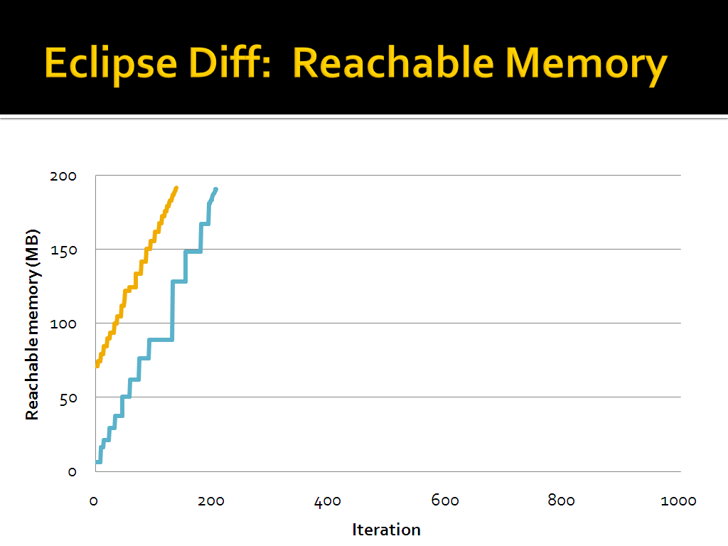

Slide 80
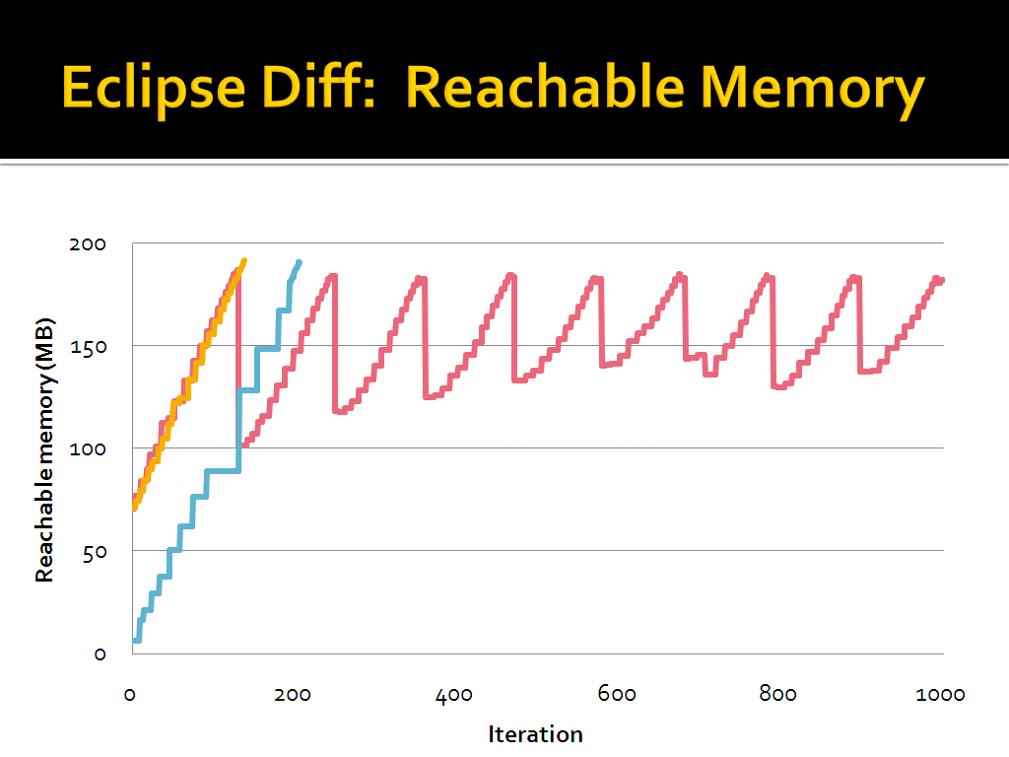

Slide 81
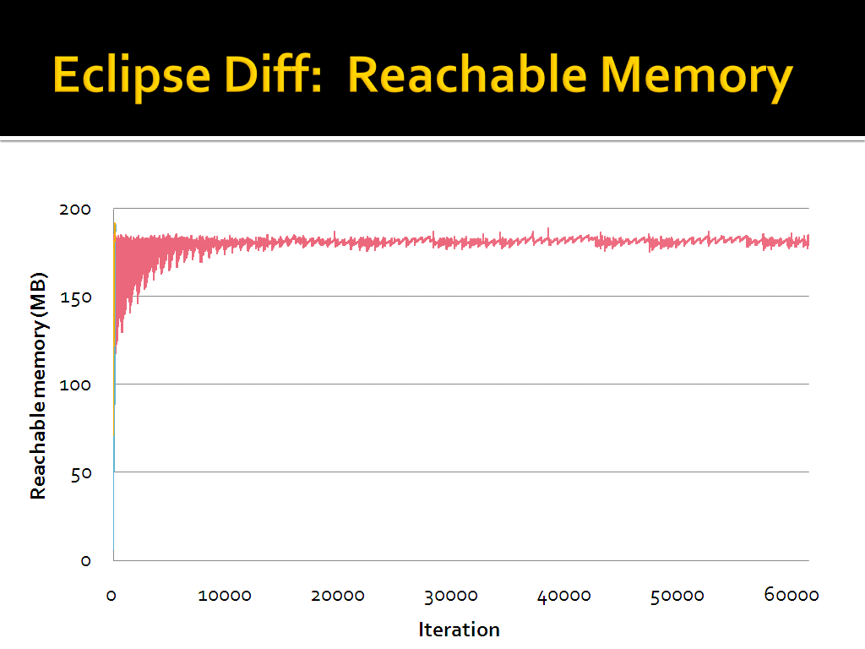

Slide 82
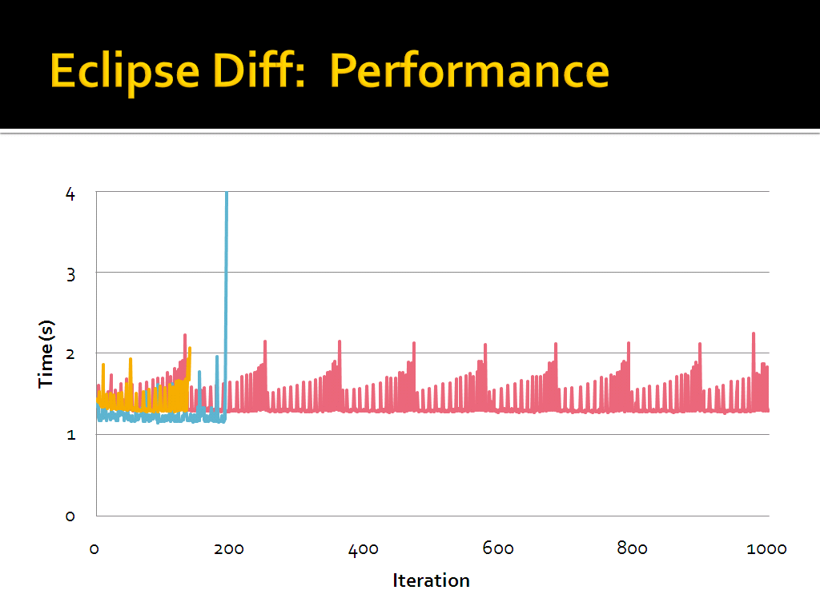

Slide 83
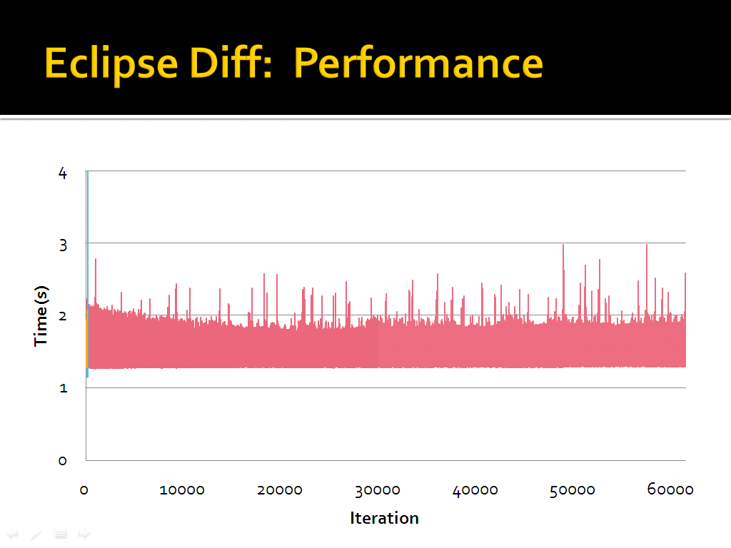

Slide 84
Performance Summary
Low footprint &
often helps a lot →
all-the-time deployed use

Slide 85
Related Work
Memory corruption & concurrency bugs
Perturb layout & scheduling [Rx, Qin et al. ’05] [DieHard, Berger & Zorn ’06] [Atom-Aid, Lucia et al. ’08] [Grace, Berger et al. ’08]
Fatal errors
Ignore errors [Failure-oblivious computing, Rinard et al. ’04] [Append, Dobolyi & Weimer ’08]

Slide 86
Related Work
Memory corruption & concurrency bugs
Perturb layout & scheduling [Rx, Qin et al. ’05] [DieHard, Berger & Zorn ’06] [Atom-Aid, Lucia et al. ’08] [Grace, Berger et al. ’08]
Fatal errors
Ignore errors [Failure-oblivious computing, Rinard et al. ’04] [Append, Dobolyi & Weimer ’08]
Memory leaks in unmanaged languages
Leak-friendly layout [Plug, Novark et al. ’08]
Bound allocation sites [Cyclic alloc, Nguyen & Rinard ’07]

Slide 87
Tolerating Memory Leaks in Managed Languages
Finding leaks before deployment is hard
Deployed systems need immediate help
Leak pruning: GC based on liveness
High precision & low overhead
Bounded resources
Preserves semantics

Slide 88
Tolerating Memory Leaks in Managed Languages
Finding leaks before deployment is hard
Deployed systems need immediate help
Leak pruning: GC based on liveness
High precision & low overhead
Bounded resources
Preserves semantics
Thank you!

Slide 89
Backup

Slide 90
Eclipse “Diff” Leak
Reported on Eclipse Bugzilla
Recursive difference leaks memory

Slide 91
Eclipse “Diff” Leak
Tree
Editor
Structural
Diff Data
Editors
Filtered
Node
Resource
Compare
Piggyback on GC: two-phase transitive closure
First phase stops at highly stale references
No instance highly stale & accessed
Editor
Tree
Editor
Structural
Diff Data
Editor
Resource
Compare
Filtered
Node
…
…
…
Tree
Editor
Structural
Diff Data
Editor
Resource
Compare
Filtered
Node

Slide 92
Fine-Grained Usage Tracking
Tree
Editor
Structural
Diff Data
Editors
Filtered
Node
Resource
Compare
Editor
Application:
t = o.f;
t.staleness = 0;
Garbage collector:
for all objects o
o.staleness++;
Tree
Editor
Structural
Diff Data
Editor
Resource
Compare
Filtered
Node
…
…
…
Tree
Editor
Structural
Diff Data
Editor
Resource
Compare
Filtered
Node

Slide 93
Fine-Grained Usage Tracking
Tree
Editor
Structural
Diff Data
Editors
Filtered
Node
Resource
Compare
Editor
Application:
t = o.f;
if (t & 0x1) {
t &= ~0x1;
t.staleness = 0;
o.f = t; [atomic]
}
Garbage collector:
for all objects o
o.staleness++;
for all fields o.f
o.f |= 0x1;
Tree
Editor
Structural
Diff Data
Editor
Resource
Compare
Filtered
Node
…
…
…
Tree
Editor
Structural
Diff Data
Editor
Resource
Compare
Filtered
Node

Slide 94
Fine-Grained Usage Tracking
Tree
Editor
Structural
Diff Data
Editors
Filtered
Node
Resource
Compare
Editor
Tree
Editor
Structural
Diff Data
Editor
Resource
Compare
Filtered
Node
…
…
…
Tree
Editor
Structural
Diff Data
Editor
Resource
Compare
Filtered
Node

Slide 95
Summarize Stale Data Structures
Tree
Editor
Structural
Diff Data
Editors
Filtered
Node
Resource
Compare
Piggyback on GC: two-phase transitive closure
First phase stops at highly stale references
No instance highly stale & accessed
Editor
Tree
Editor
Structural
Diff Data
Editor
Resource
Compare
Filtered
Node
…
…
…
Tree
Editor
Structural
Diff Data
Editor
Resource
Compare
Filtered
Node

Slide 96
Phase One of Transitive Closure
Tree
Editor
Structural
Diff Data
Editors
Filtered
Node
Resource
Compare
Editor
Tree
Editor
Structural
Diff Data
Editor
Resource
Compare
Filtered
Node
…
…
…
Tree
Editor
Structural
Diff Data
Editor
Resource
Compare
Filtered
Node

Slide 97
Phase One of Transitive Closure
Tree
Editor
Structural
Diff Data
Editors
Filtered
Node
Resource
Compare
Editor
Tree
Editor
Structural
Diff Data
Editor
Resource
Compare
Filtered
Node
…
…
…
Tree
Editor
Structural
Diff Data
Editor
Resource
Compare
Filtered
Node

Slide 98
Phase Two of Transitive Closure
Tree
Editor
Structural
Diff Data
Editors
Filtered
Node
Resource
Compare
Piggyback on GC: two-phase transitive closure
First phase stops at highly stale references
No instance highly stale & accessed
Second phase: bytes reachable from each ref
Reference type with most bytes: selected for pruning
Editor
Tree
Editor
Structural
Diff Data
Editor
Resource
Compare
Filtered
Node
…
…
…
Tree
Editor
Structural
Diff Data
Editor
Resource
Compare
Filtered
Node

Slide 99
Phase Two of Transitive Closure
Tree
Editor
Structural
Diff Data
Editors
Filtered
Node
Resource
Compare
Editor
Tree
Editor
Structural
Diff Data
Editor
Resource
Compare
Filtered
Node
…
…
…
Tree
Editor
Structural
Diff Data
Editor
Resource
Compare
Filtered
Node

Slide 100
Phase Two of Transitive Closure
Tree
Editor
Structural
Diff Data
Editors
Filtered
Node
Resource
Compare
Editor
Tree
Editor
Structural
Diff Data
Editor
Resource
Compare
Filtered
Node
…
…
…
Tree
Editor
Structural
Diff Data
Editor
Resource
Compare
Filtered
Node

Slide 101
Phase Two of Transitive Closure
Tree
Editor
Structural
Diff Data
Editors
Filtered
Node
Resource
Compare
Editor
Tree
Editor
Structural
Diff Data
Editor
Resource
Compare
Filtered
Node
…
…
…
Tree
Editor
Structural
Diff Data
Editor
Resource
Compare
Filtered
Node

Slide 102
Select Reference Type
Resource
Compare
Tree
Editor
Tree
Editor
Structural
Diff Data
Editors
Filtered
Node
Resource
Compare
Editor
Tree
Editor
Structural
Diff Data
Editor
Resource
Compare
Filtered
Node
…
…
…
Tree
Editor
Structural
Diff Data
Editor
Resource
Compare
Filtered
Node

Slide 103
Prune Selected Reference Type
Resource
Compare
Tree
Editor
Tree
Editor
Structural
Diff Data
Editors
Filtered
Node
Resource
Compare
Editor
Tree
Editor
Structural
Diff Data
Editor
Resource
Compare
Filtered
Node
…
…
…
Tree
Editor
Structural
Diff Data
Editor
Resource
Compare
Filtered
Node

Slide 104
Prune Selected Reference Type
Resource
Compare
Tree
Editor
Structural
Diff Data
Editors
Filtered
Node
Resource
Compare
Editor
Structural
Diff Data
Editor
Resource
Compare
Filtered
Node
…
…
…
Structural
Diff Data
Editor
Resource
Compare
Filtered
Node

Slide 105
Phase One of Transitive Closure
Structural
Diff Data
Editors
Filtered
Node
Resource
Compare
Editor
Structural
Diff Data
Editor
Resource
Compare
Filtered
Node
…
…
…
Structural
Diff Data
Editor
Resource
Compare
Filtered
Node

Slide 106
Select Another Reference Type
Resource
Compare
Filtered
Node
Structural
Diff Data
Editors
Filtered
Node
Resource
Compare
Editor
Structural
Diff Data
Editor
Resource
Compare
Filtered
Node
…
…
…
Structural
Diff Data
Editor
Resource
Compare
Filtered
Node

Slide 107
Prune Reference Type
Resource
Compare
Filtered
Node
Structural
Diff Data
Editors
Filtered
Node
Resource
Compare
Editor
Structural
Diff Data
Editor
Resource
Compare
Filtered
Node
…
…
…
Structural
Diff Data
Editor
Resource
Compare
Filtered
Node

Slide 108
Prune Reference Type
Resource
Compare
Filtered
Node
Editors
Resource
Compare
Editor
Editor
Resource
Compare
…
…
Editor
Resource
Compare

