Slide 1
Practical Path Profiling for Dynamic Optimizers
Michael Bond, UT Austin
Kathryn McKinley, UT Austin

Slide 2
Why path profiling?
Processors need long instruction sequences
Programs have branches
A
B
C
D
E

Slide 3
Why path profiling?
Compiler identifies hot paths across multiple basic blocks
A
B
C
D
E

Slide 4
Why path profiling?
Compiler identifies hot paths across multiple basic blocks
  Forms and optimizes “traces”
A
A
B
B
C
C
D
E
E

Slide 5
Why path profiling?
Compiler identifies hot paths across multiple basic blocks
  Forms and optimizes “traces”
A
A
B
B
C
Oops!
C
D
E
E
Oops!

Slide 6
Why path profiling?
Compiler identifies hot paths across multiple basic blocks
  Forms and optimizes “traces”
Less aggressive
More aggressive
Superblocks
Hyperblocks
rePLay frames
MSSP tasks
Dynamo fragments

Slide 7
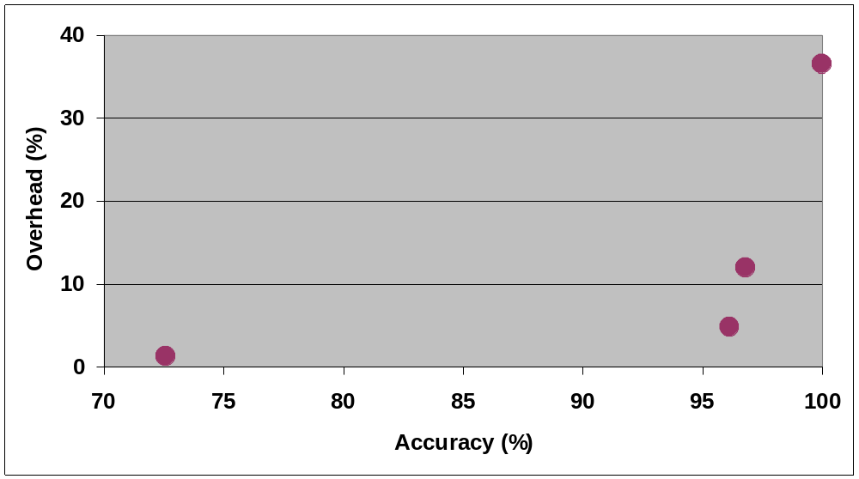
Ball-Larus path profiling
Ball-Larus path profiling
Instrumentation measures execution frequency of each path
Acyclic, intraprocedural paths
Targeted path profiling
Edge profiling
Practical path profiling

Slide 8
Edge profiling
Ball-Larus path profiling
Hardware or sampling
Estimate hot paths from edge profile
Targeted path profiling
Edge profiling
Practical path profiling

Slide 9
Ideal for dynamic optimizer
Ball-Larus path profiling
Targeted path profiling
Edge profiling
Practical path profiling

Slide 10
Targeted path profiling [Joshi et al. ’04]
Profile-guided profiling
Accuracy good
Overhead high for dynamic optimizer
Ball-Larus path profiling
Targeted path profiling
Edge profiling
Practical path profiling

Slide 11
Practical path profiling
Ball-Larus path profiling
Targeted path profiling
Edge profiling
Practical path profiling

Slide 12
Outline
Background
  Staged dynamic optimization
  Profile-guided profiling
  Ball-Larus path profiling
Practical path profiling
Methodology
  Edge profile-guided inlining and unrolling
  Measuring accuracy with branch-flow metric
Accuracy and overhead

Slide 13
Staged dynamic optimization
Stage 0
Static
optimizations

Slide 14
Staged dynamic optimization
Stage 0
Static
optimizations
Edge
profile
Sampling-based
edge profiler

Slide 15
Staged dynamic optimization
Stage 0
Stage 1
Static
optimizations
Local
optimizations
incl. inlining &
unrolling
Edge
profile
Sampling-based
edge profiler

Slide 16
Staged dynamic optimization
Stage 0
Stage 1
Static
optimizations
Local
optimizations
incl. inlining &
unrolling
Edge
profile
Larger routines
Longer paths
More challenging platform for path profiling
Sampling-based
edge profiler

Slide 17
Staged dynamic optimization
Stage 0
Stage 1
Static
optimizations
Local
optimizations
incl. inlining &
unrolling
Edge
profile
Path profiling
instrumentation
Sampling-based
edge profiler

Slide 18
Staged dynamic optimization
Stage 0
Stage 1
Static
optimizations
Local
optimizations
incl. inlining &
unrolling
Edge
profile
Path
profile
Path profiling
instrumentation
Sampling-based
edge profiler

Slide 19
Staged dynamic optimization
Stage 0
Stage 1
Stage 2
Static
optimizations
Local
optimizations
incl. inlining &
unrolling
Global
optimizations
Edge
profile
Path
profile
Path profiling
instrumentation
Sampling-based
edge profiler

Slide 20
Staged dynamic optimization
Stage 0
Stage 1
Stage 2
Static
optimizations
Local
optimizations
incl. inlining &
unrolling
Global
optimizations
Edge
profile
Path
profile
Path profiling
instrumentation
Sampling-based
edge profiler
Edge profile:
Identifies hot and cold edges
Provides partial path profile

Slide 21
Profile-guided profiling
Stage 0
Stage 1
Stage 2
Static
optimizations
Local
optimizations
incl. inlining &
unrolling
Global
optimizations
Edge
profile
Path
profile
Path profiling
instrumentation
Sampling-based
edge profiler
Edge profile:
Identifies hot and cold edges
Provides partial path profile

Slide 22
Ball-Larus path profiling
Acyclic, intraprocedural paths
  Handles cyclic routines
Instrumentation maintains execution frequency of each path
  Each path computes unique integer in [0, N-1]

Slide 23
Ball-Larus path profiling
4 paths → [0, 3]
Notes:
TODO: better explanation of Ball-Larus path profiling

Slide 24
Ball-Larus path profiling
4 paths → [0, 3]
Each path sums to unique integer
2
0
1
0
Notes:
TODO: better explanation of Ball-Larus path profiling

Slide 25
Ball-Larus path profiling
4 paths → [0, 3]
Each path sums to unique integer
Path 0
2
0
1
0
Notes:
TODO: better explanation of Ball-Larus path profiling

Slide 26
Ball-Larus path profiling
4 paths → [0, 3]
Each path sums to unique integer
Path 0
Path 1
2
0
1
0
Notes:
TODO: better explanation of Ball-Larus path profiling

Slide 27
Ball-Larus path profiling
4 paths → [0, 3]
Each path sums to unique integer
Path 0
Path 1
Path 2
2
0
1
0
Notes:
TODO: better explanation of Ball-Larus path profiling

Slide 28
Ball-Larus path profiling
4 paths → [0, 3]
Each path sums to unique integer
Path 0
Path 1
Path 2
Path 3
2
0
1
0
Notes:
TODO: better explanation of Ball-Larus path profiling

Slide 29
Ball-Larus path profiling
r: path register
  Computes path number
count:
  Stores path frequencies
r=0
r=r+2
r=r+1
count[r]++

Slide 30
Ball-Larus path profiling
r: path register
  Computes path number
count:
  Stores path frequencies
  Array by default
  Too many paths?
    Hash table
    High overhead
r=0
r=r+2
r=r+1
count[r]++

Slide 31
Outline
Background
  Ball-Larus path profiling
  Staged dynamic optimization
  Profile-guided profiling
Practical path profiling
Methodology
  Edge profile-guided inlining and unrolling
  Measuring accuracy with branch-flow metric
Accuracy and overhead

Slide 32
Practical path profiling
Goal: Reduce instrumentation overhead without hurting accuracy
  Use profile-guided profiling
Strategies
  Decrease number of possible paths
  Avoid instrumenting paths edge profile predicts well
  Simplify instrumentation on profiled paths

Slide 33
Practical path profiling
Goal: Reduce instrumentation overhead without hurting accuracy
  Use profile-guided profiling
Strategies
  Decrease number of possible paths
  Avoid instrumenting paths edge profile predicts well
  Simplify instrumentation on profiled paths
Techniques from targeted path profiling
  Improves techniques
  Adds new techniques

Slide 34
Strategy 1: Fewer possible paths
Goal: Hash table → array
Want to remove cold paths
60
40
97
3
0
100
50
50

Slide 35
Strategy 1: Fewer possible paths
Goal: Hash table → array
Want to remove cold paths
Observation: A path with a cold edge is a cold path
Remove cold edges
  Local and global criteria
60
40
97
3
0
100
New
50
50

Slide 36
Strategy 1: Fewer possible paths
Goal: Hash table → array
Want to remove cold paths
Observation: A path with a cold edge is a cold path
Remove cold edges
  Local and global criteria
Paths: 16 → 4

Slide 37
Strategy 1: Fewer possible paths
Remaining paths potentially hot
4 paths → [0, 3]
2
0
1
0

Slide 38
Strategy 1: Fewer possible paths
Remaining paths potentially hot
4 paths → [0, 3]
r=0
r=r+2
r=r+1
count[r]++

Slide 39
Strategy 1: Fewer possible paths
What if cold edge taken?
r=0
r=r+2
r=r+1
count[r]++

Slide 40
Strategy 1: Fewer possible paths
What if cold edge taken?
Cold edges “poison” path register
  Set it to N
  Cold paths use [N, 2N-1]
r=0
r=r+2
r=4
New
r=4
r=r+1
count[r]++

Slide 41
Strategy 1: Fewer possible paths
What if cold edge taken?
Cold edges “poison” path register
  Set it to N
  Cold paths use [N, 2N-1]
What if still too many possible paths?
r=0
r=r+2
r=4
r=4
r=r+1
count[r]++

Slide 42
Strategy 1: Fewer possible paths
What if cold edge taken?
Cold edges “poison” path register
  Set it to N
  Cold paths use [N, 2N-1]
What if still too many possible paths?
Adjust cold edge threshold until hashing avoided
r=0
r=r+2
r=4
r=4
r=r+1
count[r]++
New

Slide 43
Strategy 2: Avoid instrumenting paths
Consider right half of CFG

Slide 44
Strategy 2: Avoid instrumenting paths
Consider right half of CFG
  Obvious paths: Each path has an edge unique to it
  Edge profile provides perfect path profile

Slide 45
Strategy 2: Avoid instrumenting paths
Consider right half of CFG
  Obvious paths: Each path has an edge unique to it
  Edge profile provides perfect path profile
We don’t instrument the right half of the CFG
r=0
r=r+2
r=r+1
count[r]++

Slide 46
Strategy 2: Avoid instrumenting paths
Synergy: Cold edge removal creates more obvious paths

Slide 47
Strategy 2: Avoid instrumenting paths
Synergy: Cold edge removal creates more obvious paths
  Right half is obvious

Slide 48
Strategy 2: Avoid instrumenting paths
What if cold edge is part of obvious and non-obvious paths?

Slide 49
Strategy 2: Avoid instrumenting paths
What if cold edge is part of obvious and non-obvious paths?
Right half obvious

Slide 50
Strategy 2: Avoid instrumenting paths
r=0
What if cold edge is part of obvious and non-obvious paths?
Right half obvious
  But we haven’t avoided instrumenting it!
r=r+2
r=r+1
r=4
count[r]++

Slide 51
Strategy 2: Avoid instrumenting paths
What if cold edge is part of obvious and non-obvious paths?
Right half obvious
  But we haven’t avoided instrumenting it!
Aggressive instrumentation pushing
r=0
r=r+2
r=r+1
count[r]++
New

Slide 52
Strategy 2: Avoid instrumenting paths
Overcounts some hot paths
r=0
r=r+2
r=r+1
count[r]++

Slide 53
Strategy 2: Avoid instrumenting paths
Overcounts some hot paths
Example cold path counts hot path number 1
Overcount tends to be small
r=0
r=r+2
r=r+1
count[r]++

Slide 54
Some paths need profiling
Correlation between cascading branches

Slide 55
New
Strategy 3: Simplify instrumentation
Moderately biased branches
60
40
60
40
Notes:
TODO: better explanation of Ball-Larus path profiling

Slide 56
Strategy 3: Simplify instrumentation
Moderately biased branches
Put zeros on hotter edges
0
2
0
1
Notes:
TODO: better explanation of Ball-Larus path profiling

Slide 57
Strategy 3: Simplify instrumentation
Moderately biased branches
Put zeros on hotter edges
  No instrumentation on hotter edges
r=0
r=r+2
r=r+1
count[r]++
Notes:
TODO: better explanation of Ball-Larus path profiling

Slide 58
Outline
Background
  Staged dynamic optimization
  Profile-guided profiling
  Ball-Larus path profiling
Practical path profiling
Methodology
  Edge profile-guided inlining and unrolling
  Measuring accuracy with branch-flow metric
Accuracy and overhead

Slide 59
Methodology
Path profiling implemented in Scale [McKinley et al.]
  Ahead-of-time compiler → deterministic platform
Edge profile-guided inlining and unrolling precede path profiling

Slide 60
Methodology
Path profiling implemented in Scale [McKinley et al.]
  Ahead-of-time compiler → deterministic platform
Edge profile-guided inlining and unrolling precede path profiling
Alpha binaries for subset of SPEC2000
  C and Fortran 77 only
  Scale wouldn’t compile gzip, vortex, gcc
ref inputs for all runs

Slide 61
Measuring accuracy
Compare estimated profile with actual profile
  Wall weight matching* or profile overlap
Weight paths by flow: amount of execution
  Previous work measures flow with unit-flow metric
    Flow(p) = Freq(p)
  We introduce branch-flow metric
    Flow(p) = Freq(p) x NumBranches(p)

Slide 62
Motivating the branch-flow metric
Programs really execute one very long path
call
return

Slide 63
Motivating the branch-flow metric
Programs really execute one very long path
call
return

Slide 64
Motivating the branch-flow metric
Programs really execute one very long path
  Ball-Larus path profiling breaks it into multiple acyclic, intraprocedural paths
call
call
return
return

Slide 65
Motivating the branch-flow metric
Some paths longer than others
  We care more about longer paths
  Unit-flow metric unfairly rewards edge profiling
call
call
return
return

Slide 66
Outline
Background
  Staged dynamic optimization
  Profile-guided profiling
  Ball-Larus path profiling
Practical path profiling
Methodology
  Edge profile-guided inlining and unrolling
  Measuring accuracy with branch-flow metric
Accuracy and overhead

Slide 67
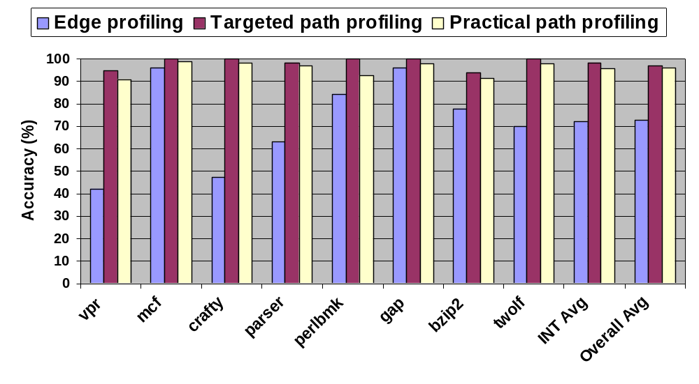
Accuracy

Slide 68
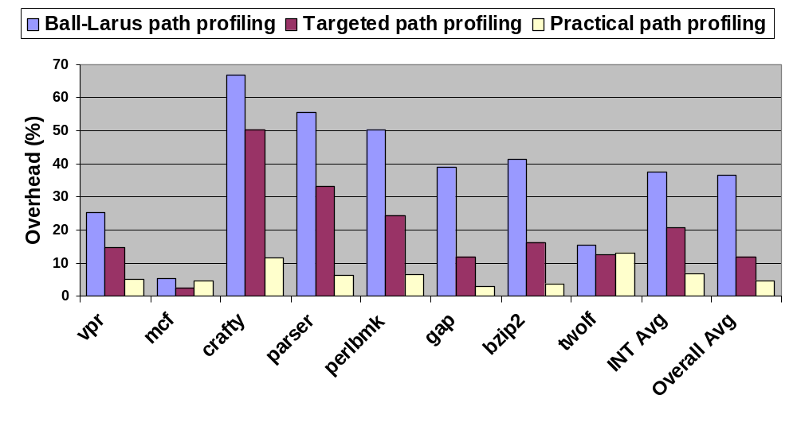
Overhead

Slide 69
Related work
Dynamo [Bala et al. ’00]
  Successful path-based dynamic optimizer
  “Bails out” when no dominant path
Instrumentation sampling & dynamic instrumentation [Arnold & Ryder ’01, Hirzel & Chilimbi ’04, Yasue et al. ’04]
  Lower overhead by extending profiling time
  Orthogonal to practical path profiling
Hardware-based path profiling [Vaswani et al. ’05]
  High accuracy when hot path table large enough

Slide 70
Summary
Contributions:
Inlining and unrolling
Branch-flow metric
Practical path profiling
Ball-Larus path profiling
Targeted path profiling
Edge profiling
Practical path profiling

Slide 71
Questions?

