Slide 1
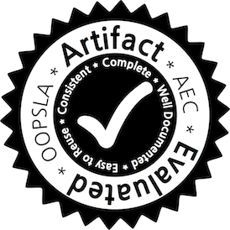
Valor: Efficient, Software-Only Region Conflict Exceptions
Swarnendu Biswas, Minjia Zhang, and
Michael D. Bond
Ohio State University
Brandon Lucia
Carnegie Mellon University
OOPSLA 2015
Notes:
Good afternoon everyone.
I will talk about our work which assigns strong semantics to all program executions at less than 100% overhead in software.

Slide 2
A Simple C++ Program
X* x = NULL;
bool done= false;
Thread T1
Thread T2
x = new X();
done = true;
if (done) {
x->func();
}
Notes:
So we start by looking at a simple C++ program, that uses threads on a shared memory system. One thread initializes a piece of data (say, x) and sets a flag (done) when it finishes. Any thread that later reads x first checks the done flag.
You expect this C++ program to work correctly most of the time.

Slide 3
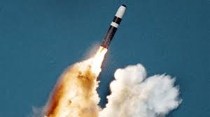
A Simple C++ Program
X* x = NULL;
bool done= false;
Thread T1
Thread T2
x = new X();
done = true;
if (done) {
x->func();
}
Notes:
But, the same C++ program can do many unexpected things on your behalf, including launching a nuclear missile. This may sound absurd, but the troubling bit is that the C++ language memory model does not guarantee against it.

Slide 4
Data Races
X* x = NULL;
bool done= false;
Thread T1
Thread T2
Data race
x = new X();
done = true;
if (done) {
x->func();
}
Notes:
And all of this is because of data races. A data race is defined as two concurrent accesses to the same shared memory location without any synchronization ordering, such that at least one access is a write.
This program has a data race on the variables done and x, highlighted in red.

Slide 5
Data Races are Evil
No semantic guarantees
Lack of semantic guarantees make software unsafe
Complicates language specifications
Challenging to reason about correctness for racy executions
Indicates other concurrency errors
Leads to atomicity, order or sequential consistency violations
Notes:
Data races introduce many undesired complicacies, both from the point of view of programmers and language memory models.
Lack of semantic guarantees for racy executions make a software unsafe.
Data races complicate language specifications, and it is challenging to reason about the correctness of racy executions.
Furthermore, data races often lead to other concurrency errors such as atomicity, order and sequential consistency violations.

Slide 6
Catch-Fire Semantics
C++ treats data races as errors
X* x = NULL;
bool done= false;
Thread T1
Thread T2
x = new X();
done = true;
if (done) {
x->func();
}
Notes:
PAUSE
C++ treats all data races as errors.
The problem with the sample C++ code snippet I just showed is that C++ gives absolutely no semantics to racy program executions, this is often referred to as catch-fire semantics.

Slide 7
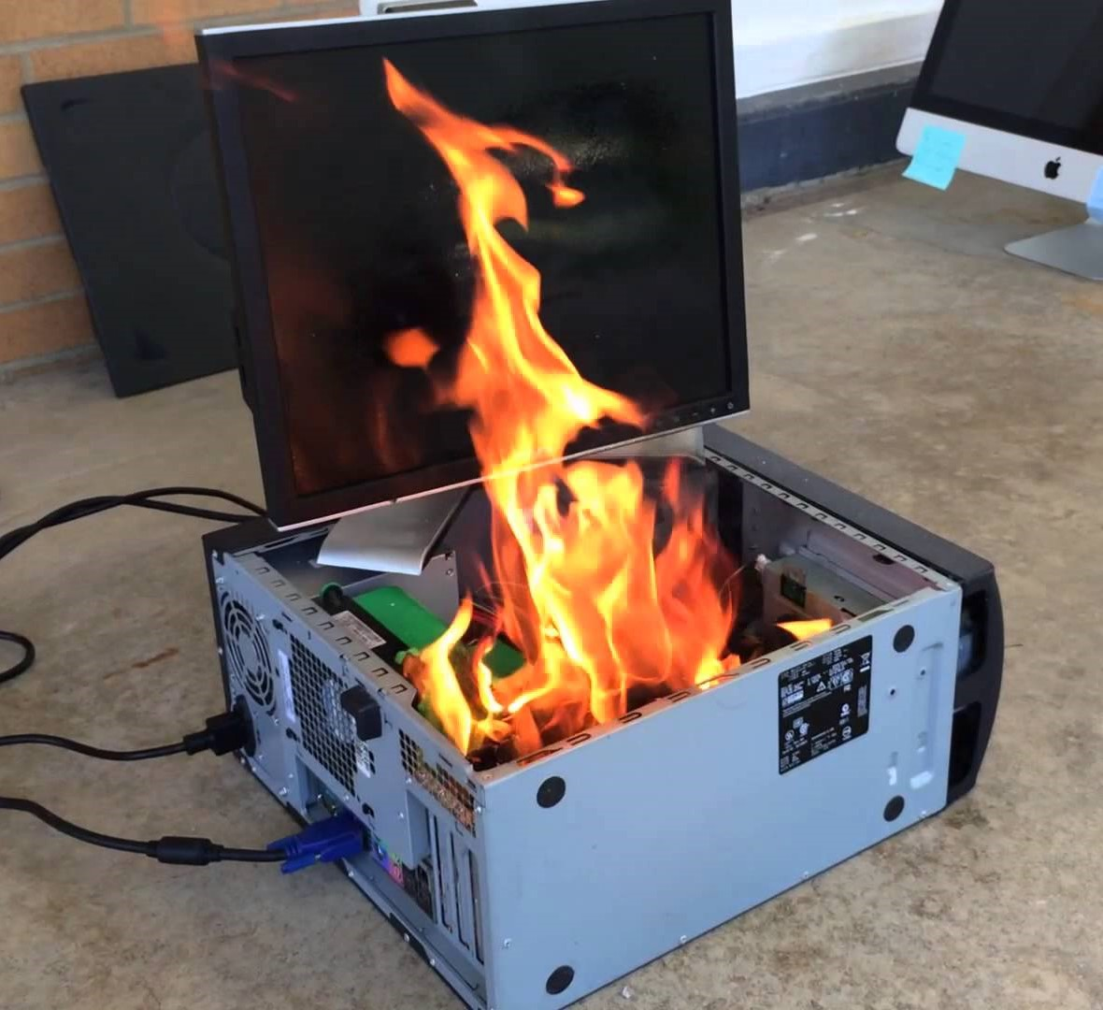
Catch-Fire Semantics
C++ treats data races as errors
X* x = NULL;
bool done= false;
Thread T1
Thread T2
x = new X();
done = true;
if (done) {
x->func();
}
Notes:
The problem with the sample C++ code snippet I just showed is that C++ gives absolutely no semantics to racy program executions, this is often referred to as catch-fire semantics.

Slide 8

Catch-Fire Semantics
C++ treats data races as errors
X* x = NULL;
bool done= false;
Thread T1
Thread T2
x = new X();
done = true;
if (done) {
x->func();
}
Notes:
I am pretty sure that no one would like to work in an environment like this.

Slide 9
A Java Example
Thread T1
Thread T2
X = new Object();
done = true;
while (!done) {}
X.compute();
Notes:
Here’s a Java example that shows a code snippet that is commonly tried in real code.
There is a data race on the variables done and X in this code snippet, so this execution will be racy.

Slide 10
A Java Example
Java tries to assign semantics, which are unsatisfactory
Thread T1
Thread T2
X = new Object();
done = true;
while (!done) {}
X.compute();
Notes:
The Java memory model tries to assign some semantics to racy executions, but they are known to be unsatisfactory. What could possibly go wrong with this code snippet?
This simple code snippet can lead to a NPE, infinite loop, and can see a partially initialized object, all because of compiler and hardware reorderings in the presence of data races.
PAUSE

Slide 11
C++ and Java Memory Models
Data-race-free execution
Strong semantics
Notes:
PAUSE
So here is why C++ and Java does not provide strong enough guarantees for racy executions.
Memory models of these languages extend the …, where DRF stands for data-race-free. As the name suggests, these memory models provide strong semantics only for data-race-free executions.

Slide 12
C++ and Java Memory Models
Data-race-free execution
Strong semantics
Execution is sequentially consistent
Notes:
By strong semantics, I mean that the execution is sequentially consistent.

Slide 13
C++ and Java Memory Models
Data-race-free execution
Strong semantics
Execution is sequentially consistent
Synchronization-free regions execute atomically
Notes:
Not only that, even synchronization-free regions, <FLAT> which are dynamic code regions between two synchronization operations </FLAT>, appear to execute atomically.

Slide 14
C++ and Java Memory Models
lock(l)
lock(m)
Data-race-free execution
Strong semantics
SFR
Execution is sequentially consistent
unlock(m)
Synchronization-free regions execute atomically
unlock(l)
Notes:
Not only that, even synchronization-free regions, <FLAT> which are dynamic code regions between two synchronization operations </FLAT>, appear to execute atomically.

Slide 15
C++ and Java Memory Models
But what about data races?
Notes:
But what about data races?

Slide 16
C++ and Java Memory Models
But what about data races?
Racy execution
???
Notes:
But what about data races?
As we saw, unfortunately these language memory models provide weak or no semantics for racy executions.

Slide 17
Need for Stronger Memory Models
Adve and Boehm, CACM 2010
“The inability to define reasonable semantics for programs with data
races is not just a theoretical shortcoming, but a fundamental hole in
the foundation of our languages and systems.”
Notes:
Thus, there is a need for stronger memory models. I quote from Adve and Boehm…
They claim …

Slide 18
Need for Stronger Memory Models
Adve and Boehm, CACM 2010
“The inability to define reasonable semantics for programs with data
races is not just a theoretical shortcoming, but a fundamental hole in
the foundation of our languages and systems.”
“We call upon software and hardware communities to develop
languages and systems that enforce data-race-freedom, ...”
Notes:
Furthermore, they encourage researchers to develop languages and systems that enforce data-race-freedom, or in other words, attach stronger semantics even to racy program executions.

Slide 19
Outline
Programming language memory models and data races
Data race and region conflict exceptions model
Valor: Our contribution
Evaluation
Notes:
Okay, so we looked at what are data races and the fact that they are bad.
SIGNIFICANT PAUSE
I will next talk about data race and region conflict exceptions model. Then, I will present Valor, which is our contribution. And then I will present evaluation results to show that our ideas do actually work.

Slide 20
Data Race
Thread T1
Thread T2
X = new Object();
done = true;
while (!done) {}
X.compute();
Notes:
Here is the racy example that we saw earlier. Wouldn’t it be nice if we had a runtime system that would detect all data races and raise an exception whenever a racy access is about to happen?

Slide 21
Data Race Exceptions
Thread T1
Thread T2
EXCEPTION
X = new Object();
done = true;
while (!done) {}
X.compute();
Notes:
The primary benefit of such a system would be improved debuggability, ultimately leading to improved software reliability.
Unfortunately, we do not know of efficient dynamic techniques that can detect all data races and raise exceptions.

Slide 22
REGION CONFLICT EXCEPTIONS MODEL
Notes:
Instead, region conflict exceptions is another way to assign strong semantics to deal with racy executions.

Slide 23
Region Conflict
Thread T1
Thread T2
Notes:
So what are region conflicts?

Slide 24
Region Conflict
Thread T1
Thread T2
wr x
Notes:
In this figure, we see two concurrent regions accessing the same shared variable x, and at least one of them is a write; this constitutes a region conflict.

Slide 25
Region Conflict
Thread T1
Thread T2
wr x
rd/wr x
Notes:
In this figure, we see two concurrent regions accessing the same shared variable x, and at least one of them is a write; this constitutes a region conflict.

Slide 26
Region Conflict
Thread T1
Thread T2
wr x
rd/wr x
Conflict
Notes:
In this figure, we see two concurrent regions accessing the same shared variable x, and at least one of them is a write; this constitutes a region conflict.

Slide 27
Region Conflict
Reports a subset of true data races that violate region serializability
Thread T1
Thread T2
wr x
rd/wr x
Conflict
Notes:
Region conflicts report a subset ….

Slide 28
Execution Models
Reports a subset of true data races that violate region serializability
sequentially consistent
Thread T1
Thread T2
region-conflict-free
data-race-free
wr x
region serializable
rd/wr x
Conflict
Notes:
If you have a data-race-free execution, it will not experience any region conflicts. In the absence of region conflicts, the regions execute as if serially, or the execution is region serializable (RS). A region serializable execution in turn is also sequentially consistent, note that RS is a stronger property than SC.
So in a nutshell, Region Conflict Exceptions gives you strong semantics. Executions will either report a region conflict (which indicates a true data race) or guarantee region serializability. This is essentially the semantics that DRF0-based memory models give you <emph>but only for race-free executions</emph>.

Slide 29
Region Conflict Exception Model
GOAL
Develop a practical region conflict detection technique
Notes:
PAUSE
So the region conflict exception model seems a promising way to assign strong semantics to racy executions. The goal of this work is to develop a practical region conflict detection technique.
So a natural question to ask is “isn’t there prior work in the literature that already detects region conflicts and can be used to provide strong semantics”? Yes, there is prior work that detects region conflicts.
Aren’t they good enough for what we want? The answer is no, and we will see why.

Slide 30
Region Conflict Detection
Hardware customizations required for good performance
Limited by resources and applicability
Needs extensive modifications and is unscalable¹
Detects serializability violations of bounded regions²
Lucia et al. Conflict Exceptions: Simplifying Concurrent Language Semantics With Precise Hardware Exceptions for Data-Races. ISCA 2010.
Marino et al. DRFx: A Simple and Efficient Memory Model for Concurrent Programming Languages. PLDI 2010.
Notes:
Hardware customizations can give you good performance, but they are not available on commodity processors.
Moreover, prior work is mostly limited by resources and applicability.
For example, Conflict Exceptions needs extensive modifications and is unscalable, and DRFx can detect serializability violations of only bounded regions.

Slide 31
Outline
Programming language memory models and data races
Data race and region conflict exceptions model
Valor: Our contribution
Evaluation
Notes:
PAUSE
I will now talk about Valor, which is an efficient, software-only region conflict detector.

Slide 32
Valor: Efficient, Software-Only Region Conflict Detector
Elides tracking last readers, only tracks last writer
Detect read-write conflicts lazily
Notes:
I will now talk about Valor, which is an efficient, software-only region conflict detector.
The key insight in Valor is to elide tracking last readers, and instead only track the last writer. Eliding tracking of last readers implies that Valor has to detect read-write conflicts lazily.

Slide 33
Valor: Efficient, Software-Only Region Conflict Detector
Tracking last writers
Detecting read-write conflicts lazily
Impact of lazy conflict detection
Notes:
Now I am going to tell you more details about Valor, and here is the outline. First, I will talk about how Valor detects different types of conflicts, and then I will discuss the impact of lazy conflict detection in Valor.

Slide 34
Tracking Last Writer
Notes:
So we will first see how Valor tracks the last writer for a shared variable x. The ideas presented in this subsection follow from prior work.

Slide 35
Per-Variable Metadata
Epoch
Has an ongoing region updated x?
j@T1
Thread T1
j
wr x
Notes:
The write metadata maintained in Valor is used to answer the following question: Has an ongoing region updated x? For this, Valor maintains an epoch, where c is the region id and T is the thread.

Slide 36
Tracking Last Writer
x
p@T0
Thread T1
Thread T2
Notes:
In our examples, we show the metadata for a shared variable up at the right corner. This example shows the current metadata for a shared variable x is p@T0, indicating that the last writer is region p from Thread T0.

Slide 37
Tracking Last Writer
x
p@T0
Thread T1
Thread T2
j
wr x
Notes:
Now say Thread T1 writes to x in a region j.

Slide 38
Tracking Last Writer
x
p@T0
Thread T1
Thread T2
Track last writer
j
wr x
Notes:
So Valor wants to track the last writer. How does it do it?

Slide 39
Tracking Last Writer
update metadata
x
j@T1
Thread T1
Thread T2
Track last writer
j
wr x
Notes:
Valor updates the metadata for x to j@T1.

Slide 40
Tracking Last Writer
x
j@T1
Thread T1
Thread T2
Track last writer
j
wr x
rd/wr x
Notes:
Now say a concurrent region from Thread T2 accesses the same shared variable x.

Slide 41
Tracking Last Writer
x
j@T1
Thread T1
Thread T2
Track last writer
j
wr x
Conflict
rd/wr x
Notes:
Before an access, Valor checks whether the last writer region is still ongoing and eagerly raises a sound and precise conflict. Recall that a region conflict corresponds to a true data race.

Slide 42
Tracking Last Writer
x
j@T1
Thread T1
Thread T2
Track last writer
Allows precisely detecting write-write and write-read conflicts
j
wr x
Conflict
rd/wr x
Notes:
Tracking the last writer allows Valor to precisely detect all write-write and write-read conflicts.

Slide 43
Valor: Efficient, Software-Only Region Conflict Detector
Tracking last writers
Detecting read-write conflicts lazily
Impact of lazy conflict detection

Slide 44
Detecting Read-Write Conflicts
Thread T1
Thread T2
rd x
wr x
Notes:
How does Valor detect read-write conflicts?

Slide 45
Detecting Read-Write Conflicts
x
p@T0
Thread T1
Thread T2
j
rd x
Notes:
Similar to tracking writers, one option is to maintain read metadata.
<emph>This is the approach taken by most prior work.</emph>

Slide 46
Detecting Read-Write Conflicts
update read metadata
x
j@T1
Thread T1
Thread T2
j
rd x
Notes:
So on a read, an analysis updates the read metadata for the shared variable x.

Slide 47
Detecting Read-Write Conflicts
x
j@T1
Thread T1
Thread T2
j
rd x
wr x
Notes:
Before a conflicting write access, a dynamic analysis can check whether the last reader regions are still ongoing and can eagerly raise a sound and precise conflict.

Slide 48
Detecting Read-Write Conflicts
x
j@T1
Thread T1
Thread T2
j
rd x
Conflict
wr x
Notes:
Before a conflicting write access, the dynamic analysis checks whether the last reader regions are still ongoing and eagerly raises a sound and precise conflict.

Slide 49
Detecting Read-Write Conflicts
x
j@T1
Thread T1
Thread T2
j
This simple mechanism used in prior work has problems
rd x
Conflict
wr x
Notes:
But <pause>
this simple mechanism, <i>that is used by most prior work</i>, has a couple of problems.

Slide 50
Remote Cache Misses Due to Tracking of Metadata
Thread T1
j
Write operation
Leads to remote cache misses
update metadata
rd x
Notes:
For example, you need to update the metadata even on reads. Updating the metadata is a write operation and could lead to remote cache misses.

Slide 51
Metadata Updates
Thread T1
j
rd/wr x
Notes:
A dynamic analysis usually associates a metadata with a shared variable x, that is updated on an access to x.

Slide 52
Metadata Updates
Thread T1
j
update metadata
rd/wr x
Notes:
A dynamic analysis usually associates a metadata with a shared variable x, that is updated on an access to x.
However, you need to avoid data races on your analysis variables themselves, you need to make sure that the metadata updates are atomic.

Slide 53
Synchronization on Metadata Updates
Thread T1
j
lock l
rd/wr x
Notes:
This is usually done by acquiring a lock for the shared variable x.

Slide 54
Synchronization on Metadata Updates
Thread T1
j
lock l
update metadata
rd/wr x
Notes:
Only then do you update the metadata.

Slide 55
Synchronization on Metadata Updates
Thread T1
j
lock l
update metadata
rd/wr x
unlock l
Notes:
And then you release the lock.

Slide 56
Synchronization on Metadata Updates
Thread T1
j
lock l
update metadata
Bad for mostly read-only data
rd/wr x
unlock l
Notes:
In effect, you are creating small critical sections that are bad for mostly read-only data.
<b>And we will show that these indeed have detrimental effects on performance.</b>

Slide 57
Elide Tracking Last Readers
Notes:
So instead, <emph>Valor</emph>, elides tracking last readers.

Slide 58
Elide Tracking Last Readers
Thread T1
Thread T2
rd x
wr x
?

Slide 59
Elide Tracking Last Readers
Detect read-write conflicts lazily
Thread T1
Thread T2
rd x
wr x
Notes:
Instead Valor detects read-write conflicts lazily.

Slide 60
Elide Tracking Last Readers
Detect read-write conflicts lazily
Thread T1
Thread T2
Log read accesses in thread-local buffers
Validate reads at region boundaries
rd x
wr x
1. Saha et al. McRT-STM: A High Performance Software Transactional Memory System for a Multi-Core Runtime. PPoPP 2006.
Notes:
Inspired from software transactional memory literature, …

Slide 61
Per-Variable Metadata
Version, Epoch
Has an ongoing region updated x?
<v, j@T1>
Thread T1
j
wr x
Notes:
To aid in lazy conflict detection, the write metadata now also includes a version, where the version is incremented on the first write to a shared variable in a region. The version is useful to tell you the number of unique writes.

Slide 62
Elide Tracking Last Readers
write metadata
x
<v, p@T0>
Detect read-write conflicts lazily
Thread T1
Thread T2
Log read accesses in thread-local buffers
Validate reads at region boundaries
j
rd x
Notes:
So let us see how can Valor detect a read-write conflict. Let the write metadata of the shared variable x be <v, p@T0> at the point of the read.

Slide 63
Elide Tracking Last Readers
x
<v, p@T0>
Detect read-write conflicts lazily
Thread T1
Thread T2
Log read accesses in thread-local buffers
Validate reads at region boundaries
j
log <x, v>
rd x

Slide 64
Elide Tracking Last Readers
x
<v, p@T0>
Detect read-write conflicts lazily
Thread T1
Thread T2
j
k
log <x, v>
rd x
wr x

Slide 65
Elide Tracking Last Readers
x
<v+1, k@T2>
Detect read-write conflicts lazily
Thread T1
Thread T2
j
k
log <x, v>
rd x
wr x

Slide 66
Elide Tracking Last Readers
x
<v+1, k@T2>
Detect read-write conflicts lazily
Thread T1
Thread T2
j
k
log <x, v>
rd x
wr x
read
validation

Slide 67
Elide Tracking Last Readers
x
<v+1, k@T2>
Detect read-write conflicts lazily
Thread T1
Thread T2
j
T1 is not the last writer
k
log <x, v>
rd x
wr x
Version read is outdated
read
validation

Slide 68
Elide Tracking Last Readers
x
<v+1, k@T2>
Detect read-write conflicts lazily
Thread T1
Thread T2
j
T1 is not the last writer
k
log <x, v>
rd x
wr x
Version read is outdated
Conflict
read
validation

Slide 69
Elide Tracking Last Readers
Avoids
Remote cache misses
Synchronization overhead
Notes:
Eliding tracking of last readers has a couple of benefits:
Local operations

Slide 70
Valor: Efficient, Software-Only Region Conflict Detector
Tracking last writers
Detecting read-write conflicts lazily
Impact of lazy conflict detection
Notes:
"So then, are there any issues with Valor's lazy detection approach?"

Slide 71
Precise Conflict Detection
Thread T1
Thread T2
rd x
Conflict
wr x
Notes:
Suppose we had detected read-write conflicts eagerly. Then, a conflict would have been immediately triggered just before the write to x in Thread T2.

Slide 72
Precise vs Lazy Conflict Detection
Thread T1
Thread T2
Thread T1
Thread T2
rd x
rd x
Conflict
delayed exception
wr x
wr x
Conflict
read
validation
Notes:
However, with lazy conflict detection, the conflict is detected only during the next read validation. So therefore there is this window during which the conflict goes undetected.

Slide 73
Precise vs Lazy Conflict Detection
Thread T1
Thread T2
Thread T1
Thread T2
Delayed exceptions
rd x
rd x
Conflict
delayed exception
wr x
wr x
Conflict
read
validation
Notes:
The idea of delayed exceptions has been used in prior work primarily with the goal of improving performance.

Slide 74
Delayed Exceptions
Thread T1
Thread T2
Thread T1
Thread T2
Delayed exceptions
Do not compromise semantic guarantees
Effects should not be externally visible
rd x
rd x
Conflict
delayed exception
wr x
wr x
Conflict
read
validation
Notes:
Sys calls validation

Slide 75
Delayed Exceptions
Thread T1
Thread T2
Thread T1
Thread T2
Debugging might be slightly harder
Exception will be thrown at the next region boundary from the reader thread
But does not compromise on soundness and precision
rd x
rd x
Conflict
delayed exception
wr x
wr x
Conflict
read
validation
Notes:
Note that delayed exceptions do not compromise the soundness and precision of conflict detection, and we prove this in the paper.

Slide 76
Outline
Programming language memory models and data races
Data race and region conflict exceptions model
Valor: Our contribution
Evaluation
Notes:
PAUSE – look at the audience
Okay, so I now move to the last part of my talk, and will now tell you about the implementation and evaluation of our work.

Slide 77
IMPLEMENTATION

Slide 78
Implementation
Developed on top of Jikes RVM 3.1.3
Notes:
We have developed Valor on top of Jikes RVM 3.1.3.

Slide 79
Implementation
Developed on top of Jikes RVM 3.1.3
Implemented FastTrack, state-of-art happens-before analysis based data race detector
1. Flanagan and Freund. FastTrack: Efficient and Precise Dynamic Data Race Detection. PLDI 2009.
Notes:
For comparison purposes, we have also implemented FastTrack, a state-of-art happens-before analysis-based data race detector.

Slide 80
Implementation
Developed on top of Jikes RVM 3.1.3
Implemented FastTrack, state-of-art happens-before analysis based data race detector
Shared on Jikes RVM Research Archive and ACM DL
Notes:
Our artifact has passed evaluation by the AEC, and we have shared our implementation on the Jikes RVM Research Archive and the ACM DL.

Slide 81
EVALUATION
Notes:
PAUSE – look at the audience

Slide 82
Experimental Methodology
Benchmarks
Large workload sizes of DaCapo 2006 and 9.12-bach suite
Fixed-workload versions of SPECjbb2000 and SPECjbb2005
Platform
64-core AMD Opteron 6272
Notes:
We evaluate large workload sizes of benchmarks from the two DaCapo suites, and fixed workload sizes of the SPECjbb benchmarks. We did our experiments on a 64-core AMD Opteron system.

Slide 83
Performance Comparison
Notes:
This graph compares the relative performance of FastTrack and Valor over unmodified Jikes RVM. Note that lower is better.
FastTrack incurs an overhead of 342% on average. The highlight is that Valor incurs an overhead of only 99%.

Slide 84
Performance Comparison
Notes:
To show the poor performance associated with tracking last readers, we have also developed an eager conflict detection technique, similar to FastTrack. ECD is a hybrid of FastTrack and Valor. As expected, it incurs a high overhead of around 267%.
If you remember, I talked about the costs of remote cache misses and synchronization at reads, those are the primary reasons for the poor performance you notice here with FastTrack and eager conflict detection.

Slide 85
Performance Comparison
First software-only region conflict detector with less than 100% overhead
Notes:
We believe this result is exciting, since Valor is the first software-only region conflict detector with less than 100% overhead. Why is this important? The reasonably low overheads possibly open up many avenues for using such an analysis, as we will discuss soon.

Slide 86
Performance Comparison: Intel Xeon
Relative performance remains comparable on an Intel Xeon architecture
Notes:
We evaluated the analyses’ performance sensitivity to the architecture. The relative performance of the three analyses remain comparable even on an Intel Xeon architecture.
We also did scalability experiments and Valor’s scalability remains unaffected on top of unmodified Jikes RVM.

Slide 87
Additional Experiments
Characterization of FastTrack and Jikes RVM
Please check the paper
Data race coverage
Space overheads
Notes:
We did additional experiments to evaluate other interesting aspects, like space overhead, and competitiveness of our implementation of FastTrack, and Jikes RVM. Please refer to the paper if you are interested.

Slide 88
Valor: Contributions
Strong execution guarantees in software
Detects all violations of region serializability
Exception-free execution
Strong semantics
Advances state-of-art
Provides strong semantics in software at less than 100% overhead
Notes:
So to conclude, what are the contributions of this work?
Valor is an efficient, sound and precise software-only region conflict detector that detects all region serializability violations. An exception-free execution with Valor implies region serializability. We believe Valor advances the state-of-art – It provides strong semantics to all program executions in software at less than 100% overhead.

Slide 89
New Opportunities with Valor
Semantic guarantees
Language runtimes could integrate this
Debugging
Can be used to detect problematic data races
Conflict exceptions
All-the-time monitoring in certain environments
Aggressive optimizations
Reorder and eliminate redundant loads and stores within synchronization-free regions
Notes:
So then where does this lead us?
We believe this work takes a step in solving a few existing problems and presents new opportunities. For examples, language runtimes could integrate this analysis and provide semantic guarantees to even racy program executions.
Developers can use this analysis to detect the more problematic data races. The relatively low performance overheads could mean using such an analysis for all-the-time monitoring of conflicts in certain environments.
And, such an analysis allows the compiler to perform more aggressive optimizations within synchronization-free regions.

Slide 90
Valor: Efficient, Software-Only Region Conflict Exceptions
Swarnendu Biswas, Minjia Zhang, and
Michael D. Bond
Ohio State University
Brandon Lucia
Carnegie Mellon University
OOPSLA 2015
Notes:
PAUSE
Thank you.

