Slide 1

Drinking from Both Glasses: Adaptively Combining Pessimistic and Optimistic Synchronization for Efficient Parallel Runtime Support
Man Cao
Minjia Zhang
Michael D. Bond
Notes:
An adaptive approach for dynamic analysis; to speed up parallel runtime systems e.g STM, Rec&Rep, Enforcing MM.

Slide 2
Dynamic Analyses for Parallel Programs
Data Race Detector, Record & Replay, Transactional Memory, Deterministic Execution, etc.
Performance is usually bad!
several times slower
Fundamental difficulties?

Slide 3
Cross-thread dependences
T1
T2
Crucial for dynamic analyses and systems
Capturing cross-thread dependences
Detecting
e.g. data race detector, dependence recorder
Controlling
e.g. transactional memory, deterministic execution
o.f = …
… = o.f

Slide 4
Typical approach
Per-object metadata (state)
E.g. last writer/reader thread
At each object access:
Check current state
Analysis-specific action
Update state if needed
Perform the access
Atomically

Slide 5
Typical approach
Per-object metadata (state)
E.g. last writer/reader thread
At each object access:
Check current state
Analysis-specific action
Update state if needed
Perform the access
Atomically
How to guarantee?
Notes:
{ WrEx_{T} , RdEx_{T} , RdSh_{c} , Int_{T}}

Slide 6
Pessimistic Synchronization
Used by most existing work
Data Race Detector
[FastTrack, Flanagan & Freund, 2009]
Atomicity Violation Detector
[Velodrome, Flanagan et al., 2008]
Record & Replay
[Instant Replay, LeBlanc et al., 1987]
[Chimera, Lee et al., 2012]

Slide 7
Pessimistic Synchronization
LockMetadata()

Slide 8
Pessimistic Synchronization
LockMetadata()
Check and compute new metadata

Slide 9
Pessimistic Synchronization
LockMetadata()
Check and compute new metadata
Analysis-specific actions

Slide 10
Pessimistic Synchronization
LockMetadata()
Check and compute new metadata
Analysis-specific actions
Program access

Slide 11
Pessimistic Synchronization
LockMetadata()
Check and compute new metadata
Analysis-specific actions
Program access
UnlockAndUpdateMetadata()

Slide 12
Pessimistic Synchronization
Synchronization on every access
6X slowdown on average
LockMetadata()
Check and compute new metadata
Analysis-specific actions
Program access
UnlockAndUpdateMetadata()
Notes:
Slowdown is for a set of large, real-world, parallel Java programs

Slide 13
Optimistic Synchronization
Used to improve performance
Biased Locking
[Lock Reservation, Kawachiya et al., 2002]
[Bulk Rebiasing , Russell & Detlefs, 2006]
Distributed Memory System
[Shasta, Scales et al. 1996]
Framework Support
[Octet, Bond et al. 2013]

Slide 14
Optimistic Synchronization
Avoid synchronization for non-conflicting accesses
Heavyweight coordination for conflicting accesses

Slide 15
Optimistic Synchronization (Cont.)
T1
T2
write check
wr o.f
write check
wr o.f

Slide 16
Optimistic Synchronization (Cont.)
T1
T2
write check
wr o.f
write check
wr o.f
read check

Slide 17
Optimistic Synchronization (Cont.)
T1
T2
write check
wr o.f
write check
wr o.f
read check
Analysis-specific action
safe point

Slide 18
Optimistic Synchronization (Cont.)
T1
T2
write check
wr o.f
write check
wr o.f
read check
Analysis-specific action
change metadata
safe point
rd o.f

Slide 19
Optimistic Synchronization (Cont.)
T1
T2
write check
wr o.f
write check
wr o.f
read check
Analysis-specific action
change metadata
safe point
rd o.f
26% on average with outliers
Expensive if there are many conflicting accesses
Notes:
How many is many?
Fewer than most people thought

Slide 20
Optimistic synchronization performs best if there are few conflicting accesses.

Slide 21
Pessimistic synchronization is cheaper for conflicting accesses.

Slide 22
Drink from both glasses?
Goal:
Optimistic sync. for most non-conflicting accesses
Pessimistic sync. for most conflicting accesses
Our approach:
Hybrid state model
Adaptive policy
Support for detecting and controlling cross-thread dependences

Slide 23
Adaptive Policy
Decides when to perform Pess → Opt
and Opt → Pess transitions
Cost—Benefit model
Formulates the problem
Online profiling
Efficiently collects information and approximates the Cost-Benefit model

Slide 24
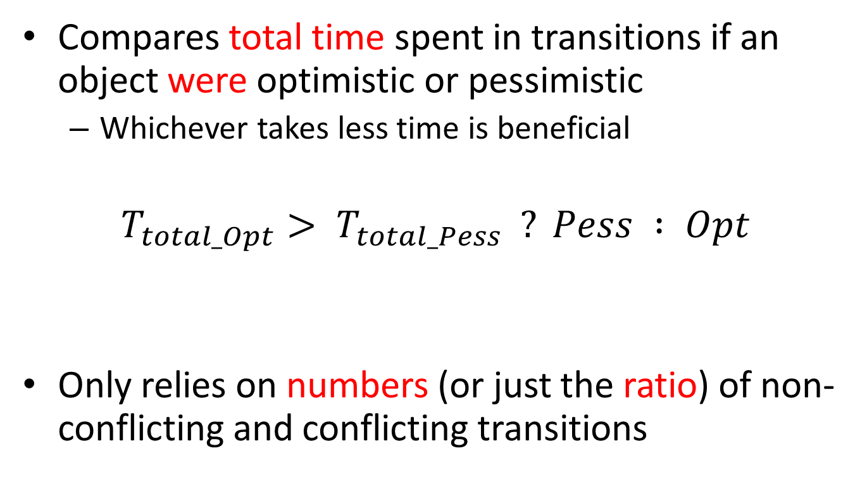
Cost—Benefit model
Compares total time spent in transitions if an object were optimistic or pessimistic
Whichever takes less time is beneficial
$$T_{total_Opt}> T_{total_Pess} ? Pess : Opt$$
Only relies on numbers (or just the ratio) of non-conflicting and conflicting transitions
Notes:
Details in paper, how we derived it

Slide 25
Evaluation
Implementation
Jikes RVM 3.1.3
Parallel programs
DaCapo Benchmarks 2006 & 2009
SPEC JBB 2000 & 2005
Platform
32 cores (AMD Opteron 6272)
Notes:
Jikes: High performance JVM

Slide 26
Performance

Slide 27
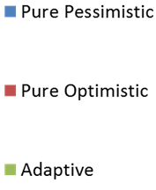
Performance

Slide 28
Performance

Slide 29
Framework support
Detecting cross-thread dependences
dependence recorder
Key challenge
Identify the source location of a happens-before edge for a pessimistic conflicting transition
Current solution requires acquiring a lock and writing to remote thread’s log

Slide 30
Framework support (Cont.)
Controlling cross-thread dependences
enforcing Region Serializability (in progress)
Key challenge
Need to keep locking pessimistic objects until the end of a region
Possible solution
Defer unlocking of pessimistic objects until program lock releases
Helps dependence recorder
Simplifies instrumentation

Slide 31
Framework support (Cont.)
Controlling cross-thread dependences
enforcing Region Serializability (in progress)
Key challenge
Need to keep locking pessimistic objects until the end of a region
Possible solution
Defer unlocking of pessimistic objects until program lock releases
Helps dependence recorder
Simplifies instrumentation

Slide 32
Conclusion & Future work
Hybrid, adaptive synchronization achieves better performance
never significantly degrades performance
sometimes improves performance substantially
Future directions
Explore different adaptive policies (e.g. aggregate profiling)
Reduce instrumentation cost by deferring unlock operations of pessimistic synchronization
Apply to control cross-thread dependences

