Slide 1


Toward Efficient Strong Memory Model Support
for the Java Platform via Hybrid Synchronization
Aritra Sengupta,
Man Cao,
Michael D. Bond
and
Milind Kulkarni
PPPJ 2015, Melbourne, Florida, USA

Slide 2

Programming Language Semantics?
Data Races
Java provides weak semantics
Notes:
Data races are buggy and omni present

Slide 3
Weak Semantics
A a = null;
boolean init = false;
T1
T2
a = new A();
init = true;
if (init)
a.field++;

Slide 4
Weak Semantics
T1
No data dependence
T2
a = new A();
init = true;
if (init)
a.field++;

Slide 5
Weak Semantics
A a = null;
boolean init = false;
T1
T2
a = new A();
init = true;
if (init)
a.field++;

Slide 6
Weak Semantics
T1
T2
init = true;
a = new A();
if (init)
a.field++;

Slide 7
Weak Semantics
Null dereference
T1
T2
init = true;
a = new A();
if (init)
a.field++;

Slide 8
Java Memory Model
JMM (Manson et al., POPL, 2005) variant of DRF0 (Adve and Hill, ISCA, 1990)
Atomicity of synchronization-free regions for data-race-free programs
Data races: weak semantics

Slide 9
Need for Stronger Memory Models
“The inability to define reasonable semantics for programs with data races is not just a theoretical shortcoming, but a fundamental hole in the foundation of our languages and systems…”
Give better semantics to programs with data races
Stronger memory models
– Adve and Boehm, CACM, 2010

Slide 10
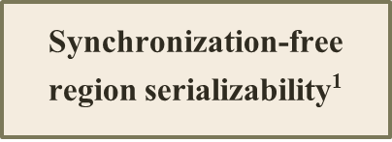

Memory Models: Run-time cost vs Strength
Synchronization-free region serializability¹
Run-time cost
Statically Bounded Region Serializability
SC
DRF0
Strength
1. Ouyang et al. ... and region serializability for all. In HotPar, 2013.

Slide 11
Memory Models: Run-time cost vs Strength
Synchronization-free region serializability
Run-time cost
Statically Bounded Region Serializability²
SC
DRF0
Strength
2. Sengupta et al. Hybrid Static-Dynamic Analysis for Statically Bounded Region Serializability. ASPLOS, 2015.

Slide 12
Statically Bounded Region Serializability (SBRS)
Compiler demarcated regions execute atomically
Execution is an interleaving of these regions
– Sengupta et al., ASPLOS, 2015

Slide 13
Statically Bounded Region Serializability (SBRS)
Synchronization operations
Method calls
Loop backedges
acq(lock)
methodCall()
rel(lock)

Slide 14
Statically Bounded Region Serializability (SBRS)
acq(lock)
methodCall()
rel(lock)

Slide 15
Statically Bounded Region Serializability (SBRS)
Loop
backedges
Statically and dynamically bounded

Slide 16
Overview
Enforcement of SBRS with dynamic locks
Precise dynamic locks: EnfoRSer-D (our prior work), low contention
Enforcement of SBRS with static locks
Imprecise static locks: EnfoRSer-S, low instrumentation overhead
Hybridization of locks
EnfoRSer-H: static and dynamic locks, right locks for right sites?
Results
EnfoRSer-H does at least as well as either. Some cases significant benefit

Slide 17
Enforcement of SBRS
Prevent two concurrent accesses to the same memory location where one is a write

Slide 18
Enforcement of SBRS
Prevent regions that have races from running concurrently!
Prevent two concurrent accesses to the same memory location where one is a write

Slide 19
Enforcement of SBRS
Acquire locks before each memory access
Acquire locks at the start of the region

Slide 20
Enforcement of SBRS
Acquire locks before each memory access
Acquire locks at the start of the region
Precise object locks: dynamic locks

Slide 21
Enforcement of SBRS
Acquire locks before each memory access
Acquire locks at the start of the region
Region level locks: statically chosen for an access site

Slide 22
EnfoRSer-D
Precise dynamic locks
Per-access locks with retry mechanism
Compiler Transformations: Speculative execution
Notes:
Calling as EnfoRSer-D to distinguish it from EnfoRSer-S and EnfoRSer-H

Slide 23

SBRS with Dynamic Locks
Y =
= X
Z =
Dynamic per-access locks

Slide 24
SBRS with Dynamic Locks
Y =
= X
Z =
Program access

Slide 25

SBRS with Dynamic Locks
Y =
= X
Z =
Ownership transferred

Slide 26
SBRS with Dynamic Locks
Dynamic locks: precise location, hence no reasoning about races statically!
Y =
= X
Z =
Ownership transferred
Notes:
No need to reason about races statically

Slide 27
SBRS with Dynamic Locks
Precise conflict detection- efficient for high-conflicting regions
High instrumentation
cost at each access
High overhead for low-conflicting programs
Y =
= X
Z =
Ownership transferred

Slide 28
Experimental Methodology
Benchmarks
DaCapo 2006, 9.12-bach
Fixed-workload versions of SPECjbb2000 and SPECjbb2005
Platform
Intel Xeon system: 32 cores

Slide 29

Implementation and Evaluation
Developed in Jikes RVM 3.1.3
Code publicly available on Jikes RVM Research Archive

Slide 30
Run-time Performance

Slide 31
Run-time Performance
27% overhead on average

Slide 32
Run-time Performance
Precise conflict detection but high instrumentation overhead!
Complex compiler transformations (additional code)
Can we do better?

Slide 33
EnfoRSer with Static Locks
Reduce the instrumentation overhead of EnfoRSer-D
Less complex code generation

Slide 34
EnfoRSer-S
Static region level locks
Racing sites acquire same lock
Coarsened locks to reduce instrumentation overhead

Slide 35
SBRS with Locks on Static Sites
Static locks: racy sites protected by same lock
L0
L1
Static Region Locks
L2
Y =
= X
Z =

Slide 36
SBRS with Locks on Static Sites
L0
L1
All locks acquired before access
L2
Y =
= X
Z =

Slide 37

SBRS with Locks on Static Sites
L0
L1
L2
Ownership transferred
Y =
= X
Z =

Slide 38
SBRS with Locks on Static Sites
Imprecise and does not lower instrumentation overhead!
L0
L1
L2
Ownership transferred
Y =
= X
Z =

Slide 39
SBRS with Locks on Static Sites
Coarsened single lock
L012
Y =
= X
Z =

Slide 40
SBRS with Locks on Static Sites
Low instrumentation overhead
Imprecise conflict
detection
Coarsened single lock
L012
Y =
= X
Z =

Slide 41
EnfoRSer-S
R1 R2 R3 R4
s0
s2
s5
s7
s3
s8
s1
s4
s6
Notes:
Imprecise transitive relation

Slide 42
EnfoRSer-S
R1 R2 R3 R4
s0
s2
s5
s7
s3
s8
s1
s4
s6
Notes:
Imprecise transitive relation

Slide 43
EnfoRSer-S
R1 R2 R3 R4
s0
s2
s5
s7
s3
s8
s1
s4
s6
RACE
Notes:
Imprecise transitive relation

Slide 44
EnfoRSer-S
R1 R2 R3 R4
s0
s2
s5
s7
s3
s8
s1
s4
s6
RACE
Naik et al.’s 2006 race detection algorithm, Chord
Notes:
Imprecise transitive relation

Slide 45
EnfoRSer-S
R1 R2 R3 R4
L3
s0
s2
s5
s7
s3
s8
L2
s1
s4
s6
L4
L0
L1
Notes:
Imprecise transitive relation

Slide 46

EnfoRSer-S
R1 R2 R3 R4
L0
L0
L1
L3
s0
s5
s7
s2
s8
s3
s1
s4
s6

Slide 47
EnfoRSer-S
R1 R2 R3 R4
L0
L0
L1
L3
L1
L1
L2
L4
L2
s0
s5
s7
s2
s8
s3
s1
s4
s6

Slide 48
EnfoRSer-S
R1 R2 R3 R4
L0
L0
L1
L3
L1
L1
L2
L4
L2
s0
s5
s7
Does not reduce instrumentation overhead!
s2
s8
s3
s1
s4
s6

Slide 49
EnfoRSer-S
R1 R2 R3 R4
s0
s2
s5
s7
s3
s8
s1
s4
s6
Notes:
Imprecise transitive relation

Slide 50
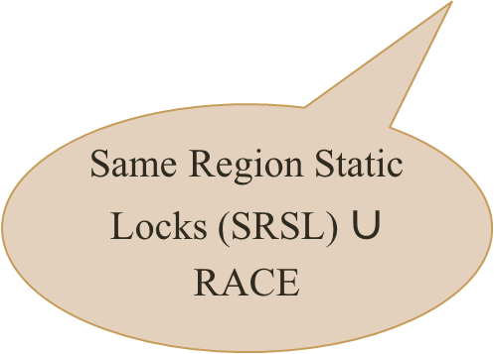
EnfoRSer-S
R1 R2 R3 R4
s0
s2
s5
s7
s3
s8
s1
s4
s6
Same Region Static Locks (SRSL) $∪$ RACE
Notes:
Imprecise transitive relation

Slide 51
EnfoRSer-S
R1 R2 R3 R4
s0
s2
s5
s7
s3
s8
s1
s4
s6
Same Region Static Locks (SRSL) $∪$ RACE
L0
L1
Notes:
Imprecise transitive relation

Slide 52
EnfoRSer-S
R1 R2 R3 R4
L0
L0
L0
L1
s0
s2
s5
s7
s3
s8
s1
s4
s6
Notes:
Imprecise transitive relation

Slide 53
EnfoRSer-S
R1 R2 R3 R4
Reduces instrumentation overhead
Increases contention
L0
L0
L0
L1
s0
s2
s5
s7
s3
s8
s1
s4
s6
Notes:
Imprecise transitive relation

Slide 54
Run-time Performance

Slide 55
Run-time Performance
2600% overhead on average

Slide 56
Run-time Performance
2600% overhead on average
EnfoRSer-S performs better

Slide 57
Hybridizing Locks
High contention sites: Precise dynamic locks (precise conflict detection)
Low contention sites: Single static lock (low instrumentation overhead)

Slide 58
EnfoRSer-H
Static locks to reduce instrumentation
Dynamic locks for precise conflict detection
Correctly and efficiently combine: best of both

Slide 59
Run-time Performance
26% overhead on average

Slide 60
Run-time Performance
Provides nearly the best of either approaches!
63% reduction in overhead

Slide 61
Run-time Performance
49% reduction in lock acquires and not increasing contention!
87% reduction in overhead

Slide 62
Run-time Performance
49% reduction in lock acquires
Dramatically improves on both when hybridization helps!
87% reduction in overhead

Slide 63
Hybridizing Locks
Right synchronization for right program sites
Combining different synchronization mechanisms
Best of different synchronization mechanisms

Slide 64
EnfoRSer-H
Right locks for right sites
Cost-benefit model
Assignment algorithm
Profiling
Combine static and dynamic locks

Slide 65
Two-iteration Methodology
Program execution
First iteration
Profiling (use RACE relation)
Assignment Algorithm
Between iterations
Compute SRSL and estimate cost
Program exectuion
Second iteration
Use hybridized instrumentation

Slide 66
Assignment Algorithm

Slide 67
Compute initial cost
Profiled data
Change a static lock to dynamic lock
Change all its racing sites to dynamic locks
Profiled data
Recompute cost
current cost < previous cost
Yes
Retain state
No
Revert to previous state

Slide 68
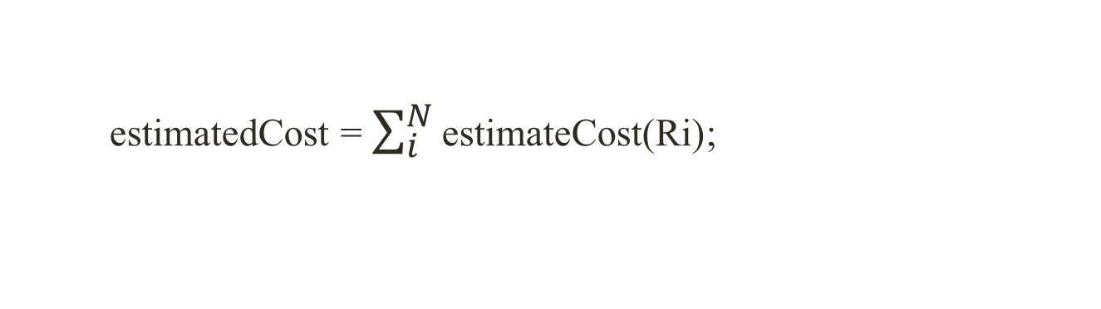
Assignment Algorithm
R1 R2 R3 R4
s7
s0
s2
s4
s5
s8
s1
s3
s9
s6
estimatedCost = $\sum_{i}^{N}{\text{estimateCost}\text{(}\text{Ri}\text{)}}$;

Slide 69
Assignment Algorithm
R1 R2 R3 R4
s7
s0
s2
s4
s5
s8
s1
s3
s9
s6
estimatedCost = $\sum_{i}^{N}{\text{estimateCost}\text{(}\text{Ri}\text{)}}$;
Conflicts on each site
Lock acquires on each site

Slide 70
Assignment Algorithm
R1 R2 R3 R4
s7
s0
s2
s4
s5
s8
s1
s3
s9
s6

Slide 71
Assignment Algorithm
R1 R2 R3 R4
s7
s0
s2
s4
s5
s8
s1
s3
s9
s6

Slide 72
Assignment Algorithm
R1 R2 R3 R4
s7
s0
s2
s4
s5
s8
s1
s3
s9
s6
If (current cost < previous cost)
// retain state

Slide 73
Assignment Algorithm
R1 R2 R3 R4
s7
s0
s2
s4
s5
s8
s1
s3
s9
s6
Switch on next site

Slide 74
Assignment Algorithm
R1 R2 R3 R4
s7
s0
s2
s4
s5
s8
s1
s3
s9
s6

Slide 75
Assignment Algorithm
R1 R2 R3 R4
s7
s0
s2
s4
s5
s8
s1
s3
s9
s6
If (current cost < previous cost)
// retain state

Slide 76
Assignment Algorithm
R1 R2 R3 R4
s7
s0
s2
s4
s5
s8
s1
s3
s9
s6
Switch on next site

Slide 77
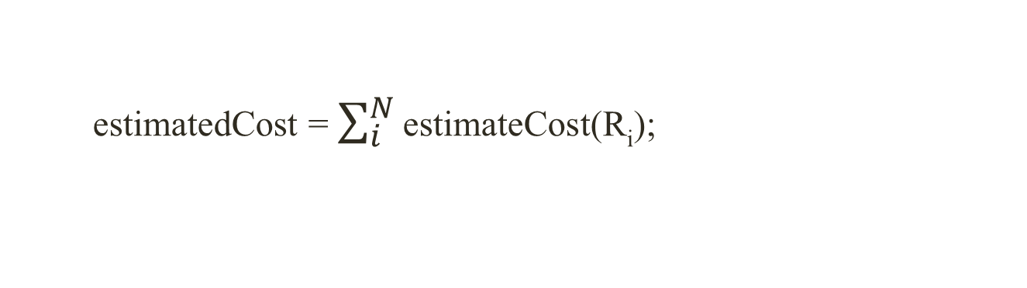
Assignment Algorithm
R1 R2 R3 R4
s7
s0
s2
s4
s5
s8
s1
s3
s9
s6
estimatedCost = $\sum_{i}^{N}{\text{estimateCost}\text{(}\text{Ri}\text{)}}$;
current cost > previous cost
// revert state

Slide 78
Assignment Algorithm
R1 R2 R3 R4
s7
s0
s2
s4
s5
s8
s1
s3
s9
s6

Slide 79
Assignment Algorithm
R1 R2 R3 R4
s7
s0
s2
s4
s5
s8
s1
s3
s9
s6
s1, s9

Slide 80
Assignment Algorithm
R1 R2 R3 R4
s7
s0
s2
s4
s5
s8
s1
s3
s9
s6
Final State!

Slide 81
Lock Assignment
R1 R2 R3 R4
s7
s0
s2
s4
s5
s8
s1
s3
s9
s6
L1

Slide 82
Lock Assignment
R1 R2 R3 R4
L1
L1
L1
s7
s0
s2
s4
s5
s8
s1
s3
s9
s6
L1

Slide 83
Lock Assignment
R1 R2 R3 R4
L1
L1
L1
s7
s0
s2
s4
s5
s8
s1
s3
s9
s6
L1

Slide 84
Lock Assignment
R1 R2 R3 R4
L1
L1
L1
s0
s2
s4
s7
s1
s5
s8
s3
s9
s6

Slide 85
Lock Assignment
R1 R2 R3 R4
L1
L1
L1
s0
s2
s4
s7
s1
s5
s8
s3
s9
s6
Per-object locks and transformations

Slide 86
Related Work
Use of static locks
Chimera, Lee et al., PLDI 2012
Use of static analysis
Static Conflict Analysis for Multi-Threaded Object-Oriented Programs, Von Praun and Gross, PLDI, 2003.
Goldilocks, Elmas et al., PLDI 2007.
Red Card, Flanagan and Freund, ECOOP 2013
Hybridizing locks
Hybrid Tracking, Cao et al., WODET 2014
Notes:
Requires custom hardware support pop up

Slide 87
Conclusion
Combine synchronization mechanisms
Static locks
Best of different kinds of synchronization
Precise conflict detection
Low instrumentation overhead
Efficient enforcement of SBRS
Select the best for a region
Dynamic locks

