Slide 1

Tolerating Memory Leaks
Michael D. Bond Kathryn S. McKinley

Slide 2
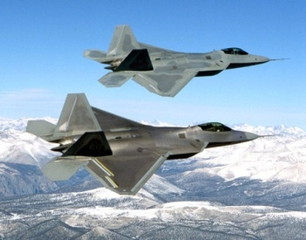
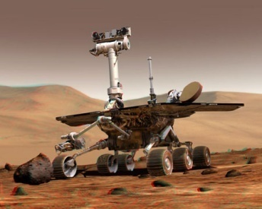
Bugs in Deployed Software
Deployed software fails
Different environment and inputs → different behaviors
Greater complexity & reliance

Slide 3
Bugs in Deployed Software
Deployed software fails
Different environment and inputs → different behaviors
Greater complexity & reliance
Memory leaks are a real problem
Fixing leaks is hard

Slide 4
Memory Leaks in Deployed Systems
Memory leaks are a real problem
Managed languages do not eliminate them

Slide 5
Memory Leaks in Deployed Systems
Memory leaks are a real problem
Managed languages do not eliminate them
Dead
Live
Reachable

Slide 6
Memory Leaks in Deployed Systems
Memory leaks are a real problem
Managed languages do not eliminate them
Live
Dead
Reachable

Slide 7
Memory Leaks in Deployed Systems
Memory leaks are a real problem
Managed languages do not eliminate them
Live
Reachable
Dead

Slide 8
Memory Leaks in Deployed Systems
Memory leaks are a real problem
Managed languages do not eliminate them
Reachable
Live
Dead

Slide 9
Memory Leaks in Deployed Systems
Memory leaks are a real problem
Managed languages do not eliminate them
Slow & crash real programs
Live
Dead

Slide 10
Memory Leaks in Deployed Systems
Memory leaks are a real problem
Managed languages do not eliminate them
Slow & crash real programs
Unacceptable for some applications

Slide 11
Memory Leaks in Deployed Systems
Memory leaks are a real problem
Managed languages do not eliminate them
Slow & crash real programs
Unacceptable for some applications
Fixing leaks is hard
Leaks take time to materialize
Failure far from cause

Slide 12
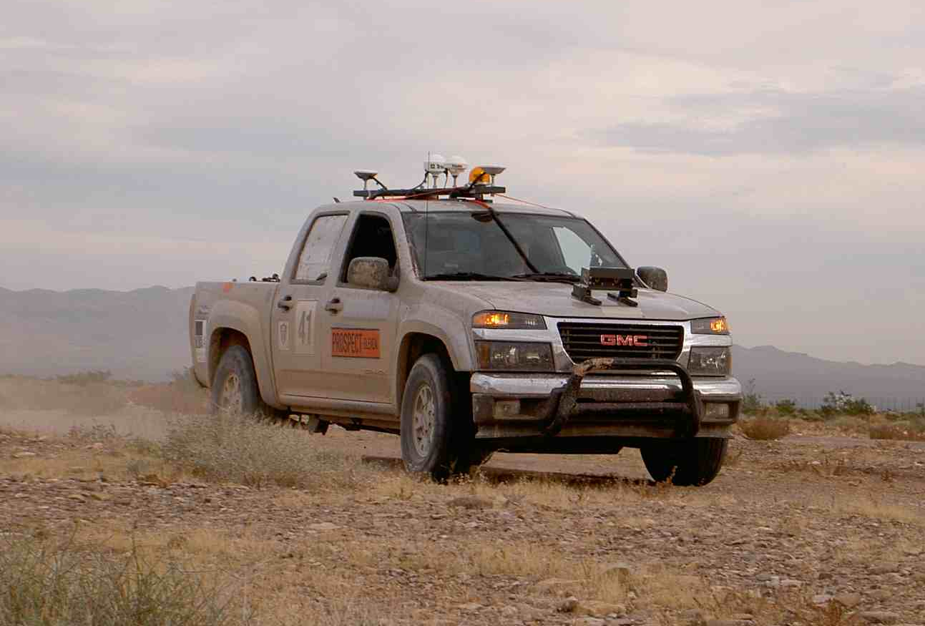
Example
Driverless truck
10,000 lines of C#
Leak: past obstacles remained reachable
No immediate symptoms
“This problem was pernicious because it only showed up after 40 minutes to an hour of driving around and collecting obstacles.”
Quick “fix”: after 40 minutes, stop & reboot
Environment sensitive
More obstacles in deployment: failed in 28 minutes
http://www.codeproject.com/KB/showcase/IfOnlyWedUsedANTSProfiler.aspx

Slide 13
Example
Driverless truck
10,000 lines of C#
Leak: past obstacles remained reachable
No immediate symptoms
“This problem was pernicious because it only showed up after 40 minutes to an hour of driving around and collecting obstacles.”
Quick “fix”: restart after 40 minutes
Environment sensitive
More obstacles in deployment
Failed in 28 minutes
http://www.codeproject.com/KB/showcase/IfOnlyWedUsedANTSProfiler.aspx

Slide 14
Example
Driverless truck
10,000 lines of C#
Leak: past obstacles remained reachable
No immediate symptoms
“This problem was pernicious because it only showed up after 40 minutes to an hour of driving around and collecting obstacles.”
Quick “fix”: restart after 40 minutes
Environment sensitive
More obstacles in deployment
Failed in 28 minutes
http://www.codeproject.com/KB/showcase/IfOnlyWedUsedANTSProfiler.aspx

Slide 15
Example
Driverless truck
10,000 lines of C#
Leak: past obstacles remained reachable
No immediate symptoms
“This problem was pernicious because it only showed up after 40 minutes to an hour of driving around and collecting obstacles.”
Quick “fix”: restart after 40 minutes
Environment sensitive
More obstacles in deployment
Unresponsive after 28 minutes
http://www.codeproject.com/KB/showcase/IfOnlyWedUsedANTSProfiler.aspx

Slide 16
Uncertainty in Deployed Software
Unknown leaks; unexpected failures
Online leak diagnosis helps
Too late to help failing systems

Slide 17
Uncertainty in Deployed Software
Unknown leaks; unexpected failures
Online leak diagnosis helps
Too late to help failing systems
Also tolerate leaks

Slide 18
Uncertainty in Deployed Software
Unknown leaks; unexpected failures
Online leak diagnosis helps
Too late to help failing systems
Also tolerate leaks
Illusion of fix

Slide 19
Uncertainty in Deployed Software
Unknown leaks; unexpected failures
Online leak diagnosis helps
Too late to help failing systems
Also tolerate leaks
Illusion of fix
Eliminate bad effects
Don’t slow
Don’t crash

Slide 20
Uncertainty in Deployed Software
Unknown leaks; unexpected failures
Online leak diagnosis helps
Too late to help failing systems
Also tolerate leaks
Illusion of fix
Eliminate bad effects
Preserve semantics
Don’t slow
Don’t crash
Defer OOM errors

Slide 21
Predicting the Future
Dead objects ⬄ not used again
Highly stale objects ⇨ likely leaked
Reachable
Dead
Live

Slide 22
Predicting the Future
Dead objects ⬄ not used again
Highly stale objects ⇨ likely leaked
[Chilimbi & Hauswirth ’04]
[Qin et al. ’05]
[Bond & McKinley ’06]
Reachable
Dead
Live

Slide 23
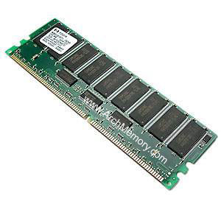

Tolerating Leaks with Melt
Move highly stale objects to disk
Much larger than memory
Time & space proportional to live memory
Preserve semantics
Stale objects
In-use objects
Stale objects

Slide 24
Sounds like Paging!
Stale objects
In-use objects
Stale objects

Slide 25
Sounds like Paging!
Paging insufficient for managed languages
Need object granularity
GC’s working set is all reachable objects

Slide 26
Sounds like Paging!
Paging insufficient for managed languages
Need object granularity
GC’s working set is all reachable objects
Bookmarking collection [Hertz et al. ’05]
☒
☑

Slide 27
Challenge #1: How does Melt identify stale objects?
roots
B
A
C
D
E
F

Slide 28
Challenge #1: How does Melt identify stale objects?
GC:
for all fields a.f
a.f |= 0x1;
roots
B
A
C
D
E
F

Slide 29
Challenge #1: How does Melt identify stale objects?
GC:
for all fields a.f
a.f |= 0x1;
roots
B
A
C
D
E
F

Slide 30
Challenge #1: How does Melt identify stale objects?
GC:
for all fields a.f
a.f |= 0x1;
Application:
b = a.f;
if (b & 0x1) {
b &= ~0x1;
a.f = b; [atomic]
}
roots
B
A
C
D
E
F

Slide 31
Challenge #1: How does Melt identify stale objects?
GC:
for all fields a.f
a.f |= 0x1;
Application:
b = a.f;
if (b & 0x1) {
b &= ~0x1;
a.f = b; [atomic]
}
roots
B
A
C
D
E
F
Add 6% to application time

Slide 32
Challenge #1: How does Melt identify stale objects?
GC:
for all fields a.f
a.f |= 0x1;
Application:
b = a.f;
if (b & 0x1) {
b &= ~0x1;
a.f = b; [atomic]
}
roots
B
A
C
D
E
F

Slide 33
Challenge #1: How does Melt identify stale objects?
GC:
for all fields a.f
a.f |= 0x1;
Application:
b = a.f;
if (b & 0x1) {
b &= ~0x1;
a.f = b; [atomic]
}
roots
B
A
C
D
E
F

Slide 34

Stale Space
Heap nearly full →
move stale objects to disk
roots
B
A
C
D
E
F
in-use space
stale space

Slide 35
Stale Space
roots
B
A
D
E
C
F
in-use space
stale space

Slide 36
Challenge #2
How does Melt maintain pointers?
roots
B
A
D
E
C
F
in-use space
stale space

Slide 37
Stub-Scion Pairs
scion
space
roots
B
B_{scion}
B_{stub}
A
D
E
C
F
in-use space
stale space

Slide 38
Stub-Scion Pairs
scion
table
scion
space
B → B_{scion}
roots
B
B_{scion}
B_{stub}
A
D
E
C
F
in-use space
stale space

Slide 39
Stub-Scion Pairs
scion
table
?
B → B_{scion}
scion
space
roots
B
B_{scion}
B_{stub}
A
D
E
C
F
in-use space
stale space

Slide 40
Scion-Referenced Object Becomes Stale
scion
table
scion
space
B → B_{scion}
roots
B_{scion}
B_{stub}
A
B
D
E
C
F
in-use space
stale space

Slide 41
Scion-Referenced Object Becomes Stale
scion
table
scion
space
roots
B_{stub}
A
B
D
E
C
F
in-use space
stale space

Slide 42
Challenge #3
What if program accesses highly stale object?
scion
table
scion
space
roots
B_{stub}
A
B
D
E
C
F
in-use space
stale space

Slide 43
Application Accesses Stale Object
b = a.f;
if (b & 0x1) {
b &= ~0x1;
if (inStaleSpace(b))
b = activate(b);
a.f = b; [atomic]
}
scion
table
scion
space
roots
B_{stub}
A
B
D
E
C
F
in-use space
stale space

Slide 44
Application Accesses Stale Object
scion
table
scion
space
C → C_{scion}
roots
B_{stub}
A
B
D
C
C_{scion}
E
C_{stub}
F
in-use space
stale space

Slide 45
Application Accesses Stale Object
scion
table
scion
space
C → C_{scion}
roots
B_{stub}
A
B
D
C
C_{scion}
E
C_{stub}
F
in-use space
stale space

Slide 46
Application Accesses Stale Object
scion
table
scion
space
C → C_{scion}
roots
B_{stub}
A
B
D
C
C_{scion}
E
C_{stub}
F
in-use space
stale space

Slide 47
Implementation
Integrated into Jikes RVM 2.9.2
Works with any tracing collector
Evaluation uses generational copying collector

Slide 48
Implementation
Integrated into Jikes RVM 2.9.2
Works with any tracing collector
Evaluation uses generational copying collector
32-bit
2 GB
64-bit
120 GB

Slide 49
Implementation
Integrated into Jikes RVM 2.9.2
Works with any tracing collector
Evaluation uses generational copying collector
mapping
stub
32-bit
2 GB
64-bit
120 GB

Slide 50
Performance Evaluation
Methodology
DaCapo, SPECjbb2000, SPECjvm98
Dual-core Pentium 4
Deterministic execution (replay)
Results
6% overhead (read barriers)
Stress test: still 6% overhead
Speedups in tight heaps (reduced GC workload)

Slide 51
Tolerating Leaks
Leak | Melt’s effect
Eclipse “Diff” | Tolerates until 24-hr limit (1,000X longer)
Eclipse “Copy-Paste” | Tolerates until 24-hr limit (194X longer)
JbbMod | Tolerates until 20-hr crash (19X longer)
ListLeak | Tolerates until disk full (200X longer)
SwapLeak | Tolerates until disk full (1,000X longer)
MySQL | Some highly stale but in-use (74X longer)
Delaunay Mesh | Short-running
DualLeak | Heap growth is in-use (2X longer)
SPECjbb2000 | Heap growth is mostly in-use (2X longer)
Mckoi Database | Thread leak: extra support needed (2X longer)

Slide 52
Tolerating Leaks
Leak | Melt’s effect
Eclipse “Diff” | Tolerates until 24-hr limit (1,000X longer)
Eclipse “Copy-Paste” | Tolerates until 24-hr limit (194X longer)
JbbMod | Tolerates until 20-hr crash (19X longer)
ListLeak | Tolerates until disk full (200X longer)
SwapLeak | Tolerates until disk full (1,000X longer)
MySQL | Some highly stale but in-use (74X longer)
Delaunay Mesh | Short-running
DualLeak | Heap growth is in-use (2X longer)
SPECjbb2000 | Heap growth is mostly in-use (2X longer)
Mckoi Database | Thread leak: extra support needed (2X longer)

Slide 53
Tolerating Leaks
Leak | Melt’s effect
Eclipse “Diff” | Tolerates until 24-hr limit (1,000X longer)
Eclipse “Copy-Paste” | Tolerates until 24-hr limit (194X longer)
JbbMod | Tolerates until 20-hr crash (19X longer)
ListLeak | Tolerates until disk full (200X longer)
SwapLeak | Tolerates until disk full (1,000X longer)
MySQL | Some highly stale but in-use (74X longer)
Delaunay Mesh | Short-running
DualLeak | Heap growth is in-use (2X longer)
SPECjbb2000 | Heap growth is mostly in-use (2X longer)
Mckoi Database | Thread leak: extra support needed (2X longer)

Slide 54
Tolerating Leaks
Leak | Melt’s effect
Eclipse “Diff” | Tolerates until 24-hr limit (1,000X longer)
Eclipse “Copy-Paste” | Tolerates until 24-hr limit (194X longer)
JbbMod | Tolerates until 20-hr crash (19X longer)
ListLeak | Tolerates until disk full (200X longer)
SwapLeak | Tolerates until disk full (1,000X longer)
MySQL | Some highly stale but in-use (74X longer)
Delaunay Mesh | Short-running
DualLeak | Heap growth is in-use (2X longer)
SPECjbb2000 | Heap growth is mostly in-use (2X longer)
Mckoi Database | Thread leak: extra support needed (2X longer)

Slide 55
Tolerating Leaks
Leak | Melt’s effect
Eclipse “Diff” | Tolerates until 24-hr limit (1,000X longer)
Eclipse “Copy-Paste” | Tolerates until 24-hr limit (194X longer)
JbbMod | Tolerates until 20-hr crash (19X longer)
ListLeak | Tolerates until disk full (200X longer)
SwapLeak | Tolerates until disk full (1,000X longer)
MySQL | Some highly stale but in-use (74X longer)
Delaunay Mesh | Short-running
DualLeak | Heap growth is in-use (2X longer)
SPECjbb2000 | Heap growth is mostly in-use (2X longer)
Mckoi Database | Thread leak: extra support needed (2X longer)

Slide 56
Tolerating Leaks
Leak | Melt’s effect
Eclipse “Diff” | Tolerates until 24-hr limit (1,000X longer)
Eclipse “Copy-Paste” | Tolerates until 24-hr limit (194X longer)
JbbMod | Tolerates until 20-hr crash (19X longer)
ListLeak | Tolerates until disk full (200X longer)
SwapLeak | Tolerates until disk full (1,000X longer)
MySQL | Some highly stale but in-use (74X longer)
Delaunay Mesh | Short-running
DualLeak | Heap growth is in-use (2X longer)
SPECjbb2000 | Heap growth is mostly in-use (2X longer)
Mckoi Database | Thread leak: extra support needed (2X longer)

Slide 57
Tolerating Leaks
Leak | Melt’s effect
Eclipse “Diff” | Tolerates until 24-hr limit (1,000X longer)
Eclipse “Copy-Paste” | Tolerates until 24-hr limit (194X longer)
JbbMod | Tolerates until 20-hr crash (19X longer)
ListLeak | Tolerates until disk full (200X longer)
SwapLeak | Tolerates until disk full (1,000X longer)
MySQL | Some highly stale but in-use (74X longer)
Delaunay Mesh | Short-running
DualLeak | Heap growth is in-use (2X longer)
SPECjbb2000 | Heap growth is mostly in-use (2X longer)
Mckoi Database | Thread leak: extra support needed (2X longer)

Slide 58
Tolerating Leaks
Leak | Melt’s effect
Eclipse “Diff” | Tolerates until 24-hr limit (1,000X longer)
Eclipse “Copy-Paste” | Tolerates until 24-hr limit (194X longer)
JbbMod | Tolerates until 20-hr crash (19X longer)
ListLeak | Tolerates until disk full (200X longer)
SwapLeak | Tolerates until disk full (1,000X longer)
MySQL | Some highly stale but in-use (74X longer)
Delaunay Mesh | Short-running
DualLeak | Heap growth is in-use (2X longer)
SPECjbb2000 | Heap growth is mostly in-use (2X longer)
Mckoi Database | Thread leak: extra support needed (2X longer)

Slide 59
Eclipse Diff: Reachable Memory

Slide 60
Eclipse Diff: Reachable Memory

Slide 61
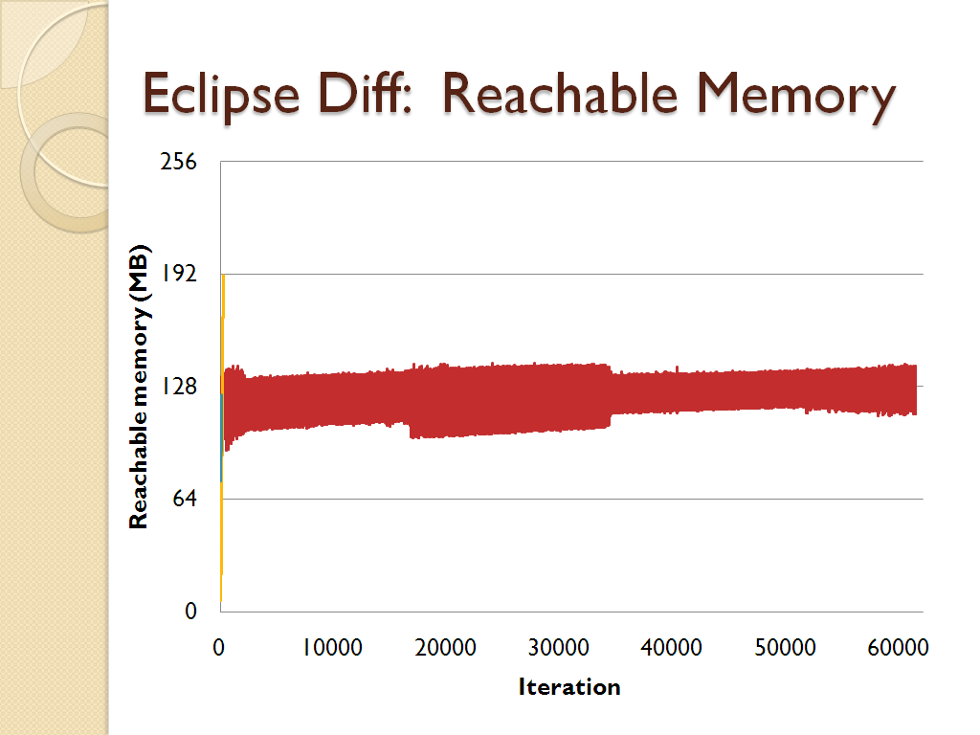

Slide 62
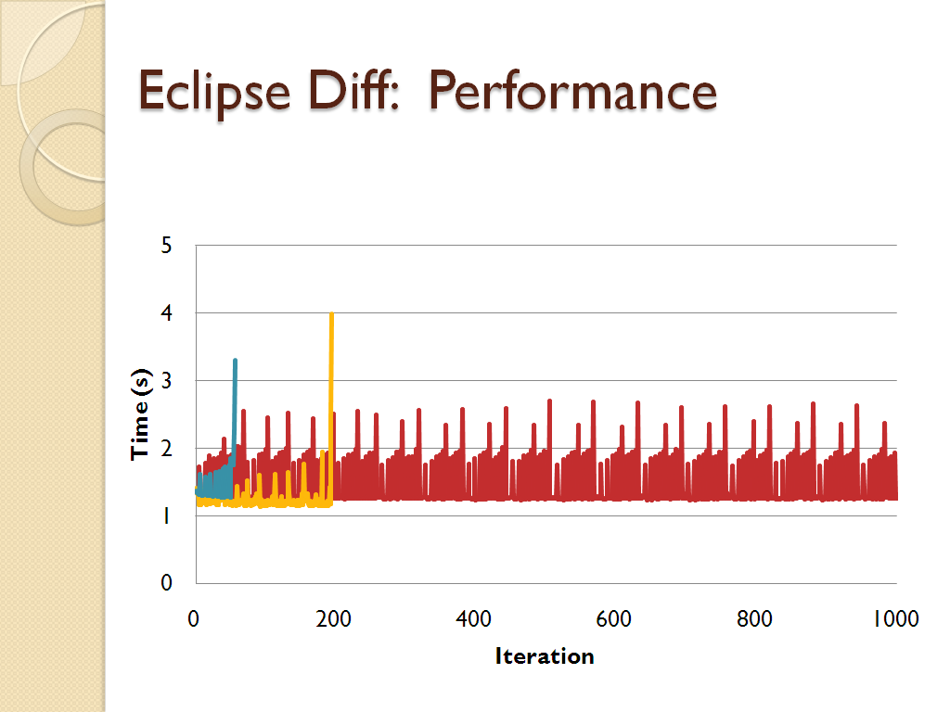
Eclipse Diff: Performance

Slide 63
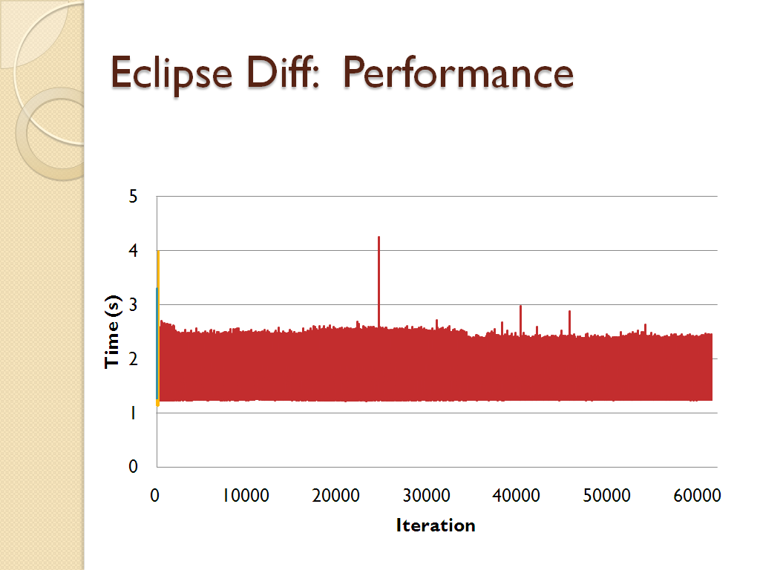
Eclipse Diff: Performance

Slide 64
Eclipse Diff: Performance

Slide 65
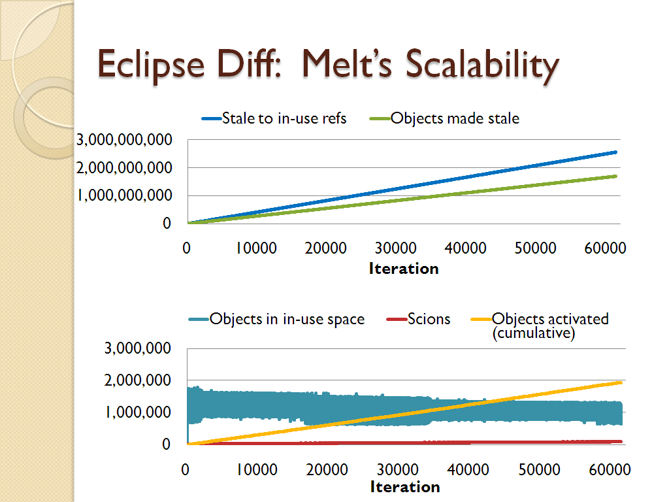

Slide 66
Related Work
Managed [LeakSurvivor, Tang et al. ’08]
[Panacea, Goldstein et al. ’07, Breitgand et al. ’07]
Don’t guarantee time & space proportional to live memory
Native [Cyclic memory allocation, Nguyen & Rinard ’07]
[Plug, Novark et al. ’08]
Different challenges & opportunities
Less coverage or change semantics
Orthogonal persistence & distributed GC
Barriers, swizzling, object faulting, stub-scion pairs

Slide 67
Conclusion
Finding bugs before deployment is hard

Slide 68

Conclusion
Finding bugs before deployment is hard
Online diagnosis helps developers
Help users in meantime
Tolerate leaks with Melt: illusion of fix
Stale objects

Slide 69
Conclusion
Finding bugs before deployment is hard
Online diagnosis helps developers
Help users in meantime
Tolerate leaks with Melt: illusion of fix
Time & space proportional to live memory
Preserve semantics

Slide 70
Conclusion
Finding bugs before deployment is hard
Online diagnosis helps developers
Help users in meantime
Tolerate leaks with Melt: illusion of fix
Time & space proportional to live memory
Preserve semantics
Buys developers time to fix leaks
Thank you!

Slide 71
Backup

Slide 72
Triggering Melt
Expected heap
fullness
INACTIVE
MARK STALE
Start
Unexpected
heap fullness
After
marking
Heap full or
nearly full
Heap not
nearly full
MOVE & MARK STALE
WAIT
Heap not nearly full
Heap full or
nearly full
Back

Slide 73
Conclusion
Finding bugs before deployment is hard
Online diagnosis helps developers
To help users in meantime, tolerate bugs
Tolerate leaks with Melt: illusion of fix
Stale objects

Slide 74
Related Work: Tolerating Bugs
Nondeterministic errors [Atom-Aid] [DieHard] [Grace] [Rx]
Memory corruption: perturb layout
Concurrency bugs: perturb scheduling
General bugs
Ignore failing operations [FOC]
Need higher level, more proactive approaches

Slide 75
Melt’s GC Overhead
Back

