Slide 1
Lightweight Data Race Detection for Production Runs
Swarnendu Biswas, UT Austin
Man Cao, Ohio State University
Minjia Zhang, Microsoft Research
Michael D. Bond, Ohio State University
Benjamin P. Wood, Wellesley College
CC 2017

Slide 2
A Java Program With a Data Race
Object X = null;
boolean done= false;
Thread T1
Thread T2
X = new Object();
done = true;
while (!done) {}
X.compute();
Notes:
Let me start by briefly telling you about data races. This is a simple Java program, which uses a commonly used synchronization paradigm. X and done are shared variables. This code snippet has a data race on done.

Slide 3
Object X = null;
boolean done= false;
Thread T1
Thread T2
read
write
X = new Object();
done = true;
while (!done) {}
X.compute();
Data race
Conflicting accesses – two threads access the same shared variable where at least one access is a write
Concurrent accesses – accesses are not ordered by synchronization operations
Notes:
Implies the absence of a happens-before ordering.
What are some of the interleavings/outcomes possible for the simple program after compiler optimizations?

Slide 4
Thread T1
Thread T2
X = new Object();
done = true;
temp = done;
while (!temp) {}
Infinite loop
LICM
Thread T1
Thread T2
done = true;
X = new Object();
while (!done) {}
X.compute();
NPE
Notes:
This racy code snippet can lead to an infinite loop, NPE, or can see a partially initialized object, all because of compiler and hardware reorderings in the presence of data races.
So you see, presence of data races can lead to nondeterministic and erroneous behavior for even simple programs.

Slide 5
Data Races are Evil
Challenging to reason about the correctness of racy executions
May unpredictably break code
Lack of semantic guarantees in most mainstream multithreaded languages
Usually indicate other concurrency errors
Atomicity, order, or sequential consistency violations
S. Adve and H. Boehm. Memory Models: A Case for Rethinking Parallel Languages and Hardware. CACM 2010.
S. Adve. Data Races Are Evil with No Exceptions: Technical Perspective. CACM 2010.

Slide 6
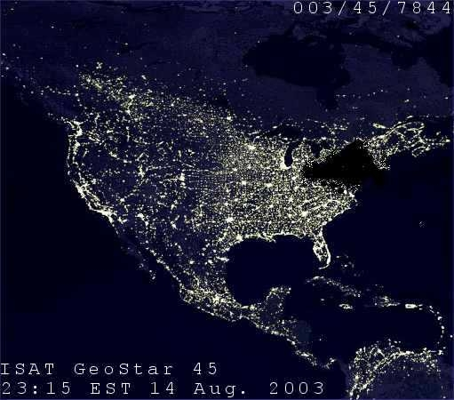
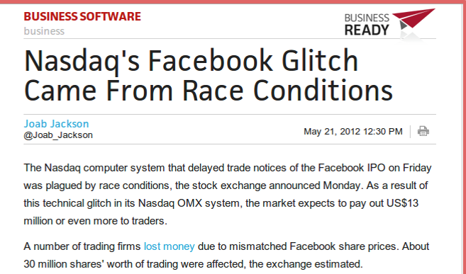
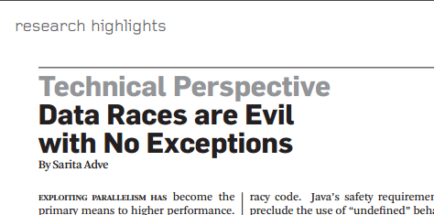
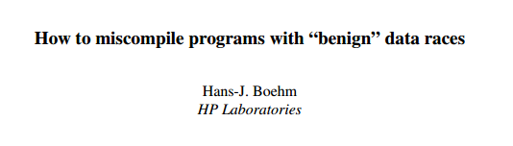
Far-Reaching Impact of Data Races
~50 million people affected
Therac-25 accidents, 1985-87
Notes:
Data races can have far reaching consequences on the society.
This shows that data races are omnipresent, they lurk even in well-tested software. In fact, that is the big problem with data races. Whether a data race manifests is very sensitive to thread interleavings, inputs, and execution environments. Moreover, researchers have shown that a potentially “benign” data race can lead to errors when the application is compiled and ported to a different architecture.
Data races are bad. Then why not detect all data races and fix them? Seems straightforward.

Slide 7
Get Rid of Data Races!!!
Avoiding and/or eliminating data races efficiently is a challenging and unsolved problem
Notes:
There have been scores of papers and years of research, could possibly even be the most researched topic. And yet practical, efficient data race detection remains elusive.

Slide 8
Data Race Detection on Production Systems
Avoiding and/or eliminating data races efficiently is a challenging and unsolved problem
No satisfactory solution to date
Notes:
It turns out that soundly and precisely detecting all data races is expensive.

Slide 9
Data Race Detection Techniques
Static and predictive analyses
Too many false positives, do not scale

Slide 10
Data Race Detection Techniques
Dynamic analysis
Lockset analysis
Happens-before analysis
Expensive, reports many false positives
Sound and precise
Expensive, not scalable, incurs space overhead
Coverage limited to observed executions
sound – no missed races
precise – no false races
C. Flanagan and S. Freund. FastTrack: Efficient and Precise Dynamic Data Race Detection. PLDI 2009.
Notes:
For example, FastTrack is a state of the art sound and precise happens before analysis based data race detector. Yet it incurs ~8X slowdown.

Slide 11
Existing Approaches for Data Race Detection on Production Runs
Happens-before-based sampling approaches
E.g., LiteRace¹, Pacer²
Overheads are still too high for a reasonable sampling rate
Pacer with 3% sampling rate incurs 86% overhead!!!
D. Marino et al. LiteRace: Effective Sampling for Lightweight Data-Race Detection. PLDI 2009.
M. D. Bond et al. Pacer: Proportional Detection of Data Races. PLDI 2010.

Slide 12
Existing Approaches for Data Race Detection on Production Runs
Happens-before-based sampling approaches
E.g., LiteRace¹, Pacer²
Overheads are still too high for a reasonable sampling rate
Pacer with 3% sampling rate incurs 86% overhead!!!
RaceMob³
Optimizes tracking of happens-before relations
Monitors only one race per run to minimize overhead
Cannot bound overhead, limited scalability and coverage
D. Marino et al. LiteRace: Effective Sampling for Lightweight Data-Race Detection. PLDI 2009.
M. D. Bond et al. Pacer: Proportional Detection of Data Races. PLDI 2010.
B. Kasikci et al. RaceMob: Crowdsourced Data Race Detection. SOSP 2013.
Notes:
Limited scalability and coverage from tracking synchronization operations

Slide 13
Existing Approaches for Data Race Detection on Production Runs
DataCollider⁴
Tries to collide racy accesses, synchronization oblivious
Samples accesses, and uses hardware debug registers for performance
Dependence on debug registers
Not portable, and may not scale well
Few debug registers
Cannot bound overhead
J. Erickson et al. Effective Data-Race Detection for the Kernel. OSDI 2009.

Slide 14
Outline
Data Races
Problems and Challenges
Data Race Detection in Production Systems
Drawbacks of existing approaches
Our contribution: efficient, complementary analyses
RaceChaser: Precise data race detection
Caper: Sound data race detection
Notes:
So far, I have talked about data races and its problems. I have highlighted the need for detecting data races on production systems, and have pointed drawbacks of existing approaches to detect data races on production systems. Next, I will talk about our contribution, two efficient data race detection techniques. I will discuss them one after the other.

Slide 15
Our Insight
Decouple data race detection into two lightweight and complementary analysis

Slide 16
Our Contributions
Decouple data race detection into two lightweight and complementary analysis
Can miss true data races
RaceChaser – Precise data race detector
Under-approximates data races
Efficient
Can report false data races
Caper – Dynamically sound data race detector
Over-approximates data races
Notes:
The first approach is called RaceChaser, which is a precise data race detector. Detecting precise data races enables developers to find and fix software bugs, ultimately improving software reliability. Note that RaceChaser can miss data races, so it basically under-approximates the set of all data races possibly in the system. The second approach is called Caper, which is a dynamically sound data race detector. Caper is imprecise, so it over-approximates data races from several observed runs. It is useful for record and replay, or for generating a set of data races for RaceChaser/RaceMob/DataCollider. We believe that separate analyses that each provide soundness or precision are beneficial. An important takeaway is we show that soundness and precision alone can each be efficient. We will now look at each of these analysis in more detail.

Slide 17
RaceChaser: Precise Data Race Detection
Desired Properties:
Performance and Scalability ?
Bounded time and space overhead ?
Coverage and Portability ?
Design:
Monitor one data race (two source locations) per run
Use collision analysis
Bound overhead introduced
Notes:
Is it possible to design a data race detection analysis that has all these desriable properties? Our proposed solution for this is RaceChaser. Collision, i.e, making two accesses happen at the same time, is a sufficient condition for a data race, and is well suited for sampling. RaceChaser is not just RaceMob + collision analysis.

Slide 18
avrora.sim.radio.Medium:access$302()byte offset 0
←→
avrora.sim.radio.Medium:access$402() byte offset 2
Two static sites involved in a potential data race
True data race!
RaceChaser
Max overhead 5%
Data race not reproduced
RaceChaser Algorithm

Slide 19
Instrumenting Racy Accesses
avrora.sim.radio.Medium:
access$302() byte offset 0
avrora.sim.radio.Medium:
access$402() byte offset 2
Limited to one potential race pair

Slide 20
Randomly Sample Racy Accesses
avrora.sim.radio.Medium:
access$302() byte offset 0
avrora.sim.radio.Medium:
access$402() byte offset 2
Use frequency of samples taken
and
Compute overhead introduced by waiting
Dynamic instance 992
Sampled
Dynamic instance 993

Slide 21
Try to Collide Racy Accesses
avrora.sim.radio.Medium:
access$302() byte offset 0
avrora.sim.radio.Medium:
access$402() byte offset 2
Block thread for some time
Dynamic instance 992
Sampled
Dynamic instance 993

Slide 22
Collision is Successful
avrora.sim.radio.Medium:
access$302() byte offset 0
avrora.sim.radio.Medium:
access$402() byte offset 2
Dynamic instance 992
Sampled
Dynamic instance 993
True data race detected
Dynamic instance 215
Notes:
Same variable

Slide 23
Collision is Unsuccessful
avrora.sim.radio.Medium:
access$302() byte offset 0
avrora.sim.radio.Medium:
access$402() byte offset 2
Thread unblocks, resets the analysis state, and continues execution
Dynamic instance 992
Sampled
Dynamic instance 993
Next instruction
Notes:
So, although RaceChaser is oblivious to synchronization patterns, it can miss data races.

Slide 24
Evaluation of RaceChaser
Implementation is publicly available
Jikes RVM 3.1.3
Benchmarks
Large workload sizes of DaCapo 2006 and 9.12-bach suite
Fixed-workload versions of SPECjbb2000 and SPECjbb2005
Platform
64-core AMD Opteron 6272
Notes:
Before talking about Caper, let us see how this simple scheme compares to more elaborate approaches.

Slide 25
adapted from
B. Kasikci et al. RaceMob: Crowdsourced Data Race Detection. SOSP 2013.
Notes:
Why is LiteHB slower than RaceChaser? You talked about remote cache misses, but why's that more of an issue for HB than collision analysis?
Update per variable metadata at read only accesses
RaceMob evaluated on PARSEC benchmarks. Java programs have more synchronization operations.

Slide 26
Effectiveness of RaceChaser
Collision analysis can potentially detect data races that are hidden by spurious happens-before relations
Data race coverage of collision analysis depends on the perturbation and the delay
Prior studies seem to indicate that data races often occur close in time
RaceChaser did as well as RaceMob/LiteHB over a number of runs
Notes:
Other than run-time performance, the other interesting question about RaceChaser is data race coverage. For our experiments,
One reason is that the inputs are the same.

Slide 27
Outline
Data Races
Problems and Challenges
Data Race Detection in Production Systems
Drawbacks of existing approaches
Our contribution: efficient, complementary analyses
RaceChaser: Precise data race detection
Caper: Sound data race detection
Notes:
Now that we have discussed how to design a precise but efficient data race detector, let us see how can we design a sound and efficient data race detector.
Many dynamic analyses need a sound knowledge about all possible data races for correctness.

Slide 28
Sound, Efficient Data Race Detection
Options
Too many false positives
Use static analysis offline
Efficient enough for production runs?
Use dynamic analysis online
Notes:
We have two options. We could use static analysis to generate the set offline, but then there are too many false positives. During our experiments, static analysis can generate hundred thousand potential race pairs, which makes precise data race detection intractable.
So you need to use a dynamic analysis for a more precise estimate. So you need to generate the set on actual production machines, otherwise you run into the coverage problem.

Slide 29
Caper: Sound Data Race Detection
dynamically
sound
Input program
Caper algorithm
Set of potential race pairs
multiple runs
Static analysis
Dynamic analysis
Notes:
Is it possible to exploit the production setting in order to detect all data races soundly, i.e., without missing any true races that have occurred in production runs? Yes. Our proposed solution is called
Caper. Caper takes an input program, and observes the program over multiple runs, and generates a sound set of all potential race pairs that could have occurred during those runs.

Slide 30
Caper Algorithm
Input program
Static analysis
Dynamic analysis
Set of potential race pairs
Input program
Static data race detector
Dynamic analysis
dynamic race
pairs (dpPairs)
Static race
pairs (spPairs)
multiple runs
Notes:
Caper incurs low run-time overhead by using two insights. First, Caper refines spPairs and dpPairs on each successive program execution, so that in steady state, production runs are unlikely to detect and move any new pairs from spPairs to dpPairs. This feature allows Caper to optimize for not detecting new pairs in spPairs that should move to dpPairs. Second, Caper employs lightweight, sound dynamic escape analysis, described next.

Slide 31
Sound Dynamic Escape Analysis for Data Race Detection
q
p
ESCAPED
NOT_ESCAPED
NOT_ESCAPED
Reachability-based analysis
f
g
q
p
q.f = p
ESCAPED
ESCAPED
ESCAPED
f
g
Notes:
Researchers have used different variants of escape analysis for data race detection, but they have generally been unsound.
Not everyone might know escape analysis

Slide 32
Caper’s Dynamic Analysis
deSites = { s | ( ∃ s’ |〈s, s’〉∈ spPairs ⋃ dpPairs) ∧
s escaped in an analyzed execution }
dpPairs = {〈s₁, s₂〉| s₁ ∈ deSites ∧ s₂ ∈ deSites }
Notes:
The dynamic escape analysis in Caper produces a set called deSites, which contains the set of all sites that have escaped during an analyzed execution.
A race pair from spPairs is promoted to dpPairs if both s1 and s2 belong to deSites.

Slide 33
27%
9%
3%
Notes:
Tell about dynamic alias analysis, 13X.
For comparison with Caper, we have implemented a dynamic alias analysis, which detects all pairs of aliasing sites. It reports s1,s2 if and only if accesses at s1 and s2 by threads T1 and T2 at memory locations m1 and m2 such that T1 != T2 ∧ m1 = m2.
Dynamic lockset analysis is around 18X.

Slide 34
Effectiveness of Caper
 | Sound static data race detector | Caper | Dynamic alias analysis
hsqldb6 | 212,205 | 1,612 | 757
lusearch6 | 4,692 | 302 | 292
xalan6 | 83,488 | 1,241 | 581
avrora9 | 61,193 | 19,941 | 570
luindex9 | 10,257 | 192 | 193
lusearch9 | 7,303 | 34 | 39
sunflow9 | 28,587 | 200 | 1,086
xalan9 | 20,036 | 1,861 | 600
pjbb2000 | 29,604 | 11,243 | 1,679
pjbb2005 | 2,552 | 984 | 447
Notes:
The important question over here is why are we claiming Caper to be better than a sound static analysis or a more expensive but more precise dynamic analysis?
To get a sense of the savings with Caper, we did the following study.

Slide 35
Static data race detector,
e.g., Chord
Caper
Notes:
This plot shows the tradeoff space.

Slide 36
Usefulness of Caper
Improve performance of analyses whose correctness relies on knowing all data races
Record and replay systems
Atomicity checking
Software transactional memory
Generate potential data races for analyses like RaceChaser/RaceMob/DataCollider

Slide 37
Lightweight Data Race Detection for Production Runs
Swarnendu Biswas, UT Austin
Man Cao, Ohio State University
Minjia Zhang, Microsoft Research
Michael D. Bond, Ohio State University
Benjamin P. Wood, Wellesley College
CC 2017

