Slide 1
Targeted Path Profiling:
Lower Overhead Path Profiling for
Staged Dynamic Optimization Systems
Rahul Joshi, UIUC
Michael Bond*, UT Austin
Craig Zilles, UIUC

Slide 2
Path information is useful
Enlarges scope of optimizations
  Superblock formation
  Hyperblock formation
Improves other optimizations
  Code scheduling and register allocation
  Dataflow analysis
  Software pipelining
  Code layout
  Static branch prediction
Notes:
TODO: Motivate the need for path profiling better. What are other optimizations? “Global information” is a little vague; is there a better explanation?
Figure out how to briefly explain how speculation and the processor-memory gap motivate path profiling.

Slide 3
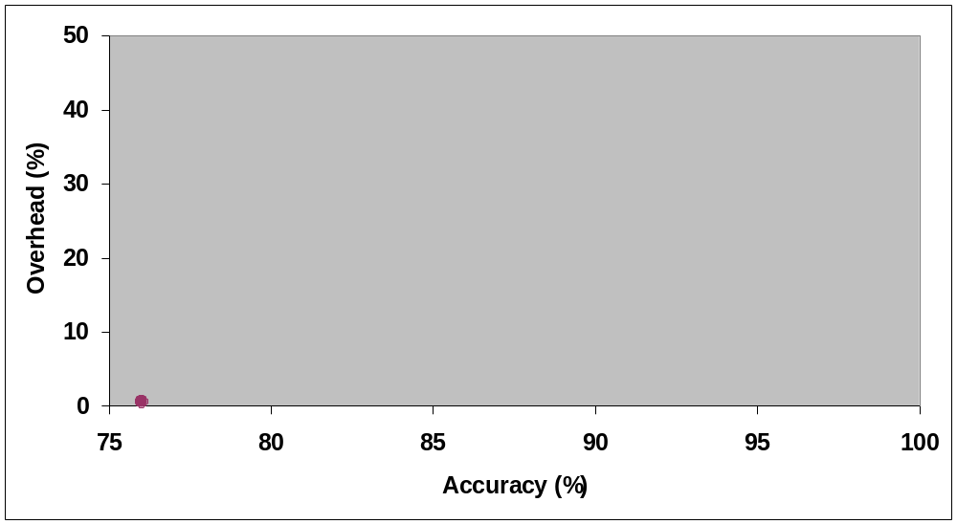
Overhead vs. accuracy
Edge profiling
(SPEC 95 INT)
Notes:
TODO: Consider inserting Overhead vs. Accuracy graph.

Slide 4
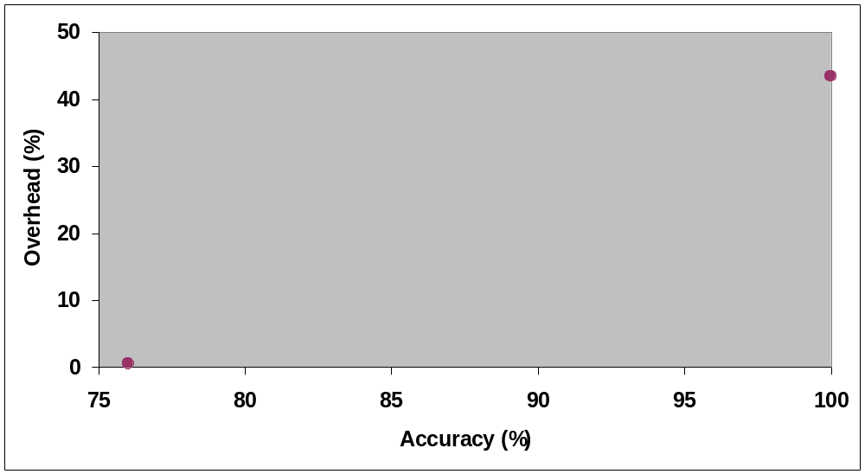
Overhead vs. accuracy
Ball-Larus
path profiling
(SPEC 2000 INT)
Edge profiling
(SPEC 95 INT)
Notes:
TODO: Consider inserting Overhead vs. Accuracy graph.

Slide 5
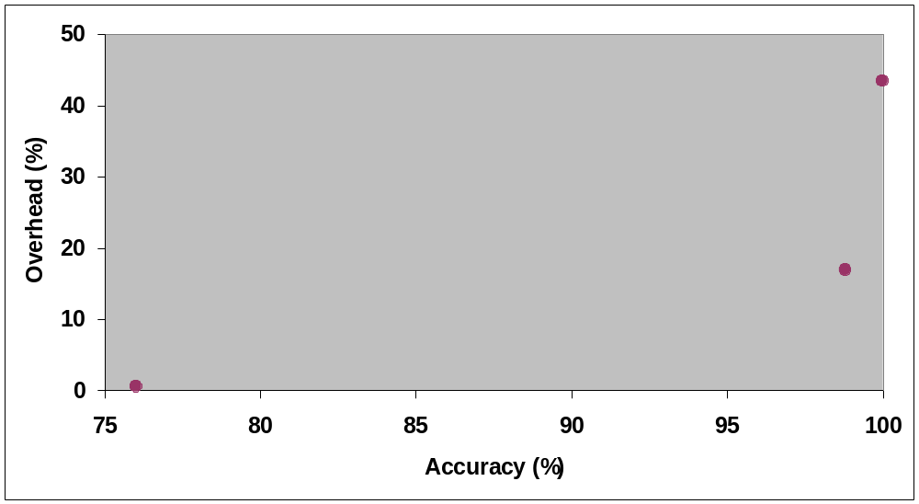
Overhead vs. accuracy
Ball-Larus
path profiling
(SPEC 2000 INT)
Targeted
path profiling
(SPEC 2000 INT)
Edge profiling
(SPEC 95 INT)
Notes:
TODO: Consider inserting Overhead vs. Accuracy graph.

Slide 6
Overhead vs. accuracy
Ball-Larus
path profiling
(SPEC 2000 INT)
Profile-guided profiling
Targeted
path profiling
(SPEC 2000 INT)
Edge profiling
(SPEC 95 INT)
Notes:
TODO: Consider inserting Overhead vs. Accuracy graph.

Slide 7
Outline
Background
  Staged dynamic optimization and profile-guided profiling
  Ball-Larus path profiling
  Opportunities for reducing overhead
Targeted path profiling
Results
  Overhead and accuracy

Slide 8
Staged dynamic optimization
Stage 0
Static
optimizations

Slide 9
Staged dynamic optimization
Stage 0
Static
optimizations
Edge
profile
Hardware
edge profiler

Slide 10
Staged dynamic optimization
Stage 0
Stage 1
Static
optimizations
Local
Optimizations
(code layout)
Edge
profile
Hardware
edge profiler

Slide 11
Staged dynamic optimization
Stage 0
Stage 1
Static
optimizations
Local
Optimizations
(code layout)
Edge
profile
Path profiling
instrumentation
Hardware
edge profiler

Slide 12
Staged dynamic optimization
Stage 0
Stage 1
Static
optimizations
Local
Optimizations
(code layout)
Edge
profile
Path
profile
Path profiling
instrumentation
Hardware
edge profiler

Slide 13
Staged dynamic optimization
Stage 0
Stage 1
Stage 2
Static
optimizations
Local
Optimizations
(code layout)
Global
Optimizations
(superblock
formation)
Edge
profile
Path
profile
Path profiling
instrumentation
Hardware
edge profiler

Slide 14
Profile-guided profiling
Stage 0
Stage 1
Stage 2
Static
optimizations
Local
Optimizations
(code layout)
Global
Optimizations
(superblock
formation)
Edge
profile
Path
profile
Path profiling
instrumentation
Hardware
edge profiler
Notes:
TODO: better transition to Ball-Larus path profiling

Slide 15
Ball-Larus path profiling
Acyclic, intraprocedural paths
Handles cyclic CFGs
  Paths end at loop back edges
Each path computes unique integer

Slide 16
Ball-Larus path profiling
4 paths
A
B
C
D
E
F
G
Notes:
TODO: better explanation of Ball-Larus path profiling

Slide 17
Ball-Larus path profiling
4 paths
Each path computes unique integer
A
2
B
C
D
1
E
F
G
Notes:
TODO: better explanation of Ball-Larus path profiling

Slide 18
Ball-Larus path profiling
4 paths
Each path computes unique integer
Path 0
A
2
B
C
D
1
E
F
G
Notes:
TODO: better explanation of Ball-Larus path profiling

Slide 19
Ball-Larus path profiling
4 paths
Each path computes unique integer
Path 0
Path 1
A
2
B
C
D
1
E
F
G
Notes:
TODO: better explanation of Ball-Larus path profiling

Slide 20
Ball-Larus path profiling
4 paths
Each path computes unique integer
Path 0
Path 1
Path 2
A
2
B
C
D
1
E
F
G
Notes:
TODO: better explanation of Ball-Larus path profiling

Slide 21
Ball-Larus path profiling
4 paths
Each path computes unique integer
Path 0
Path 1
Path 2
Path 3
A
2
B
C
D
1
E
F
G
Notes:
TODO: better explanation of Ball-Larus path profiling

Slide 22
Ball-Larus path profiling
r: path register
count: array of path frequencies
r=0
A
r=r+2
B
C
D
r=r+1
E
F
G
count[r]++

Slide 23
Overhead in Ball-Larus path profiling
 | SPEC 95 | SPEC 2000
gcc | 96% | 87%
INT Avg | 41% | 43%
FP Avg | 12% | 22%
Overall Avg | 28% | 37%
Notes:
Say that these are for subsets of SPEC 95 and 2000

Slide 24
Overhead in Ball-Larus path profiling
 | SPEC 95 | SPEC 2000
gcc | 96% | 87%
INT Avg | 41% | 43%
FP Avg | 12% | 22%
Overall Avg | 28% | 37%
Opportunities for reducing overhead?
  When there are many paths
  When edge profile gives perfect path profile
Notes:
Say that these are for subsets of SPEC 95 and 2000

Slide 25
Routines with many paths
Many possible paths
  Exponential in number of edges
  Can’t use array of counters
Number of taken paths small
  Ball-Larus uses hash table
  Hash function call expensive
    Hashed path ~5 times overhead
Notes:
Say: We can use a hash table because the number of distinct taken paths is small (i.e., the counter space is sparse).

Slide 26
Edge profile gives perfect path profile
Notes:
Example from gcc.

Slide 27
Edge profile gives perfect path profile
Notes:
Example from gcc.

Slide 28
Edge profile gives perfect path profile
An obvious path contains an edge that is only on that path
  Path uniquely identified by edge
  Path freq = edge freq
If all paths obvious, edge profile gives perfect path profile
Notes:
Example from gcc.

Slide 29
Outline
Background
  Staged dynamic optimization and profile-guided profiling
  Ball-Larus path profiling
  Opportunities for reducing overhead
Targeted path profiling
Results
  Overhead and accuracy
Notes:
Use actual amounts for overhead reduction?

Slide 30
Targeted path profiling
Profile-guided profiling
  Use existing edge profile
Exploits opportunities for reducing overhead
  When there are many paths
    Remove cold edges
  When edge profile gives perfect path profile
    Don’t instrument obvious routines and loops

Slide 31
Removing cold edges
Examine relative execution frequency of each branch
if (relFreq < threshold)
edge is cold
3
97

Slide 32
Removing cold edges
Examine relative execution frequency of each branch
if (relFreq < threshold)
edge is cold
60
40
97
3
0
100
3
97
50
50

Slide 33
Removing cold edges
Examine relative execution frequency of each branch
if (relFreq < threshold)
edge is cold
60
40
97
3
0
100
3
97
50
50

Slide 34
Removing cold edges
A path that contains a cold edge is a cold path
Removing an edge may halve number of paths
60
40
97
3
0
100
50
50

Slide 35
Removing cold edges
A path that contains a cold edge is a cold path
Removing an edge may halve number of paths
Number of paths: 16 → 4
60
40
97
100
50
50

Slide 36
Removing cold edges
A path that contains a cold edge is a cold path
Removing an edge may halve number of paths
Number of paths: 16 → 4
Goal: hashed → non-hashed
60
40
97
100
50
50

Slide 37
Removing cold edges
Remaining paths potentially hot
4 paths → [0, 3]
2
1

Slide 38
Removing cold edges
r=0
Remaining paths potentially hot
4 paths → [0, 3]
r=r+2
r=r+1
count[r]++

Slide 39
Removing cold edges
r=0
What if cold edge taken?
r=r+2
r=r+1
count[r]++

Slide 40
Removing cold edges
r=0
What if cold edge taken?
Cold edges poison path
r=r+2
r=poison
r=poison
r=r+1
count[r]++

Slide 41
Removing cold edges
r=0
What if cold edge taken?
Cold edges poison path
Instrumentation checks for poisoned path
r=r+2
r=poison
r=poison
r=r+1
if (r poisoned)
cold_counter++
else
count[r]++

Slide 42
Checking for poison
if (r poisoned)
cold_counter++
else
count[r]++

Slide 43
Obvious routines
All paths obvious
We don’t instrument obvious routines
Edge profile gives perfect path profile
Notes:
Example from gcc.

Slide 44
Obvious loops
…
Loop with obvious body
Don’t instrument obvious loops with high average trip counts
Edge profile yields high-accuracy path profile
…
Notes:
Say: Why we need to disconnect loops.

Slide 45
Obvious loops
…
Loop with obvious body
Don’t instrument obvious loops with high average trip counts
Edge profile yields high-accuracy path profile
…
Notes:
Say: Why we need to disconnect loops.

Slide 46
Summary of our techniques
Remove cold edges
  Eliminates many cold paths
  Count paths with array (instead of hash table)
Don’t instrument obvious routines and loops
  Edge profile derives path profile

Slide 47
Outline
Background
  Staged dynamic optimization and profile-guided profiling
  Ball-Larus path profiling
  Opportunities for reducing overhead
Targeted path profiling
Results
  Overhead and accuracy
Notes:
Use actual amounts for overhead reduction?

Slide 48
Implementation
Static profiling
PP: tool for path profiling
TPP: tool for targeted path profiling
Tools instrument native SPARC executables
  SPEC 95 ref
  SPEC 2000 ref

Slide 49
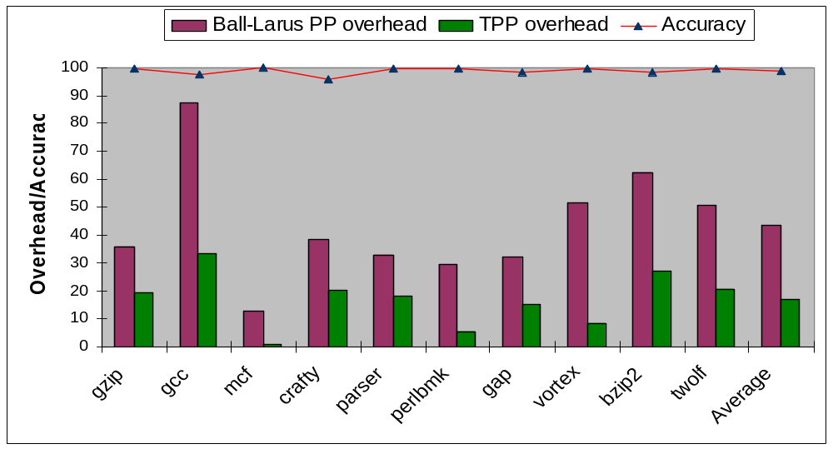
Results: SPEC 2000 INT
Notes:
Average Overhead: 43.4% to 16.9%, Accuracy 98.6%
Say: Accuracy of PP is 100%
TODO: How many total SPEC 2000 INT benchmarks are there?

Slide 50
Where does benefit come from?
Cold path elimination alone: 60%
Add obvious path elimination: + 40%
Little benefit from obvious path elimination alone

Slide 51
Related work
Dynamo [Bala et al. ‘00]
  Successful online path-guided optimization
  “Bails out” when no dominant path
Instrumentation sampling [Arnold & Ryder ‘01]
  Orthogonal to targeted path profiling
Selective path profiling [Apiwattanapong & Harrold ’02]
  Useful when only a few paths of interest

Slide 52
Summary
Profile-guided profiling in a staged dynamic optimization system
Two synergistic techniques
  Remove cold paths
  Don’t instrument obvious routines and loops
Reduces overhead by half (SPEC 95) to two-thirds (SPEC 2000)
High accuracy: ~99%
Notes:
Say: High accuracy, and we lose information about paths we don’t care about

